Slide 1
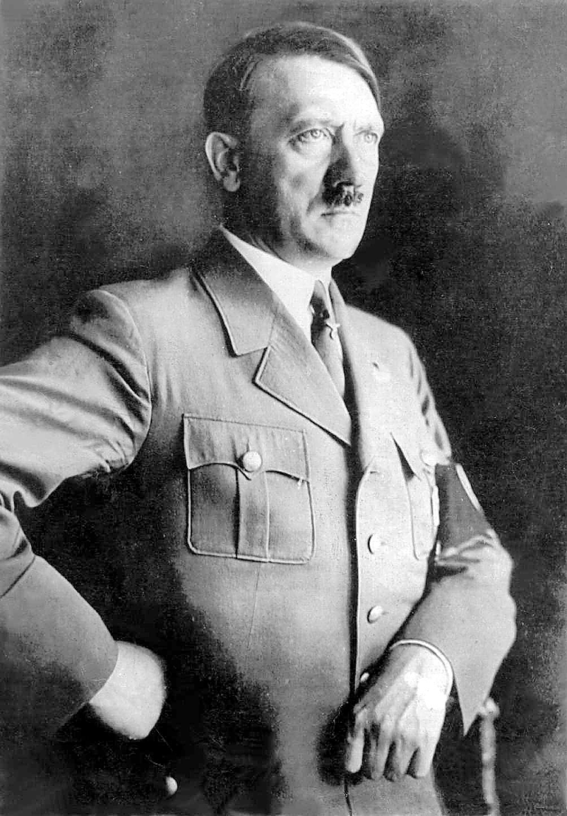
Extension – Research on new Topic Adolf Hitler
Parents & His childhood
School Life
Life after school
WWI
His views

