Slide 1
Thursday 4th March 2021

Slide 2
Design A Book Cover

Slide 3
Create Your Own Character
Is it an animal?
Is it an creature?
Is it a person?

Slide 4
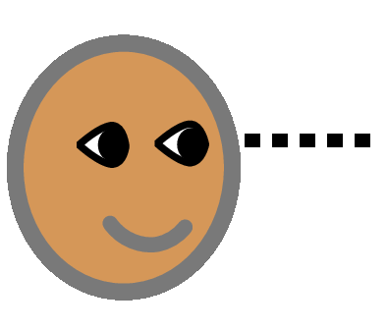
Look at the following pictures
Say what you see
What can you see?
What do you think I happening in each picture?

Slide 5
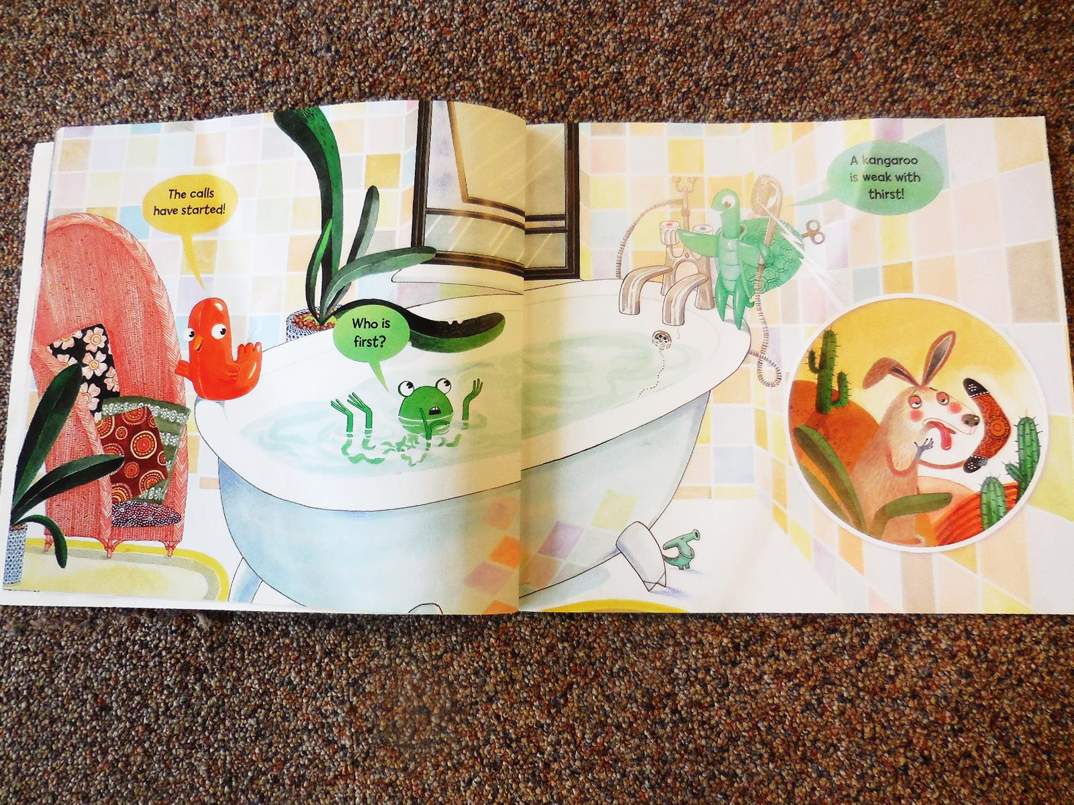

Slide 6
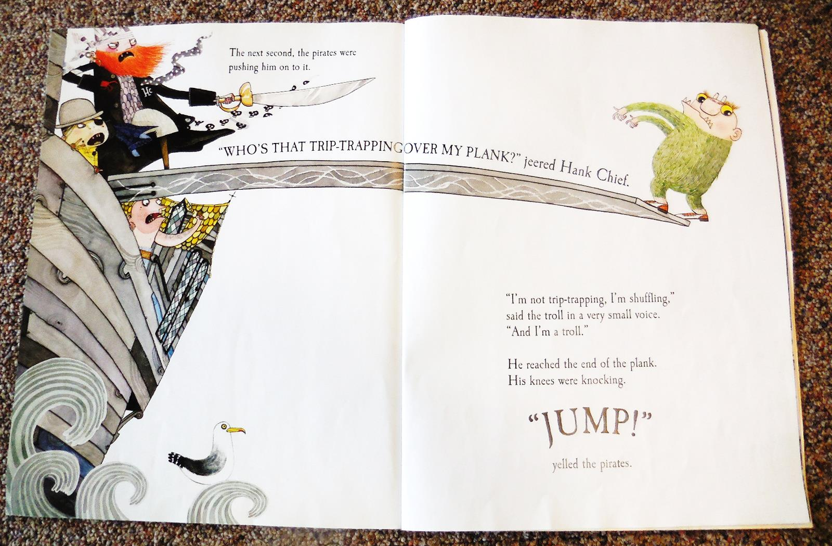

Slide 7
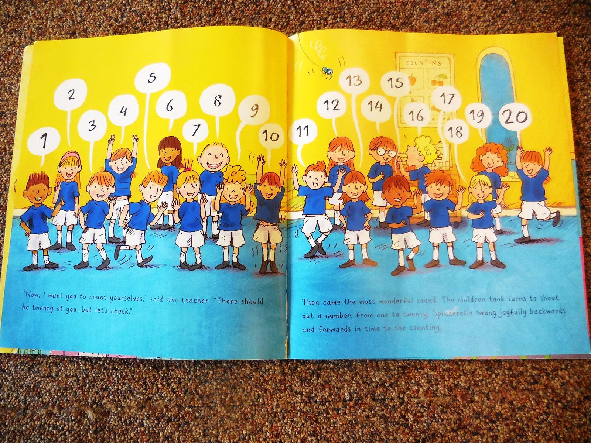

Slide 8
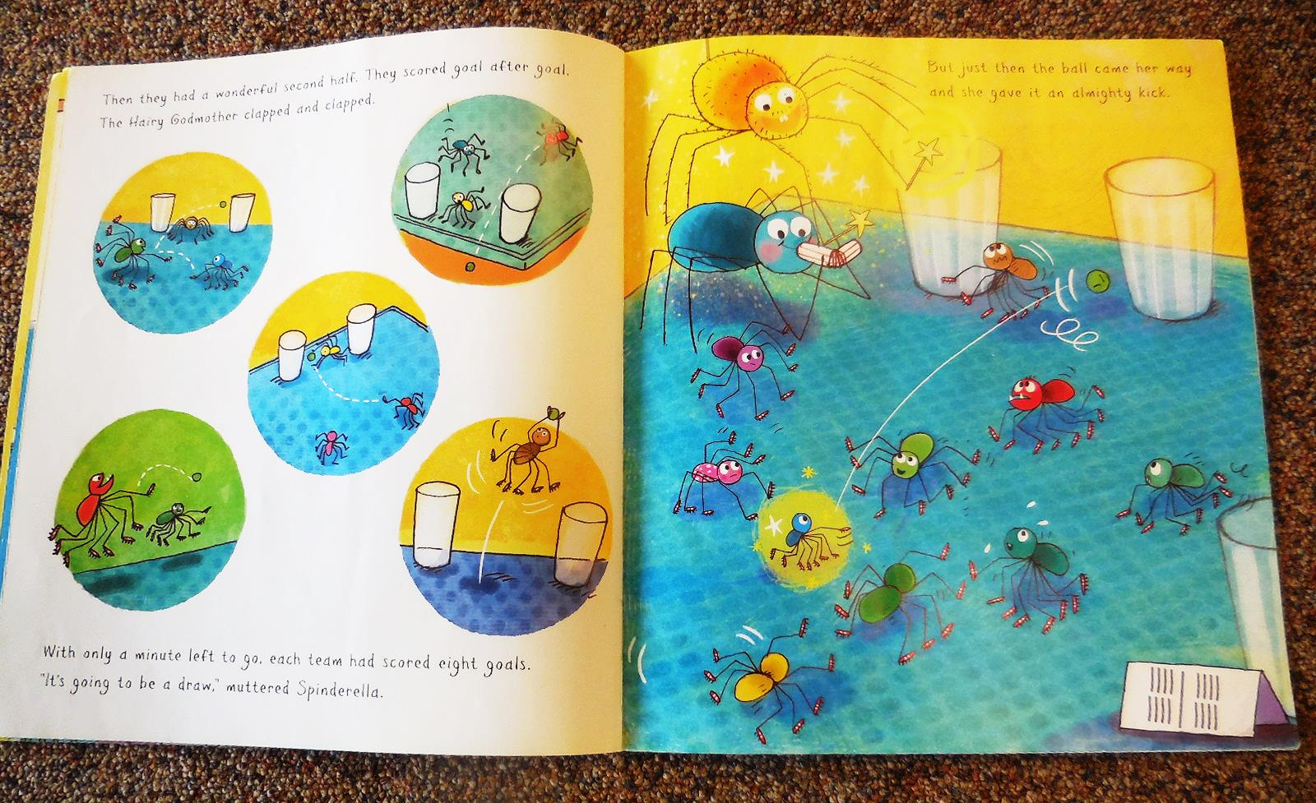

Slide 9
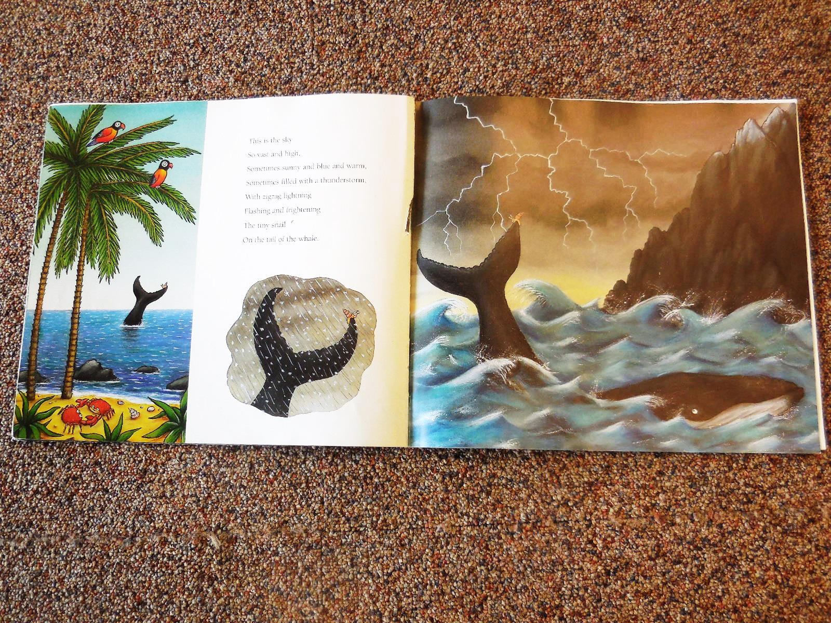

Slide 10
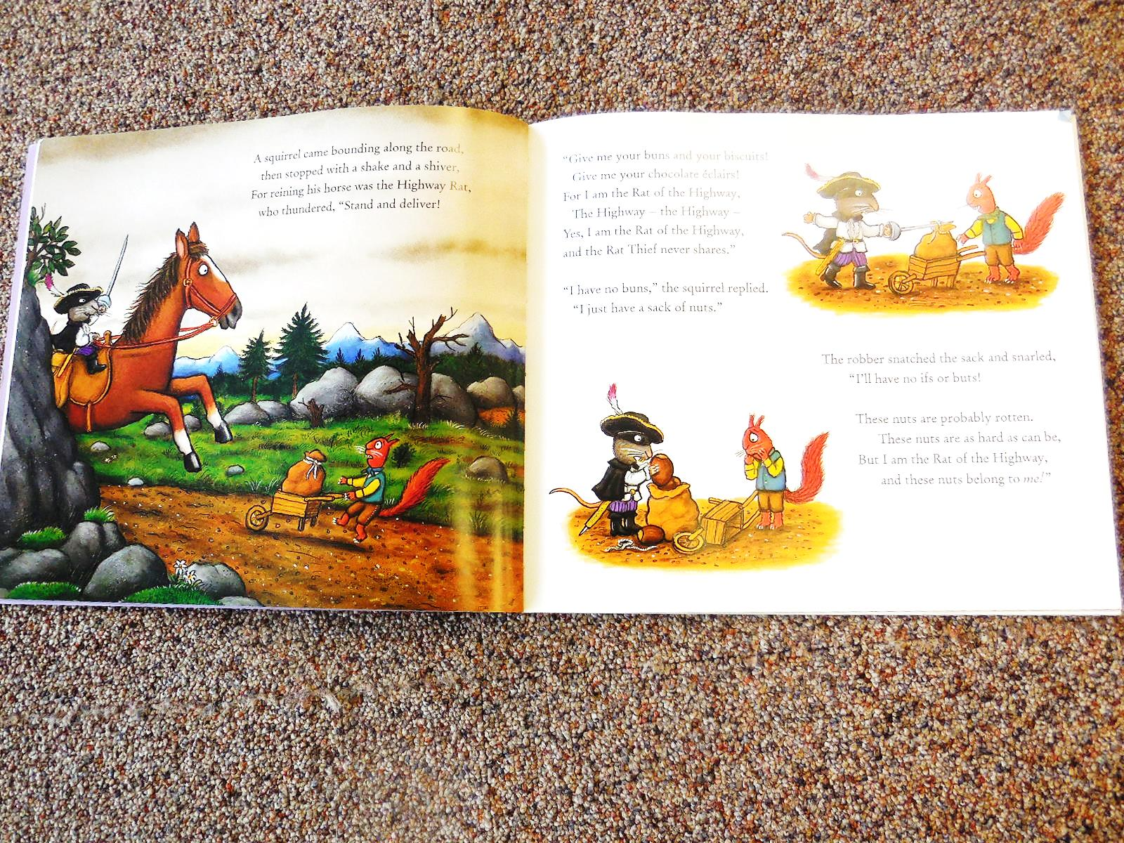

Slide 11
Type read aloud story books into Youtube Choose a story Sit back and Listen

Slide 12
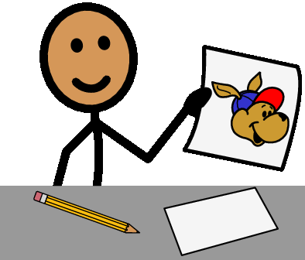
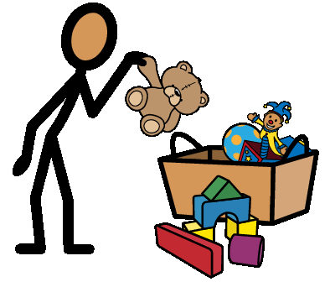
Create Your Own Story
You can create your own story in several ways.
Draw the characters and put them in order to tell a story.
Look around the house and find some toys and act out a story.
Take photos on your walk and put them into an order to tell a story.

Slide 13
Happy World Book Day Have a Fun Day Be Creative!

