Slide 1
Say what you see?

Slide 2
Say what you see?

Slide 3
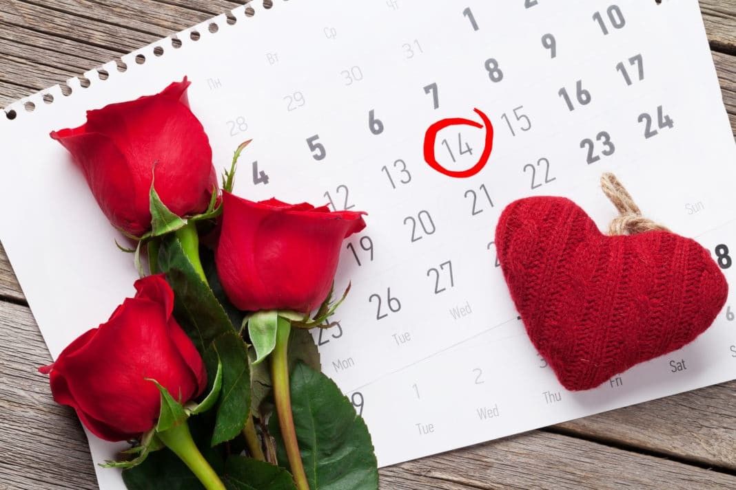
Say what you see?

Slide 4
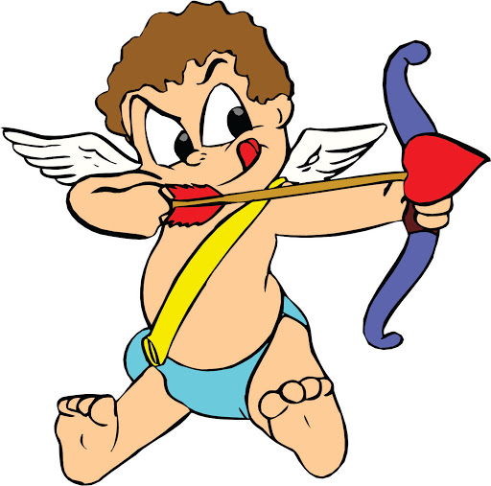
Say what you see?

Slide 5
Say what you see?

Slide 6
Say what you see?

Slide 7
Say what you see?

Slide 8
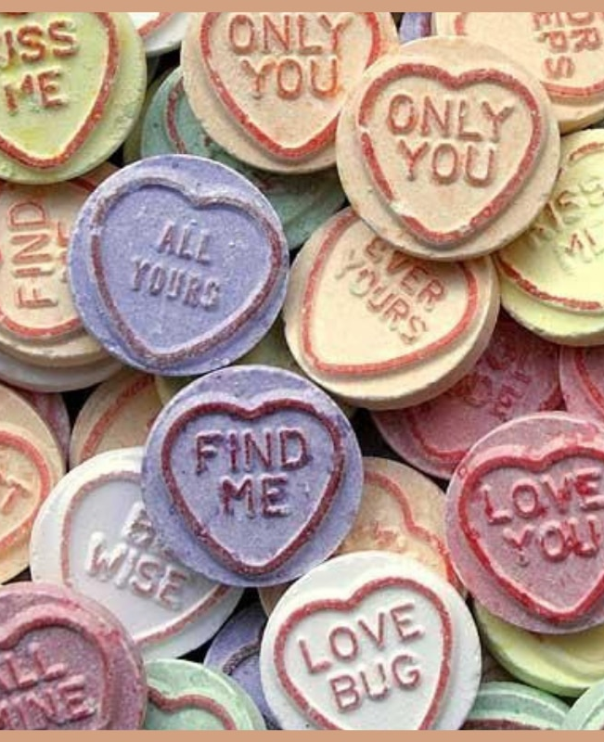
Say what you see?

Slide 9
Say what you see?

Slide 10
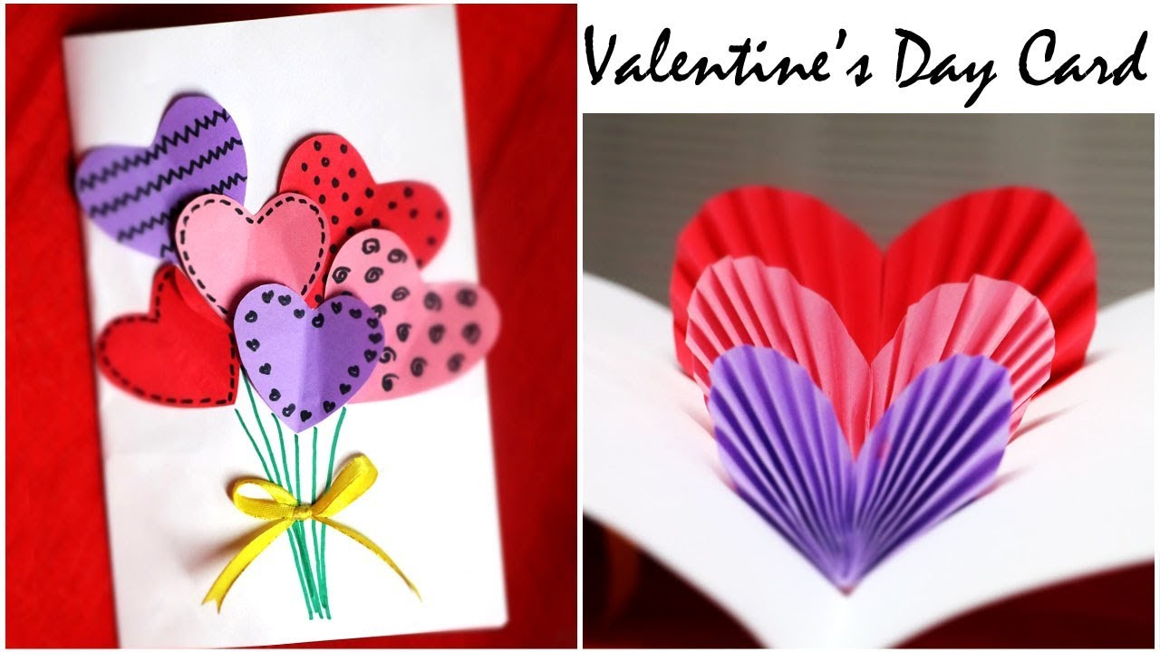
Can you make a Valentine’s card?

