Slide 1
Can you make this?

Slide 2
Can you make this shape?

Slide 3
Can you make this shape?

Slide 4
Can you make this shape?

Slide 5
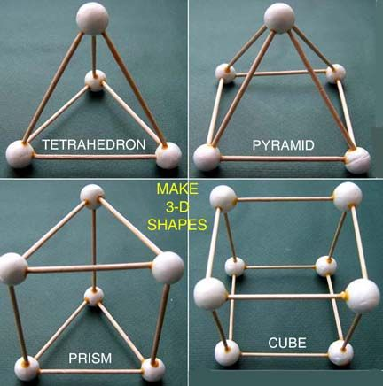
Can you make any of these shapes?

Slide 6
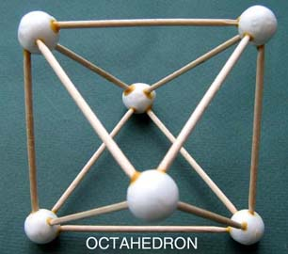
Can you make this shape?

Slide 7
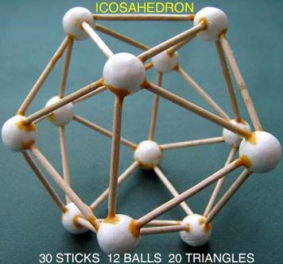
Can you make this shape?

