Slide 1
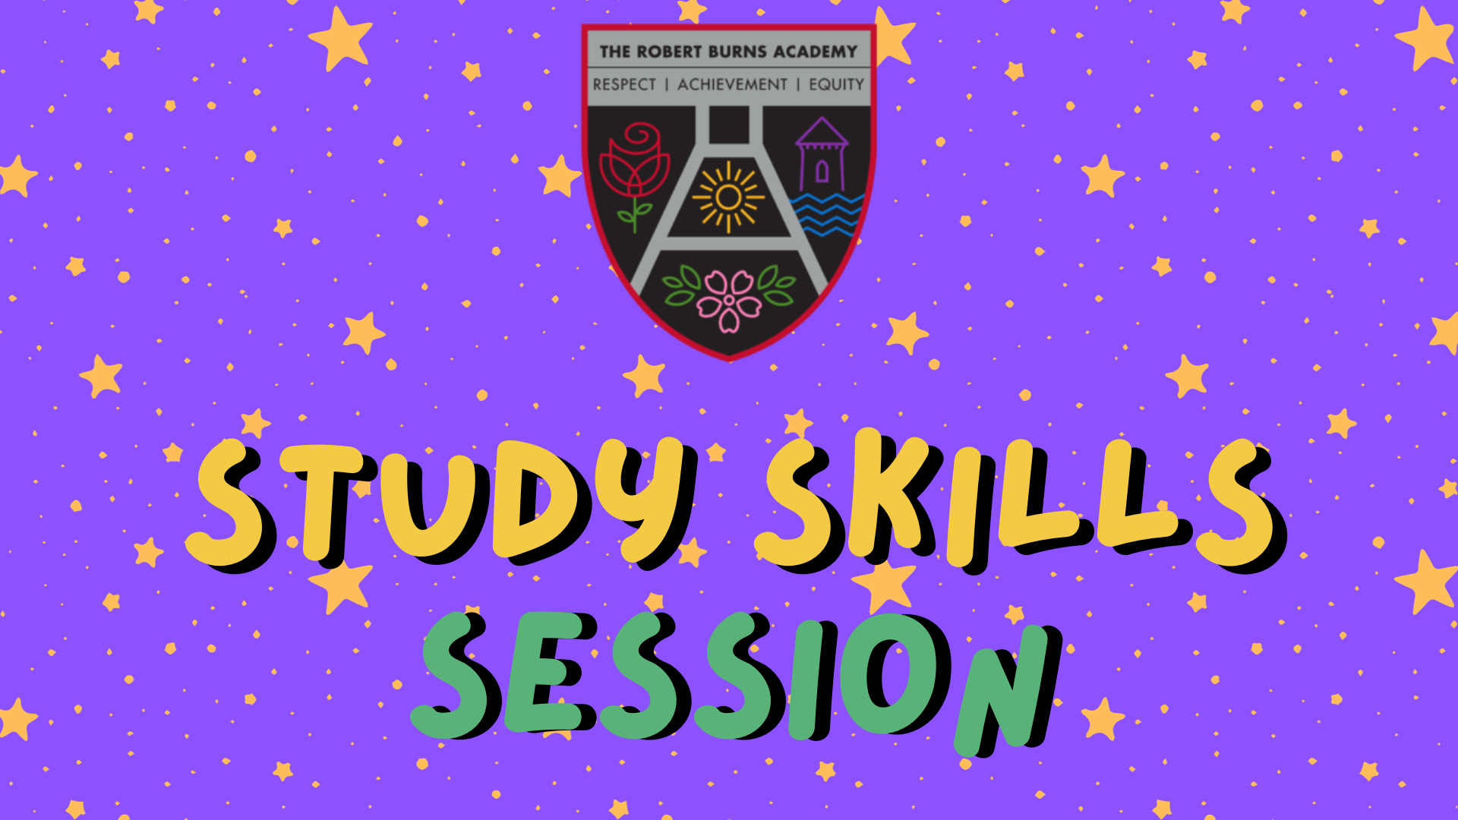

Slide 2
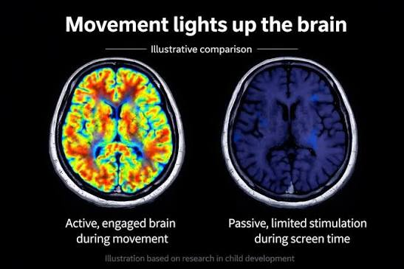
Passive Reading
Active Retrieval
Notes:
These are two actual scans of the human brain while trying to learn. On the left, you see a brain when someone is sitting on their bed, highlighter in hand, passively re-reading their textbook for the fourth time. Notice how quiet and dark it is? The science shows that this kind of studying is basically a chore—the brain is practically asleep.
Now look at the right. That is a brain where someone is actively forcing themselves to recall information using a flashcard, a blank piece of paper, or a mind map. It is literally lighting up because it is firing electrical signals and carving out long-term memory pathways.
Tonight, we are going to show you that effective studying isn't about working for four exhausting hours. It’s an art form, it’s a science, and it’s about making your brain look like the one on the right in just 25 minutes.

Slide 3
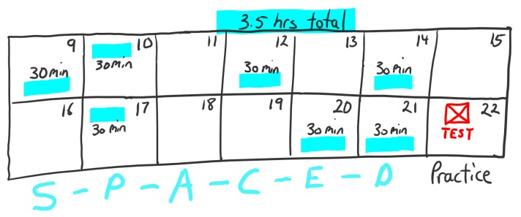
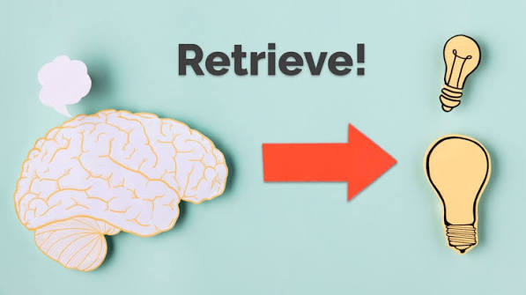
The Heavyweights of Revision
1. Active Retrieval 🧠
Don't just put info IN.
Force your brain to pull info OUT.
👉 See our FLASHCARDS & MIND MAPS at the pupil stalls tonight for how they have forced retrieval
2. Spaced Repetition 📅
We forget 70% of new data within 24 hours.
Fighting 'The Forgetting Curve' means reviewing in small, timed intervals.
Notes:
The Forgetting Curve: Explain that our brains are hardwired to forget. If you read something today, you will forget 70% of it by tomorrow unless you fight back.
Active Retrieval: You don't learn by putting information in; you learn by forcing your brain to pull information out.
Stall:
student experts are showcasing the 'Art' of revision. They aren't just highlighting paper—they are using Flashcards to force active retrieval and Mind Maps to connect the dots visually. Go visit them after this to see the brain muscle in action!"

Slide 4
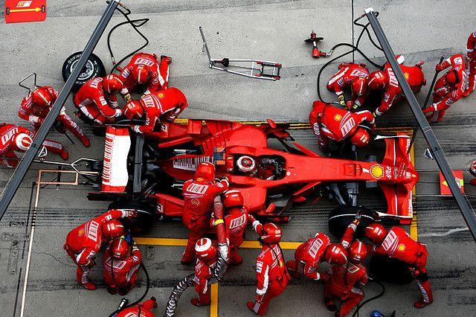
The 'Pit Crew'
1. The Quiz Master: Grab the flashcards and test them. Struggling to remember is where the learning happens!
2. The Distraction: Help lock the phone away for short bursts. (Yes, TikTok will survive 25 minutes!)
3. The Fuel Supplier: Keep them stocked up with water, healthy snacks, and a quiet space.

Slide 5
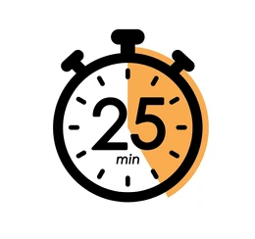
The 25-Minute Rule: Work hard with zero distractions for 25 minutes, then take a 5-minute guilt-free break. Do that twice a night, and you are winning.

Slide 6
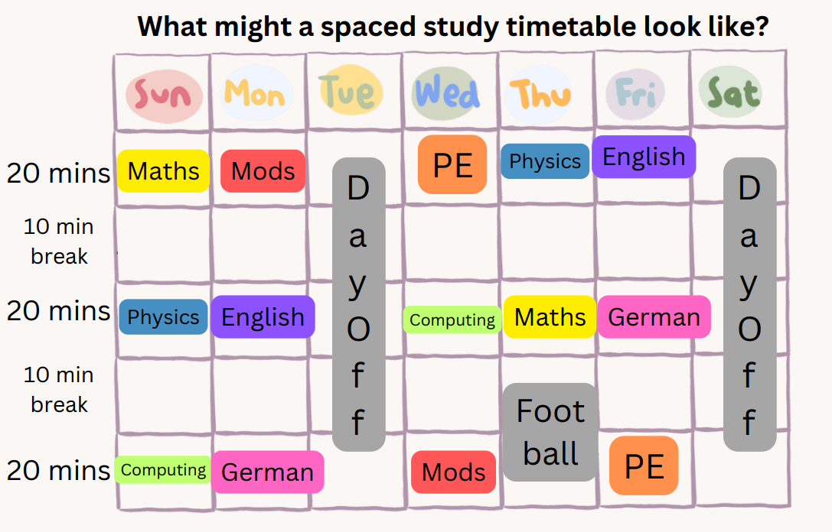
Notes:
Example of study timetable that allows for space

