Slide 1
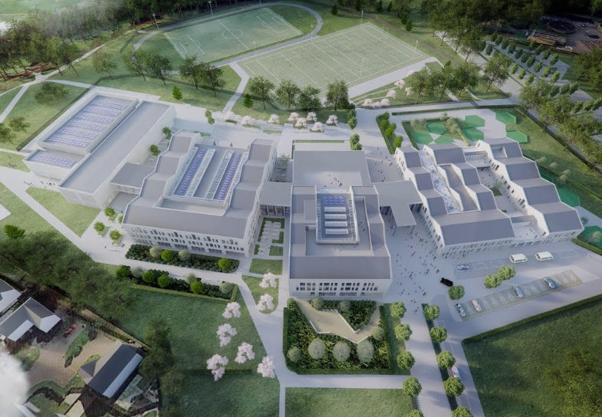

Science
How to be Successful in Science National Qualifications

Slide 2
Science Course Structure
Unit 1
Unit 2
Unit 3
Assignment 20%
+
Final Exam
80%
Considering the final Science exams are worth 80% of the final mark it is essential for pupils to regularly engage with revision resources.

Slide 3
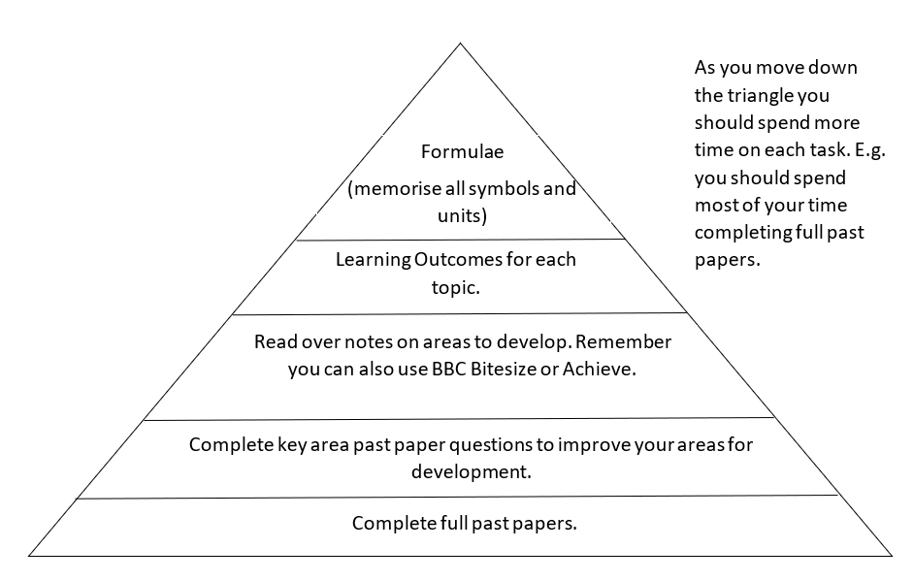
Science Revision
What tasks should I complete when revising?

Slide 4
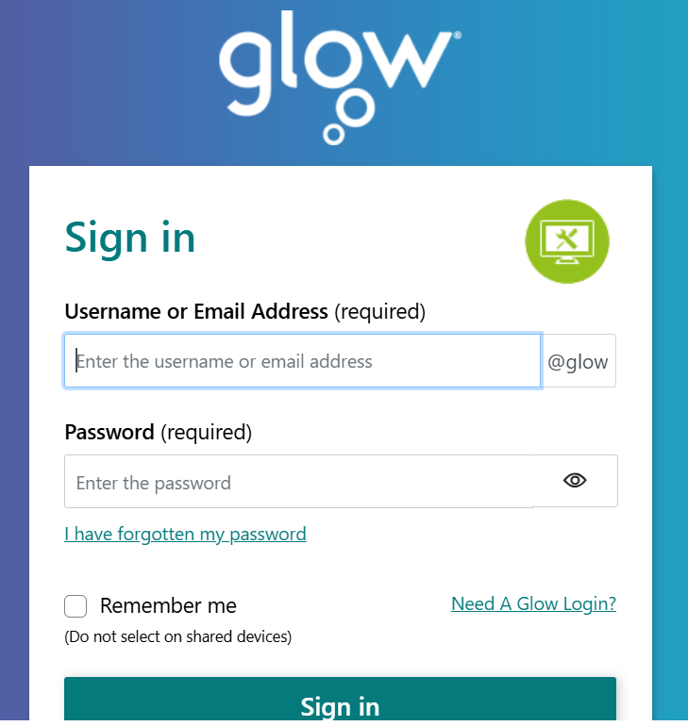
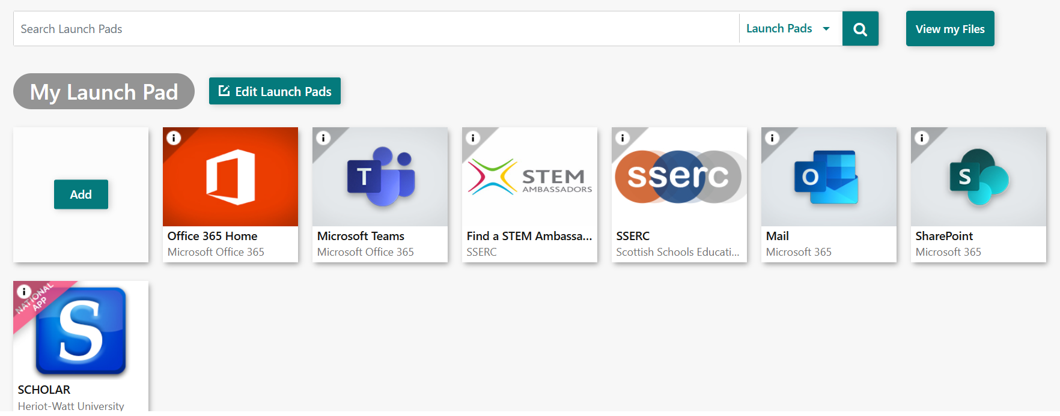
Accessing Teams
The Teams app is accessed using pupil’s GLOW accounts.

Slide 5
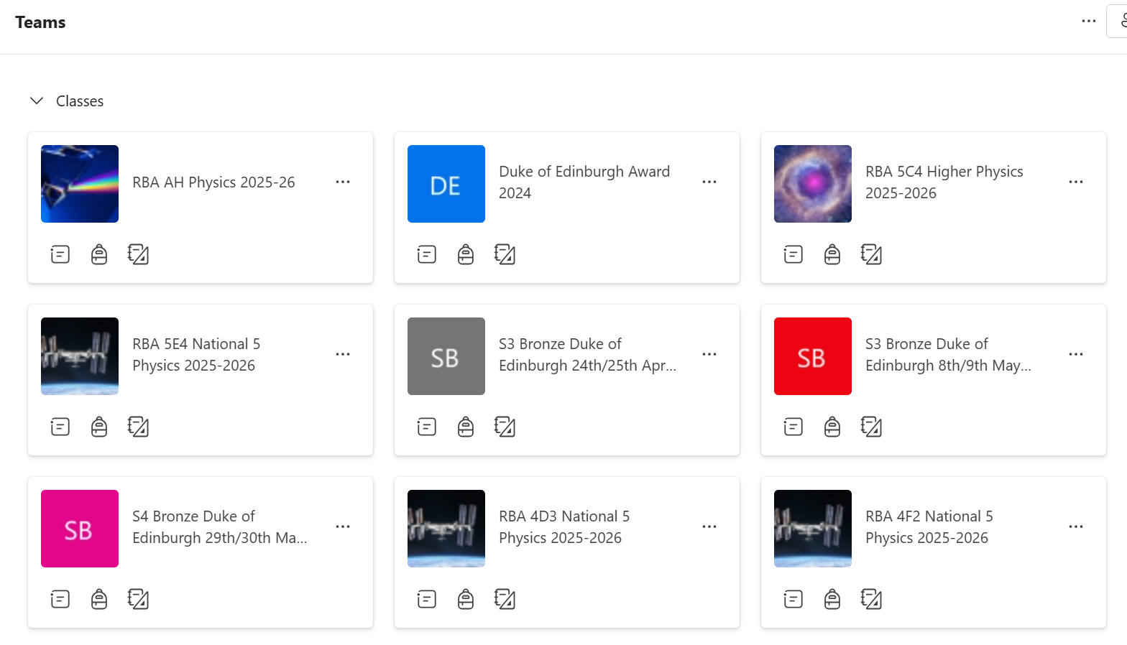
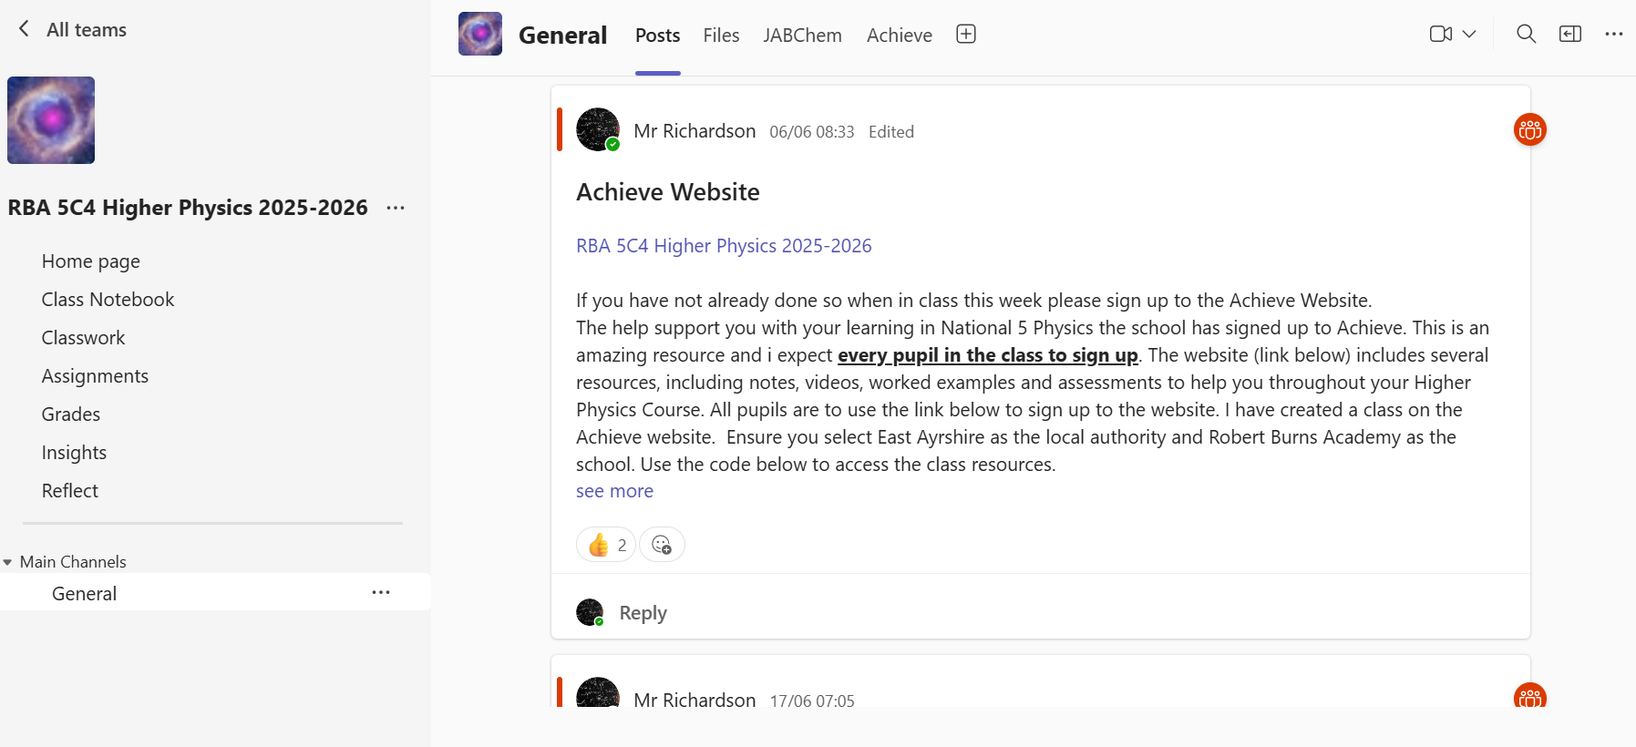
Microsoft Teams
Microsoft Teams is a platform initially developed to support collaboration and communication.

Slide 6
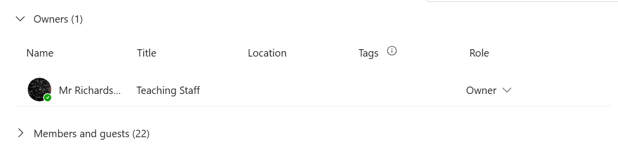
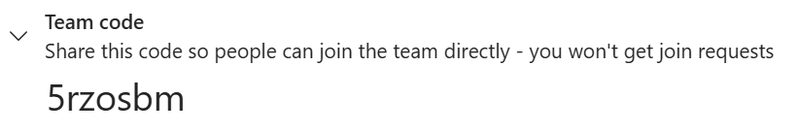
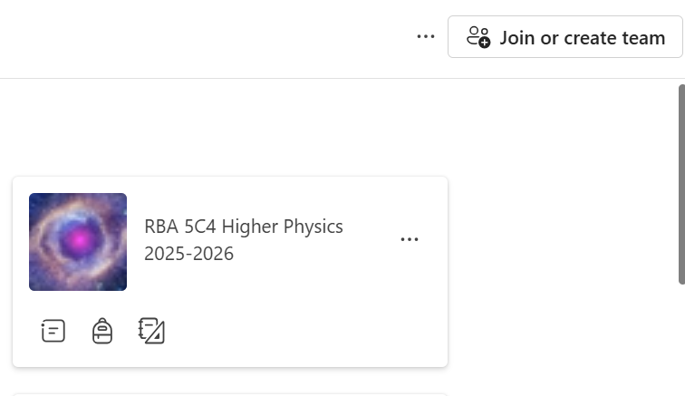
Accessing the Class Team
Class teacher adds pupils to the class Team
Class teacher shares the Team code with the class and asks pupils to join.

Slide 7
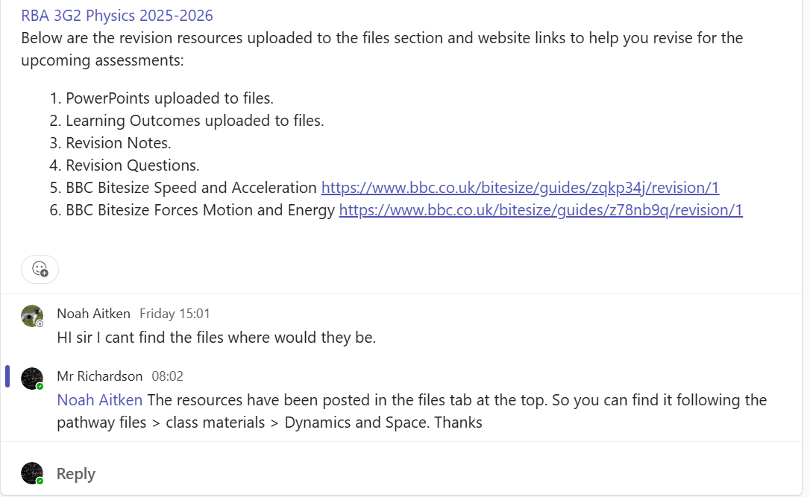
Posts
Each Team has a General channel, this provides an opportunity for pupils to communicate with their teacher by posting.

Slide 8
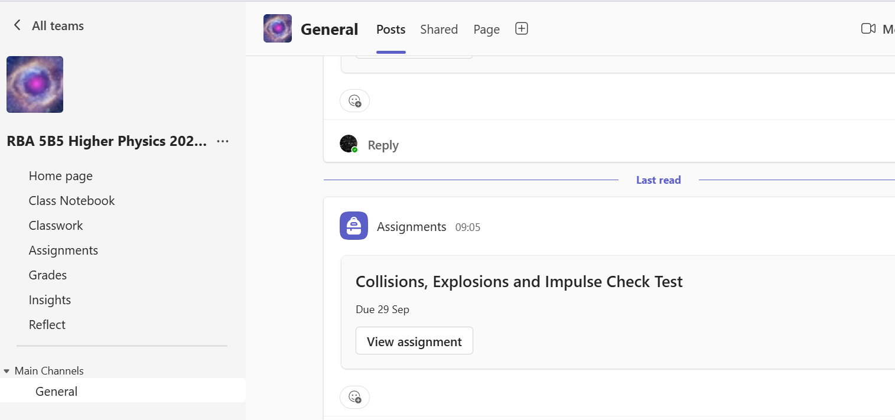
Accessing Resources

Slide 9
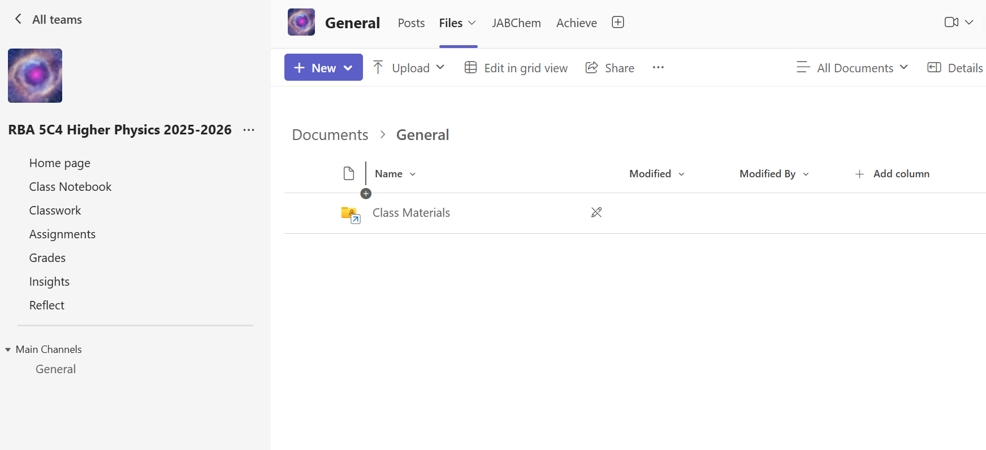
Accessing Resources

Slide 10
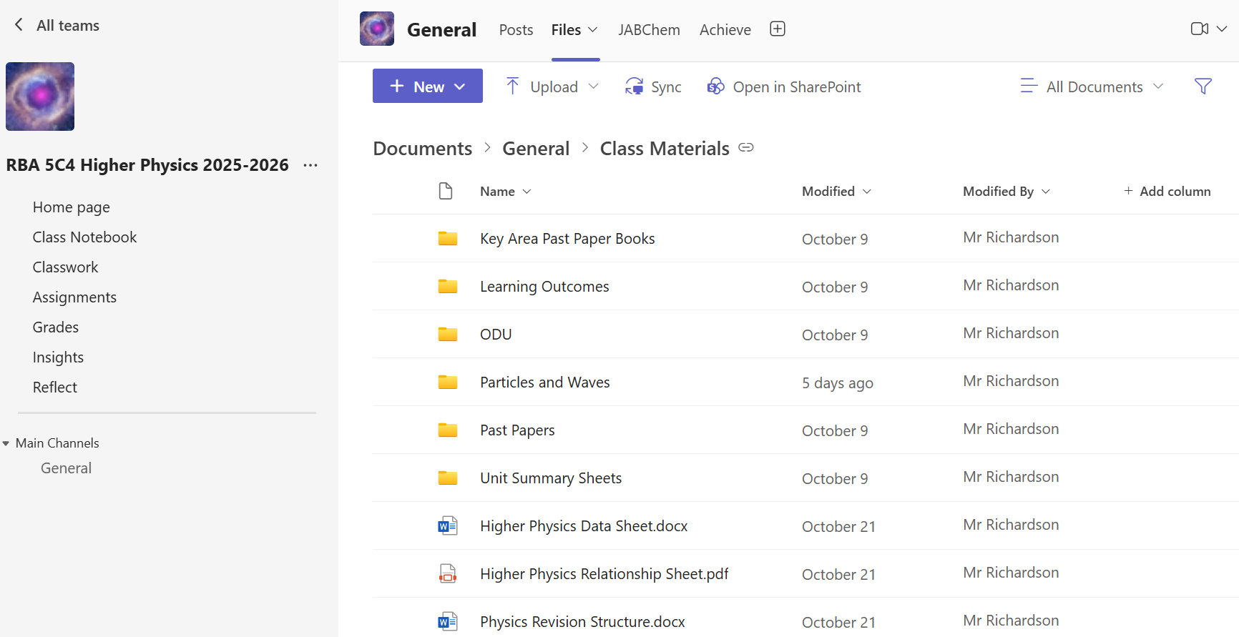
Accessing Resources

Slide 11
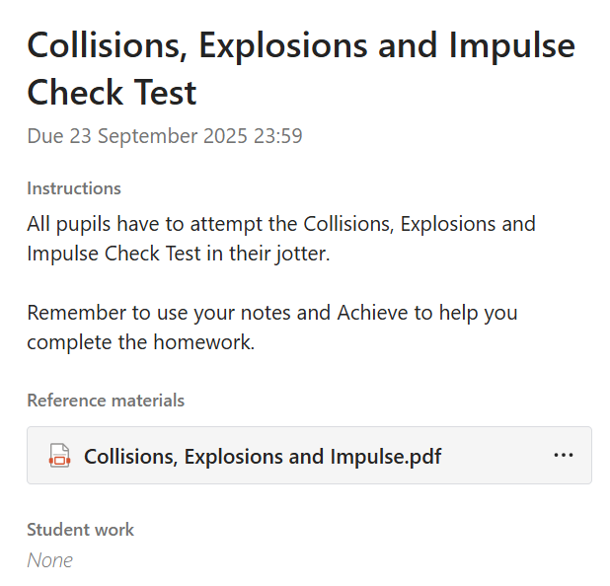
Homework on Teams
Homework tasks are posted on Teams as an ‘Assignment’. The ‘Assignment contains details of the homework tasks and the due date.

Slide 12
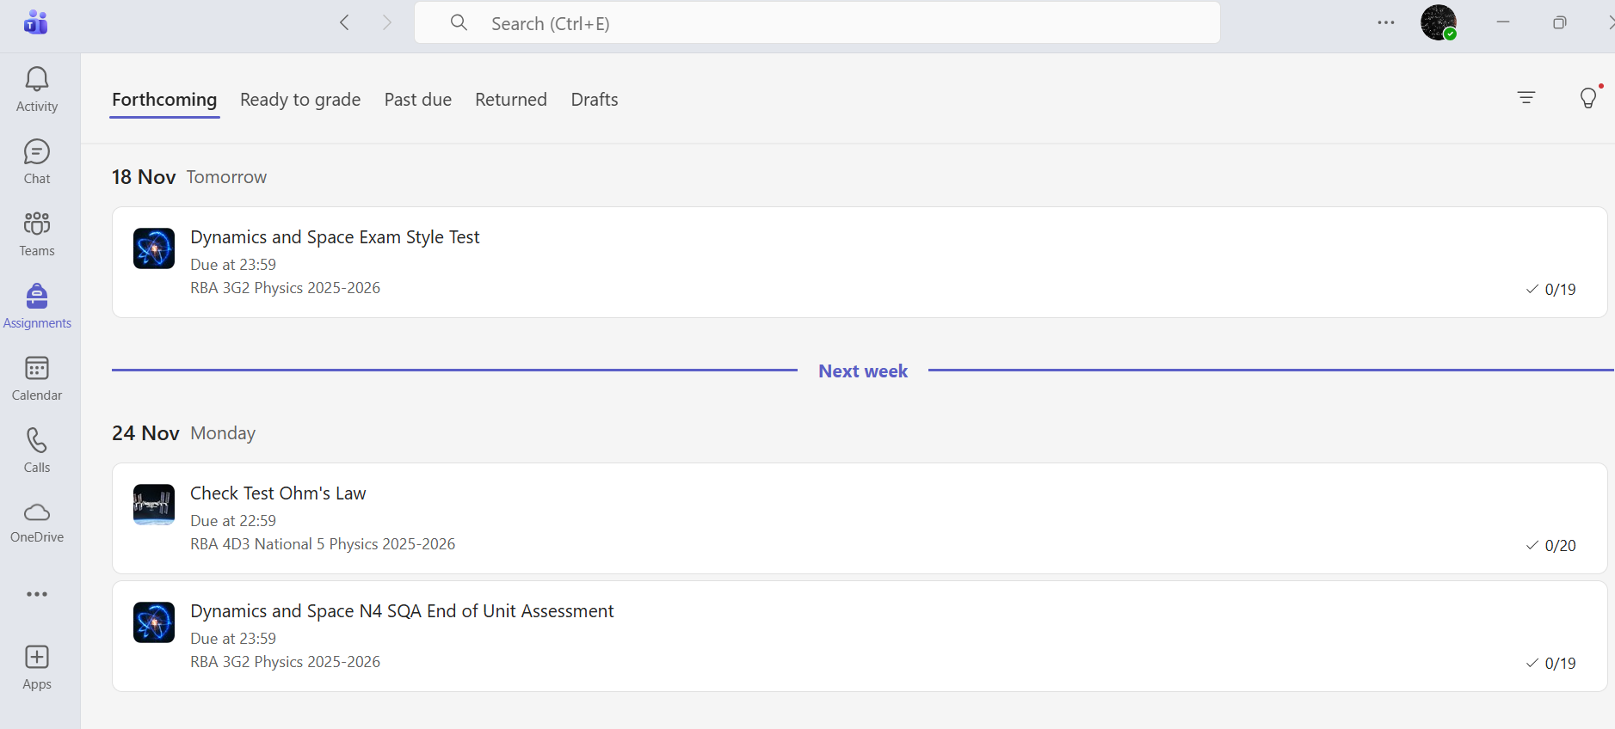
Monitoring ‘Assignments’
To allow you to check assignments due, pupils need to allow you access to their Teams.

Slide 13
Additional Resources
There are a variety of additional resources pupils can access to help support their learning.
Achieve
JabChem
BBC Bitesize
YouTube – Mr Stewart Physics
Mrs Physics Website

Slide 14
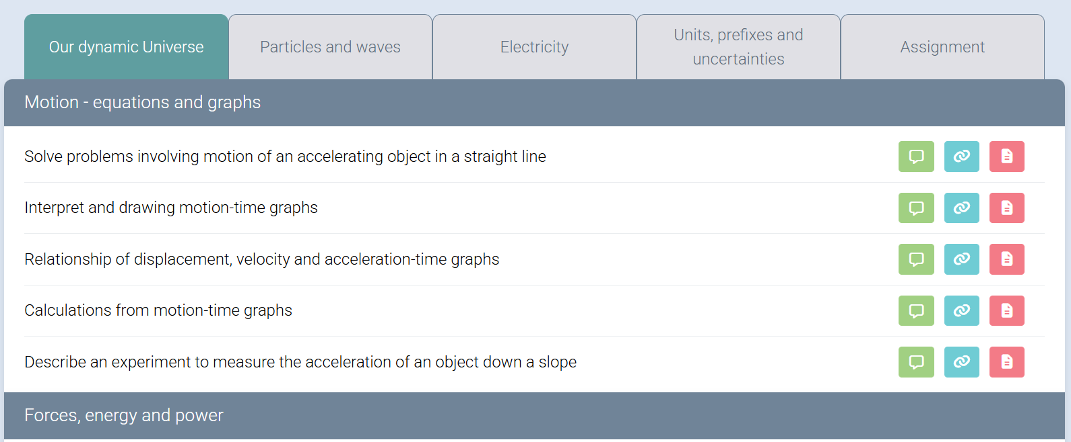
Achieve Website
Achieve is a fantastic resource that allows pupils to complete revision tasks linked to their areas identified for development from evaluation of homework tasks and assessments.
Provides theory and exemplars
Links to past paper questions
External website links

Slide 15
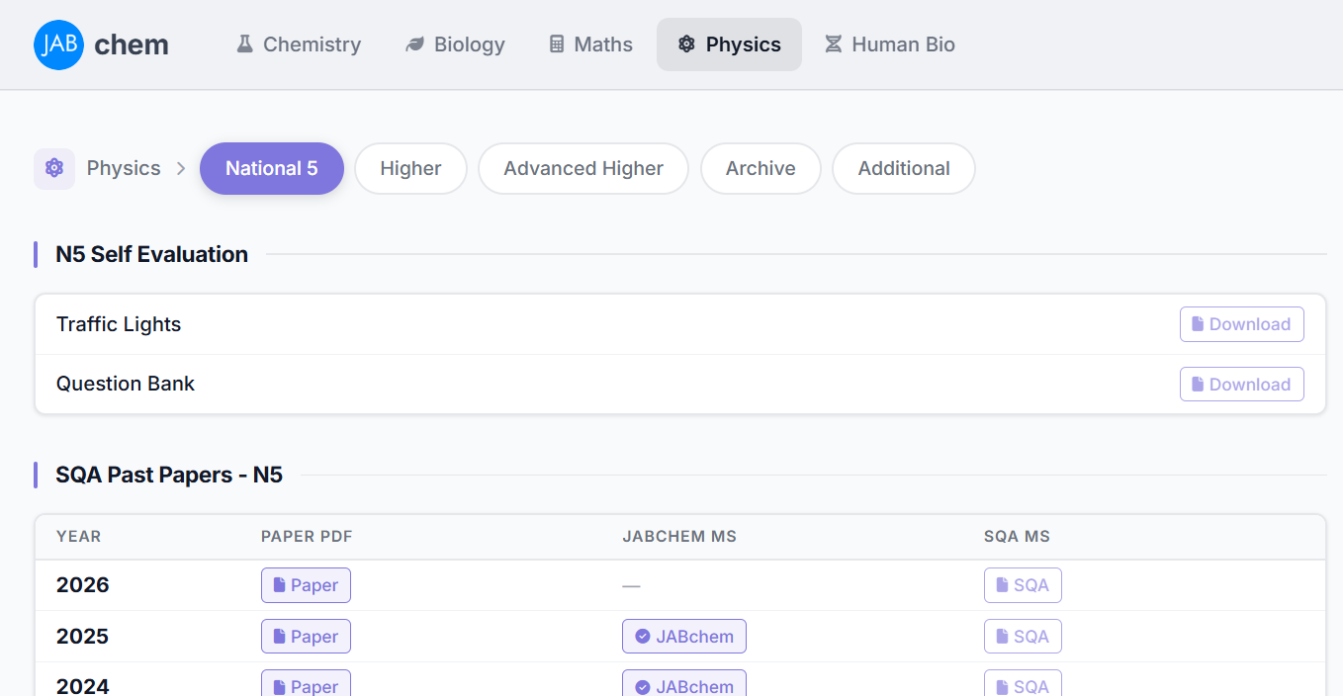
JabChem
Access to Past Papers – plus more helpful marking schemes

Slide 16
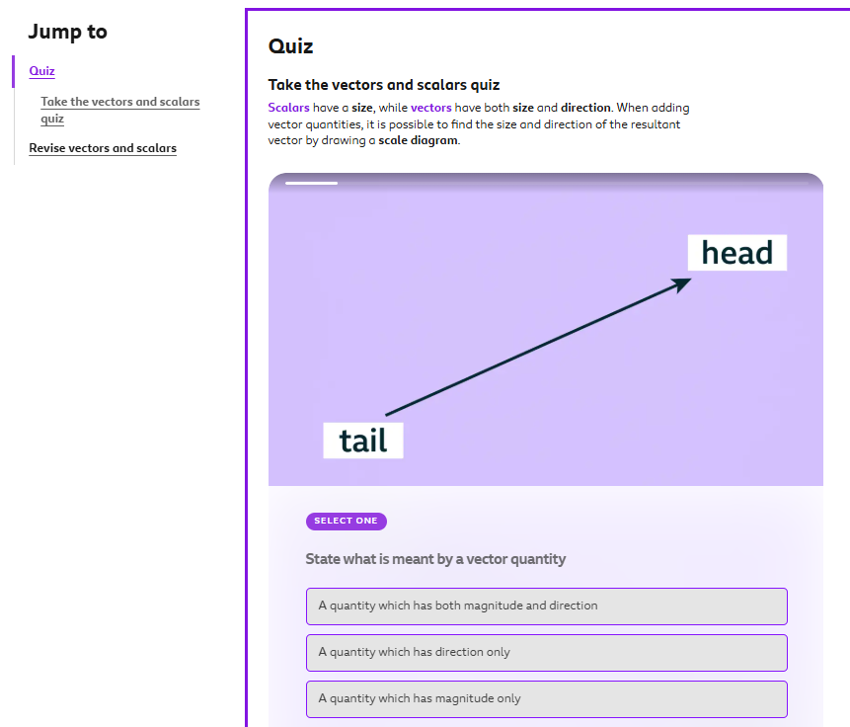
BBC Bitesize
A resource to support pupils with their areas to develop.
Provides theory and quizzes on each key area of the course.
Note – This is appropriate to develop grade C level knowledge.

Slide 17
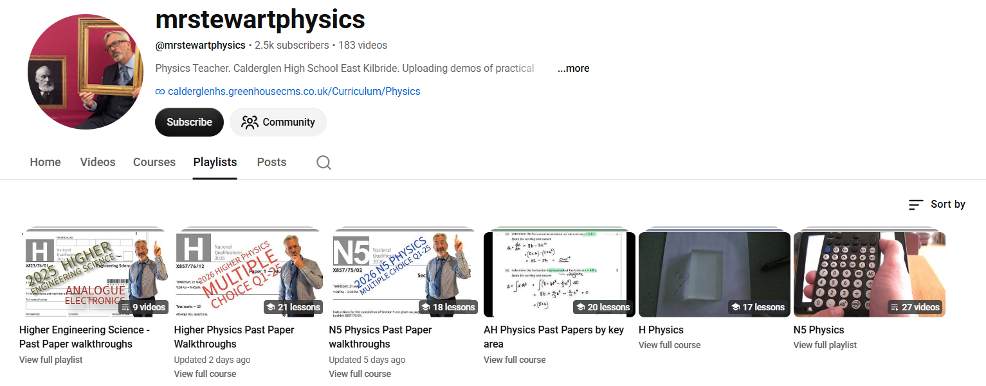
YouTube – Mr Stewart
Mr Stewart has created videos including past paper walk through examples and experiments.

Slide 18
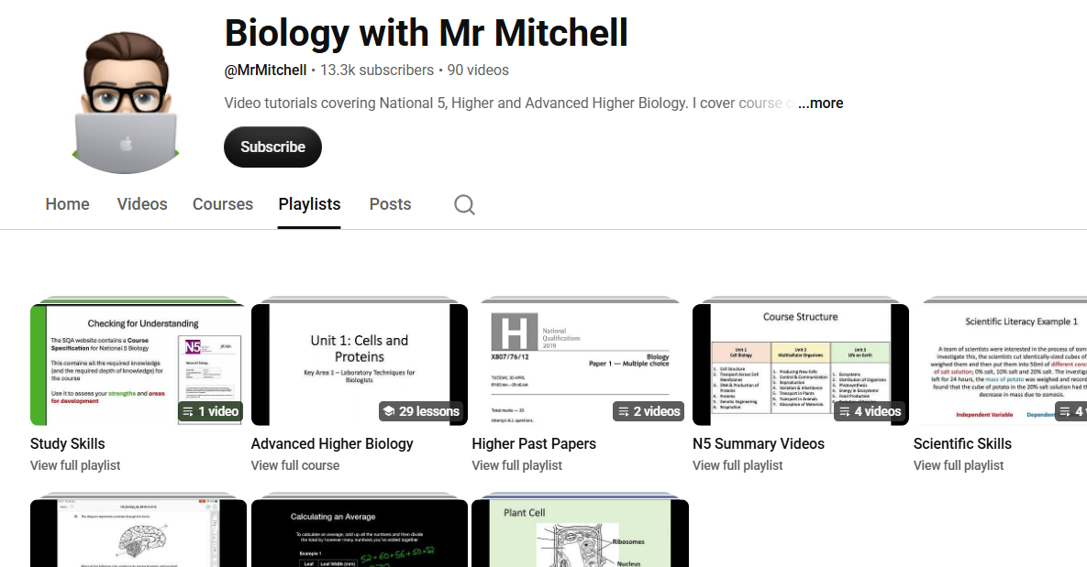
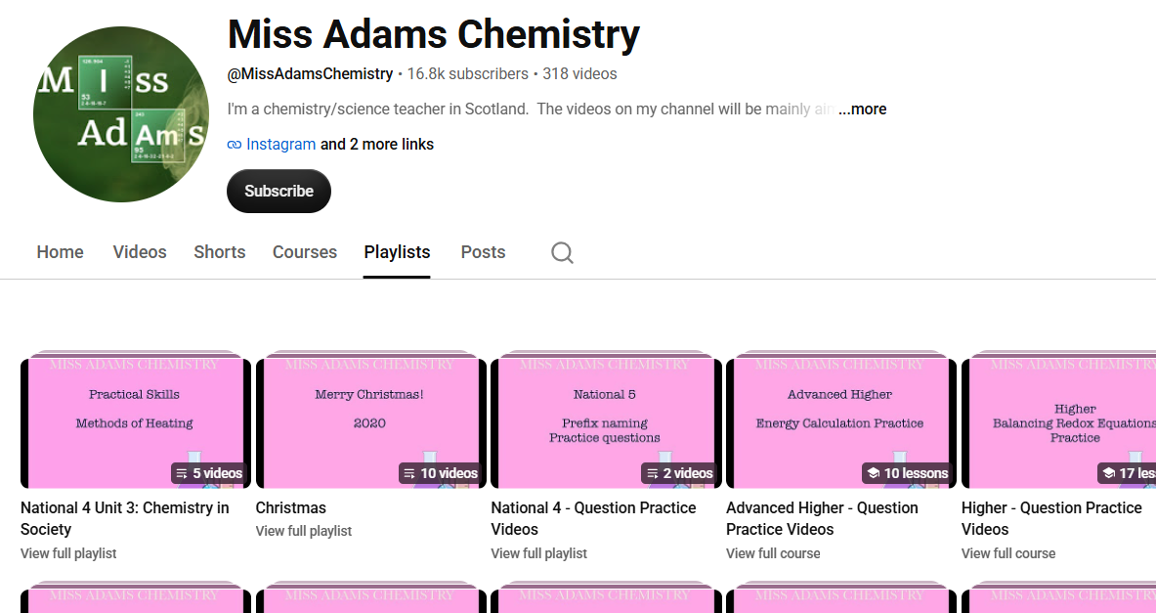
Similar Resources in Biology and Chemistry
Mr Mitchell and Miss Adams have created videos including past paper walk through examples.

Slide 19
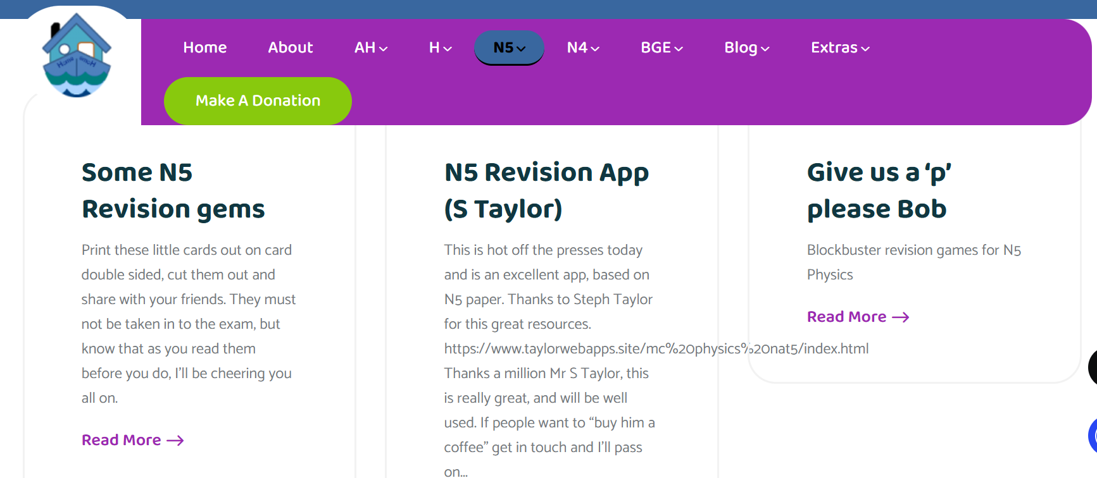
Mrs Physics Website
Mrs Physics has collated resources produced by Physics teachers across Scotland.
Note – Example of too many resources

Slide 20
Your Teacher – Biggest Resource
Attend supported study – come prepared with questions or areas of the course you need help with
Seek support with homework tasks to ensure they are completed to the best of your ability
Ask for help if you are struggling with an area of the course – no matter how small or big the problem is

