Slide 1
How to succeed in English
Assessment Advice Evening RBA

Slide 2
What are pupils assessed on in English?
Reading and understanding texts
Analysing how writers use language
Writing effectively
Talking and listening
English isn’t a subject you can revise by simply memorising information, it comes from practising the skills regularly.

Slide 3
Biggest mistake for revision
Re-reading notes
Which is better for revision?
Read your “The Great Gatsby” notes three times.
Close your notes and write down everything you can remember about the character Jay Gatsby.

Slide 4
Biggest mistake for revision
Re-reading notes
Which is better for revision?
Read your “The Great Gatsby” notes three times.
Close your notes and write down everything you can remember about the character Jay Gatsby.
This is much more useful because you need to retrieve the information rather than simply recognising it.

Slide 5
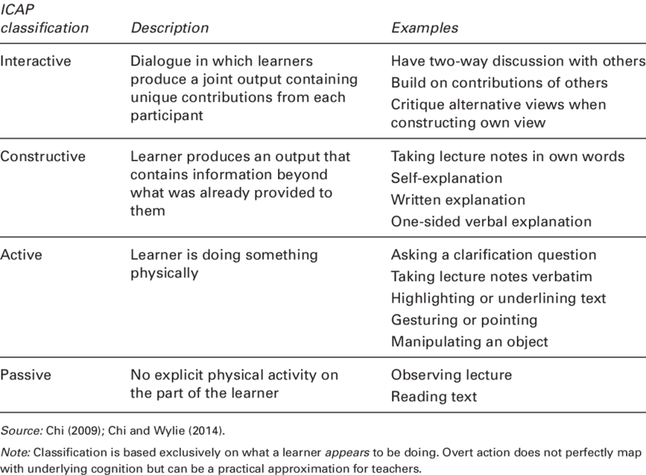
ICAP Framework
More likely to remember the information
Less likely to remember the information

Slide 6
Questions you can ask without knowing the books
What can you remember without looking?
Can you explain this quote to me?
What question could you use that evidence for?
Why is that word important?
What technique has the writer used?
I have more of these on some information cards which you can take at the stalls ☺

Slide 7
RUAE Practise: Little and often
Assessment – 30% of their final mark
National 5 – 1h
Higher – 1h30m
(This excludes people with extra time)

Slide 8
RUAE Practise: Little and often
Read a short newspaper article / extract
Identify an important word / phrase
Explain its connotations (extra meanings to the word)
Summarise a paragraph in their own words

Slide 9
Critical Essay / Scottish Set Text
Assessment – 40% of their final mark
National 5 – 1h30m
Higher – 1h45m
(This excludes people with extra time)

Slide 10
Critical Essay / Scottish Set Text
Don’t memorise an entire essay
Example:
Give your child a blank sheet of paper and five minutes. Ask them things like:
  Write down every quotation they can remember
  Write down the analysis for the quotation
Once they have done that, they can check their notes and highlight what they forgot

Slide 11
Writing / Folio
Parents / carers should support rather than rewrite.
Does the opening make you want to continue?
Is the meaning clear?
Where could they add more detail?
Checking things like spelling / punctuation can be really helpful as well.

Slide 12

AI Policy for English
Qualifications Scotland state:
“… learners must not submit AI-generated outputs or ideas as their own for assessment tasks that contribute towards an SQA qualification. Doing so would constitute malpractice and may result in awards being cancelled.”

Slide 13
This includes:
Generating a model response which is specific to your task.
Generating key ideas or a specific structure or plan.
Asking for advice on how to rephrase wording.
Using AI for corrections of errors in spelling or punctuation.
The only accepted use for AI is to find source materials, e.g. where can I source information about driving laws?
However – be aware that the suggestions by AI are not always accurate, so double check.
If you do use AI for this purpose, you must cite the source: e.g. ‘ChatGPT was used to generate ideas for…’

Slide 14
At the Stall
How to revise English sheets
Examples of revision materials
Test your child help cards
Feel free to come and ask me anything else ☺

