Slide 1
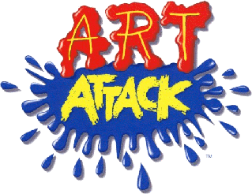
Express Yourself
Release the inner artiste!

Slide 2
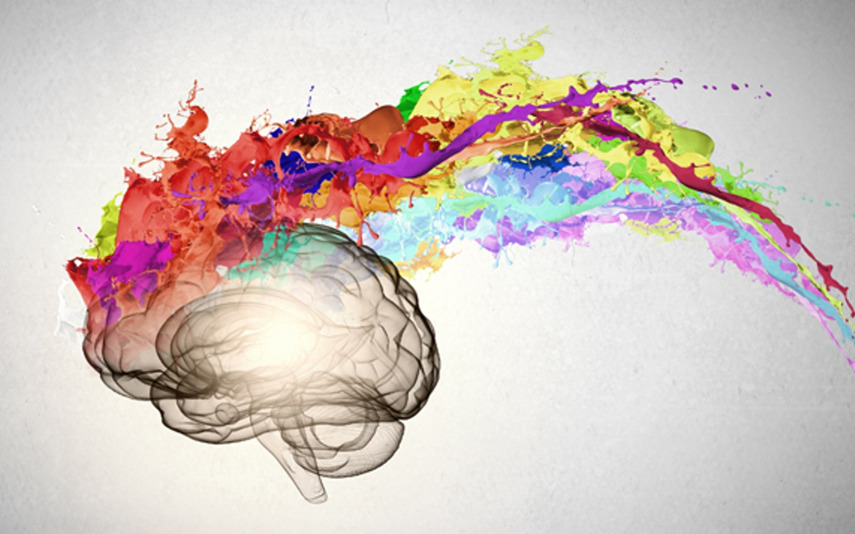
Why Art?
The best part is that it helps people to improve their mental health through creativity. Making art is helping many people express themselves, without having to use words.
The creative process relieves burdensome stress, encourages creative thinking, boosts self-esteem, and provides a sense of accomplishment.

Slide 3
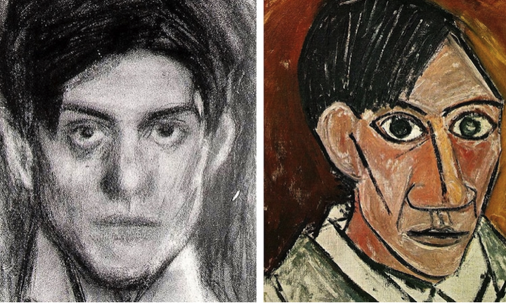
PABLO PICASSO
Portraits are a great way to explore express yourself because they are so deeply connected with identity.
Exploring them–through the use of paper collage inspired by Picasso’s work just makes it even more fun.

Slide 4
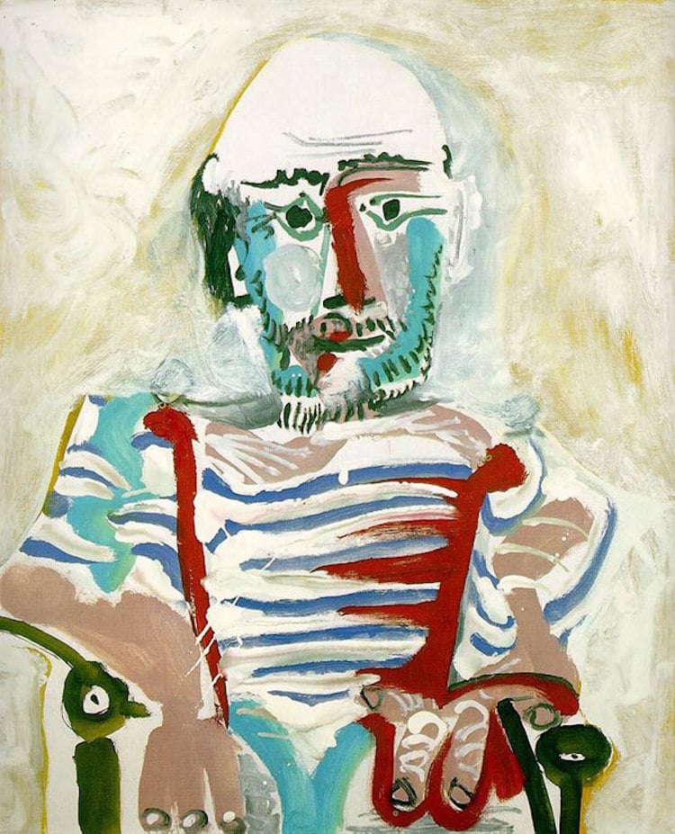
https://www.bbc.co.uk/bitesize/clips/zdfgkqt
Click this link to
learn about
Pablo Picasso!

Slide 5
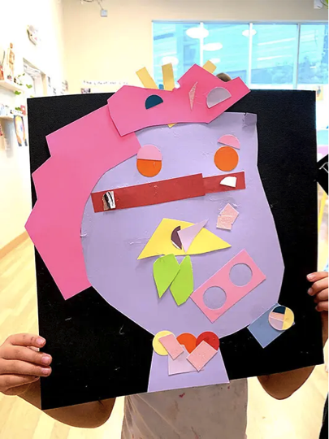
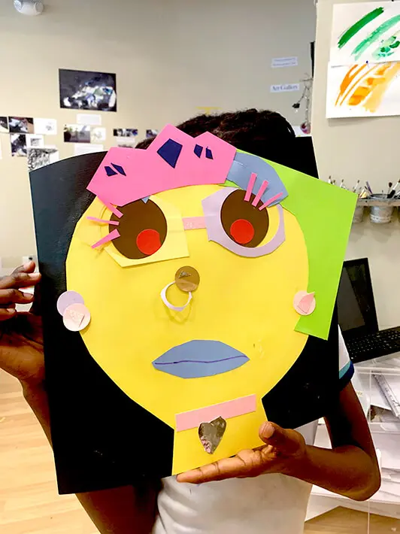
Activity
Picasso Collage Inspired Self Portrait
Imagine YOU are Picasso and have been commissioned to do a portrait of yourself.
What would it look like?
Create your own Picasso collages while being both the artist and the subject matter

Slide 6
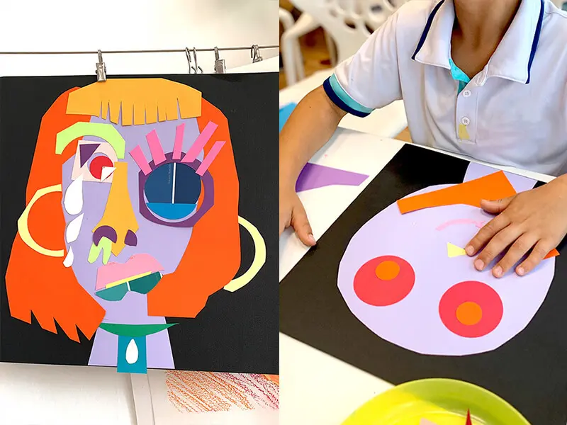

Slide 7
Materials
Paper any size large or small
Paint/colured pens or pencils
Colored paper
Any other fun paper you may have around
Circle hole punchers/stencils/
Glue sticks/sticky tape/blue tac
Scissors

Slide 8
Video- How to make it!
https://youtube.com/watch?v=wrXmE6XYbYw
https://www.youtube.com/watch?v=2iKmH84hoZo

Slide 9
If you want to, you can share your self-portraits and explain a little of what is going on and why you made certain choices for your artwork.
Good Luck

