Slide 1
“Let it Out” A creative music project
Express yourself during Children’s Mental Health Week 2021

Slide 2
You might have experienced a huge range of emotions during the last few months

Slide 3
This will have been the case for most people around you too – family, friends, teachers and neighbours

Slide 4
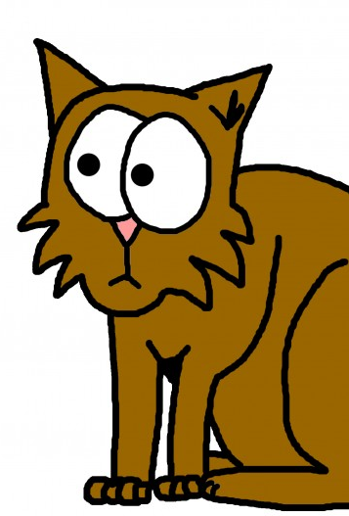
All of your feelings are valid, that means you don’t need a reason to feel sad or scared or worried

Slide 5
But it’s important to let them out so that they don’t take over

Slide 6
Creating an original piece of music is a great way to express yourself and have some fun at the same time!

Slide 7
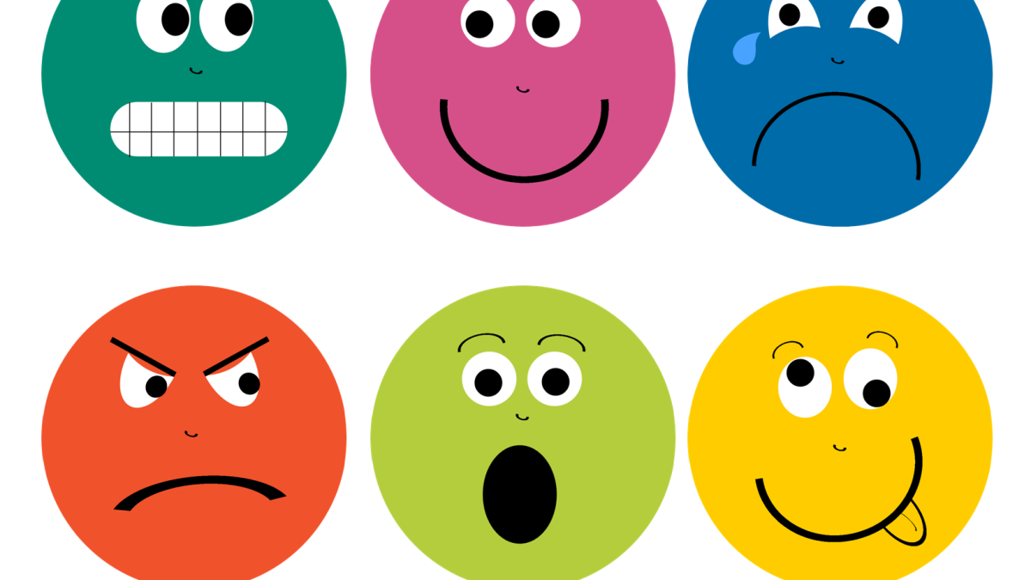
Follow the steps on the next slide to create your own music and perform this however you like! Make a RAP or a SONG or even use an APP to Express Yourself and “Let It OUT”!
This Photo by Unknown Author is licensed under CC BY-NC

Slide 8
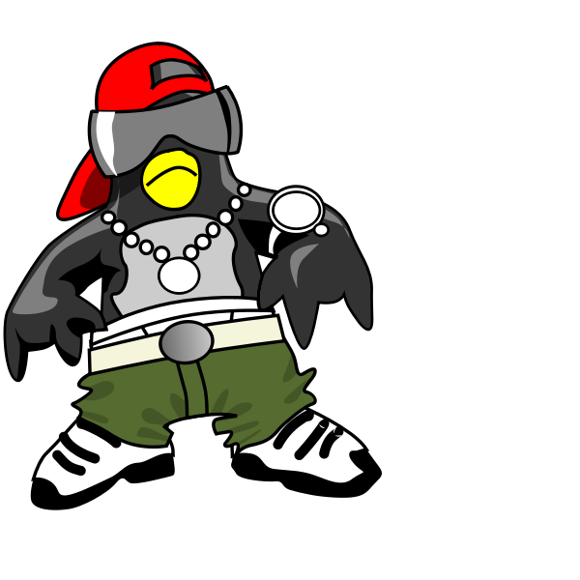
You don’t need to have ANY musical skills to do this, just some imagination!
WRITING LYRICS
Make a list of things that could be your theme – this might be the way you feel about something or someone, something that’s happened to you or someone around you, hopes and dreams for when life returns to normal – anything at all that you want to express!
Then think of as many words/phrases as you can that fit into that theme (write these down to help you!)
Try out different combinations of rhythms and sentences until you’ve created a verse and a chorus

Slide 9
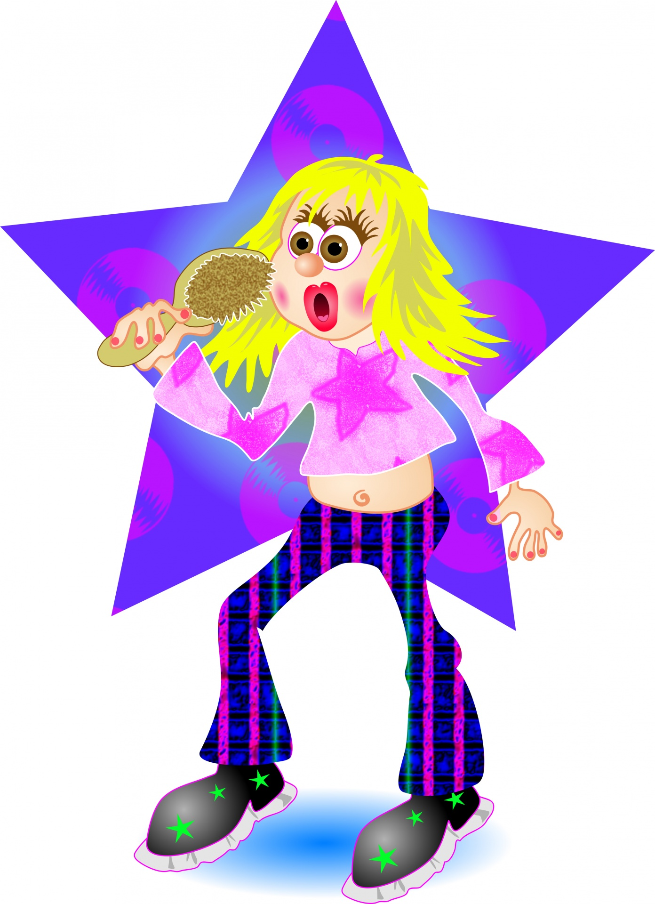
You don’t need to have ANY musical skills to do this, just some imagination!
creating melody or rhythm
Use one of the backing tracks as your starting point. Choose a note to start on that sounds good with the chords and take it from there!
Remember that notes which are near each other will sound better so try not to jump from low notes to high notes.
If you’re creating a rap, focus on the rhythm and see how you can fit your lyrics into the beat. Try different speeds or emphasizing different words

Slide 10
You don’t need to have ANY musical skills to do this, just some imagination!
Resources: backing tracks
Rap track
Song track

Slide 11
You don’t need to have ANY musical skills to do this, just some imagination!
Using your own instrument
If you have access to a guitar or keyboard at home try creating your own backing using the chords of C, Am, F, G
Improvise your melody over this!

Slide 12
You don’t need to have ANY musical skills to do this, just some imagination!
USING AN APP
If technology is more your thing, download the Music Maker JAM app for free
You can use the loops and samples to create your own piece of music
You can record lyrics if you like but you might prefer to express yourself without any words

Slide 13
Share your performance or keep it just for yourself but don’t forget to express yourself and LET IT OUT!

