Slide 1
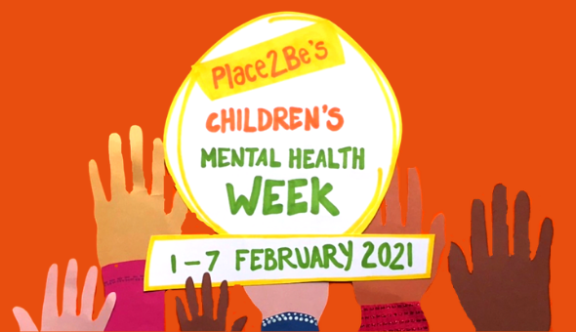
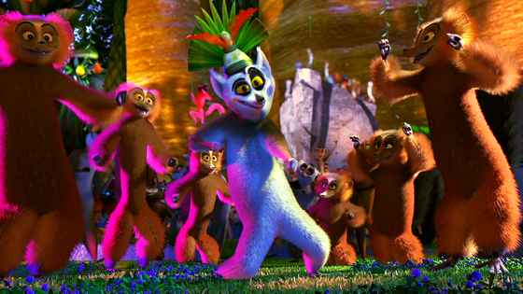
Express Yourself!
MOVE IT!

Slide 2
Why dance?
“Most of us are familiar with the great feeling obtained from spending time out on the dance floor.
From weddings and holiday parties to aerobic classes or even dance lessons, moving our body often does a lot to lift our mood.
It turns out there is a scientific explanation behind those mood-boosting moves, and there are ways we can use dance to improve our mental health.
There are many benefits of dance supported by research. Dance improves your heart health, overall muscle strength, balance and coordination, and reduces depression.”
MindWise Innovations 2021

Slide 3
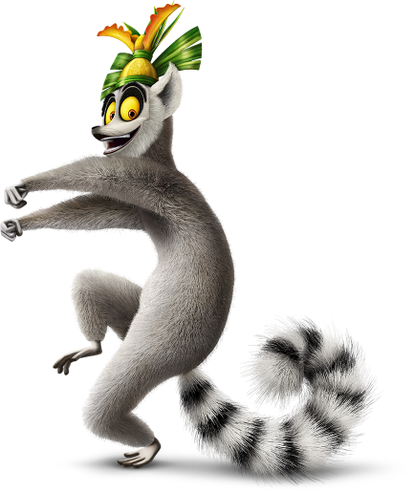
Activity!
Watch the following two video clips.
Choreograph or freestyle your own dance routine.
Think like King Julian and ‘move it’!
Have FUN!

Slide 4
https://www.youtube.com/watch?v=uBGUx55qpZ0
https://www.youtube.com/watch?v=ISxmYT4fbBQ

Slide 5
Share your performance or keep it just for yourself but don’t forget to express yourself and remember ‘I like to move it, move it’!

