Slide 1
The Robert Burns Academy
Art, Design
&
Photography Department

Slide 2
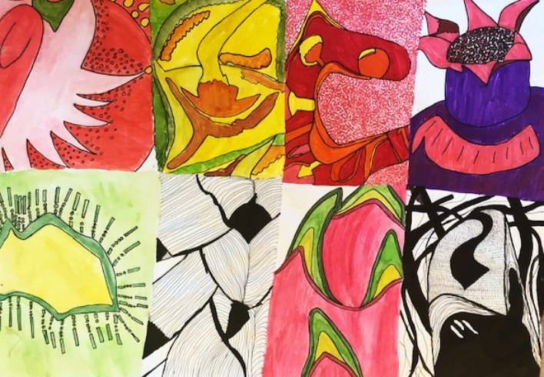
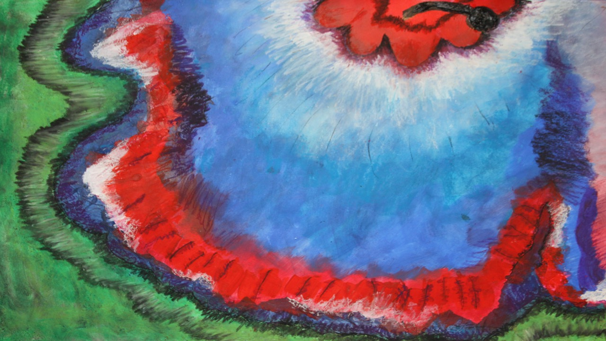
Welcome S1
Please meet the
Art, Design & Photography
Department Staff

Slide 3
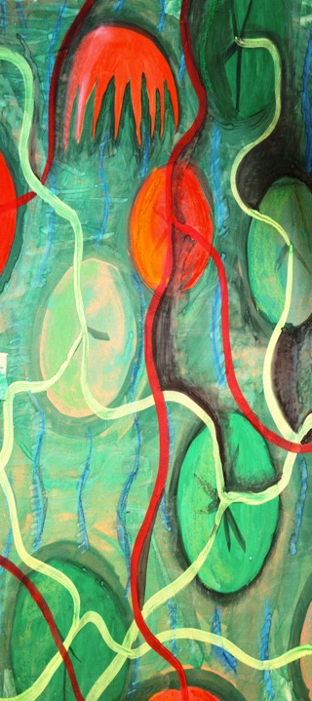
Hello and welcome to the
Art, Design and Photography Department
I am Ms Lopez the Principal Teacher
For those of you who don’t know me here are some facts about me...

Slide 5
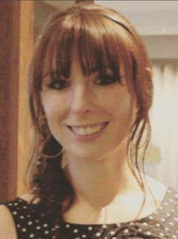
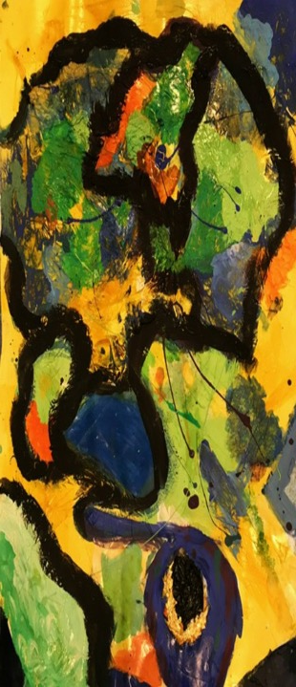
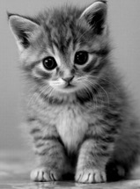
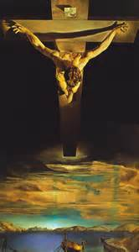
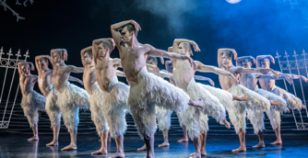
Hello everyone, I’m Miss Smith.
I’ve been teaching Art and Design for 12 years and look forward to meeting you all at our new school.
I Love dance. I taught ballet, tap and Modern for 10 years and I’ve choreographed school shows such as Hairspray, Sunshine on Leith and High School Musical. My favourite show is Matthew Bourne’s Swan Lake.
I love going to music gigs, some of my favourite bands/musicians are Idlewild, Snow Patrol, The Who, Jack Garratt…in fact too many to mention.
I also adore piano music…although I play terribly!
Some of my favourite artists are JMW Turner, Dali and Horatio McCulloch.
I love cats, I have one (very fat) cat called, Nermal.
My favourite foods are pizza, halloumi and pick and mix!
One of my biggest fears is flying….but I did manage to fly to
NY last year.
My best Art tip is….HAVE FUN! Don’t worry if it isn’t great, everything gets better with practice and time. As long as you’re enjoying yourself, that is what matters.

Slide 6
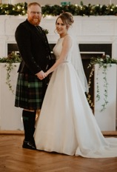
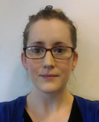
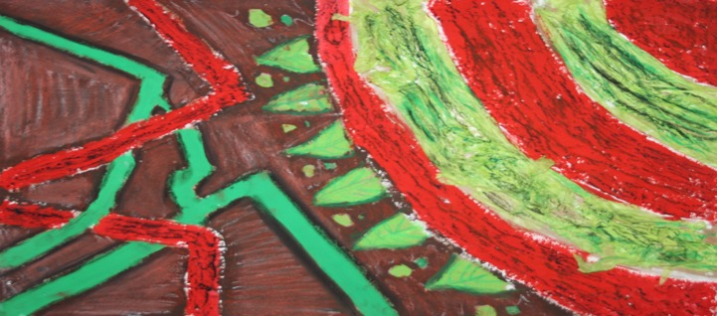
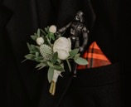
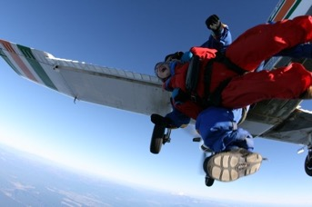
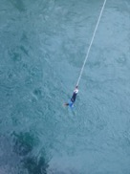
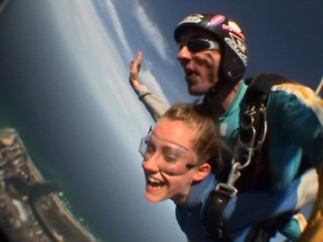
Hello, I am Mrs Ross For those of you who don’t know me, here is a bit about me...
I just recently got married and as I love Christmas time and am a fan of Country music and my husband is a fan of Star Wars, we decided to have a Country/Star Wars Christmas time wedding!
I am vegetarian and have never been to McDonalds (people usually find that a bit shocking ☺)
My favourite foods are sushi (the veggie kind) and pizza
I have worked at Cumnock Academy for 10 years but did lots of different jobs before becoming an Art Teacher, for example I once worked as a towel folder in a laundry factory in New Zealand!
I love to travel and to try out different things when abroad, like skydiving and bungy jumping
I have a different Christmas jumper for everyday in December!
I look forward to getting to know you all over the next year!

Slide 7
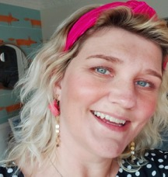
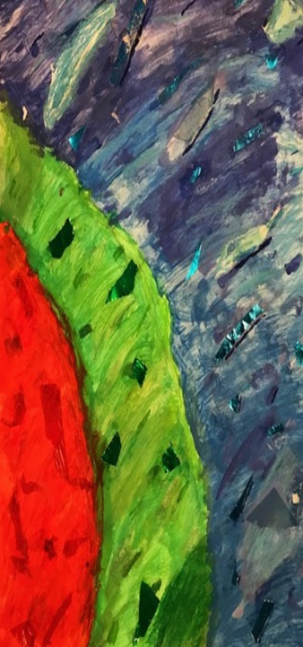
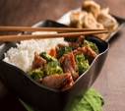
Hello !!!!!
My Name is Mrs Wallace.
Fact file: Mrs Wallace
I have been teaching Art & Design for nearly 15
years now.
I am married and have three children,
Olivia 9, Elliot 6 and Gregor 4 – nearly 5!
I love playing Netball, I play for a team in Kilmarnock.
I love Chinese and eating Chocolate.
I love listening to a range of music.
I have been listening to a lot of chill out music recently.
I love Take That, and I am still a big fan.
I enjoy jogging and going long walks with my family.
Interesting fact: I can touch my nose with my tongue!!

Slide 8
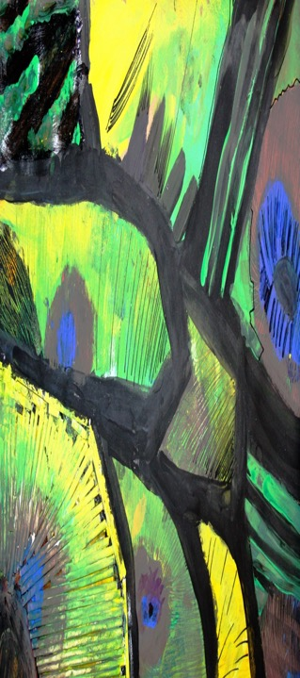
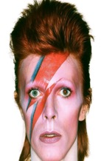
Hello I am Mr Traynor
I look forward to meeting you all when we get back
to school.
.
Fact file:
I am married and have two children, Jack and Jessica
I like football and tennis
I like Indian and Chinese food
I love music. Particularly New Order and David Bowie
I love going on holiday but hate flying
I hope you enjoy the start of your Art & Design journey in Robert Burns Academy.

Slide 9
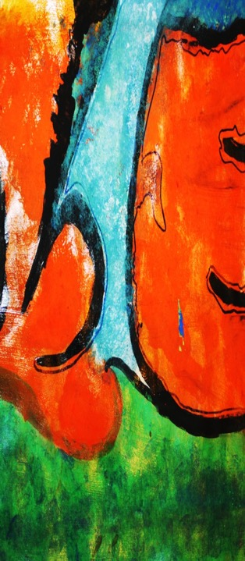
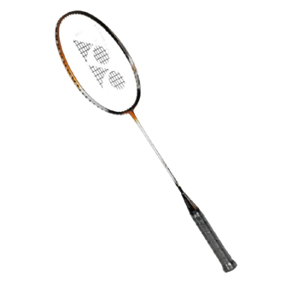
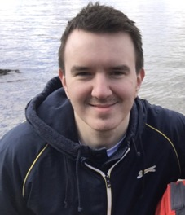
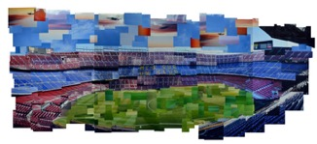
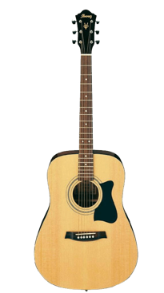
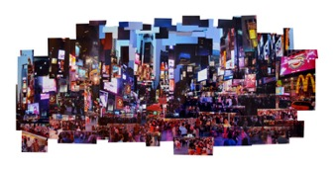
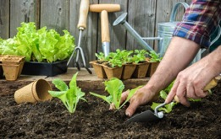
Hello, I’m Mr McGlynn
I Studied Digital Art at UWS in Ayr.
I was a Swimming Teacher for 5 years and a competitive swimmer at club level before that.
I have done a fair bit of photography work over the years, did some photo collages of New York and Barcelona.
Play badminton once a week and have challenged many pupils and teachers to games (all ending the same way).
Been learning to play guitar for a while now and hope to take up keyboard soon.
When I was younger my friends use to ask me to draw their favourite cartoon characters. (Thinking back I should have charged them for it... Oh well).
This year, I have become a bit of a gardener and have grown my own tomatoes, peppers etc. Even got some fruit trees on the go!
Lover of pizza and make the best pizzas from scratch!

Slide 10
Don’t worry if you don’t think you are good at art.
You will learn to draw
You will learn to design things
You will learn to make things
We hope you will also learn to enjoy Art & Design if you don’t already
Art can be messy
Art can be tidy
Art can be exciting
Art can be creative
Art can be fun
Art is the one, the one, the one

Slide 11
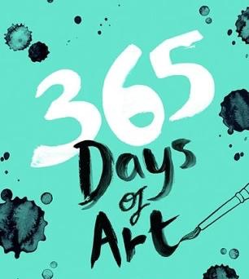
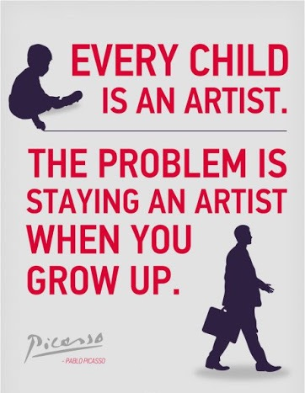
Believe
Achieve
Create
Enjoy

Slide 12
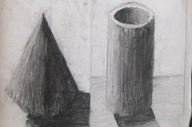
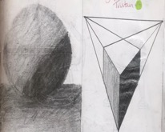
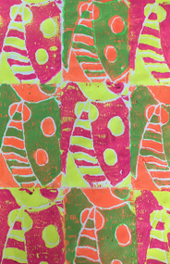
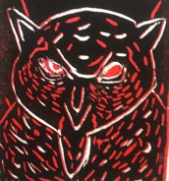
In S1 you will have the opportunity to take part in a range of different activities
both in the classroom and outside the classroom. Below are the main topics you will cover in class.
Visual Elements Front Cover
This unit focusses on introducing the Visual Elements to the pupils whilst building in some numeracy
Essential elements to be covered: visual elements and measuring
Basic Shapes – Structural/Mechanical Objects e.g. robots, vehicles, cars, spaceships, building etc
This is an introductory unit to build on pupils’ prior Primary School knowledge of basic shapes. Pupils will be be taught that the basic shapes are the building blocks of any drawing.
Ceramics Design Unit – Vessel Design
This unit will introduce the Design Process to pupils as well as working with 3d modelling material. The final outcome is a clay vessel.
Essential elements to be covered: pattern, form, texture, line and scale.
Multiple Colour Polystyrene Print
This unit focuses mainly on polystyrene printing however various printing techniques are touched on throughout the unit. The theme is nature based and pupils will work from primary sources where possible. The final outcome is a multiple colour print on paper or fabric.
Essential elements to be covered: line, tone, shape, colour and pattern.

Slide 13
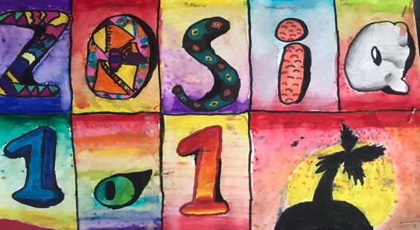
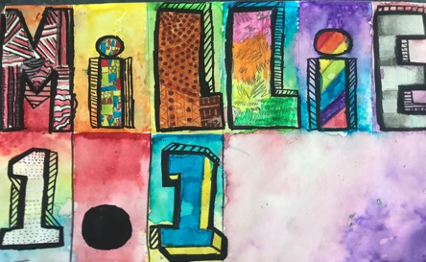
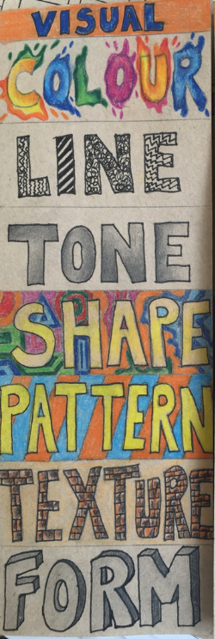
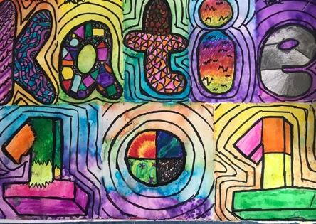
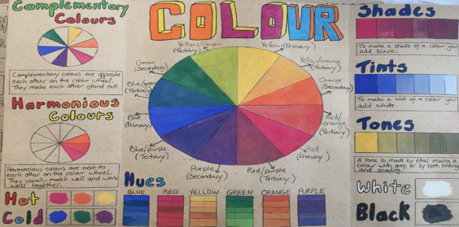
S1 VISUAL ELEMENTS FRONT COVER Includes drawing, painting, measuring, dividing, introduction to the visual elements

Slide 14
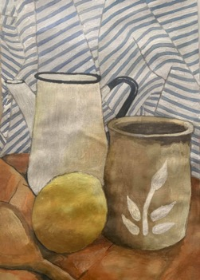
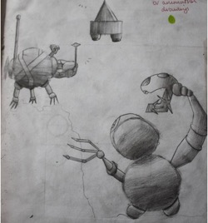
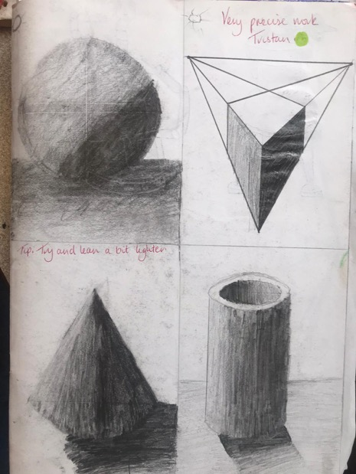
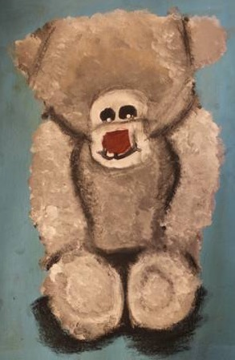
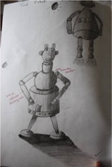
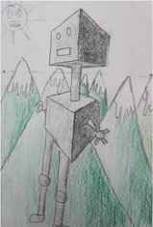
S1 BASIC SHAPES Includes drawing, measuring, painting, dividing, still life

Slide 15
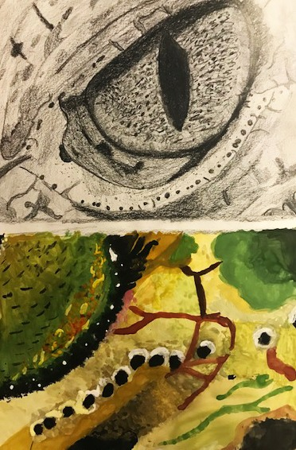
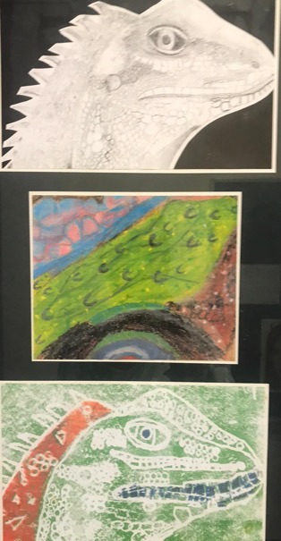
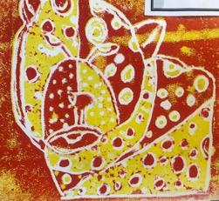
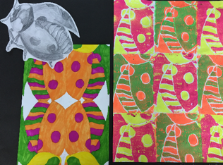
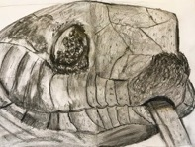
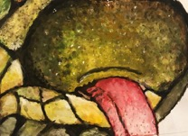
S1 PRINT UNIT Includes drawing, painting and printing

Slide 16
S1 CLAY UNIT Includes drawing, designing, making an object from clay & glazing once fired
SOME GLAZED EXAMPLES

Slide 17
You will also have the opportunity to take part in:
Lunchtime clubs
Fashion shows
Competitions
Work with professional artists
Art, Design and Photography trips

Slide 18
Moving up the school:
The next few slides show some of the things you will get to try as you move up the school in The Robert Burns Academy
BE INSPIRED

Slide 19
S2 In S2 you will cover Portraiture, 2 point perspective, Fashion Design, Graphic Design Design/Illustration

Slide 20
S3 WORK In S3 you will have the chance to really experiment with materials

Slide 21
Nat 5/Higher Expressive drawing and painting

Slide 22
Nat 5/Higher Expressive drawing and painting

Slide 23
Nat 5 & Higher Expressive Drawing and Painting

Slide 24
Higher & Advanced Higher Expressive Drawing and Painting

Slide 25
Nat 5 & Higher Design Here are some examples of parts of Design Units

Slide 26
Higher Photography Here are some examples of Higher Photography

Slide 27
Thank you for watching and we cannot wait to meet you.

