Slide 1
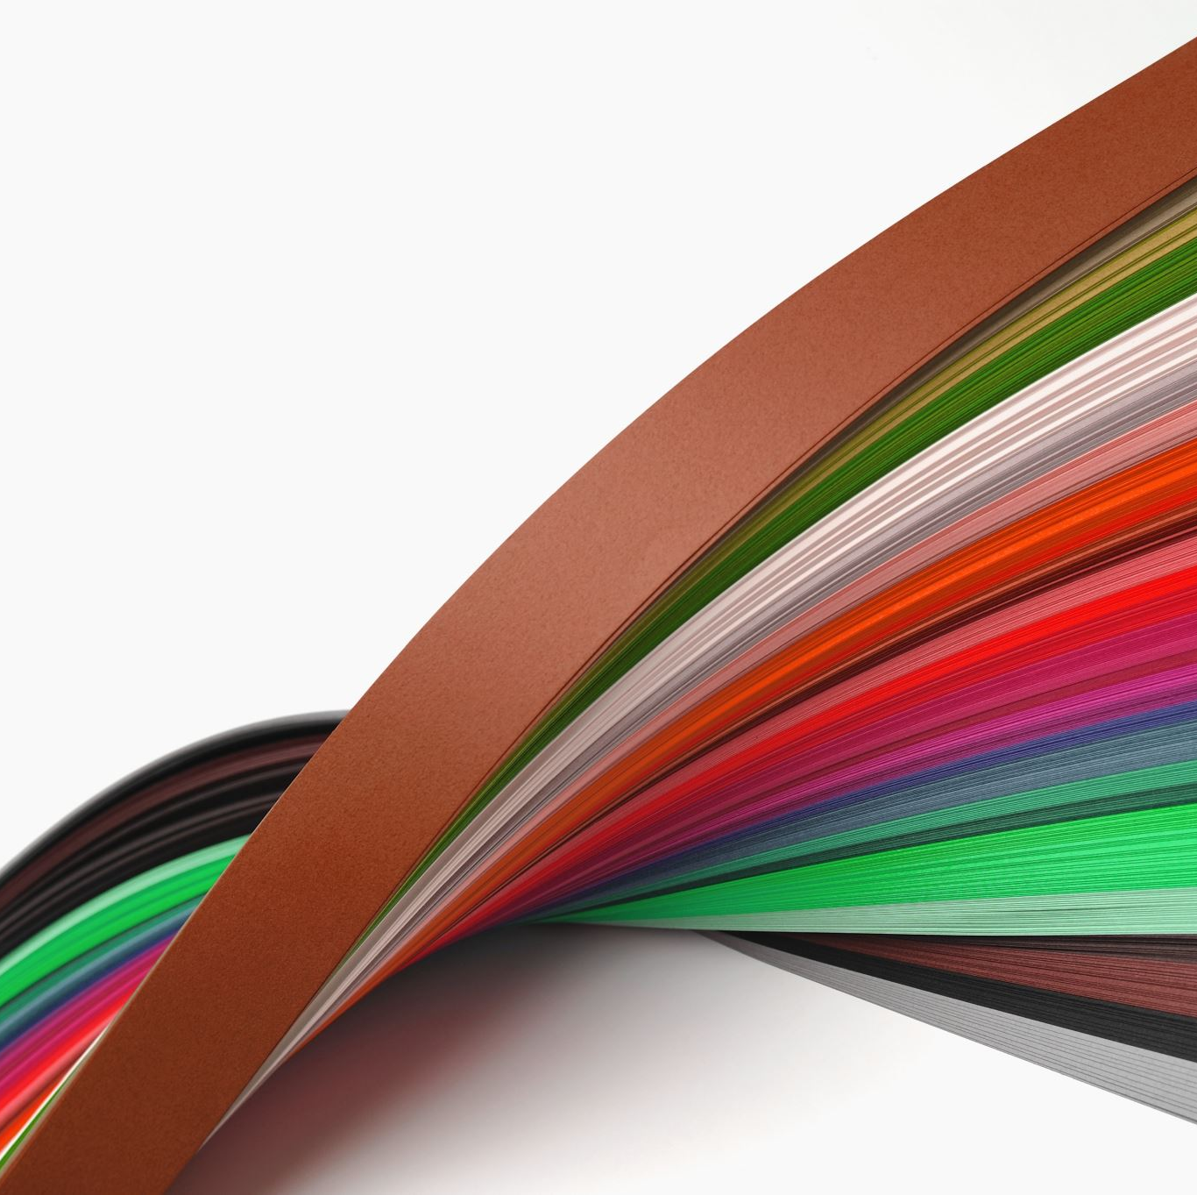
Robert Burns Academy
Primary 7 to S1 – Technical Transition Curriculum Overview

Slide 2
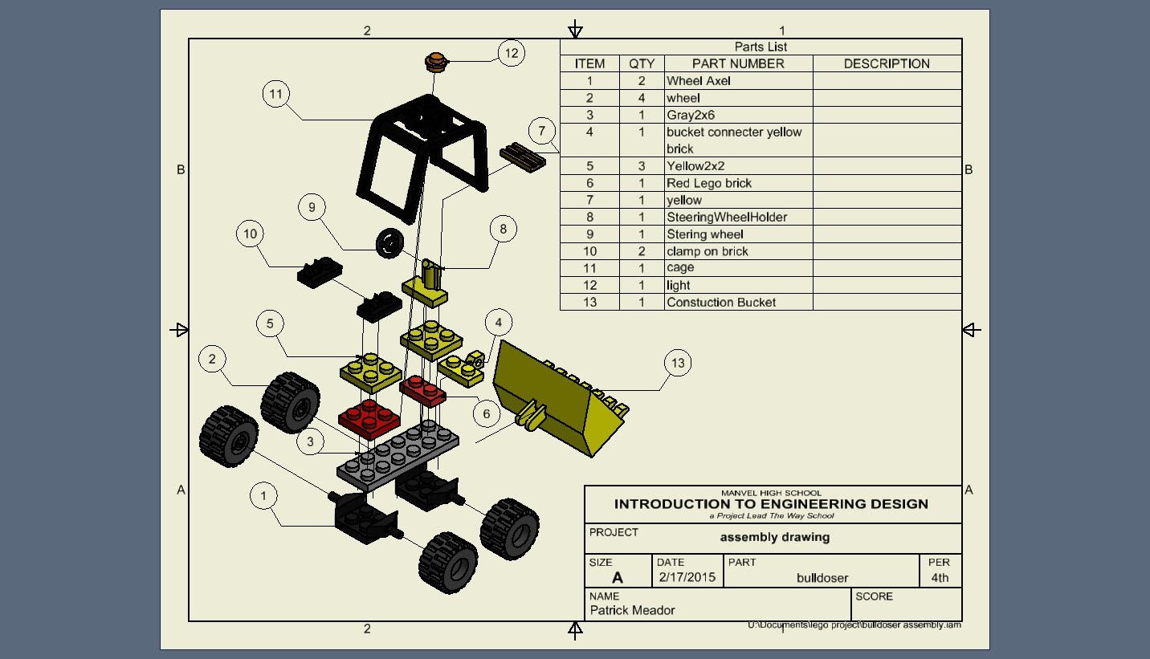
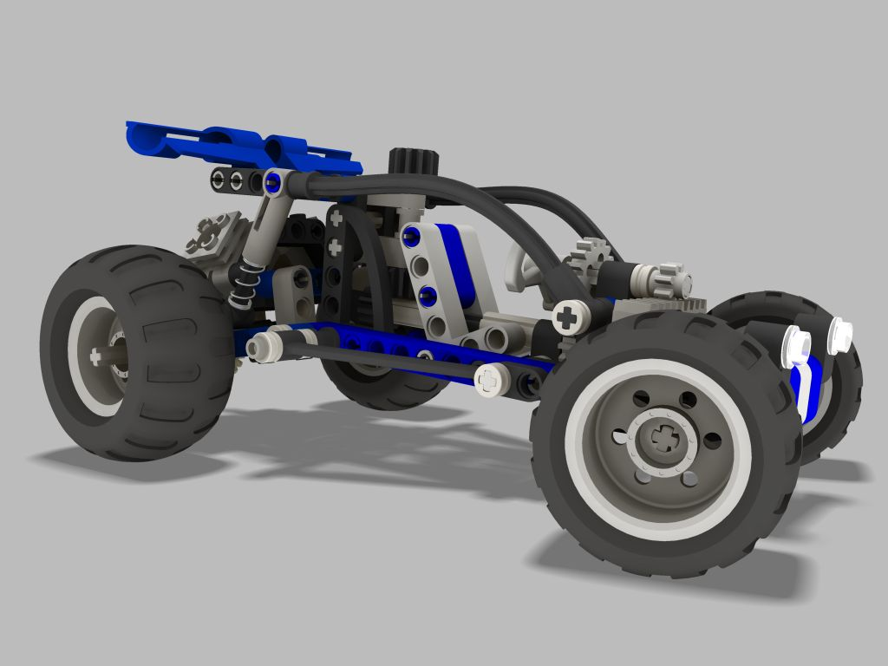
S1 Curriculum
When you come to the RBA you will have the opportunity to attend Technical twice per week.
The Periods will be split where you will over the year engage in both Graphic Communication and Design and Manufacture.

Slide 3
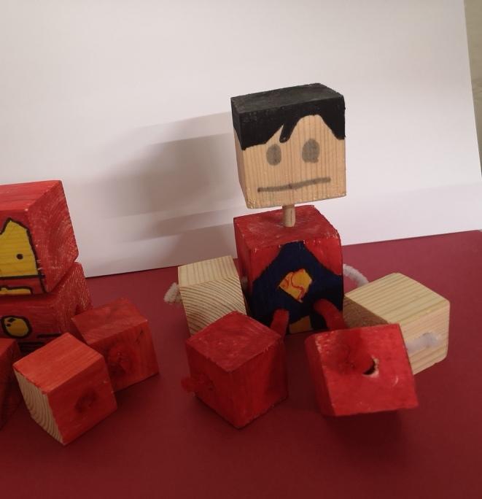
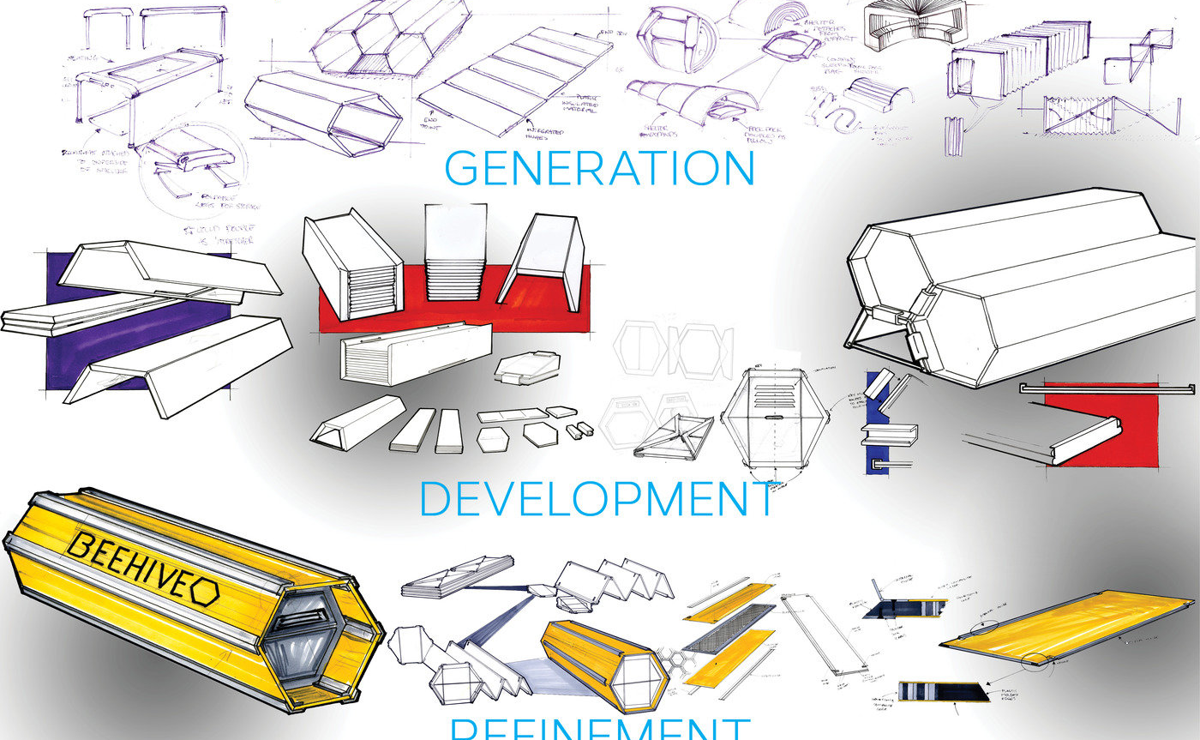
Design and Manufacture
Folio
Product design analysis task – feedscammp
Modelmaking skills
Cad Modelling -sketch-up & inventor
Workshop tasks – Wood, Plastic & Metal product

Slide 4
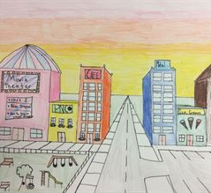
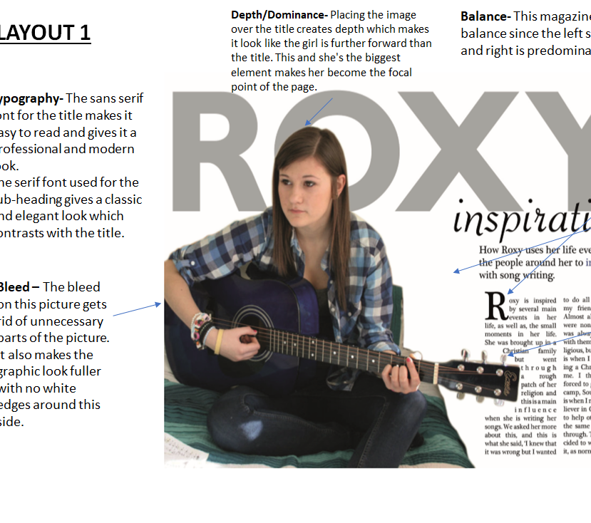
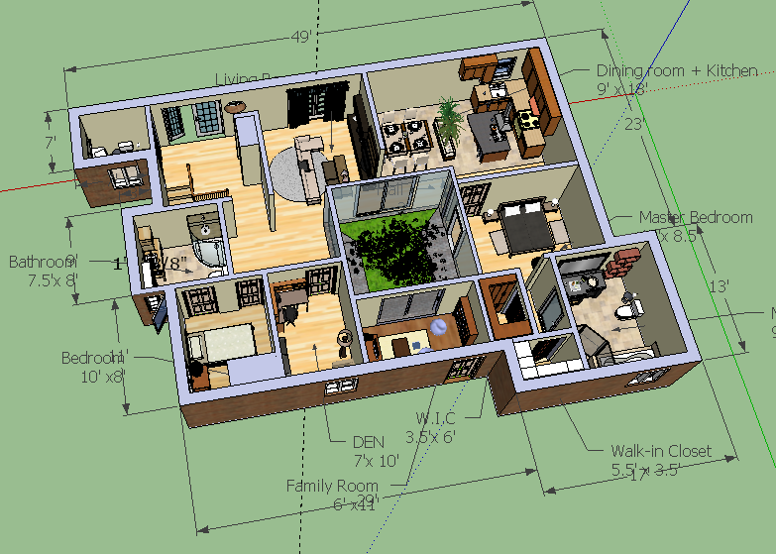
Graphic Communication
Orthographics - board and freehand
1 point perspective
Google Sketchup
Inventor - - extrude, revolve,
Dtp (Serif) - alignment, contrast, depth, dominance
Sketching – everyday shapes/products, thick/thin line technique
Rendering - pencil rendering, tonal scale, colour theory

Slide 5
Technical – see you soon

