Slide 1
Welcome to the PE Department

Slide 2
EXPECTATIONS
This is simple! When you come to PE we ask you to bring 2 things:
Your PE kit
and your manners

Slide 3
PE Kit
What is suitable PE kit?
Tops – any type of sports top e.g. t-shirt, long sleeve top, tank top, jumper, or hoodie. NO FOOTBALL TOPS.
Bottoms – shorts, trackies, leggings. NO DENIMS.
Footwear – trainers, sports shoes. NO SANDALS or WHEELIES.
Why do you need to wear this?
You will take part in wide range of activities where you will be active and move about more and perform a wider range of movements.

Slide 4
Manners
Why do I need to bring manners?
PE is an extremely interactive subject where we have to work with others to be successful. We cannot get better at PE without working with other people.
Therefore we must be able to rely on others (and they have to rely on you) to help you improve. E.g. In gymnastics you will have to support others and be supported. In team games and competitive games such as football, rugby, netball ,basketball, badminton etc you will have to practice with, and compete against others.
Working RESPECTFULLY with your classmates and the teacher is the most important thing we expect of you in PE.

Slide 5
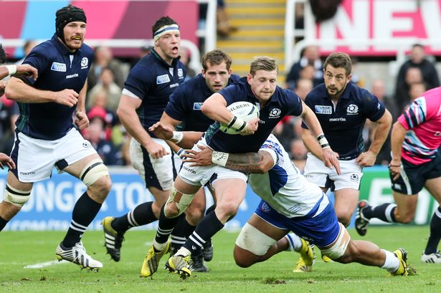
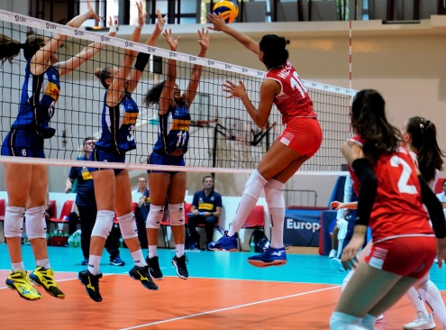
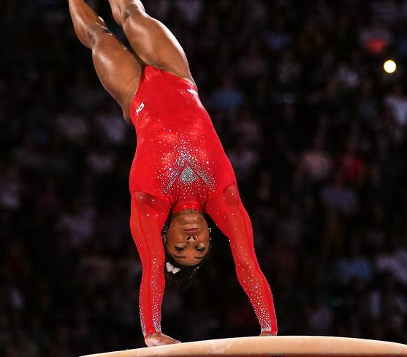
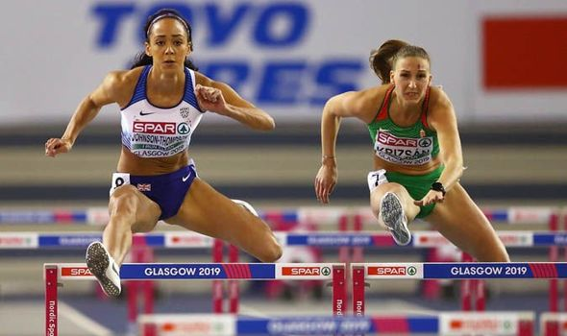
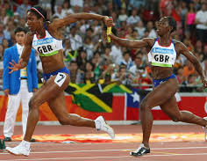
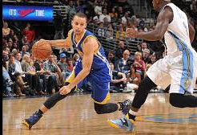
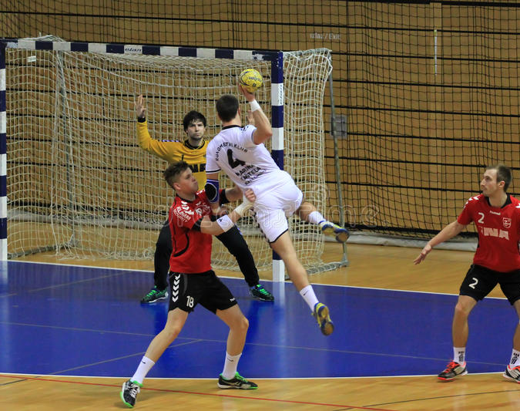
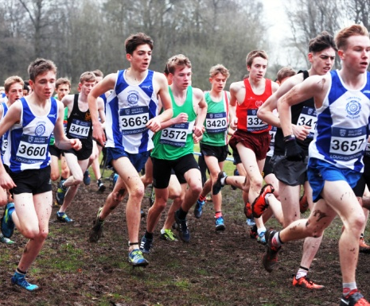
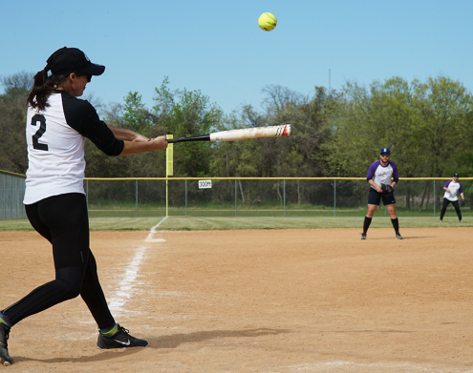
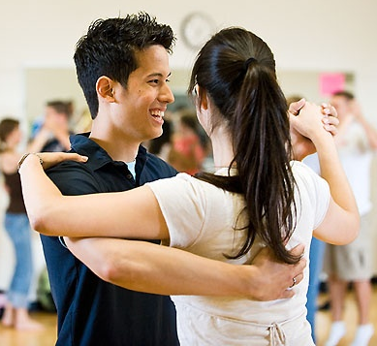
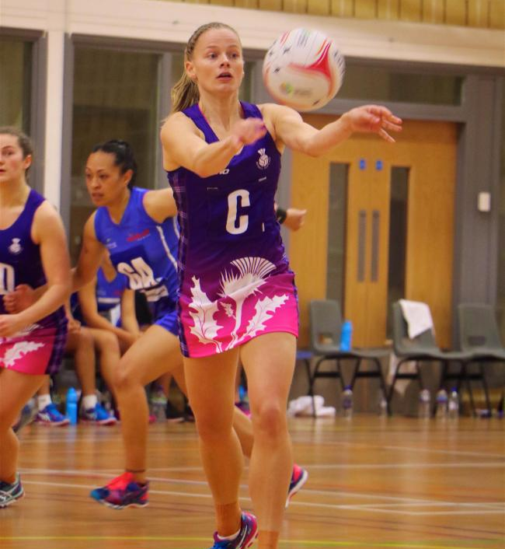
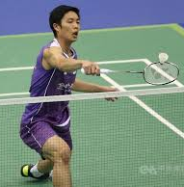
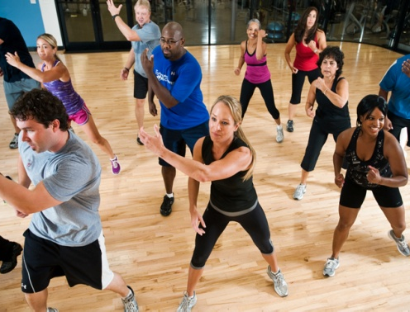
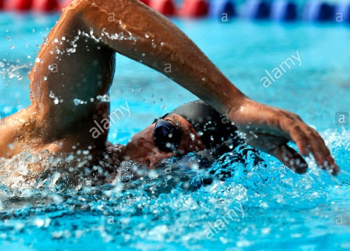
Curriculum activities we usually cover

Slide 6
What is core PE about?
Many pupils have the wrong idea about PE.
PE is about taking part and giving different activities a try.
It is NOT about being good at sport.
Through taking part and working with other people you will naturally get better at the sports/activities.
Our main focus is to develop an enjoyment of being active and making you a better person e.g. develop your co-operation, communication and leadership skills, build your resilience and tolerance of others, develop compassion and empathy for others etc.

Slide 7
Extra-Curricular Teams/Clubs
We will have a wide range of extra-curricular opportunities for you.
Clubs usually run at lunchtime or afterschool and include:
Netball, Football, Badminton, Gymnastics, Rugby, Dance, Volleyball, Handball.
If you would like to see any other extra-curricular activities offered the PE department are usually able to support these.
We also have school teams which take part in competitive leagues/competitions.
These include: Netball, Football, Rugby, Handball, Cross-Country, and Athletics teams.

