Slide 1
Faculty of Business, Computing Science and Administration & IT
Welcome to our new S1!

Slide 2
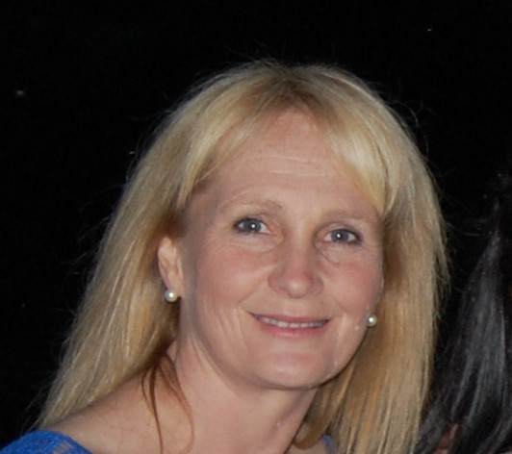
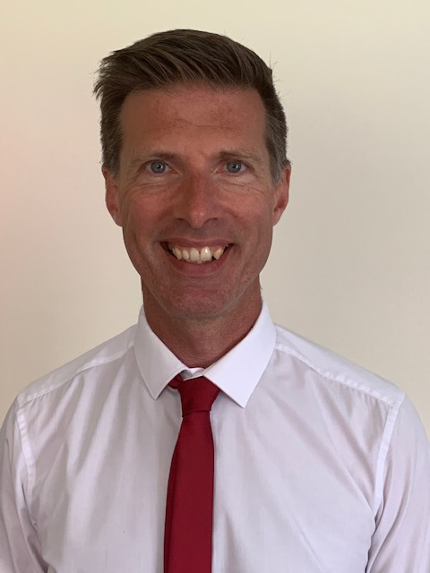
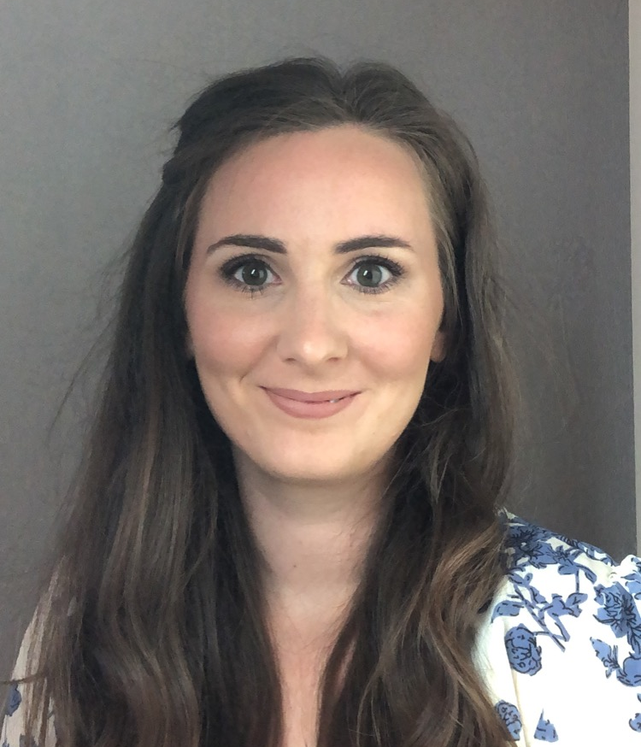
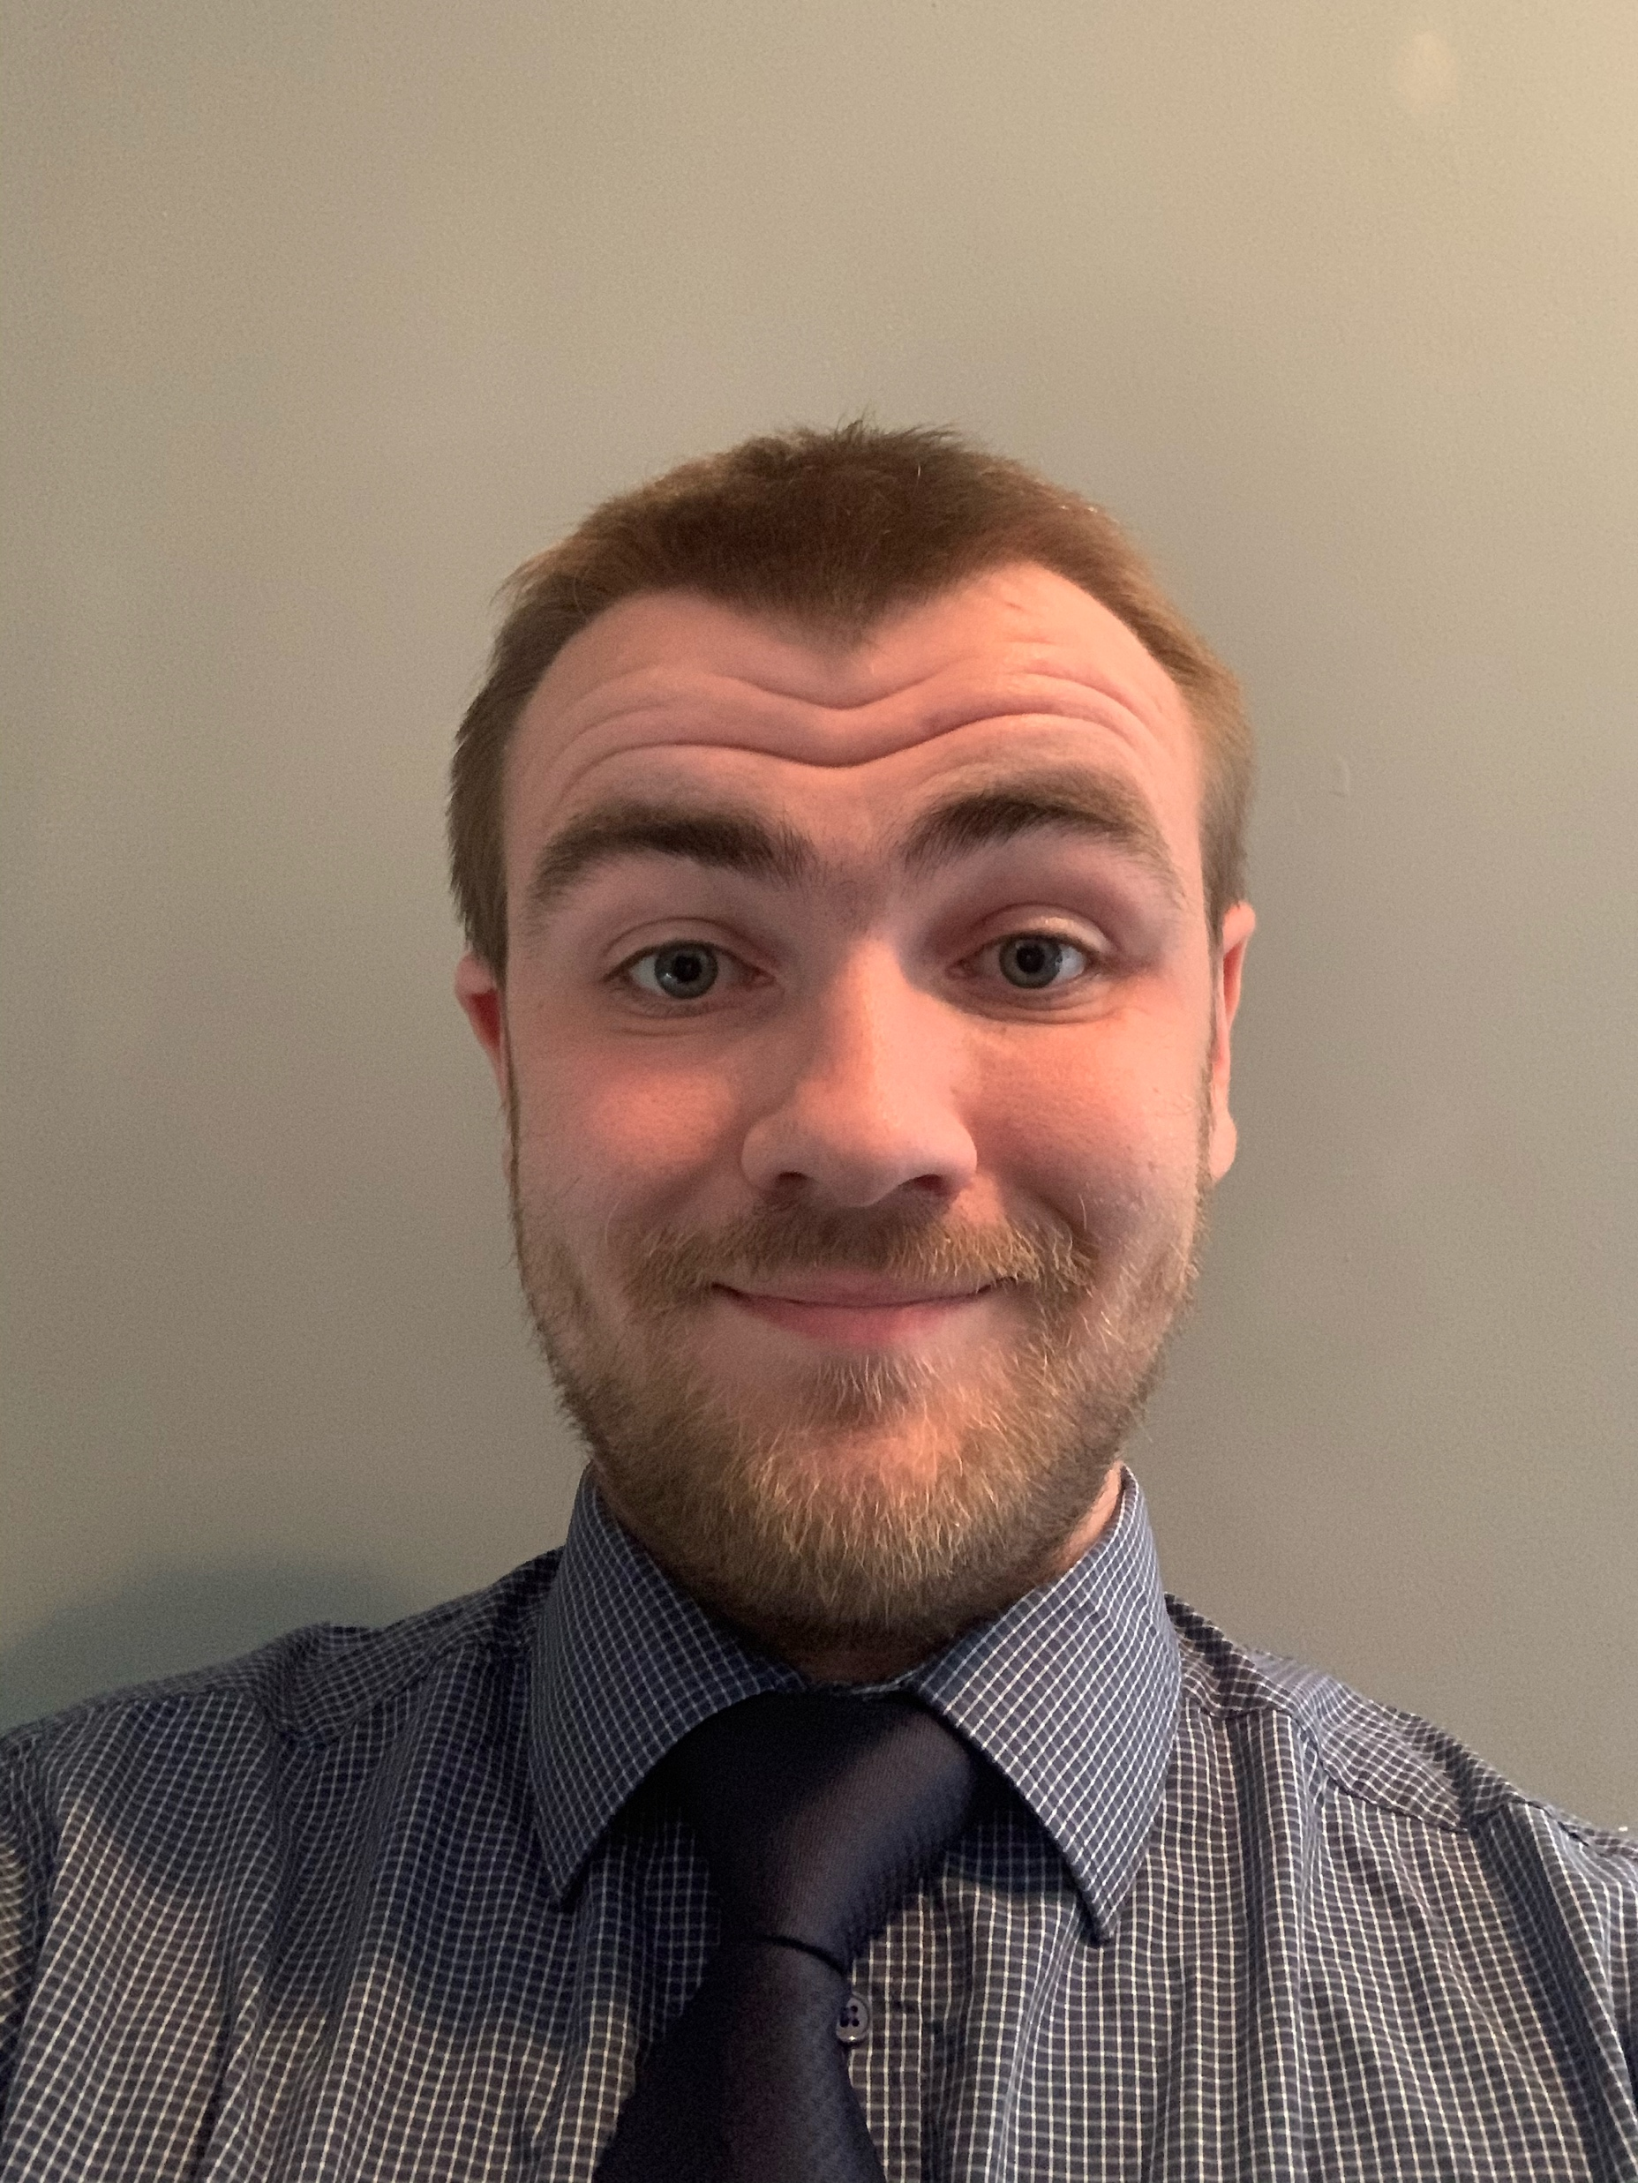
Our Staff
Principal Teacher
Mrs Hammersley
Teaching Staff
Mr Blyth
Mrs Campbell
Mrs Ferguson
Miss Kilpatrick
Mr Robertson (DHT)
Mr Rutherford
Mr Tickner (PTG)

Slide 3
Our S1 Course
Our S1 course covers all three of the subject areas that we offer in our faculty. The 3 subjects are:
Administration & IT
Business
Computing Science

Slide 4
Administration & IT
You will study:
Word Processing & Desktop Publishing (DTP)
Database
Spreadsheet
Communication

Slide 5
Business
You will study:
The role of business
Business ethics
Global Brands
Globalisation & Multinational Businesses

Slide 6
Computing Science
You will study:
Computer Systems
Programming using BYOB
Creating basic web pages
Computational Thinking

