Slide 1
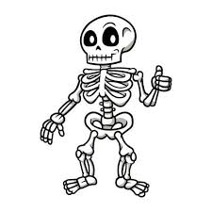
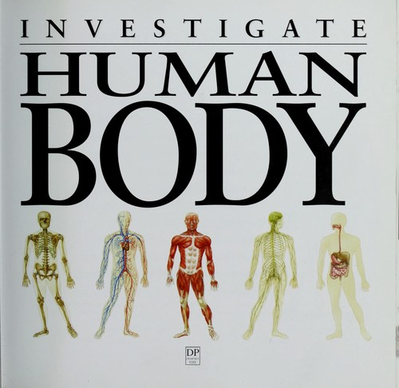
Our Amazing Body
P3/4 Week 2

Slide 3
BBC Bitesize Parts of Our Body -Introduction

Slide 5
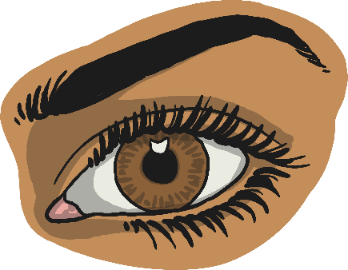
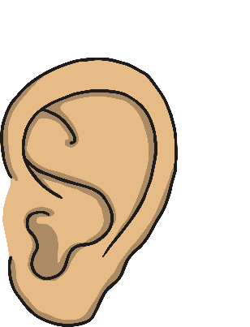
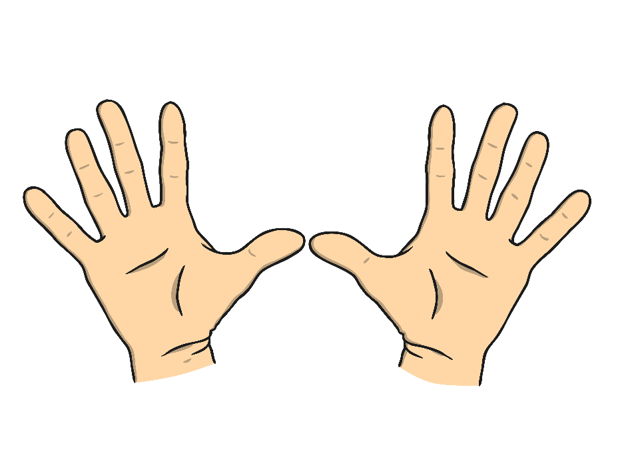
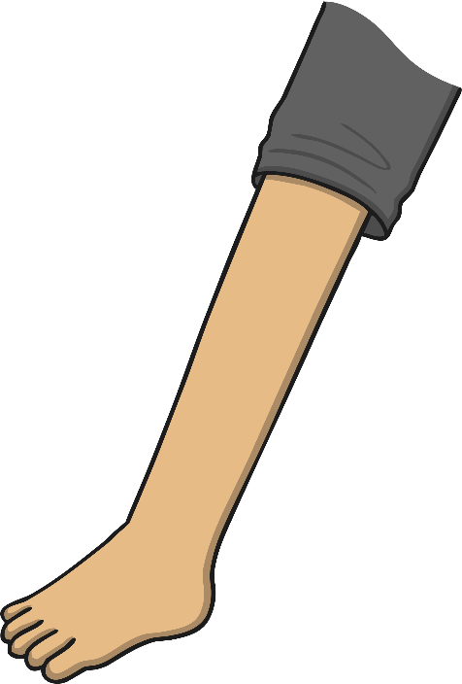
Parts of the Body
There are lots of different parts to our body.

Slide 6
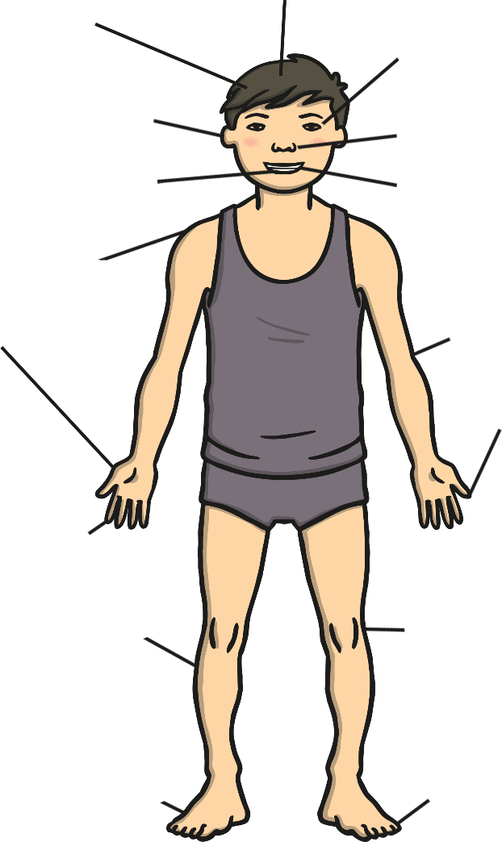
Can you name the parts of the body?
head
hair
eyes
ears
nose
mouth
teeth
neck
shoulders
chest
elbow
hand
thumb
arm
fingers
wrist
leg
knee
ankle
foot
toes

Slide 7
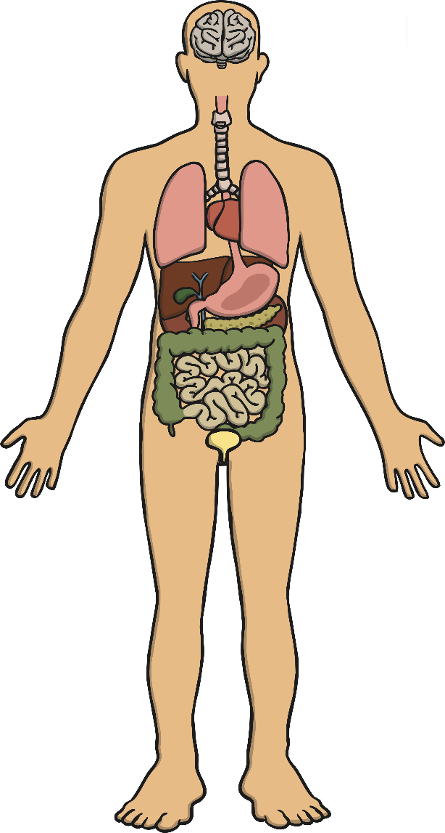
Parts of the Body
There are lots of important parts of the body that we can’t see.
This is because they are hidden away inside our body.
They all have important jobs to do and work together to help us stay healthy.

Slide 8
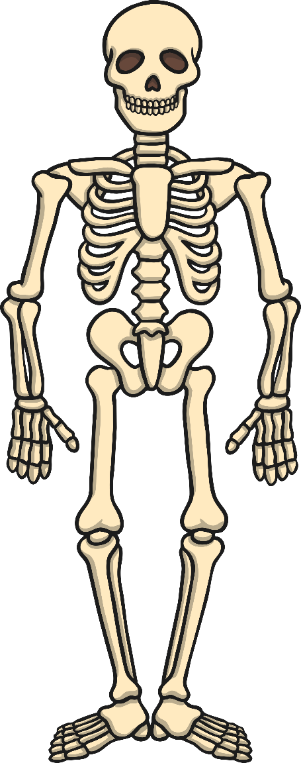
The Skeleton
The skeleton is made up of lots of bones.
These bones give the body its shape.
They also protect the organs that are inside our body.
An adult skeleton has 206 bones.

Slide 9
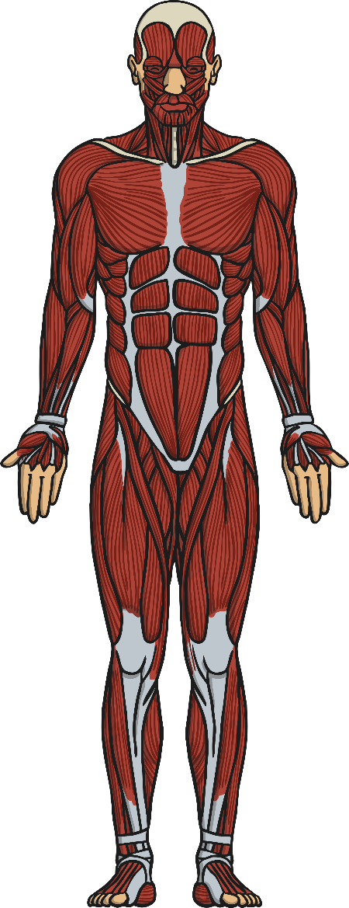
Muscles
Muscles help our body to move.
There are muscles of all shapes and sizes in our body.
The strongest muscle in your body is the muscle in your jaw that helps you to chew!

Slide 10
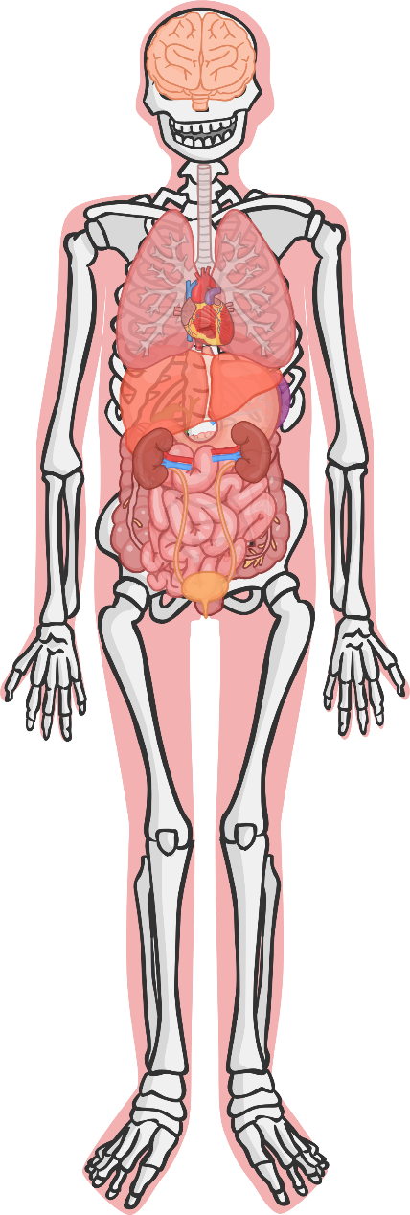
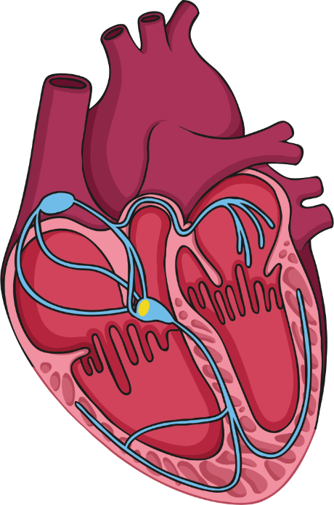
The Heart
The heart is a special muscle inside your body.
It is found inside your chest.
It is protected by your ribs.
Can you feel your ribs?

Slide 11
The Heart
The heart has a very important job to do, it pumps the blood all around your body.
The blood takes oxygen from your lungs to all of the different parts of your body.
Your heart is about the same size as your fist.
fist

Slide 12
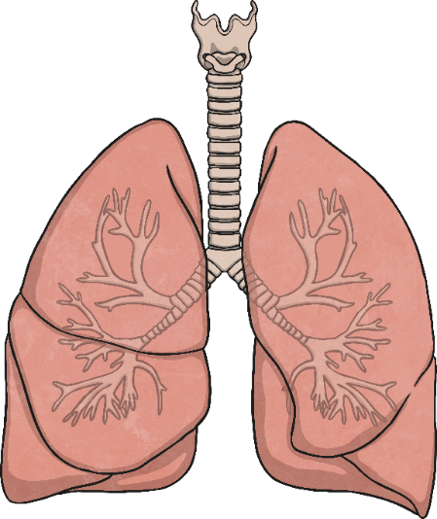
Lungs
There are two lungs inside your chest.
Your lungs help you to breathe.
When we breathe, we take in air.
When you take a deep breath, you can feel your chest getting bigger. This is because your lungs are filling up with air.
Our bodies use some of the air (the oxygen) to keep us healthy.
Our lungs then breathe out the air we don’t need.

Slide 13
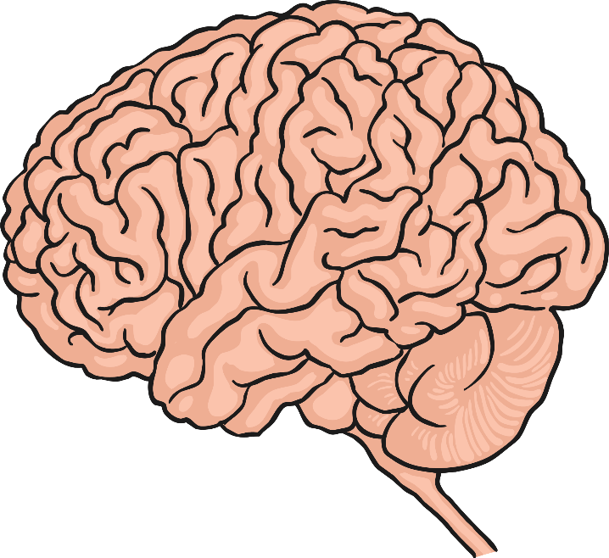
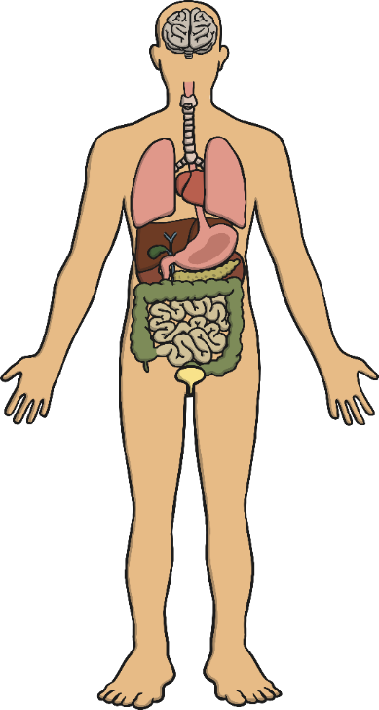
Brain
Your brain controls all of your actions, even the actions like breathing that you don’t need to think about.
Your brain helps you to learn new things.
Your brain is inside your head and is protected by your skull.

Slide 14
Let's Look Inside Our Body
Operation Ouch The Body Roadtrip!

Slide 15
https://kidshealth.org/en/kids/center/htbw-main-page.html
ALL LINKS IN LAB

