Slide 1
Famous Scot
I can create a fact file.

Slide 2
Can you think of a famous Scottish person?

Slide 3
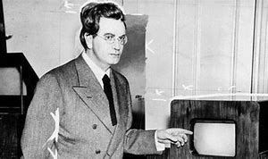
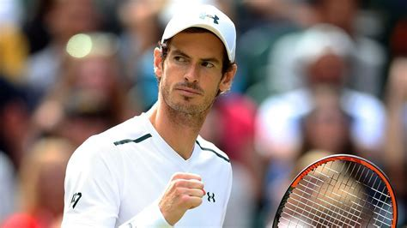
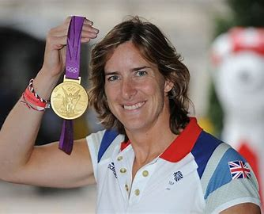
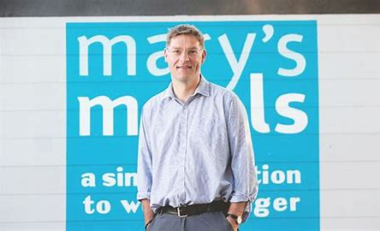
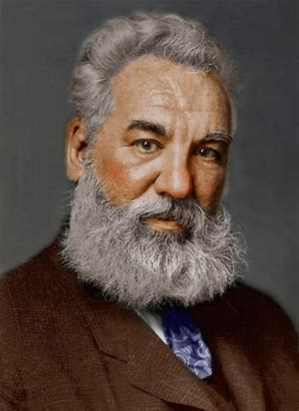
Have you heard of any of these people?
John Logie Baird – inventor of the TV
Katherine Grainger – Rower and Olympic medal winner
Andy Murray – Tennis Champion
Choose your famous Scot for your Fact file, you can use one of these people or research someone else!
Alexander Graham Bell – Inventor of the first telephone
Magnus MacFarlane-Barrow – Founder of Mary’s Meals

Slide 4
Once you have decided which famous Scot you are going to research, you will need to take some notes to help you when it comes to creating your fact file.
Perhaps you could write these headings down, and as you research fill in the useful information.
The Person’s name
Where and when they were born.
What are the famous for?
What have they achieved?
An interesting fact about this person…

Slide 5
Now let’s think about of fact file. Have a look at these examples.
Can you think of 2 features of these fact files that make them good fact files?

Slide 6
These Fact files are good examples,
There is a title to tell the reader what the fact file is about
The fact files contain facts
They are laid out in a clear manner
There are bright pictures / drawings
Your Fact file should contain these things too.
I am looking forward to seeing your wonderful fact-file about the famous Scot that you have researched!

