Slide 1
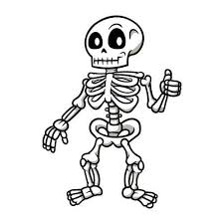
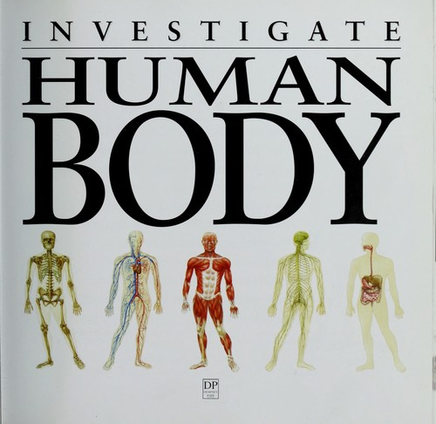
Our Amazing Body
P3/4 Super Science

Slide 3
BBC Bitesize- Skeletons Clip

Slide 4
BBc Bitesize. What does your skeleton do?
Copy and paste this into your browser. https://www.dairy.edu.au/build-a-skeleton

Slide 6
Funnybones Videos
Shake Rattle and Roll
OPERATION OUCH
Operation Ouch Quiz

