Slide 1
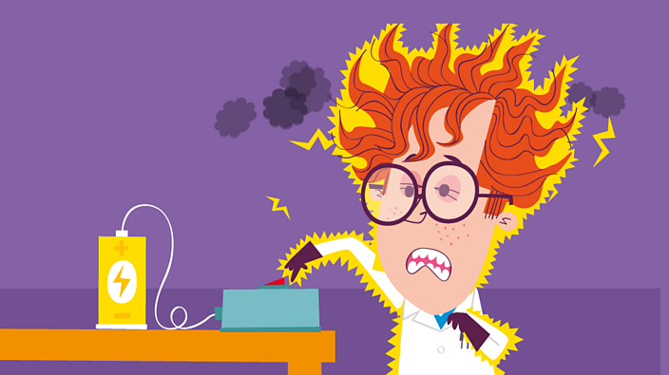
Electricity\P3/4
What Have I Learnt?

Slide 2
BBC Teach How is Electricity made ?

Slide 3
https://www.switchedonkids.org.uk/
All Links in Virtual lab.

Slide 4
Batteries and Their Uses
https://www.learningcircuits.co.uk/ LINK IN LAB

Slide 5
What are Conductors and Insulators

