Slide 1
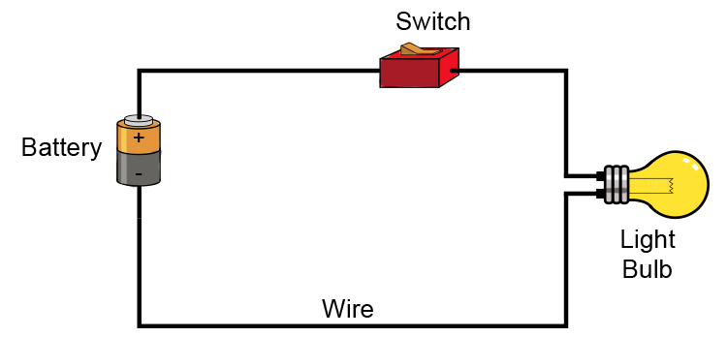
Electricity Week 4 P3/4
A Simple Circuit
Insulators/Conductors

Slide 3
BBC Bitesize. How an electric circuit works.

Slide 4
CUT AND PASTE WEBSITES INTO BROWSER OR VISIT VIRTUAL LAB (all links there)

Slide 5
BBC TEACH Insulators/Conductors
BBC Bitesize Conductors and Insulators

