Slide 1


INSPIRE AND TRANSFORM
St Joseph’s Academy, Kilmarnock
Introduction to LearnWell

Slide 2
Context
INSPIRE AND TRANSFORM
St Joseph’s Academy, Kilmarnock
Scotland’s Mental Health Strategy 2017 -27
Prevention and early intervention
Ambitions
Every child and young person to have appropriate access to emotional and mental well-being support in school.
Appropriate, evidence-based, parenting programmes should be available across Scotland.
Evidence-based interventions to address behavioural and emotional issues in children and young people should be available across Scotland.
Mental health support and treatment for young people involved in offending who have mental health problems should be available across Scotland.
Mental health training for non-mental health staff should be available across health and social care services.
Training in first aid approaches for mental health should become as common as physical first aid.

Slide 3
INSPIRE AND TRANSFORM
St Joseph’s Academy, Kilmarnock
Context
Education
Along with literacy and numeracy, health and wellbeing is one of the three core areas that are the responsibility of all staff in the school.
All adults who work in Scotland's schools have a responsibility to support and develop the mental, emotional, social and physical wellbeing of pupils, as part of what is referred to as 'Responsibility of All'.
To support this responsibility, Education Scotland provides training and professional development, as well as promoting good practice on positive relationship and behaviour approaches.
Making sure that children and young people are included, engaged and involved in their education is fundamental to achievement and attainment in school.
That means ensuring that schools provide a positive culture for all students' social, emotional and mental wellbeing, and that appropriate pastoral care and access to educational psychologists is available. The school environment can then help children to feel secure, resilient, confident, supported, and ready to learn.
Action 1 : Review Personal and Social Education (PSE), the role of pastoral guidance in local authority schools, and services for counselling for children and young people.
Action 2 : Roll out mental health training for those who support young people in educational settings.

Slide 4
INSPIRE AND TRANSFORM
St Joseph’s Academy, Kilmarnock
What is LearnWell
LearnWell is a whole school initiative launching St. Joseph’s Academy in 2021/22. It is aimed at supporting the wellbeing of young people, in order that they have the best possible opportunity to
meet their potential. It will also look to support the Wellbeing of staff and parent/carers and all involved in our community.
This initiative will focus on 4 main areas:-
Physical Wellbeing Mental Wellbeing Social Wellbeing Spiritual Wellbeing
Each year, there will be a calendar of events and initiatives to focusing on each of these areas of Wellbeing. There are many pre-existing activities in school which already work towards these areas, but LearnWell will look
to build on these and provide a comprehensive plan to complement and enhance support.
LearnWell also provides an umbrella term which allows us to calendar and catalogue the huge amount of and variety of activities, initiatives and supports which take place in school to support wellbeing. These vary in nature and using this as term under one of the 4 areas of Learnwell will help to inform young people, parents and partners. The aim is that the butterfly symbol will become synonymous with the support the school provides and that we prioritise the wellbeing of everyone in our community.
Using the calendar, a blog, leaflet, events and other methods of promotion will better show what we are doing as a school to support wellbeing.
The 4 aspects of Wellbeing also gives a foundation for us to self-evaluate progress in each area.

Slide 5
INSPIRE AND TRANSFORM
St Joseph’s Academy, Kilmarnock
What is LearnWell

Slide 6
INSPIRE AND TRANSFORM
St Joseph’s Academy, Kilmarnock
What is LearnWell
Create a culture of safety, support and inclusion where the wellbeing of all in our school community is a priority
Promote Awareness
Develop Staff Capacity
Enhance Support

Slide 7
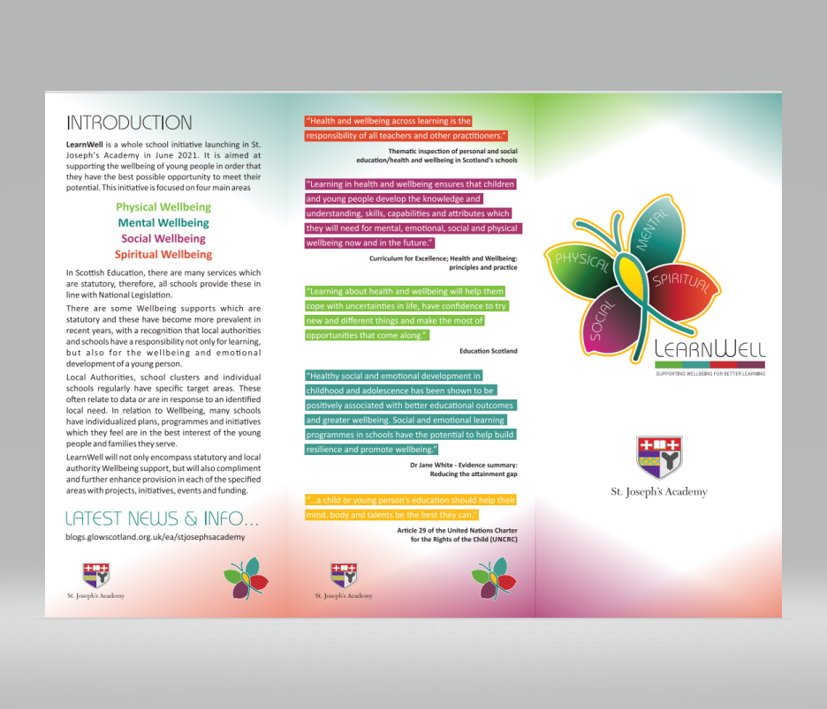
INSPIRE AND TRANSFORM
St Joseph’s Academy, Kilmarnock

Slide 8

INSPIRE AND TRANSFORM
St Joseph’s Academy, Kilmarnock

Slide 9
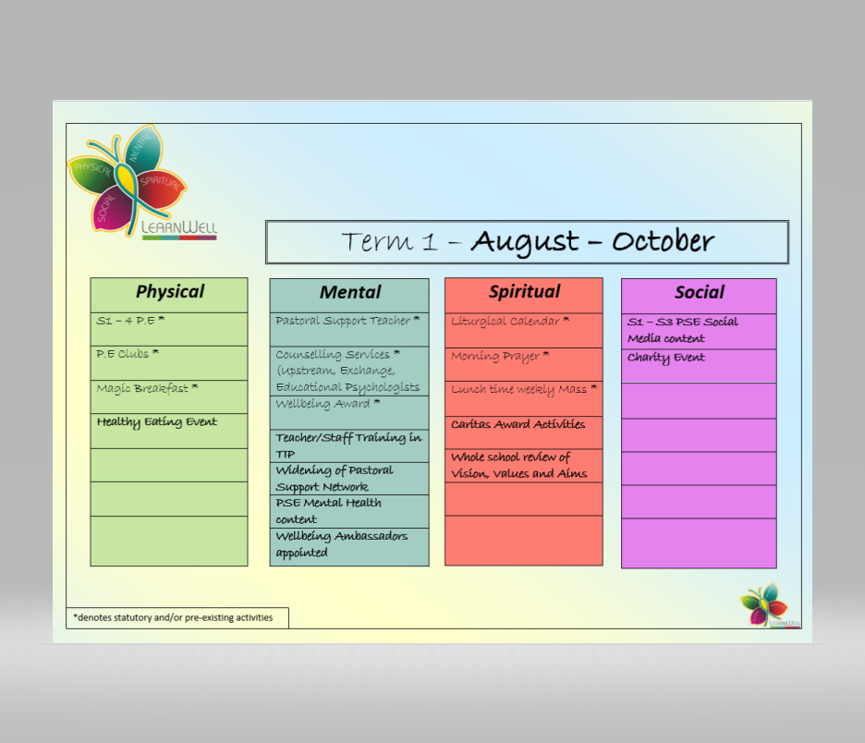
INSPIRE AND TRANSFORM
St Joseph’s Academy, Kilmarnock

Slide 10
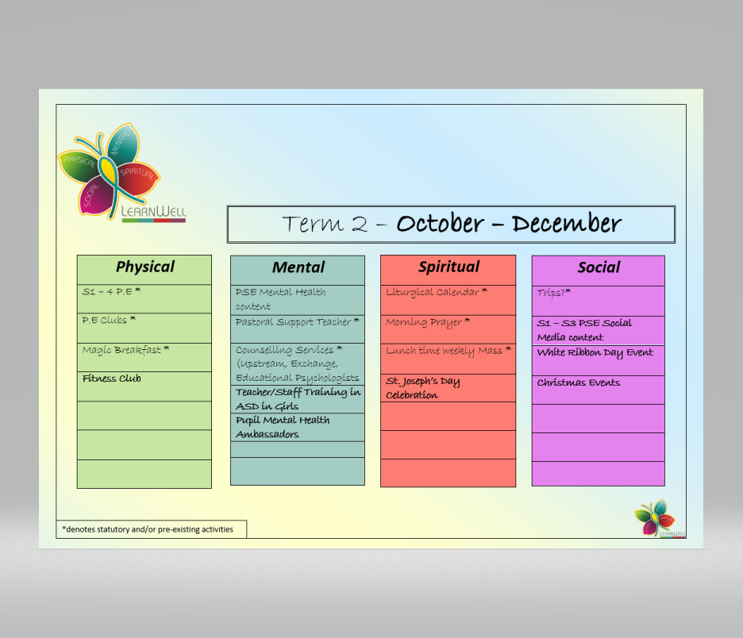
INSPIRE AND TRANSFORM
St Joseph’s Academy, Kilmarnock

Slide 11

INSPIRE AND TRANSFORM
St Joseph’s Academy, Kilmarnock

