Slide 1
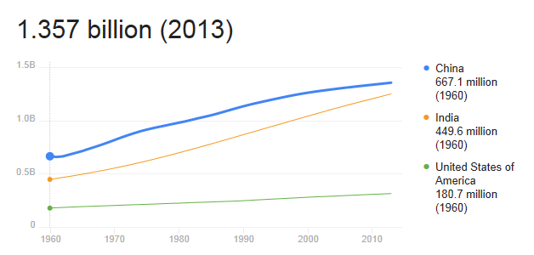
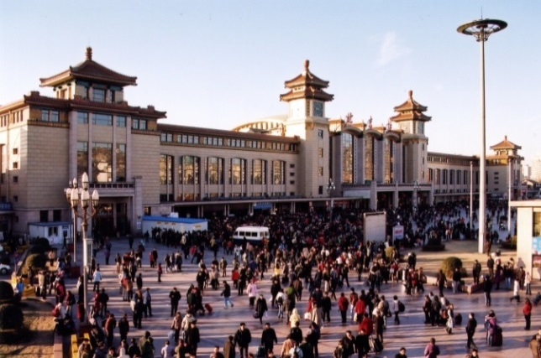
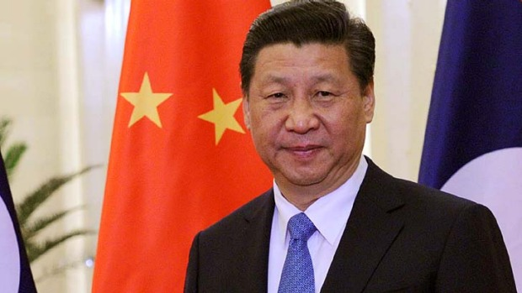
Quickfire Questions
What is the population of China?
What is the capital city of China?
Who is the current President of China?
Roughly 1.4 billion
Beijing
Xi Jinping

Slide 2



aaaaaa
Communism in China
19/06/19
Learning
To understand how communism took hold in China
Success
To describe at least 3 ways that Mao Zedong changed China
To explain whether Mao Zedong was a successful leader
Today
Create a poster on Communism and Capitalism

Slide 3
A Great Leader?
Choose any five of the following words/phrases which you think describe a “great leader”. Write them down in your jotter.
STRONG WISE LOUD
AUTHORITATIVE CHARISMATIC
HUMBLE INTELLIGENT SCARY
GOOD LISTENER COMMANDING
FUNNY INDEPENDENT CREATIVE
TRUTHFUL HARSH
REALISTIC OPTIMISTIC ENERGETIC

Slide 4

WHO became the leader of China in 1949?
WHAT were the Red Guards?
WHERE were many teachers taken during the Cultural Revolution?
WHEN did the Chinese Civil War take place?
WHY did many Chinese people believe Communism would change their lives for the better?

Slide 5
Democracy should be introduced in China immediately. Everyone should have the right to choose the government. The people of China would be better off if they had a democratic government. Most Chinese people say they want democracy. - Amber Gray
The CPC say democracy will not be introduced into China. The history and culture of China is different from the UK. Few Chinese people say they want democracy. There is no evidence that China would be better off if it had a democratic government. - Rhys O’Rourke
Amber and Rhys have different views on democracy in China. What are these differences? Mention two differences in your answer.

Slide 6
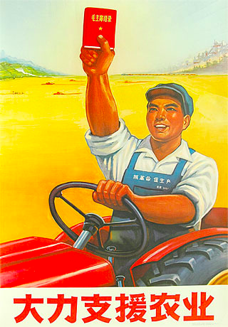
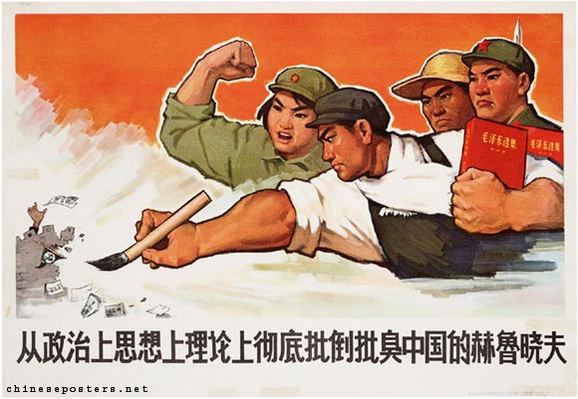
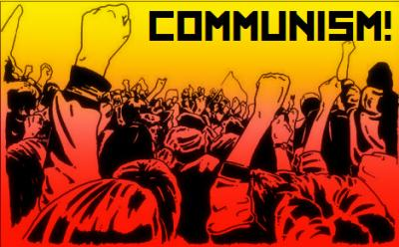
Communism in China

Slide 7
We are learning to…
Describe how Communism took hold in China
Discuss whether Mao Zedong was a good leader or bad leader of China

Slide 8

Did I…
Accurately describe the Communist revolution in China.
Answer questions about Mao Zedong’s time as the leader of China.

Slide 9
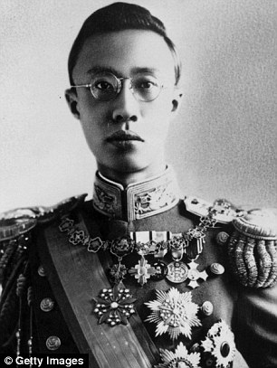
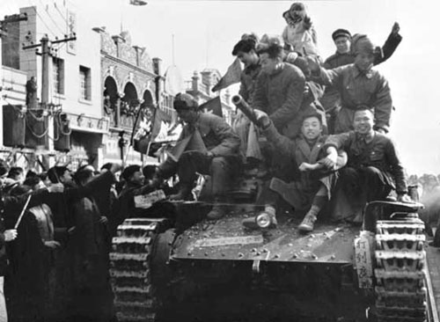
Background – Take notes in jotter
For many centuries, China was ruled by dynasties (royals) and led by an Emperor
In 1911, the Chinese people overthrew the Emperor to establish a democratic system
However this was unstable. Many millions of Chinese people lived in terrible poverty.
From 1927, a civil war was fought between those loyal to the government and the Communist Party of China (CPC)
This ended in 1949 with the victory of the CPC and the establishment of the Peoples’ Republic of China in 1949, led by Mao Zedong
Mao declares the People's Republic of China (Subtitled)

Slide 10
History Channel Biography –
Mao Zedong
https://www.youtube.com/watch?v=ACscsX2VsLA
You should take detailed notes watching the programme on the following;
The type of leader Mao was
What he did to make people live in fear In China
What life was like for ordinary people (the famine; working conditions)
The Red Guard

Slide 11
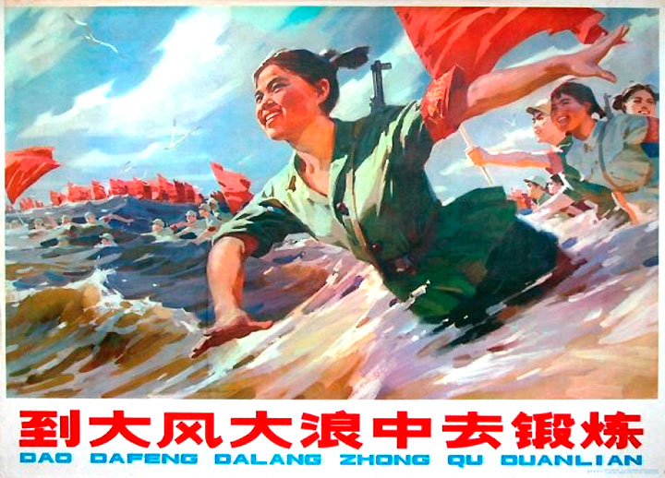
TASK ONE
Create a MIND MAP in your jotter.
Take notes on the rise of Communism in China and the policies of Chairman Mao.
These notes will help you to answer questions later on, so be as detailed as possible!

Slide 12
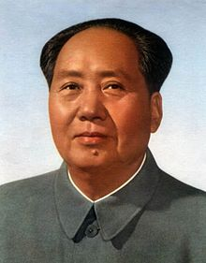
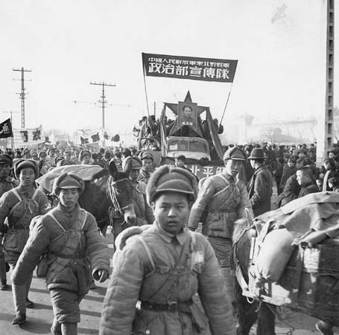
The rise of Communism in China
Chairman Mao told Chinese citizens that workers would be the most important people in the new China, and that they would form the backbone of the new nation.
He wanted to turn China into an industrial powerhouse by following a system of centralized planning.
All agricultural production was controlled and planned directly by the Chinese government.
Mao’s system of reforms became known as ‘The Great Leap Forward’

Slide 13
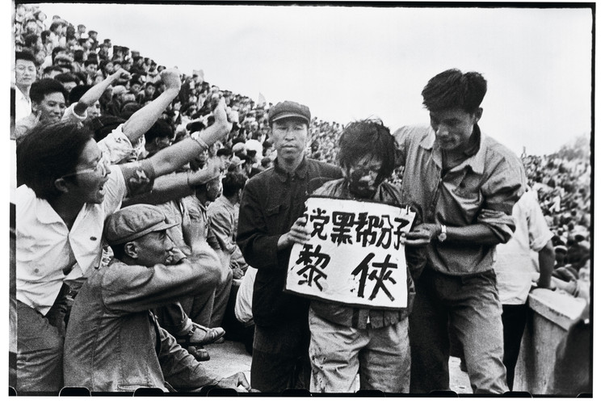
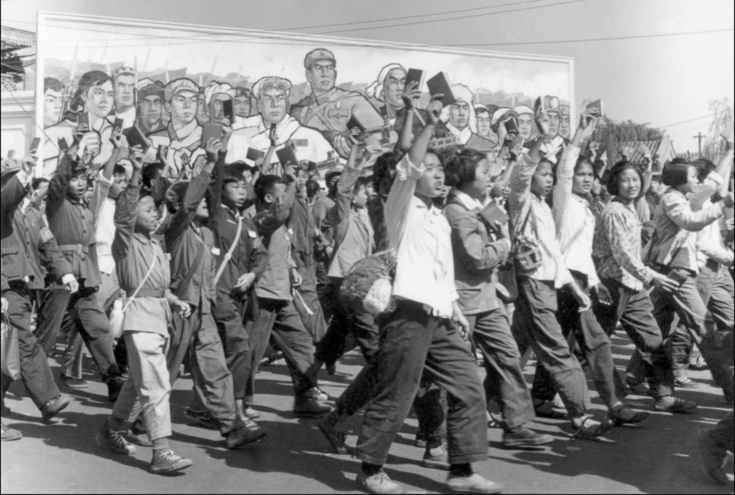
Communism and Chairman Mao
Mao’s industrial revolution wasn’t enough though – he wanted to completely change how Chinese people thought.
His solution was to start ‘The Cultural Revolution’.
Mao empowered young students, getting them to ‘tear down tradition’, by denouncing their teachers, professors and even parents as supporters of the old regime.
Anyone seen as not Communist enough was publicly humiliated and often killed.
Mao’s victory was absolute, and Communism ruled supreme.

Slide 14
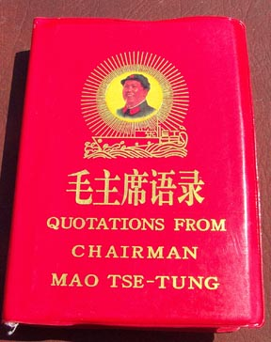
The Cultural Revolution
Watch the following clips about “The Cultural Revolution” in China in the 1960s and take notes on:
The failure of the “Great Leap Forward”
The Red Guards and their actions
How the Cultural Revolution affected ordinary Chinese people
What was the Cultural Revolution?
Participating in the Red Guards
Notes:
https://www.youtube.com/watch?v=7G0UXnXpABw
https://www.youtube.com/watch?v=PZ_63MpSt5w
https://www.youtube.com/watch?v=CCA6ME81RLQ

Slide 15
Task Two: Was Chairman Mao a SUCCESSFUL leader?
In pairs, read over the following points. Decide whether Chairman Mao was a successful or unsuccessful leader of China. Be prepared to share your ideas with the class.
Pride was restored among the Chinese people following years of civil war.
Severe food shortages lead to mass starvation – an estimated 15 to 30 million people died.
The Chinese Army grew stronger and developed an international reputation.
The CPC was internally “cleansed” by Chairman Mao and left only with supporters of his communist beliefs.
The Great Leap Forward failed – China did not become a world leading “industrial powerhouse.”
Health services improved in both urban and rural areas.
Students forced to leave university and follow Mao or face severe punishment
Thousands were tortured for not believing in Communism.

Slide 16
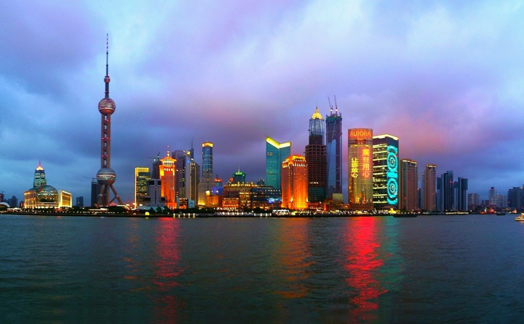
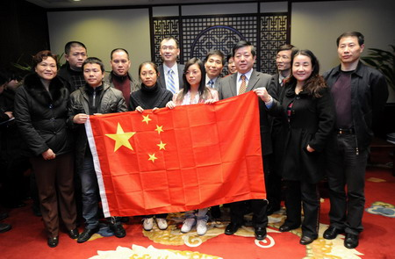
Communism Today
The CPC remain the ruling political party in China today and still maintain a great degree of control over citizens everyday lives.
However, major changes in China since Chairman Mao’s death have led many people to question whether it is still a truly communist country.

Slide 17
TASK THREE: Coded Questions
Start with the green questions and work your way up towards the red. As you progress through the colours, you should write more detailed answers.
Who ruled China before 1911 and what happened to them?
How did the Communists come to power?
What did Chairman Mao promise the ordinary citizens of China?
What was ‘The Great Leap Forward’?
What was ‘The Cultural Revolution’?
Was Chairman Mao a successful leader? Give at least two reasons for your answer.
From your own knowledge of modern China, what kind of changes have occurred in recent years?
Why do you think that China no longer follows the exact Communist ideas of Chairman Mao?

Slide 18
Poster Task
Create a poster, in pairs, on Communism in China. Your poster must include the following information:
At least 3 facts about China between 1911 and 1949.
At least 3 facts about Chairman Mao Zedong
A full description the Great Leap Forward
A full description of the Cultural Revolution
A detailed explanation on who the Red Guards were and what they did in China, including real-life examples.
At least 2 drawings, graphs or diagrams.

Slide 19
The view of Joanna Smyth is:
“Mao Zedong was a cruel and brutal dictator who made people in China live in fear”
Task 4 National 4/5 Question
1. Decide whether you support or oppose the view of Joanna Smyth.
Use four pieces of evidence from your sources (notes) to support your view. 4
Structure:
One reason to support/ oppose (pick one) the view of Joanna Smyth is that the source shows that…
Repeat x 4

Slide 20

On your post-it note write down ANY THREE things you know understand about Communism in China

Slide 21
I can…
Accurately describe the Communist revolution in China.
Answer questions about Mao Zedong’s time as the leader of China.

