Slide 1
Starter Task
In this country, what happens to you if you commit a crime?
Write down at least 3 points!

Slide 2
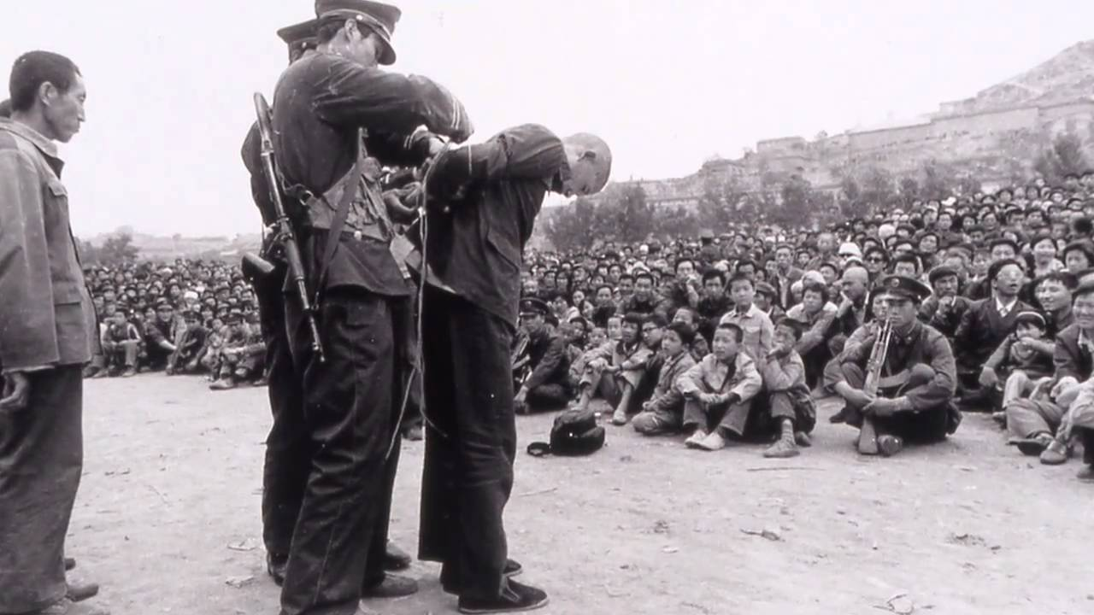
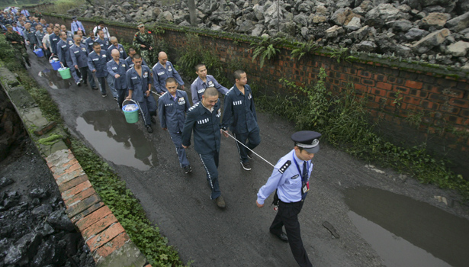
The Loagai Camps

Slide 3
We are learning to…
Recognise that what a Laogai camp is
Describe the conditions in Laogai camps
Explain why Chinese citizens are sent to Laogai camps

Slide 4
I can…
Identify what a Laogai camp is
Discuss why Chinese citizens are sent to Laogai camps
Accurately describe the ways that Laogai camps abuse human rights

Slide 5

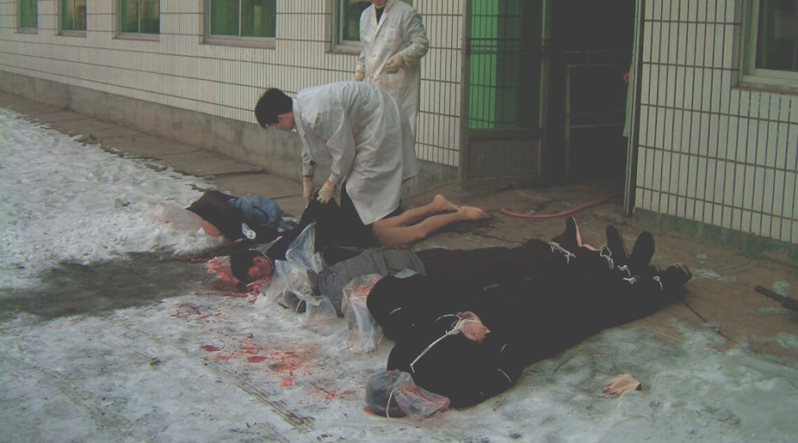
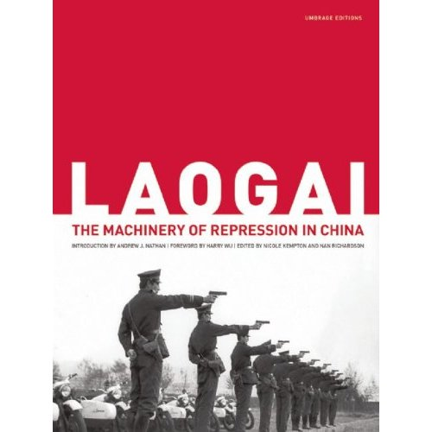
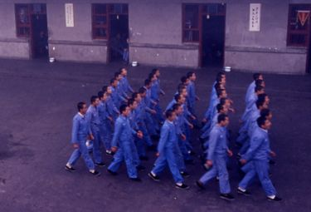
In Mandarin ‘Laogai’ means ‘reform through labour.’
Chairman Mao introduced the system in the 1950s.
It is a way of punishing and re educating criminals in a way which is useful to the state.

Slide 6
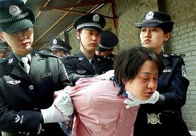
Watch the following documentary and make notes on life inside the Laogai camps. You should take notes on:
Who is sent to the camps
Conditions in the camps
Methods of torture in the camps
Laogais and the Death Penalty
Any other useful information.

Slide 7
Recap: Laogai Camps
Many people are imprisoned because they have been associated with groups that are critical of the government.
Others are imprisoned for religious beliefs such as membership of the Falun Gong – religion is officially banned in China.
Once inside the Laogai, prisoners are subject to cruel and degrading treatment and oftentimes torture.
Much of Chinas exports are made in Laogai camps, such as tea and cotton products.
Each Laogai has both a camp name and a public name. For example, the Shanghai Municipal Prison is also called the Shanghai Printing, Stationery Factory.

Slide 8
Laogai – Modern Day Slavery?
At the start of this unit we discovered that the vast majority of our household items are Made in China. Watch the following documentary and take notes on:
The products made in Laogais
Why Laogai prisoners can be considered modern day slaves
The conditions that Laogai prisoners work in.
What does the word Laogai mean?
Reform through Labour
Slavery: A 21st Century Evil

Slide 9
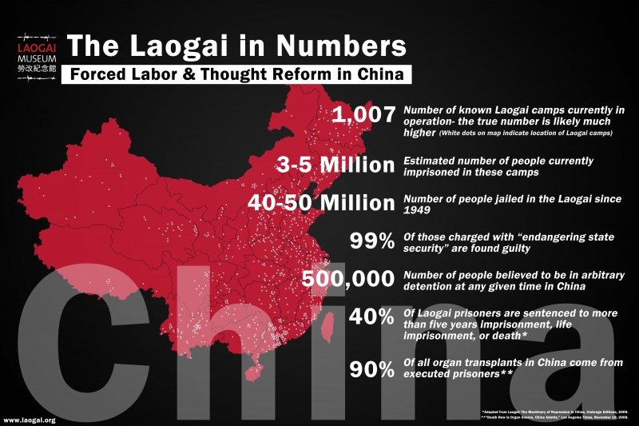

Slide 10
Quick Questions – Answer in full sentences!
What reasons do the Chinese government give for sending people to Laogai camps?
Why do the Chinese government believe that prisoners should be “re-educated”?
Describe the conditions in the Laogai including accommodation and work the prisoners are expected to do.
What happens to prisoners if they do not work hard in the Laogai? Explain in detail!
What types of goods are produced in the Laogai?
Why are Laogai camps an abuse of basic human rights?

Slide 11
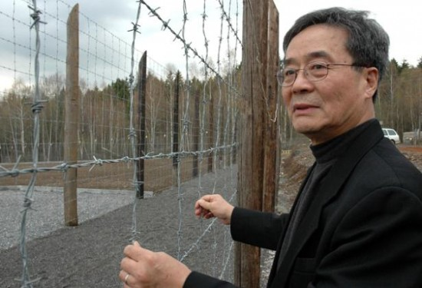
Harry Wu – Laogai Survivor
Harry Wu is a former political prisoner who spent 19 years in the Chinese Laogai.
Harry Wu was determined to survive his ordeal, inflicted upon him for exercising his freedom of speech when, as a geology student he criticised the Soviet invasion of Hungary in 1956 (the Chinese Government supported the Soviet Union). After his release in 1979, he was invited to go to Berkeley in the USA.
In 1991, he and his wife returned to China to further document - with the help of his small hidden camera - the deplorable conditions in the Laogai. Since then he has devoted his life to making the world aware of the cruel conditions in China's labour camps. He has helped make several widely publicised television features.
He remains committed to pursue the cause of human rights in his native country by denouncing the human rights violations in the Laogai as well as organ sales and other violations. In 1995, he returned again to China, incognito, with a USA passport, but this time he was arrested by the Chinese authorities and convicted. Only after heavy pressure by human rights groups and international governments was he released.
Harry Wu on the Laogai
Read the extracts from Harry Wu’s book “Bitter Winds” – Worksheet 6 - on the S3 blog and then complete the diary entry task.

Slide 12
Laogai Camps – Why? Why? Why?
Exemplar:
Why? To send money home to family members
Why? Developing countries often have poor rates of pay
Why? They want to earn more money
ISSUE:
Why do people move to the UK?
Why? Civil War
Why? There is a lot of fighting in their homeland
Why? They are refugees
Why? Terrorism
Why? Home invaded by another country
Why? They believe they will have a better life
Why? The UK has good healthcare, education etc
Why? UK has an international reputation

Slide 13
Laogai Camps – Why? Why? Why?
In your group, choose one of the following Why questions to focus on. You should try to make your Why? Why? Why? Chain as long and as in depth as possible.
ISSUE:
Why are Laogai camps a human rights abuse?
ISSUE:
Why do the Chinese Government allow Laogais?

Slide 14
National 4/5 Question Task
Explain, in detail, two reasons why Laogai camps are an abuse of human rights
6 marks

Slide 15
Laogai Camps Poster Assessment Task
We are learning to…
Explain what Laogai camps are and the conditions within them.
I can…
Create a detailed poster on Laogai camps.
Your assessed poster must contain:
A detailed description of Laogai camps
Recent factual information on Laogais
A detailed explanation of why Laogais exist
At least one example of a real-life Laogai prisoner
Other key facts and relevant information
Colourful presentation
Illustrations/drawings
Assessed Posters;
Contain key facts/ figures/ statistics
Have a logical layout
Are well presented and designed

Slide 16
Did I…
Identify what a Laogai camp is
Discuss why Chinese citizens are sent to Laogai camps
Accurately describe the ways that Laogai camps abuse human rights

