Slide 1
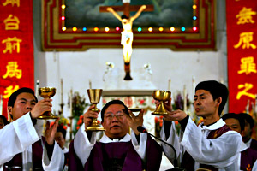

Human Rights in China
Religious Control in China

Slide 2
We are learning to…
Identify which religions are allowed and which religions are banned in China
Discuss why the CPC does not want religion in China
Explain why Falun Gong and Catholicism are specifically banned.

Slide 3
I can…
Identify which religions are allowed and which religions are banned in China
Participate in a discussion on “communism vs religion”
Accurately write an explanation on the banning of religion in China.

Slide 4
China is an Atheist country
If a person is atheist they deny that God exists.
China, as a whole country, is officially ATHEIST. This means the Chinese Communist Party denies that God (in any and all forms) exists.

Slide 5




However…
The Communist party does allow some religions to be practiced in China but under strict regulation and surveillance. They are:
Buddhism
Christianity
Islam
Taoism

Slide 6
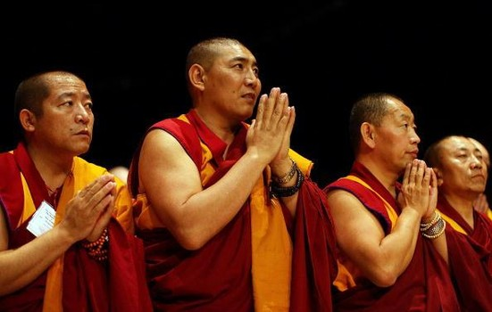

Allowed Religions
All 4 of the allowed religions must receive licenses from the government.
This means the government can keep track of membership and ensure at membership number so that they do not grow too quickly or too large in size.

Slide 7
Buddhism – Buddhists do not believe in God; instead they believe that they can become enlightened through deep personal mediation and reflection and that nothing in life is fixed.
Christianity – Christians believe in the teachings of Jesus Christ, the Messiah who was sent down from heaven to save humanity from the consequences of sin. They attend churches, pray to God and the saints and celebrate feasts.

Slide 8
Allowed Religions
Islam – followers of Islam are called Muslims. They believe in one God and believe that he sent many prophets to Earth to teach them how to live by his laws.
Taoism – Taoists have many different Gods whom they pray to in order to find The Way. Taoism follows the principles of Ying and Yang; unity and opposites.
Crackdown on aspects of Islam
Notes:
https://www.youtube.com/watch?v=C5IwwnP5e78

Slide 9
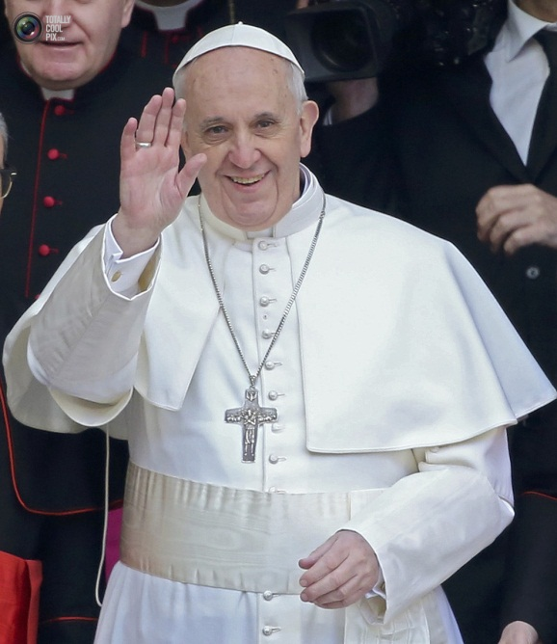

Banned Religions
Roman Catholicism – Catholicism is banned in China because Catholics must considered the Pope as their leader and look to Rome for guidance on matters such as abortion.
This goes directly against Communist values and the policies of the Chinese Communist Party such as the One Child Policy.
Crackdown on Christianity

Slide 10


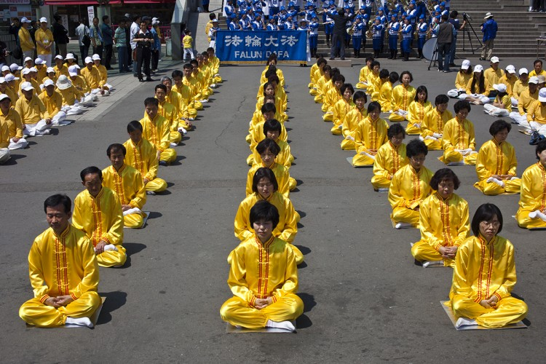
Banned Religions
Falun Gong – Falun Gong is a spiritual movement whose followers believe in morality, truthfulness and compassion.
In some parts of the world Falun Gong is known as Falun Dafa.
By 1998 there were an estimated 100 million followers of Falun Gong in China.
Notes:
http://persecutionoffalungong.com/why

Slide 11
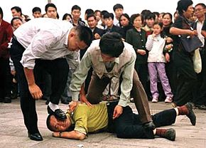
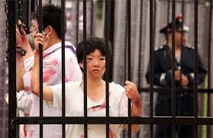
Persecution of the Falun Gong
Persecution of the Falun Gong
Watch the mini-documentary on the Persecution of the Falun Gong and take notes on:
Why the Falun Gong are persecuted by the Communist Party
What happens to Falun Gong members
What Falun Gong practitioners do to stop the persecution.

Slide 12
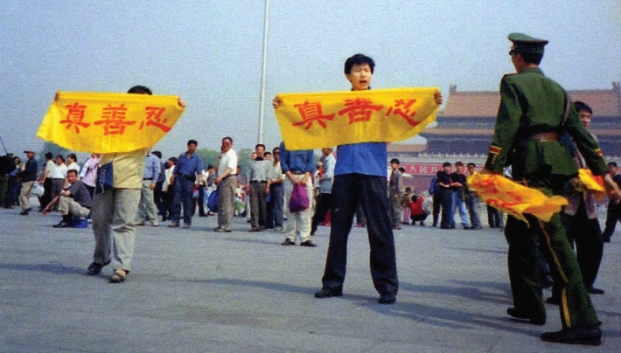
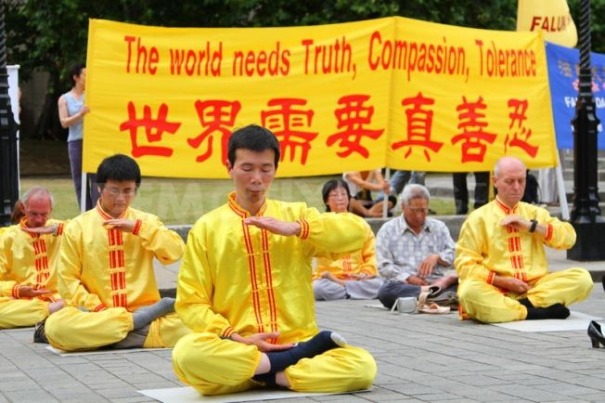
In 1998, a Chinese government survey showed that there were more people practicing Falun Gong than there were members of the Chinese Communist Party. Falun Gong was arguably the largest independent group in the history of the People’s Republic of China.
The Communist Party seeks to control all volunteer organizations, religions, media, and educational institutions in China. It suppresses those that don’t submit to its control, including Falun Gong.
Some Party leaders saw Falun Gong, with its belief in the existence of Buddhas, Daos, and Gods, and its conviction that anyone can reach a divine realm through self-refinement, as challenging the ideology that the Party is the highest authority.

Slide 13
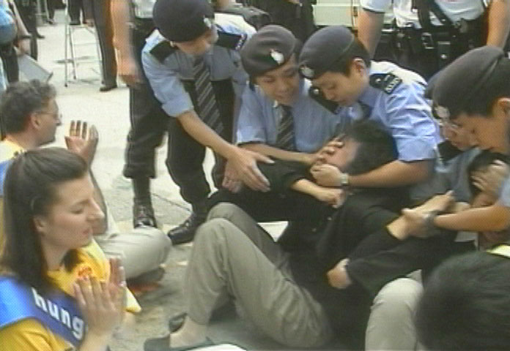
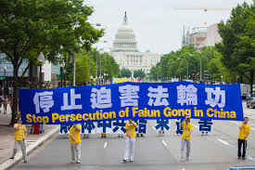
Falun Gong and the Laogai
Because the CPC are so worried that the Falun Gong movement will overrun the government, its members are sent, without trial, to the Laogais.
About 50% of Laogai prisoners are Falun Gong members. They are used as the main source of organ harvesting in China because they lead such healthy lifestyles.
Falun Gong and Organ Harvesting
Notes:
https://www.youtube.com/watch?v=bvAOOwvJMZs

Slide 14
Nat 4/5 Question Task
Read the article “Why is Falun Gong Banned?” (on the blog) and add to your notes on the Persecution of the Falun Gong then answer the following National 4/5 questions.
Remember to answer both questions in the P.E.E style!
Describe, in detail, two of the ways the Chinese government has abused Falun Gong members. 6
Explain, in detail, two of the reasons why the Chinese Communist Party has banned most religions in China. 6
Notes:
https://www.newstatesman.com/blogs/the-faith-column/2008/08/falun-gong-party-chinese

Slide 15
Religion in China Report
Your report should include the following information:
A Front Cover/Name/Role at Amnesty International
Contents Page
A detailed description of religion in China today (religions that are allowed , controls on religion etc)
A detailed explanation of why certain religions are banned in China
Key facts on the treatment of religious practitioners in China.
Key recommendations for the United Nations on what should be done to help religious citizens in China
Imagine you work for the charity Amnesty International
You have been asked to write a report on the state of religion and religious rights in China.
Your report will be handed to the United Nations Human Rights Commission.

Slide 16
Poster/Leaflet Activity
Create a poster or leaflet on either:
The banning/restriction of religion in China (overall)
The Falun Gong in China
Catholicism in China
Success Criteria:
At least 5 facts
At least 1 drawing/picture diagram
Real life examples of the treatment of religious followers in China

Slide 17
Did I…
Identify which religions are allowed and which religions are banned in China
Participate in a discussion on “communism vs religion”
Accurately write an explanation on the banning of religion in China.

