Slide 1
Think / Pair / Share
What are Human Rights?
What Rights do we have in Scotland?
What is the most important human right you have?

Slide 2

Some Basic Human Rights...
Article 3: The Right to Life. We all have the right to life, and to live in freedom and safety.
Article 5: No Torture. Nobody has any right to hurt us or to torture us.
Article 9: No Unfair Detainment. Nobody has the right to put us in prison without good reason and keep us there, or to send us away from our country.
Article 10: The Right to Trial. If we are put on trial this should be in public. The people who try us should not let anyone tell them what to do.
Article 18: Freedom of Thought. We all have the right to believe in what we want to believe, to have a religion, or to change it if we want.
Article 19: Freedom of Expression. We all have the right to make up our own minds, to think what we like, to say what we think, and to share our ideas with other people.
Article 21: The Right to Democracy. We all have the right to take part in the government of our country. Every grown-up should be allowed to choose their own leaders.

Slide 3
Discuss with your partner why Human Rights are so important.
Try to come up with 3 different reasons.

Slide 4
Some Basic Human Rights...
Article 19: Freedom of Expression. We all have the right to make up our own minds, to think what we like, to say what we think, and to share our ideas with other people.
What is a “free media”?
Why would a free media be important for us all?

Slide 5
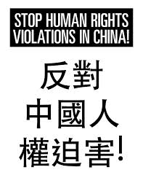
Human Rights in China
CENSORSHIP

Slide 6
We are learning to…
Describe what censorship is and how relates to human rights
Explain why the Chinese government censors information in the media/online
Identify the issues which arise from censorship of the media/online

Slide 7
I can…
Describe what censorship is
Answer Questions on internet censorship in China
Create my own political cartoon on censorship in the People’s Republic of China.

Slide 8

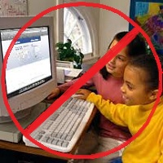

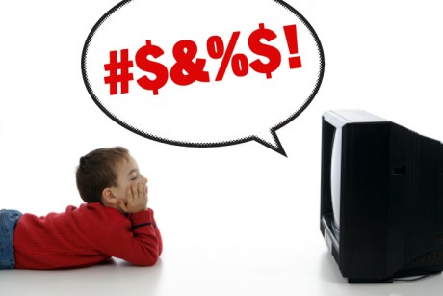
What is censorship?
Censorship - the control of the information and ideas circulated within a society.
What human rights does censorship go against?

Slide 9
What is censorship?
The Chinese Government actively censor information that is published in the Chinese media (newspapers, internet sources, films, TV etc)
The Communist Party takes action to prevent both individual citizens and the media from criticising the actions of the Government.
The State Administration of Press, Publication, Radio, Film and Television closes monitors all forms of media and has powers to edit, control and remove information from publications.
The Administration also has the power to arrest journalists and individuals, throw foreign journalists out the country and block international media from the country.
The New York Times website has been blocked in China since 2012 for critiquing freedom of speech in China.

Slide 10

Task: Websites & Social Media
You have three minutes to Write a list of websites/ social media that you use regularly
Which of these do think will be blocked in China?
Thinking point:
Is accessing websites and social media part of our Human Rights?

Slide 11






Which of these websites can you access in China?
http://www.greatfirewallofchina.org/
BLOCKED
BLOCKED
BLOCKED
BLOCKED
BLOCKED
BLOCKED

Slide 12

Watch the Clip Below and take detailed notes – questions to follow
https://www.youtube.com/watch?v=Po9qrFyZOM8

Slide 13
Internet Censorship in China - Questions
How many internet users does China have?
Why was the start of the internet a worry to the Communist Party of China?
What is the nickname of the Chinese internet firewall?
What problem do Chinese Bloggers have?
How many Internet Police Officers does China have?
What does China have the largest recorded numbers of?
What is the ‘Great Cannon’?

Slide 14
Internet Censorship in China - Questions
How many internet users does China have? 618m
Why was the start of the internet a worry to the Communist Party of China? People could find out about other parties i.e. CDP
What is the nickname of the Chinese internet firewall? The Great Shield
What problem do Chinese Bloggers have? Common blogging platforms are blocked
How many Internet Police Officers does China have? 2million
What does China have the largest recorded numbers of? Journalists in prison/ internet contributors in prison
What is the ‘Great Cannon’? The new method of giving a virus/ shutting down sites which allow Chinese people to get round the firewall

Slide 15
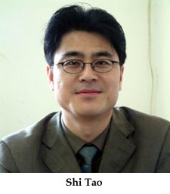
Case Study
In April 2004, the Chinese journalist Shi Tao used his Yahoo! email account to send a message to a U.S.-based pro-democracy website
In his email, he summarised a government order directing media organizations in China to downplay the upcoming 15th anniversary of the 1989 crackdown on pro-democracy activists.
Police arrested him in November 2004, charging him with "illegally providing state secrets to foreign entities."
Shi Tao was sentenced in April 2005 to 10 years’ imprisonment and two years’ subsequent deprivation of his political rights.
He was released from prison in 2013 after a massive international campaign. He now writes about his time in prison and remains under watch by the Chinese government.

Slide 16
China censorship facts
One in every 10 websites is blocked in China.
In February 2008 the organisation Reporters Without Borders was campaigning for the release of more than 81 internet users in China imprisoned or held in labour camps for criticising their government in emails, including students, people in the Falun Gong spiritual movement, workers, writers, lawyers, teachers, civil servants, former police officers, engineers, and business people.
Some of the biggest IT companies in the world, that benefit a great deal from business in China, have built surveillance and censorship equipment for the Chinese Government.
Yahoo! supplied private information about their email users to the Chinese authorities, leading to their prosecution and wrongful imprisonment. Microsoft and Google also censor their Chinese customers.

Slide 17
Thinking point:
Is accessing websites and social media part of our Human Rights?

Slide 18
Video Task
Internet Censorship
Newspaper Protests in China
Watch the video clips on censorship in China and take notes on:
What the government does to protestors
Why the government censors journalists and writers

Slide 19
Question Task
Using all of the information you have gathered about Censorship in China, answer the following knowledge questions in full sentences.
If you complete these questions then access Worksheet 5 on the blog for an Extension Task.
What is state sponsored censorship?
Does media censorship defy basic human rights? Explain your answer.
Why do the Chinese Communist Party so tightly control the media/internet in China?
What are some of the punishments that freedom of speech protestors can receive in China?
What can the State Administration of Press, Publication, Radio, Film and Television do to media outlets and companies who defy the censorship laws?

Slide 20
Political Cartoons
You will see 4 cartoons.
In pairs you are come up with a caption or headline to go with each and write it on your show me boards
You have 1 minute for each cartoon.
You should also be able to explain what each cartoon represents.

Slide 21
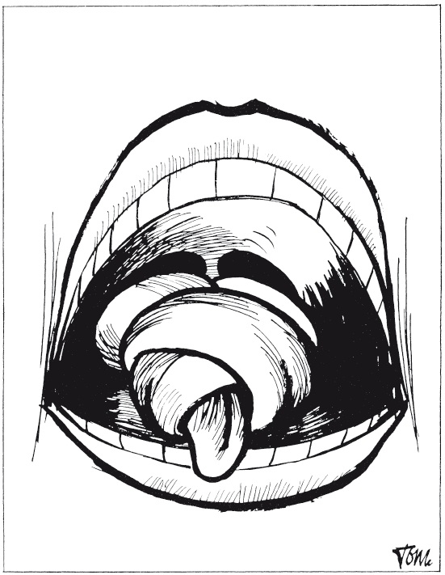

Slide 22
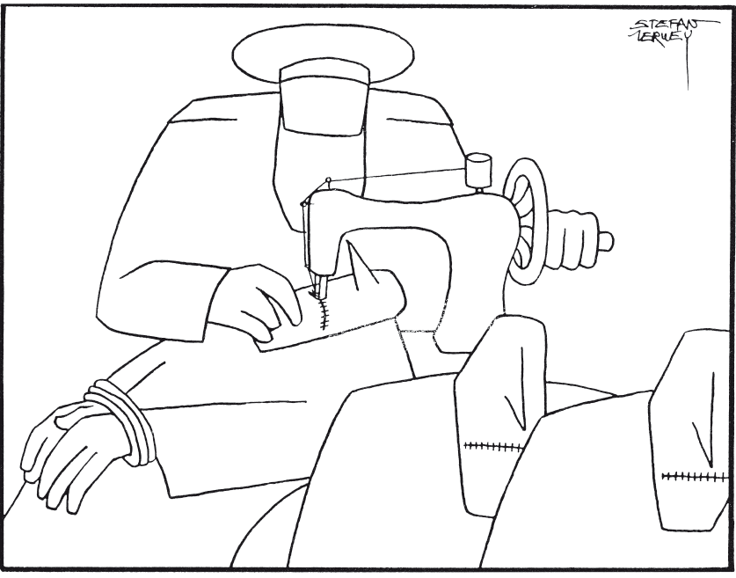

Slide 23
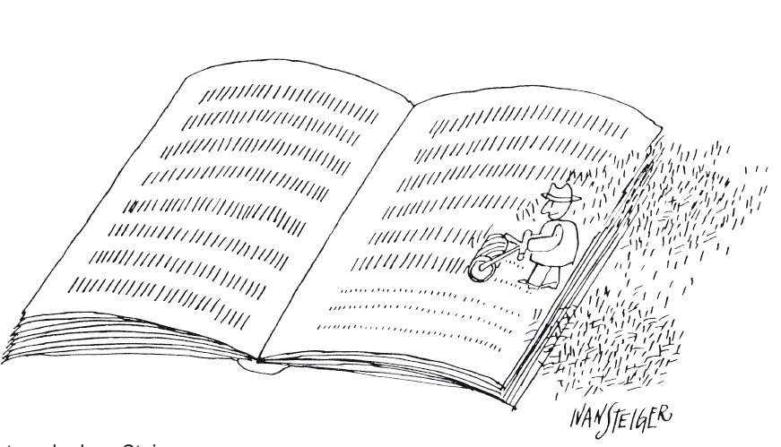

Slide 24
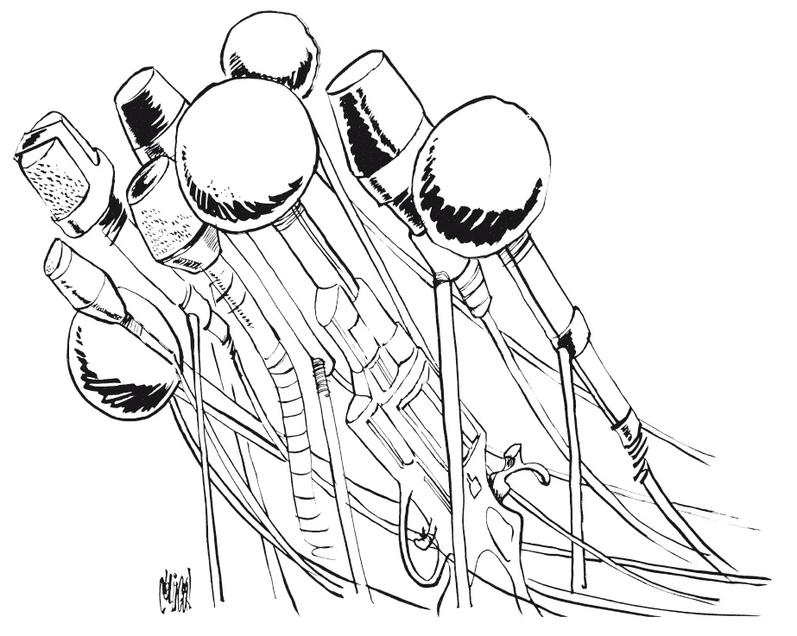

Slide 25
Political Cartoons
Create your own cartoon representing China’s lack of free speech.
You have 15 minutes to create your cartoon.
It should be black and white although you can add some red if you wish.

Slide 26
National 4/5 Questions
1. Describe, in detail, two of the human rights which Chinese people are routinely denied.
6 marks = 2 x P.E.Es
2. Explain, in detail, two of the ways in which the Chinese government limits the freedom of speech of its citizens.
6 marks = 2 x P.E.Es

Slide 27
Did I…
Describe what state sponsored censorship is
Discuss the ways the Chinese government is violating citizens rights
Create my own political cartoon on censorship in the People’s Republic of China.

