Slide 1
Internet Censorship in China Newspaper Article
We are learning to…
Describe the censorship of the internet in China
Give my opinion on censorship
I can…
Create a newspaper article on Internet Censorship

Slide 2
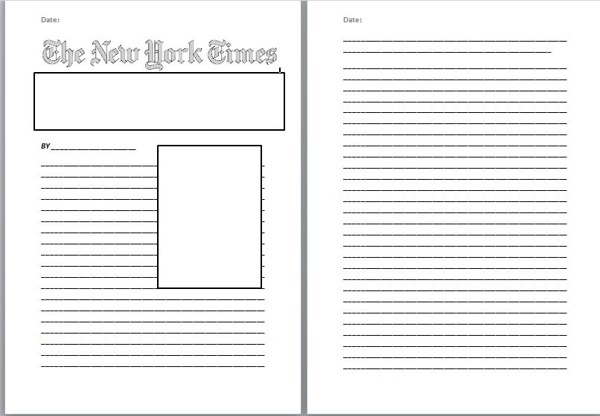
You have been asked by the New York Times to write an article exposing the censorship of the internet in China

Slide 3
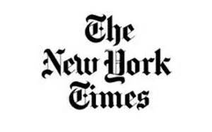
You should include…
Information Criteria:
How internet censorship works in China
Facts about internet censorship
Websites which are blocked in China
The terms ‘The Great Shield’ and ‘Great Cannon’ & their meaning
A picture/ political cartoon
Your opinion on internet censorship – abuse of human rights or not?
Literacy Criteria:
Headline
Date and Name
Picture/Illustration
Clear paragraphs, capital letters, full stops etc.

Slide 4
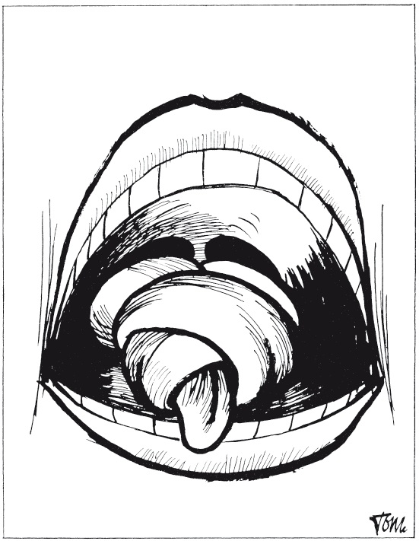

Slide 5
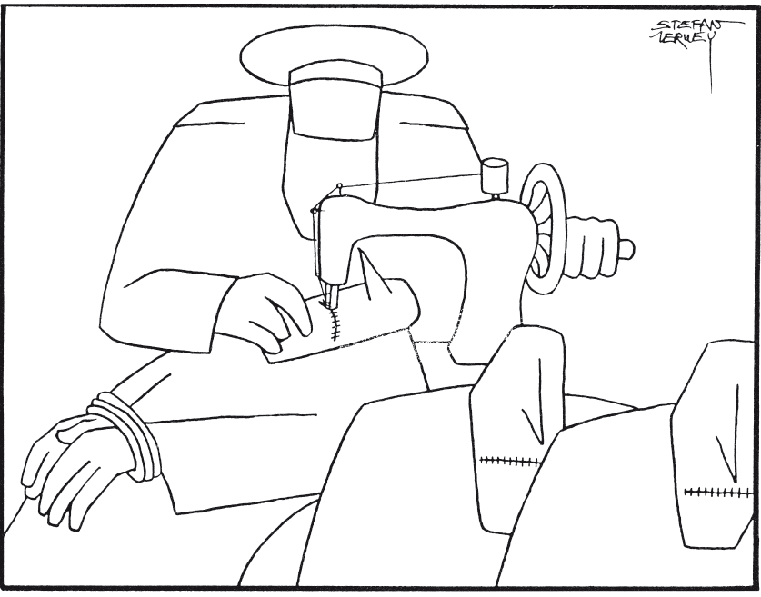

Slide 6
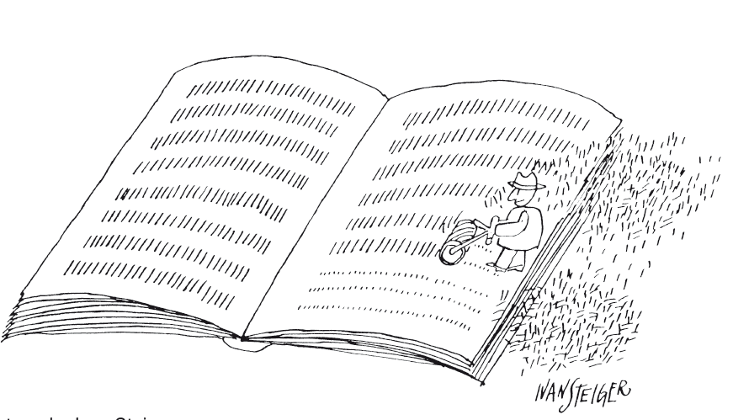

Slide 7
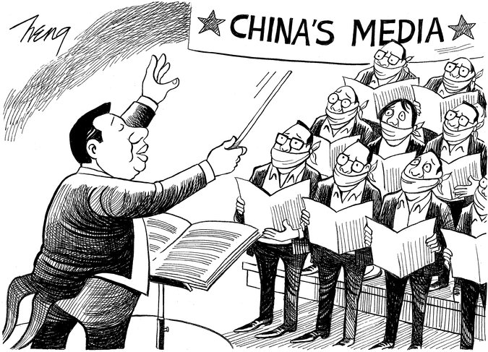

Slide 8
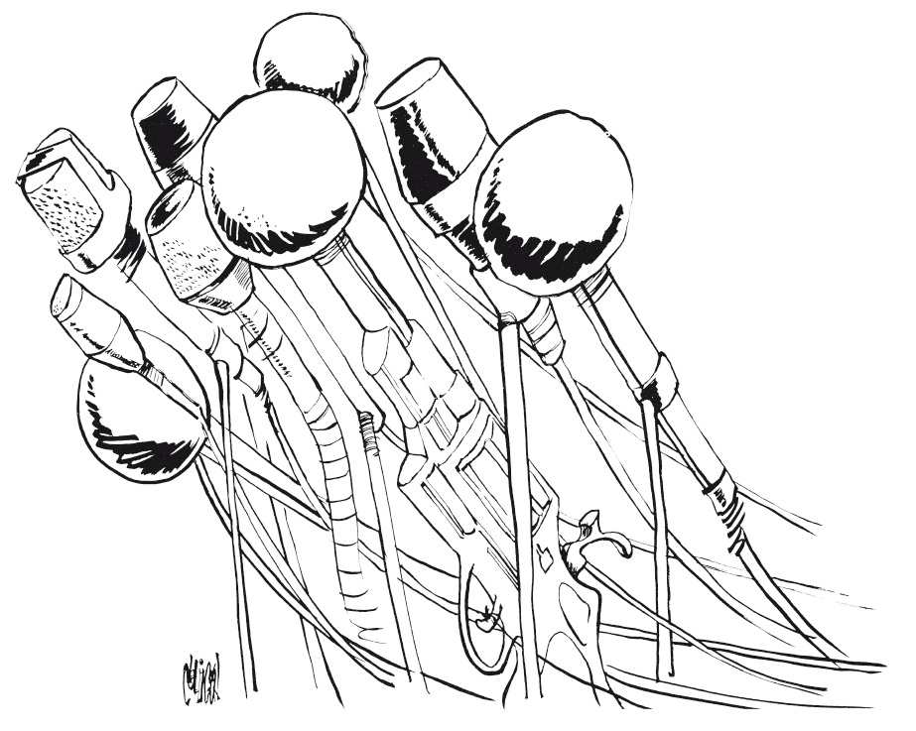

Slide 9
