Slide 1
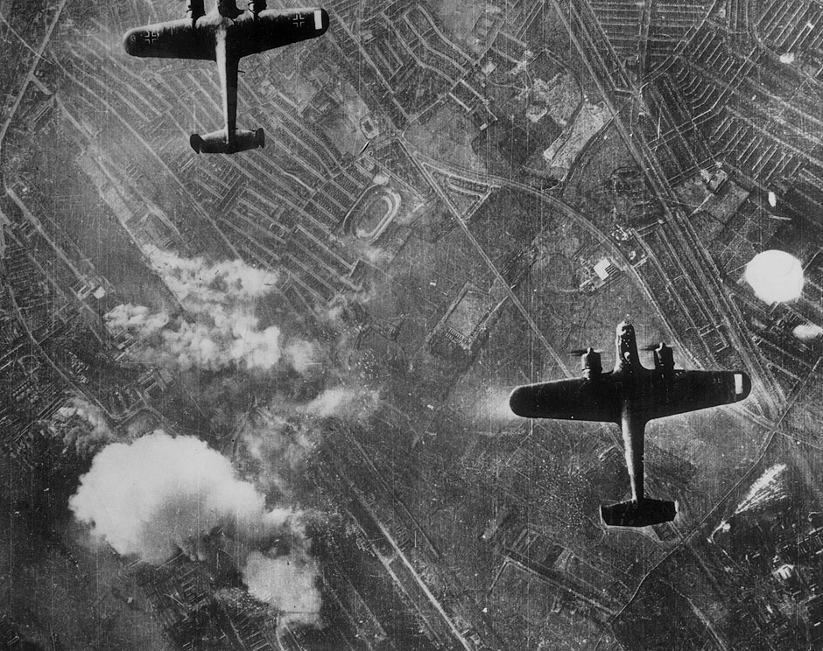
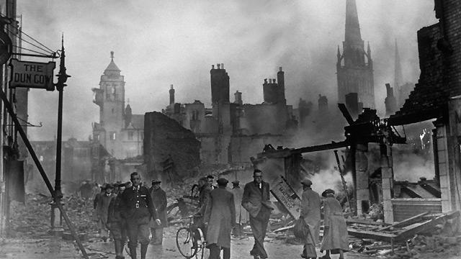
WWII revision lesson

Slide 2
D-Day landings
The steps to war- why WW2 started- Hitler
WWII assessment focus’
Treatment of the Jews in Nazi Germany- concentration camp conditions
The lives of Brits during the war

Slide 3
Structure
5 questions overall:
Timeline task
Primary/secondary source sorting task
One describe question- choice of two topics
One explain question- choice of two topics
One source question- extracting information from the source given and speaking of reliability of sources.

Slide 4
Timeline, Primary & Secondary sources
What does ‘chronological order’ mean?
What is a primary source? Think of 4 examples of primary sources.
What is a secondary source? Think of 4 examples of a secondary source.

Slide 5
How to answer the questions
If a question asks you to describe one aspect of learning you should follow this structure-
4 marks= 4 points made about the topic in question (4 full sentences about each point).
You will be able to choose your topic from a selection given
choose the one you know most about and ensure you are speaking of SPECIFIC events/ use dates and factual information.
Ensure you write in FULL sentences

Slide 6
How to answer the questions
An ‘explain’ question should be answered following this structure-
Demonstrate your knowledge of a particular issue or the effect this had on the lives of people.
4 marks= 4 points
Ensure you write in 4 FULL sentences
choose the one you know most about and ensure you are speaking of SPECIFIC events/ use dates and factual information.

Slide 7
How to answer source questions
Think about primary and secondary sources-
Which is more reliable?
Why?
What information can you select from a source?
What does that tell you?
Anything a source is missing?

Slide 8
Learn 4 facts minimum about each of these aspects of the unit- ensure it is factual/ use dates and specific details we have learned

Slide 9
D-Day landings-
Where, When, who was involved?
Why did this invasion take place?
Names of the beaches?
How many soldiers took part?
Your D-Day paragraph will be incredibly helpful for this question!!!!
Treatment of the Jews in Nazi Germany
Kristallnacht
Propaganda
Humiliation
Concentration camps
Nuremberg laws
Jewish shops
Yellow benches
Jude- passport stamp
Concentration camp conditions-
What happened to Jews in the camps- think of the Holocaust projects- steps taken in the camp etc. Refer to notes
The lives of Brits during the war-
Rationing
Conscription
Blackout
The blitz
Air raid shelters
Evacuation
Steps to WWII-
Timeline of invasion
Treaty of Versailles
Germany’s invasion of other countries

Slide 10
5.Treatment of the Jews in Germany
3. D-Day landings
1.The rise of Hitler and the Nazi’s
A Fishbone Diagram (Ishikawa)
WWII revision
6. Concentration camps
4. Lives of Brits during the war
2.The cause of WWII/steps to war

Slide 11
During this period you will have the chance to use your notes to study, you can either-
Complete a Ishikawa diagram
or
make mind maps in your jotter using the revision guidance given!!

