Slide 1
The rise of the Nazis
20.05.2019
1. tearty fo elaservils
2. yilimart
3. wauchistz
4. zani yarpt
Challenge:
What year did Hitler come to power?
Why did Hitler go to prison?
What is the name of Hitler’s book he wrote while imprisoned?

Slide 2
Learning
To understand the reasons why Germans voted for Hitler.
I must be able to describe why Germans voted for Hitler.
I should be able to describe in detail why Germans voted for Hitler by giving 2 examples.
I could be able to describe in detail why Germans voted for Hitler by giving 3 examples.
Success
Today
Think, pair, share
I see, I think, I wonder
Priority pyramid
Speech task

Slide 3
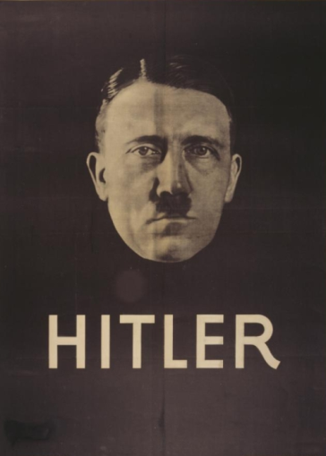
Think, Pair, Share
But why did people vote for Hitler?
In your groups discuss the reasons why you think people voted for Hitler
3 minutes
End
Notes:
https://www.youtube.com/watch?v=7urZxqxJzKw

Slide 4
But why did people vote for Hitler?
Watch the clip and use your note-taking skills to gather information on why people voted for the Nazis
You will use these for the next task
Notes:
https://www.youtube.com/watch?v=7urZxqxJzKw

Slide 5
Create a mind map in your jotter titled
“Why did people vote for the Nazis?”
Take short notes on each!

Slide 6
Why did people vote for Hitler?
High unemployment – Hitler promised jobs
Propaganda posters

Slide 7
What is propaganda?
Propaganda is information, especially of a biased nature, used to promote a political point of view

Slide 8
I see, I think, I wonder
Nazi propaganda ‘The Fuhrer and the people of youth.’
‘Hitler our last hope’

Slide 9
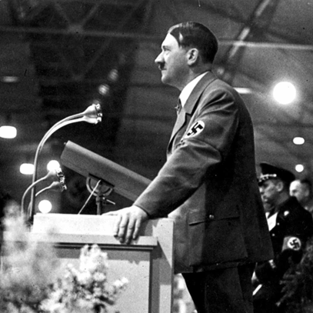
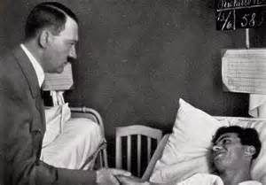
Why did people vote for Hitler?
Hitler’s speeches
Speeches were a very important tactic used by Hitler in gaining the support of the German people
Watch the following clip and note down at least 2 things you notice about Hitler’s speech.
Hitler went on visits during his election campaigns
Notes:
https://www.youtube.com/watch?v=XjFnVTxteDs
Play to 1:30s

Slide 10
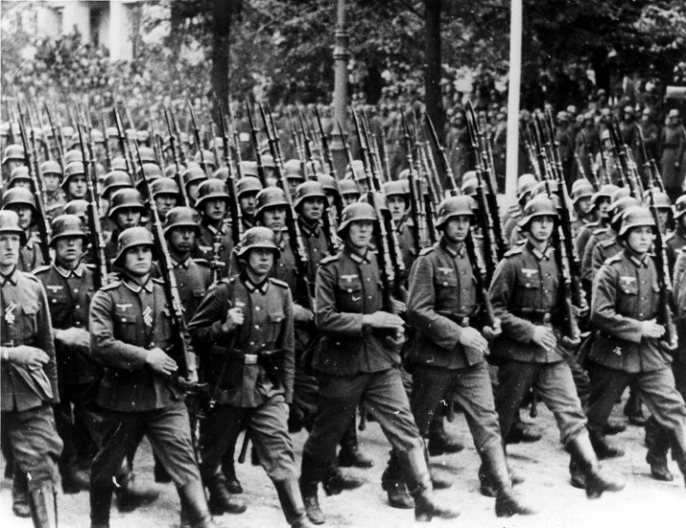
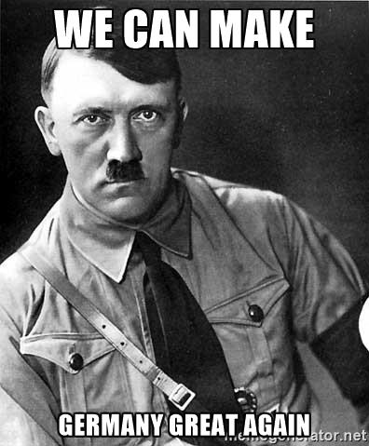
Why did people vote for Hitler?
Hitler promised to rebuild the army
He said he would restore German greatness

Slide 11
Out of the 6 reasons we have looked at, order them from most important to least important. You must write a sentence and say why you think the one at the top is the most important
Most important
Hitler promised jobs
Propaganda posters
Hitler’s speeches
Visits during campaigns
Hitler promised to rebuild the army
Make Germany great again

Slide 12
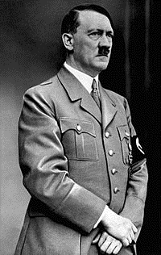
Create a short speech for the Nazi party which would appeal to one of the people below.
Your speech must be at least 3 sentences.
Remember Hitler’s speech – he was passionate and enthusiastic.
An unemployed person
An army general
A businessman
A young person who has just left University
Extension Task
You are living in Germany in the 1930s. Would you vote for the Nazi party?
You must give a reason for your decision.

Slide 13
Model- A German mother with children
Give your child the best chance at life and vote for the Nazi party!
We will take back what is rightfully ours and eradicate the unfair Treaty of Versailles.
We promise to prioritise German blooded children regarding employment opportunities and ensure Germany is great again!!!

Slide 14
Stick your post it on the board in either YES or NO as you are being dismissed
Would you vote for Hitler if you lived in the 1930’s?
Write a short reason as to why….

