Slide 1
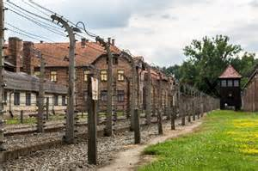
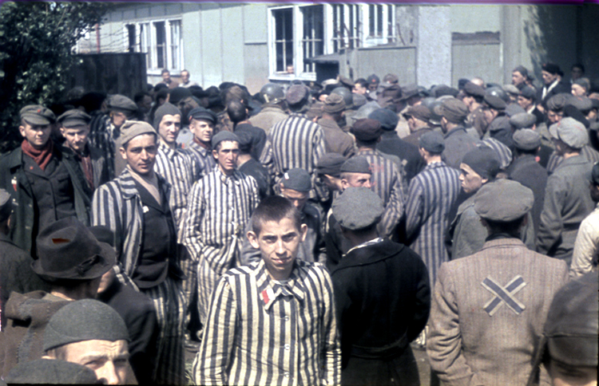
The Holocaust
Lesson starter:
Recap last lesson’s learning;
Describe the ways Jews were treated in Nazi Germany.

Slide 2
We are learning to…
Describe the ‘Final Solution’ and the Holocaust
Explain why it is important for us to remember those who died in the Holocaust
I can…
Create a product for Holocaust Education purposes

Slide 3
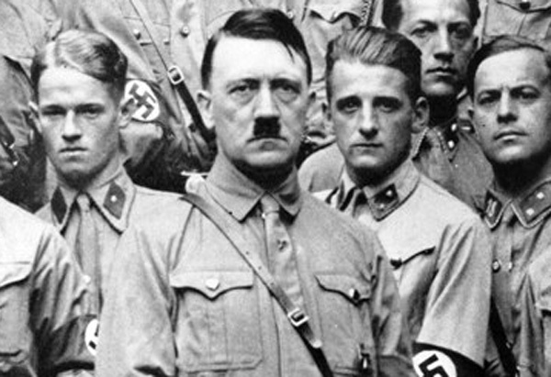
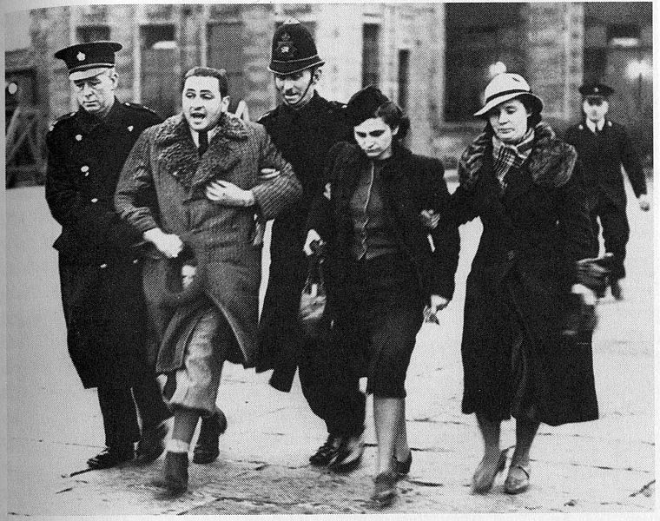
Background
Hitler was anti-Semitic and introduced many cruel laws against Jewish people in Germany
In 1942, the Nazis decided on a ‘Final Solution’ for the Jews in Europe at a conference
The ‘Final Solution’ was a codename for the murder of Jewish people
The Nazis came up with a plan to do this in an organised way

Slide 4
Vocabulary
Genocide – a deliberate attempt to destroy a single race or religion
The Holocaust - the mass murder of Jews under the German Nazi regime during the period 1941–5

Slide 5
Task One: The Path to Nazi Genocide
https://www.youtube.com/watch?v=sRcNq4OYTyE
Take notes from the documentary from the United States Holocaust Museum
You will use these to help with your final project on the Holocaust

Slide 6
Task 1: Historical Source Work
Each of the following sources you will see tells us something about the Holocaust.
In groups, write down what information you can take from the source.

Slide 7
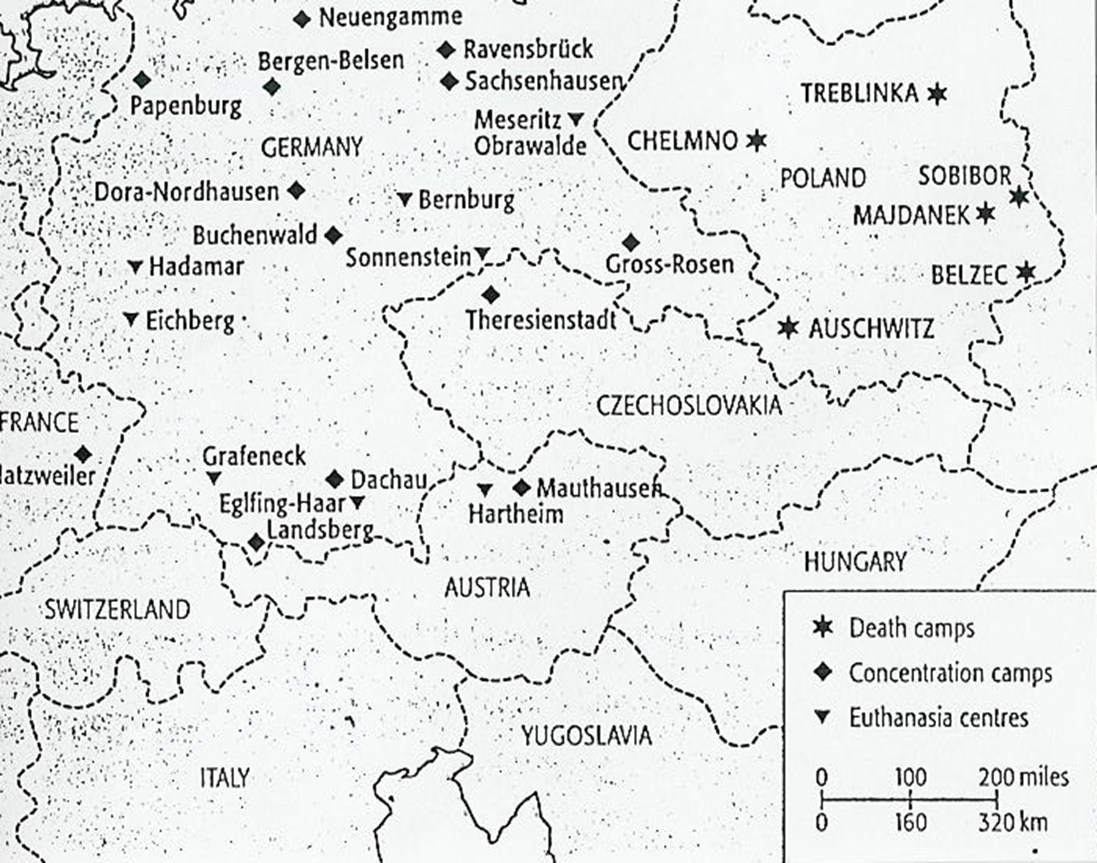
Notes:
Key idea – the Nazis had death camps across Europe

Slide 8
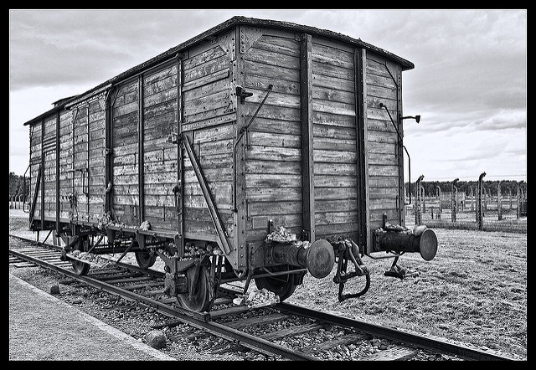
Notes:
Prisoners were taken to camps on cattle trucks. Each camp had it’s own railway station and the camps were linked by an extensive railway network.

Slide 9
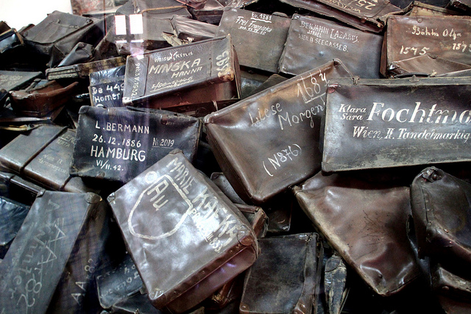
These are suitcases taken from prisoners arriving at Auschwitz what does that tell us?
Notes:
Goods and valuables were seized from prisoners, gold fillings were even removed. It suggests that prisoners thought they would leave again if they brought their possessions.

Slide 10
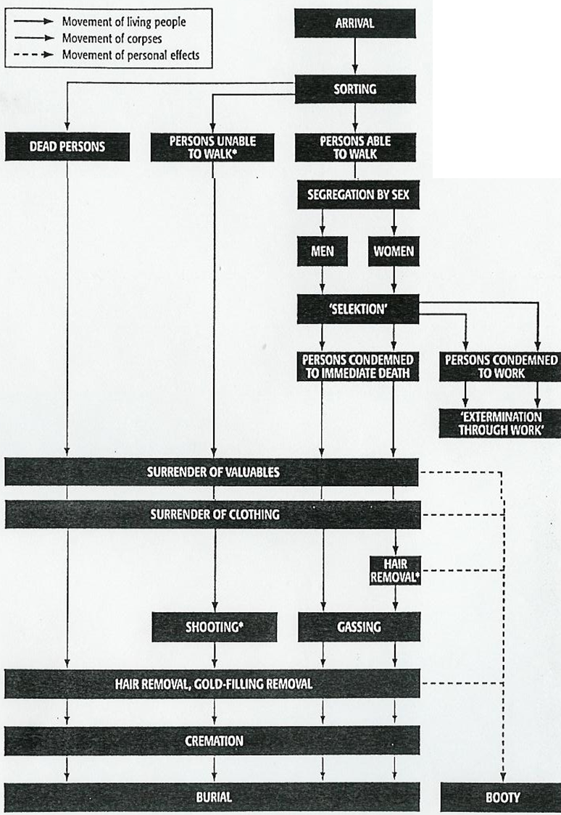
Notes:
The sorting and selection process at concentration camps.

Slide 11
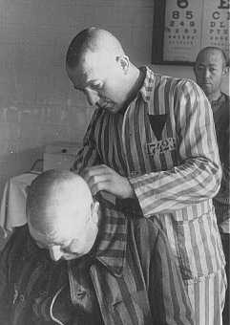
Notes:
Prisoners had their heads shaved. This was to prevent lice but also removed the person’s identity.

Slide 12
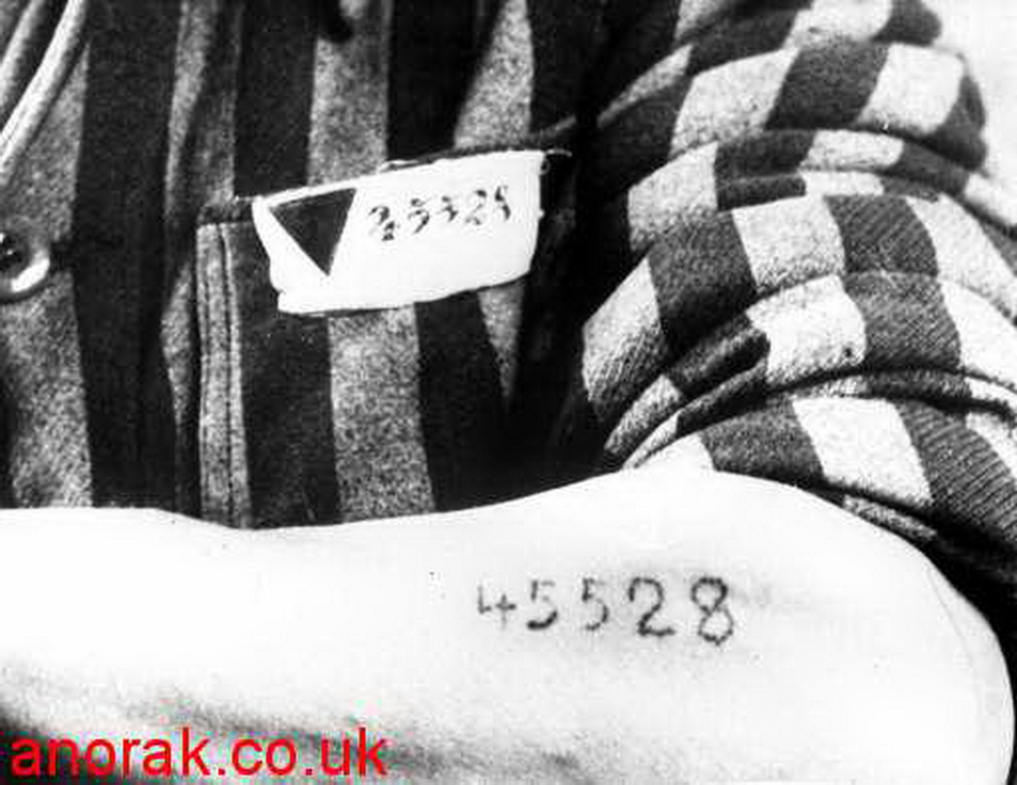
Notes:
Prisoners were branded or tattooed. They lost their identity and became a number.

Slide 13
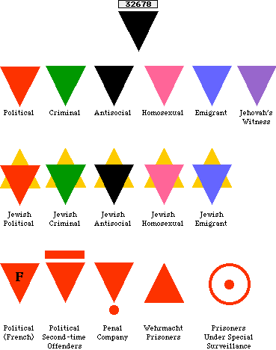
Notes:
Not only Jews were sent to camps & killed – other prisoners were political opponents, ‘asocials’ i.e. alcoholics or prostitutes or homosexuals

Slide 14
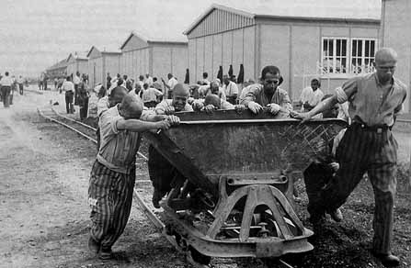
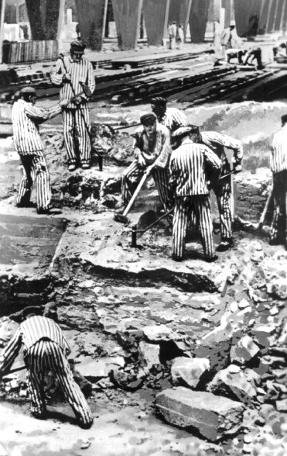
Notes:
Prisoners had to do hard physical labour in camps, on little food. Many died from over exertion.

Slide 15
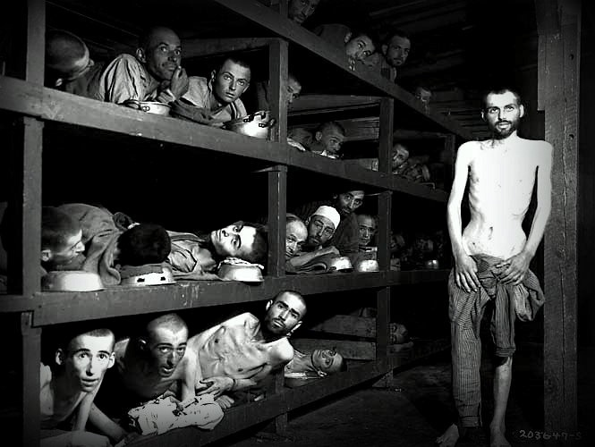
Notes:
Prisoners were packed into wooden bunks in filthy barracks. Many were dying/ died from starvation.

Slide 16
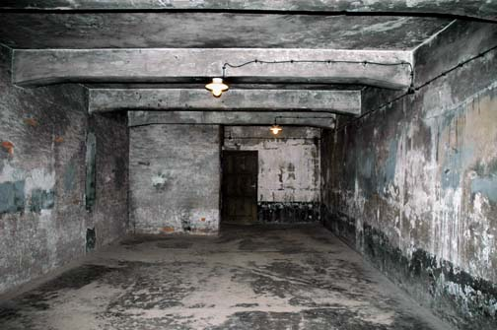
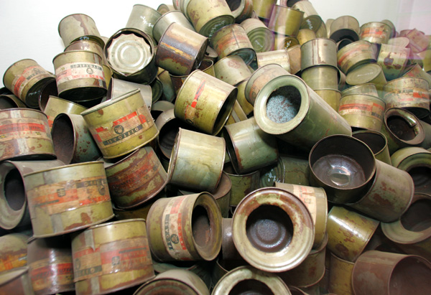
Notes:
Gas chambers used to kill prisoners who were usually told to remove their clothing for a shower. Zyklon B was commonly used

Slide 17
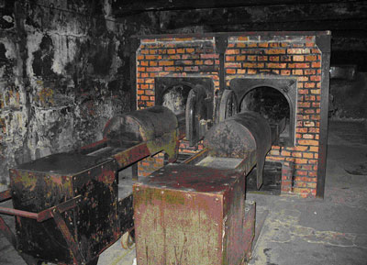
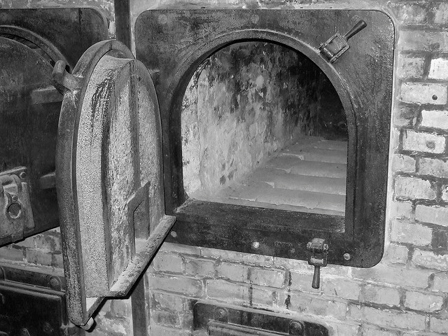
Notes:
Incinerators used to dispose of bodies at Auschwitz. Bodies were usually burned by Sonderkommando, fellow Jews. Ashes were then scattered as fertiliser.

Slide 18
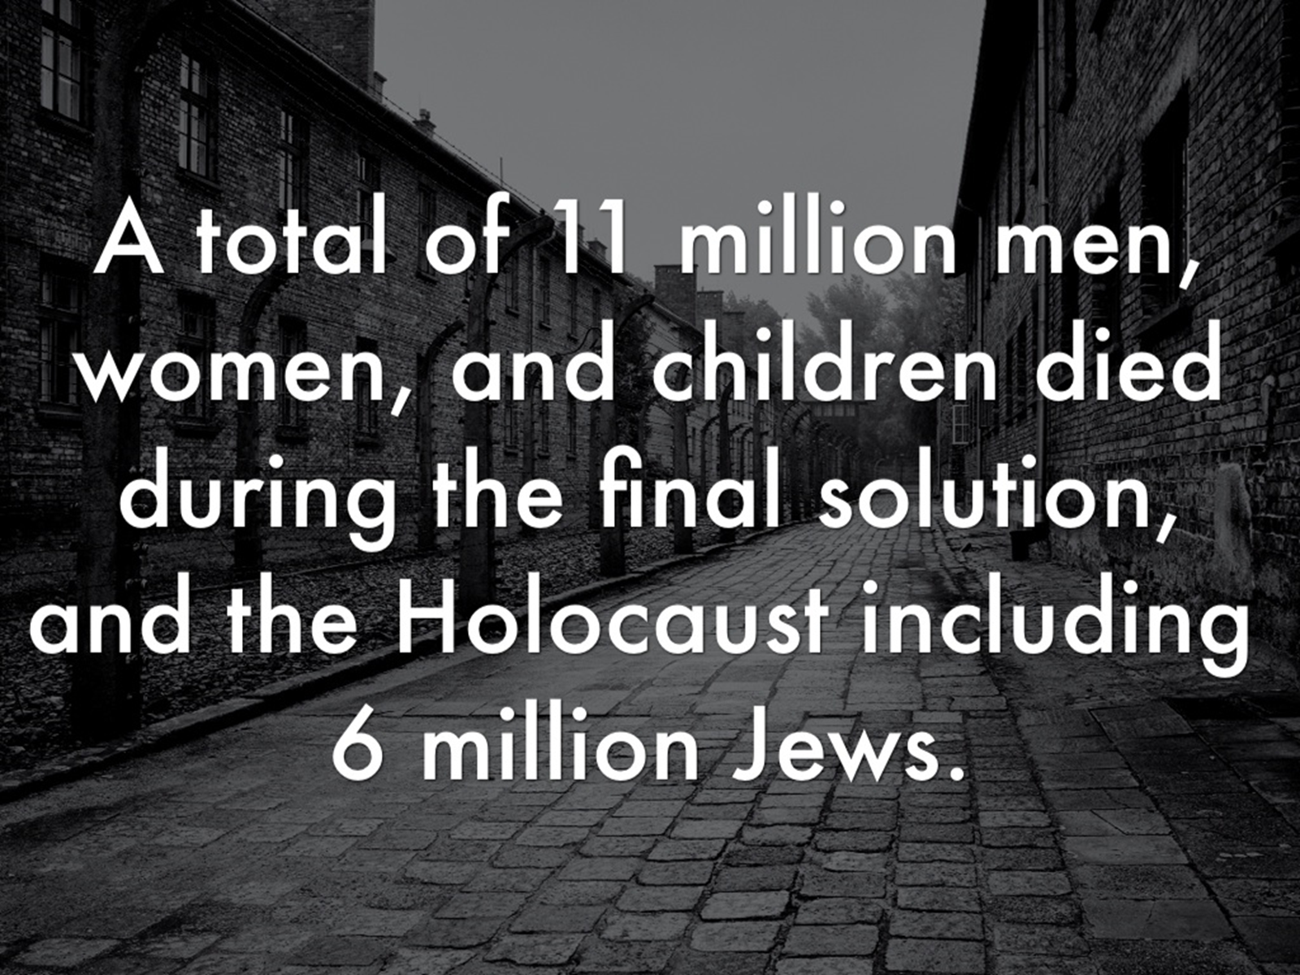

Slide 19

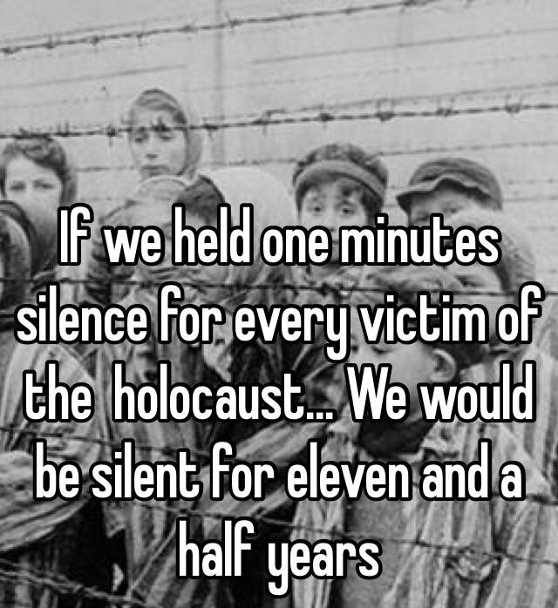
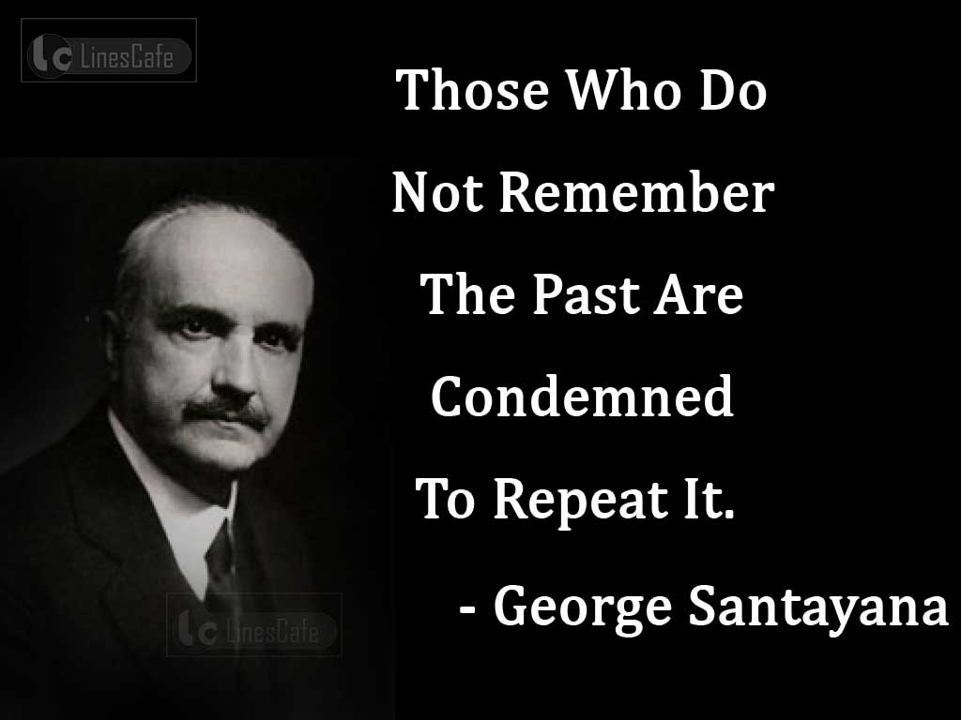
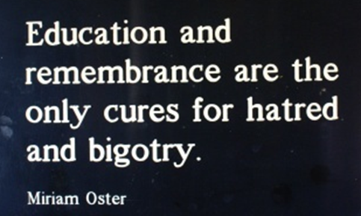
Task 2: Group Discussion of Quotes
Read through the quotes made about the Holocaust
As a group, discuss what they mean. What do they tell us?

Slide 20


Remembrance & Education
Your job is to create something which can be used to educate people about the Holocaust
It can be a poster, a story, a poem, a song etc.
These will be used in our whole school commemoration of the Holocaust on 27th January, Holocaust Memorial Day
Your project should focus on the events of the Holocaust but also why it is important that we remember the victims.

Slide 21
We were learning to…
Describe the ‘Final Solution’ and the Holocaust
Explain why it is important for us to remember those who died in the Holocaust
Did I…
Create a product for Holocaust Education purposes?

