Slide 1
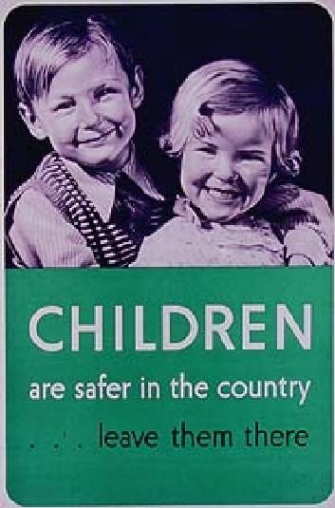
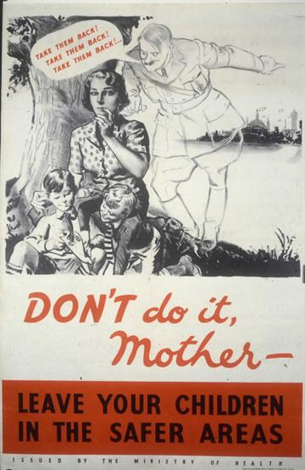

Evacuation
Lesson starter:
Below are two British posters from the outbreak of war. Write down a)what the posters tell us and b)what they are encouraging people to do.
Notes:
The first 10 minutes shows how evacuation was organised.

Slide 2
We are learning to…
Describe the experience of evacuation for British children
I can…
Create an information poster or leaflet on evacuation
Complete a piece of writing on Life as an Evacuee

Slide 3
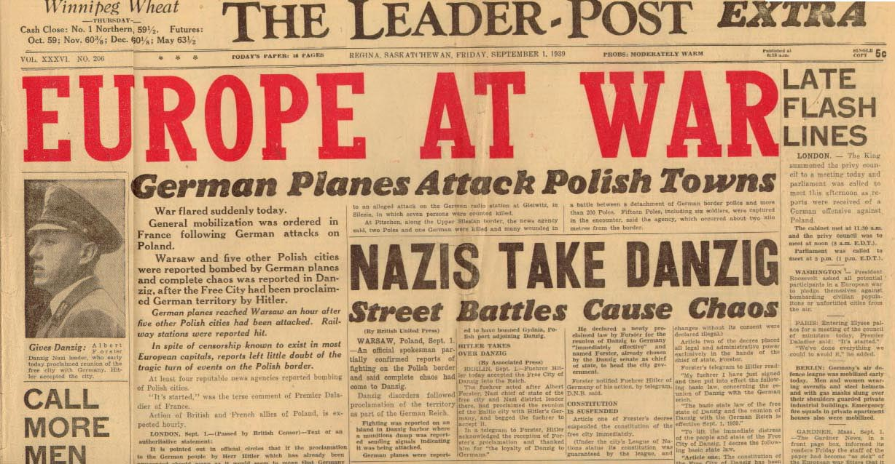
Evacuation – Note for jotter
The Evacuation programme in Britain started on 1st September 1939, the same day Britain declared war on Germany.
It was known as Operation ‘Pied Piper’

Slide 4
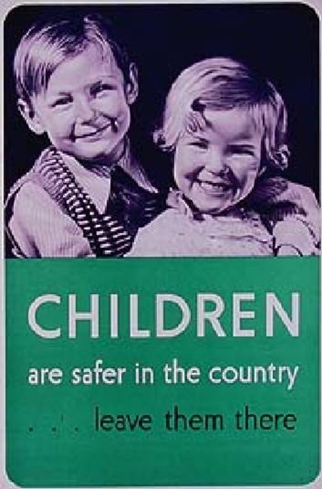

Task 1 – Note-taking
Take notes (or pictures on ipad ) from the following slides
You will use this information to create you information leaflet

Slide 5

Why was it important for people to be evacuated?
Evacuation tried to ensure the safety of young children from the cities that were considered to be in danger of German bombing.
Children were sent to the countryside to stay with ‘host families’, the countryside was less likely to be bombed by the German Luftwaffe
Who was evacuated?
Schoolchildren (5 years +) and their teachers
Mothers with children under five
Pregnant women
Some disabled people

Slide 6
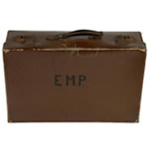
What clothes did children take with them?
The government recommended that in addition to their gas mask and identity card the evacuees had the following items:
Girls:
Vest
Pair of knickers
Petticoat
2 pairs of stockings
6 handkerchiefs
Slip
Blouse
Cardigan
Boys:
2 vests
2 pairs of pants
Pair of trousers
2 pairs of socks
6 handkerchiefs
Pullover or jersey

Slide 7
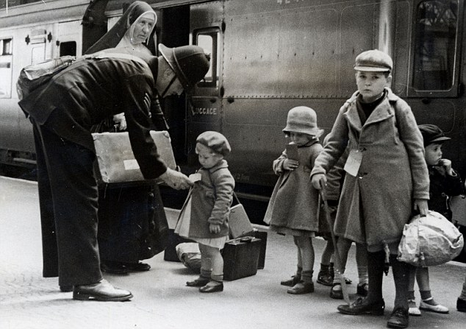

Slide 8
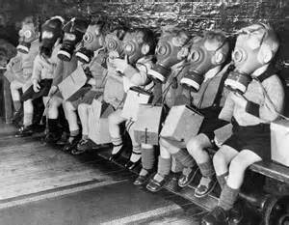

Slide 9
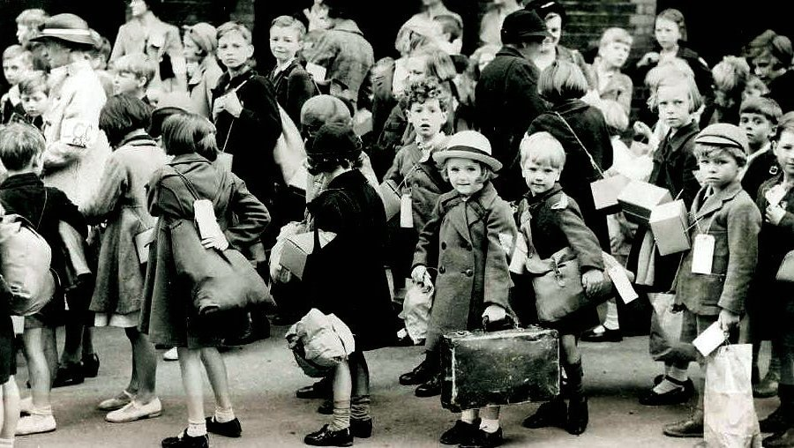

Slide 10
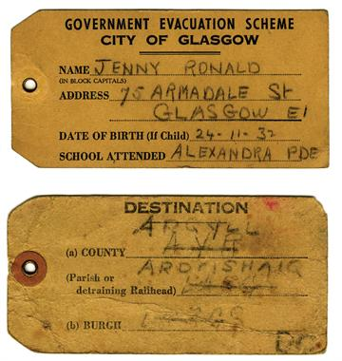

Slide 11
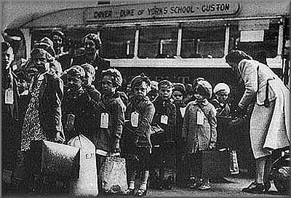
What else did they pack in their suitcases?
Overcoat or mackintosh
Comb
1 pair of Wellington boots
Towel
Soap
Facecloth
Toothbrush
Boots or shoes
Plimsolls
Sandwiches
Packet of nuts and raisins
Dry biscuits
Barley sugar (rather than sugar)
Apple

Slide 12

Task 1: Evacuation Poster
You must create a poster or leaflet that informs people in cities about evacuation
This will inform parents of the importance of evacuation & how to prepare
It must include;
Who is being evacuated
Why children must be evacuated
What children must bring
What extras they may choose to bring

Slide 13
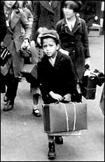

The Experience of Evacuees
Listening Exercise
You will hear a clip of an evacuee, James, talking about his time as an evacuee
Listen carefully and take detailed notes on James’s experience
You will need these notes to do the writing task
James

Slide 14


Task Two – Positive & Negative experiences of evacuation
Each person has a sheet with 2 primary sources.
You have 2 colours of highlighter pen – read your sources and with one colour, highlight the positive opinions about evacuation, and with the other colour highlight the negative opinions about evacuation.
Share the information from your sources with your partner

Slide 15

Class Discussion Point
In what ways was evacuation a positive experience for some children?
In what ways could it be negative?
Do you think the evacuation programme was a good idea?

Slide 16
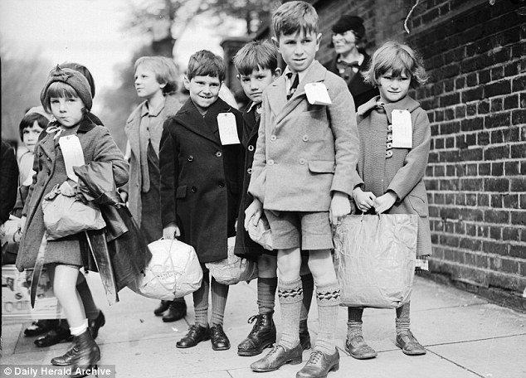
CBBC Programme - Evacuation
https://www.youtube.com/watch?v=rj5kiH5XZxw
This programme gives more information on the experience of evacuees
Take notes as you watch – these will help you with your final written piece on evacuation

Slide 17
Writing Task – Evacuee Letter
You are going to imagine you have been evacuated from the city to the Isle of Bute (Rothesay)
You are writing a letter home to let your parents/ friend know you are safe and to describe your experience to them
You should include;
Information about your journey
The family/ host you are living with
What your are enjoying about your experience
What you miss/ dislike
It should be written in the form of a letter.

Slide 18
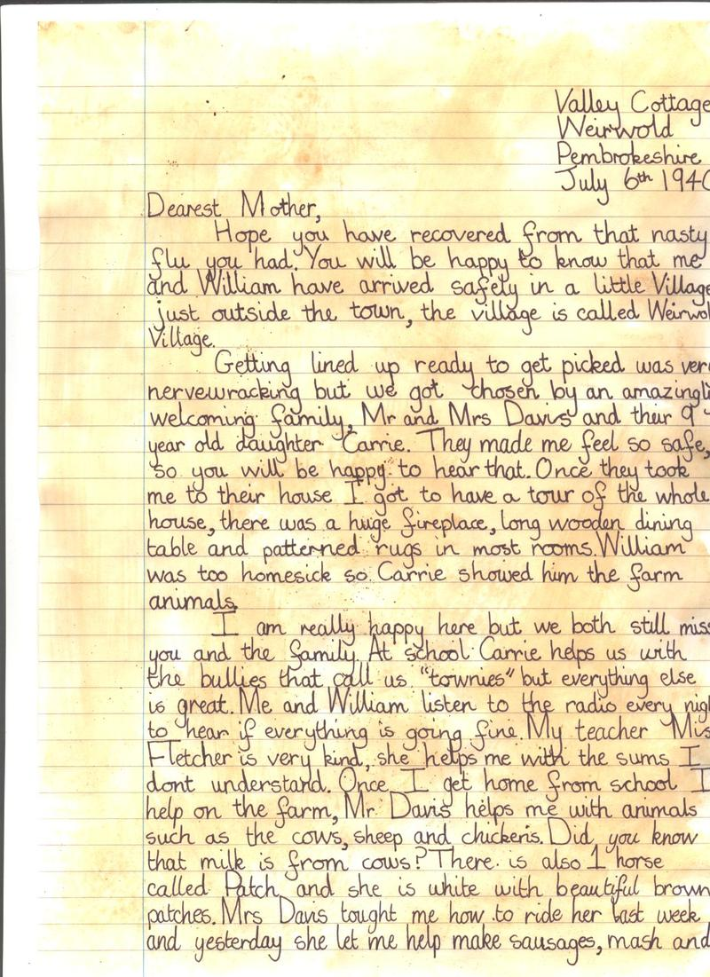
The address you have been evacuated to
The date
The recipient of the letter
Written in paragraphs

Slide 19
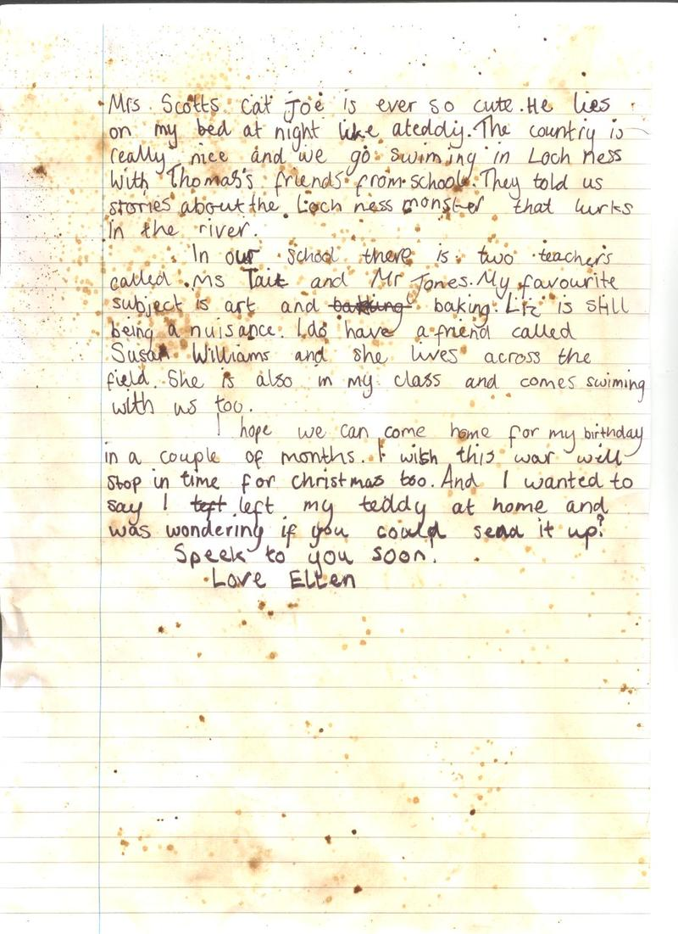
Asks the recipient questions
Signed off by you

Slide 20
Class Plenary
On your post it note write down:
1 fact about evacuations
1 aspect of evacuations that shocked you
1 aspect of evacuations that you think you would enjoy

Slide 21
We were learning to…
Describe the experience of evacuation for British children
Did you…
Create an information poster or leaflet on evacuation?
Complete a piece of writing on Life as an Evacuee?

