Slide 1
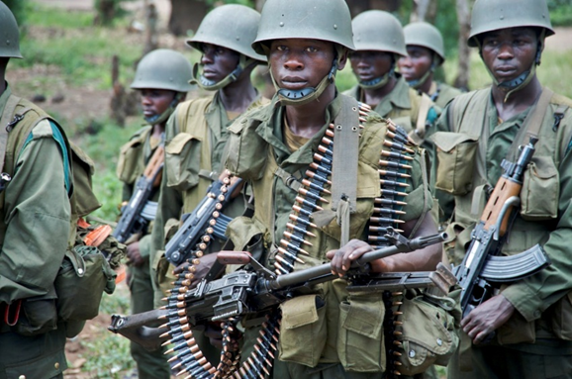
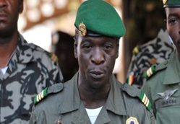
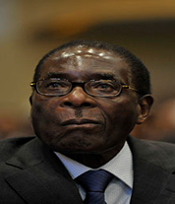
Bad Governance: What is it and what are the consequences?
Soldiers Ready to Fight in the DRC
Army leader Amadou Sanogo
President Mugabe of Zimbabwe

Slide 2
We are learning to…
Understand the terms ‘good governance’ and ‘bad governance’
Describe the problems caused by bad governance
Explain why bad governance often leads to a lack of development

Slide 3

I can…
Define both “good” and “bad” governance
Identify the problems associated with bad governance.
Give basic explanations of why bad governance leads to a lack of development

Slide 4
What is Governance?
“Governance determines who has power, who makes decisions, how other players make their voice heard and how account is rendered”.
In pairs, try to rewrite this definition using simpler language

Slide 5

What is Governance?
“Governance determines who has power, who makes decisions, how other players make their voice heard and how account is rendered”.
Governance is the way in which a government is run: who holds power, the decisions that are made and how the government is held to account.

Slide 6
Create the following table in your jotter and then complete the sorting task.*
Good Governance involves… | Bad governance allows…
Problems between countries to develop and get worse
Money to be stolen or used for personal gain
Spending money on education and healthcare
Ensuring citizens’ rights are protected
Resources to be abused and managed poorly
Resources being used properly and developed for the future
Working closely with other countries
Ignoring the rights of citizens
*Worksheet 5 for cut out version

Slide 7

Good & Bad Governance
Good governance: improves development as it takes citizens’ needs into account
Bad governance: citizens voices are not heard and development is hindered.

Slide 8
Starter: 3 things…
Tell your partner 3 things you have learned so far about development in Africa.
Once you have both spoken, write the 3 most interesting points into your jotters.

Slide 9
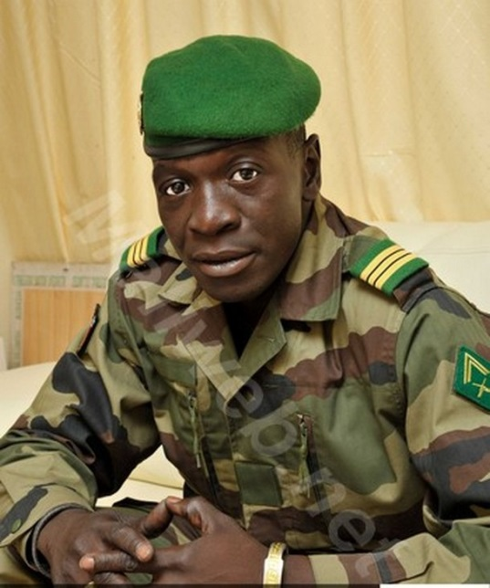
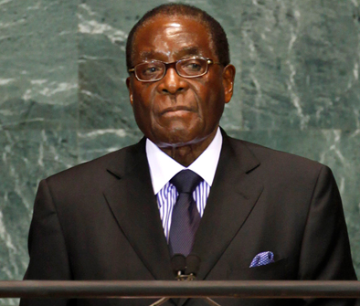
Examples of Bad Governance in Africa
Malian Army Officer
Amadou Sanogo
President Mugabe of Zimbabwe
Create a mind map in your jotter called “Bad Governance in Africa “ and take notes from the following slides

Slide 10
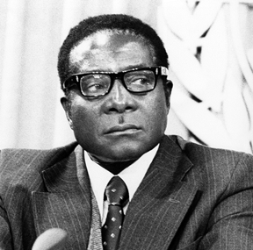
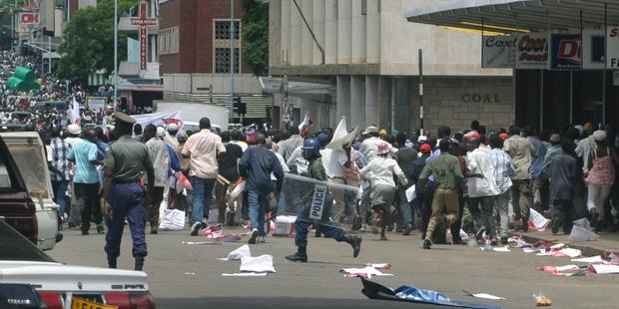
President Robert Mugabe of Zimbabwe
President of Zimbabwe from 1980-2017
Zimbabwe was run as one-party state, with Mugabe as its leader.
He did not allow fair and free elections.
In 2008, multi-party elections were held however there was no change in government and many incidents of Mugabe’s forces being violent were recorded.

Slide 11
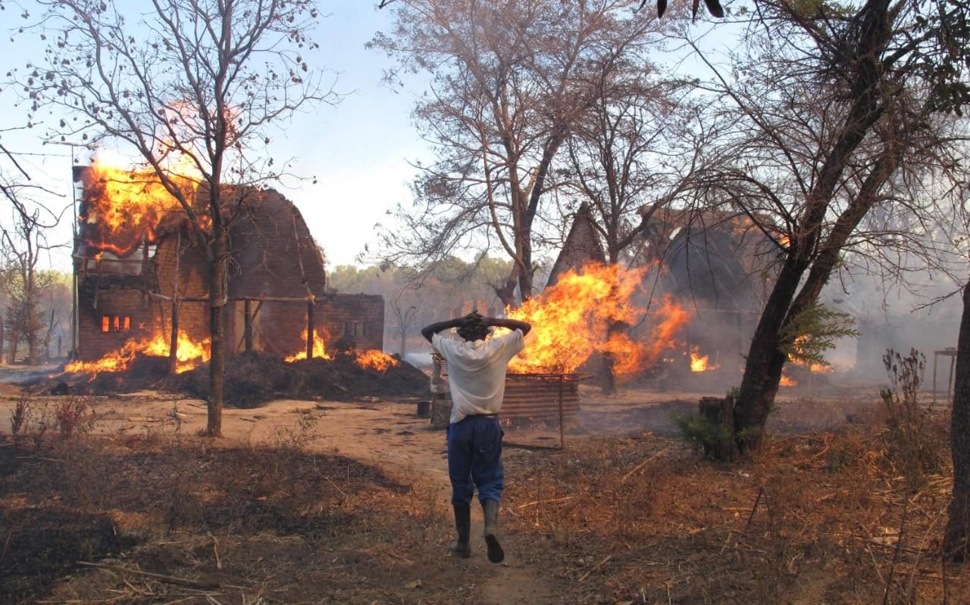
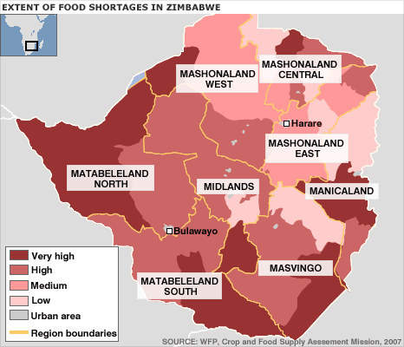
President Robert Mugabe of Zimbabwe
Mugabe has been criticised for destroying the economy of Zimbabwe.
Beginning in 2000, he encouraged the violent takeovers of white-owned commercial farms, leading to economic collapse mass food shortages.
Most Zimbabweans are unemployed and malnourished unlike the Mugabe family.
Notes:
https://www.youtube.com/watch?v=KOkYFhh-zgg – Food Shortages in Zimbabwe

Slide 12
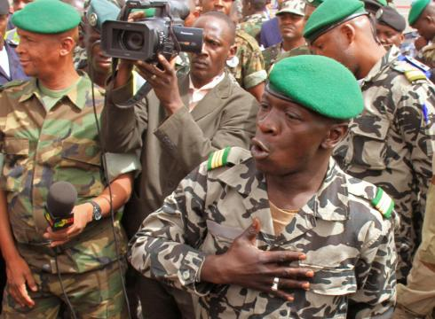
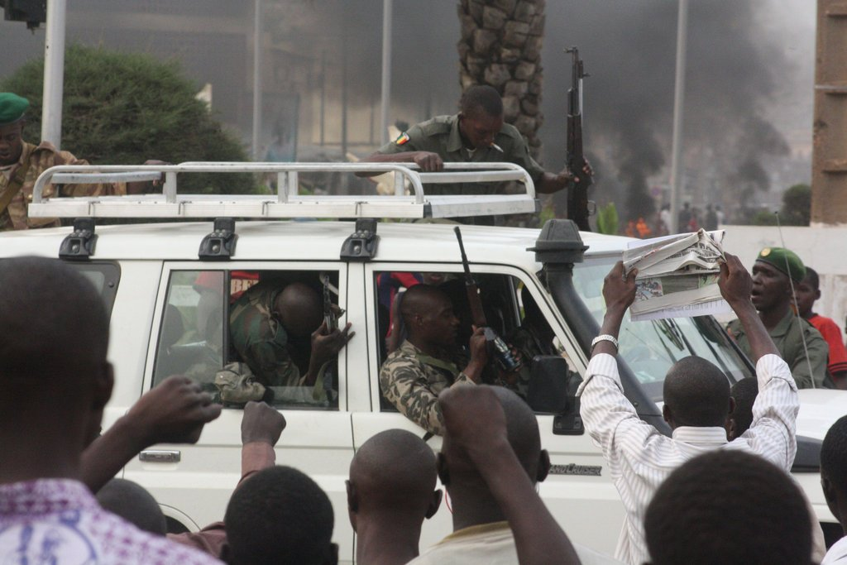
Army Officer in Mali: Amadou Sanogo
A junior officer in the Malian Army who led a coup d'état in 2012 against the Malian President.
His soldiers attacked several locations in the capital city, Bamako, including state television stations and military barracks and looted the presidential palace, before declaring that they had seized power just days before the scheduled presidential elections.
Despite ‘stepping down’ as the country’s leader later that year many people believed he was still running the country in the background.
Notes:
https://www.youtube.com/watch?v=gwgVI9uWadI – Military Coup D’etat

Slide 13
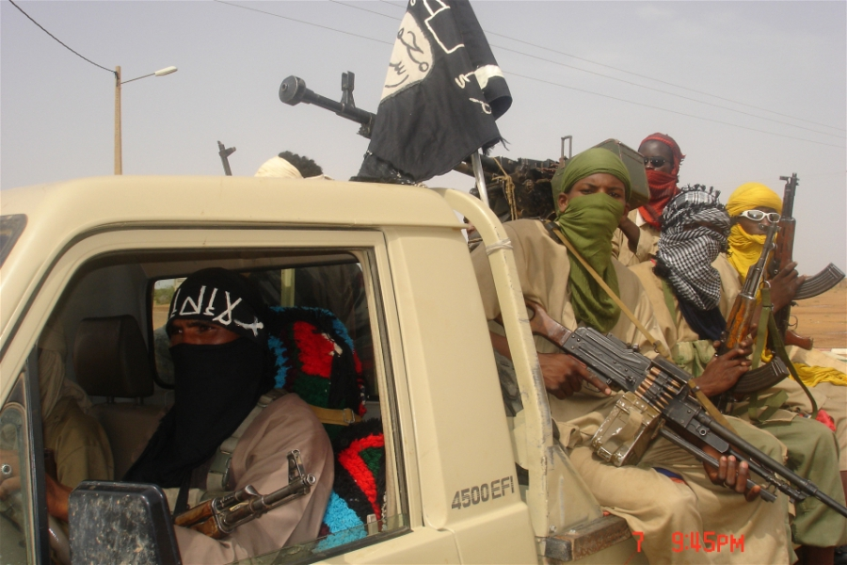
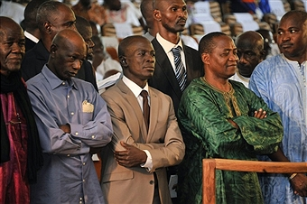
During his takeover, Islamic terrorists took control of several large towns in the north of Mali
Mali’s neighbouring countries put harsh restrictions and blocks on the country because of Sanogo’s takeover.
Sanogo was arrested in 2013 on charges of murder after 23 military officers disappeared whilst he was running the country.

Slide 14
HOTS Questions
Remembering
For how long was Robert Mugabe the leader of Zimbabwe?
In what year did Amadou Sanogo take control of Mali?
Understanding
3. Describe what governance is in your own words.
4. What kind of problems can bad governance lead to for a country?
Analysing
5. What problems did Robert Mugabe create in Zimbabwe?
6. What are the features of a coup d'état?
7. Why were Islamic terrorists able to take control of towns in northern Mali during Sanogo’s leadership?

Slide 15

Starter: Word Fill
Governance refers to the way that ______ are run – who holds _____ and kind of ______ are made.
Bad governance usually leads to a lack of _____________ as citizens needs are _______ by those in government.
In some African _____, bad governance has caused ______, ________ and _____.
Notes:
Countries, power, decisions, development, ignored, nations/countries, famine, poverty and abuse.

Slide 16
Extension: Robert Mugabe – End of a Dictator
Report on Robert Mugabe
Watch the short documentary on Robert Mugabe’s history as the President of Zimbabwe and take notes on his actions as President.
Thinking Point: Why do you think Zimbabweans finally rebelled against Mugabe and his government?

Slide 17
The Consequences of Bad Governance
If there is bad governance then a country will find it more difficult to develop as the majority of the population’s voices are not being heard and their needs not being catered for.
2,4,6 Task
On your own come up with 2 consequences of bad governance.
In your pair or three come up with 4 consequences
In your big group come up with 6 consequences
Be prepared to share your ideas with the class
Notes:
Timing for 2,4,6
1 minute for 2 ideas
1 min 30 for 4 ideas
2 mins 30 for 6 ideas

Slide 18
The Consequences of Bad Governance
Using all of your notes, in pairs you are going to create a Consequence Wheel highlighting the various consequences of bad governance in African countries.

Slide 19
Explain two of the problems caused by bad governance in African countries (6 marks)
P.E.E Style Question
You will need two separate reasons to get full marks
Each reason goes in a new paragraph.
Follow the P.E.E method for each paragraph
POINT
EXPLAIN
EXAMPLE

Slide 20
Homework
1. Evaluating
Explain why bad governance leads to a lack of development within a country.
2. Researching
Research one of the following African countries which has suffered/currently suffers from bad governance and write half a page in your jotter describing a) Who runs the country or has run the country and b) the problems faced in the country because of bad governance.
The Comoros
The Democratic Republic of the Congo (DRC)
Togo

Slide 21
Plenary: Taboo
Each group has a set of cards face down. Person number 1 should take the top card without showing anyone else.
Now, describe your word or phrase without actually saying it.
The person who guesses correctly takes the next card…

Slide 22
Did I…
Define both “good” and “bad” governance
Identify the problems associated with bad governance.
Give basic explanations of why bad governance leads to a lack of development

