Slide 1
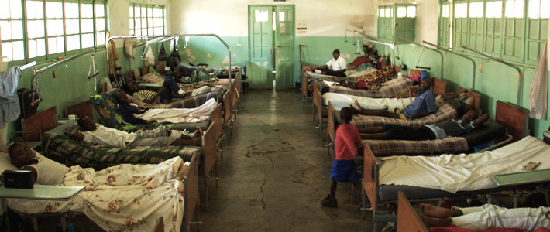
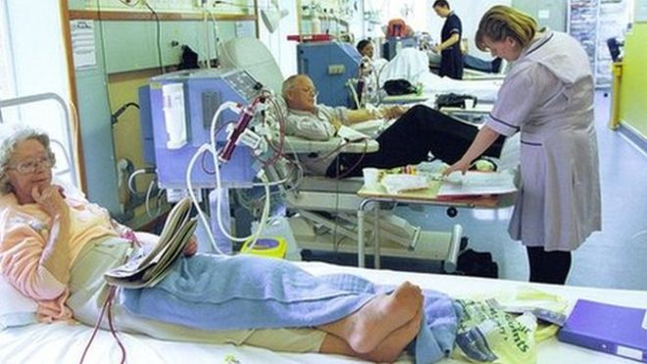
Compare the picture of the African Hospital with the British Hospital:
What are the conditions in both like?
Do you think both sets of patients will receive the same level of care?
Why do these differences exist?

Slide 2
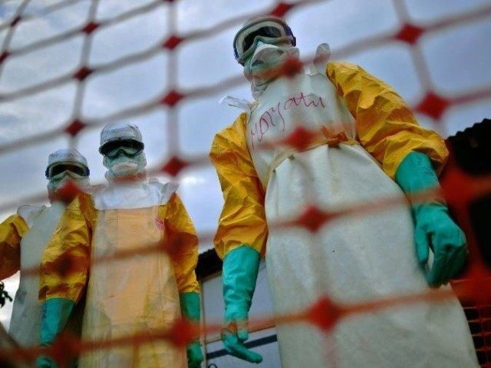
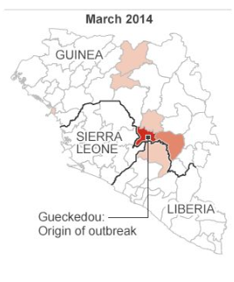
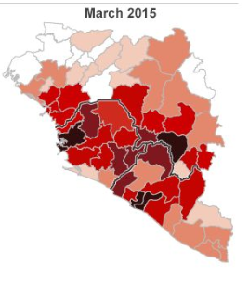
HEALTH AND HEALTHCARE IN AFRICA:
EBOLA OUTBREAK 2013-2016

Slide 3
We are learning to…
Outline the 2014-2016 Ebola outbreak in West Africa
Explain the impact of the Ebola outbreak on Africans and African countries.

Slide 4

Did I…
Answer HOTS questions about the Ebola outbreak
Create an academic poster about the Ebola outbreak in West Africa.

Slide 5
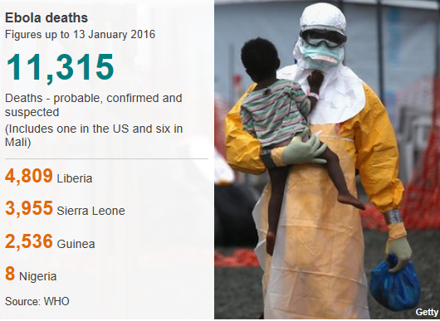
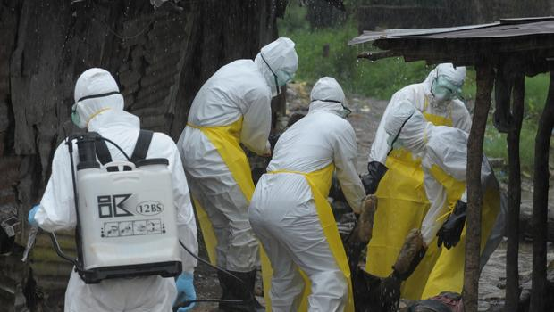
What is Ebola?
Ebola is a virus which is spread through contact with infected blood or bodily fluids.
The initial symptoms can include a sudden fever, intense weakness, muscle pain and a sore throat
Subsequent stages are vomiting, diarrhoea and - in some cases - both internal and external bleeding.

Slide 6
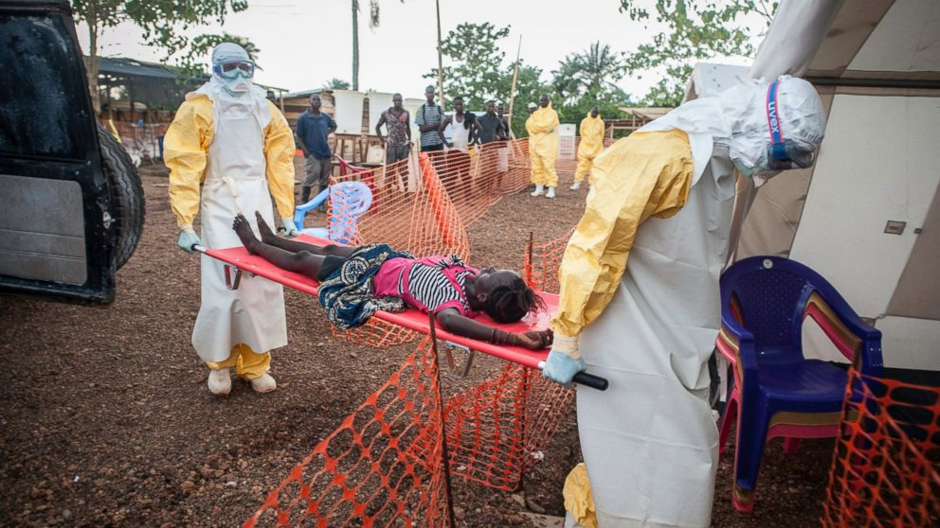
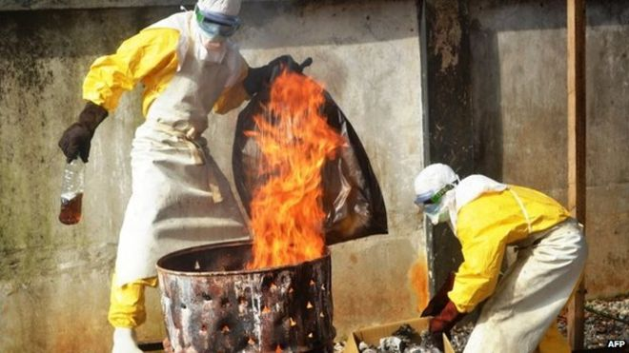
What is Ebola?
Watch the BBC documentary “This World - Outbreak, The Truth About Ebola” and take notes under the following headings.
Why the Ebola Virus spread so quickly
The physical effects of Ebola on individuals
The effects of Ebola on villages, towns and countries
What governments and charity organisations did during the outbreak.
Outbreak - The Truth About Ebola

Slide 7
Information Gathering
You are going to add to the notes on the West African Ebola Outbreak you already have by reading a secondary source – an extract from a newspaper article.
Add to the notes that you have already taken under the following headings:
Available Treatments for Ebola
African Healthcare systems
Cultural Issues

Slide 8
EBOLA OUTBREAK 2013-2016
In your groups you will now collate all of the information you have gathered about the Ebola Outbreak to help prepare for the next task.
Each group has been provided with a flipchart sheet split into three.
In each section put in as much detailed information as you can under the appropriate headings
You have 10 minutes to complete the task.

Slide 9
Causes of the Outbreak
Consequences of the Outbreak
Ebola Outbreak
West Africa, 2013 -2016
Development Issues Highlighted by the Outbreak

Slide 10
HOTS Questions
Remembering
Can you remember what animal is believed to carry the Ebola virus?
Can you remember the country in which the first Ebola case occurred?
Explain why the disease spread so quickly across West Africa?
Analysing
Why did the Government of Guinea deliberately refuse to count ALL Ebola cases in the country?
Creating
What outcome would you predict if the Governments had taken faster action to control the outbreak?

Slide 11
Academic Poster Task
We are learning to… explain the impact of the Ebola Outbreak
I can… create a detailed poster on the West Africa Ebola Outbreak (2013-2016)
Your assessed poster must contain:
A description of the Ebola virus and its symptoms
An explanation of how the virus is spread from person to person
At least detailed 2 reasons why the virus spread so rapidly during the outbreak
At least 2 detailed consequences of the outbreak on African countries
At least 2 maps/diagrams or drawings
Assessed Posters;
Contain key facts/ figures/ statistics
Have a logical layout
Are well presented and designed

Slide 12
Homework HOTS Questions
Understanding
What health and healthcare problems exist in Africa?
Are most ordinary Africans able to access decent healthcare facilities?
Analysing
Why do diseases such as HIV/AIDS and Ebola have such a massive impact in Africa?
In what ways can we link poor health with poor development?
Evaluating
6. What would you recommend African governments do to improve the health of their citizens?

Slide 13
I can…
Answer HOTS questions about the Ebola outbreak
Create an academic poster about the Ebola outbreak in West Africa.

