Slide 1
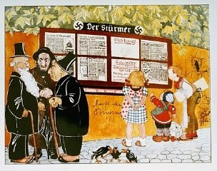
Source 1
Illustration from a children's book. The headlines say "Jews are our misfortune" and "How the Jew cheats." Germany, 1936.
— United States Holocaust Memorial Museum

Slide 2
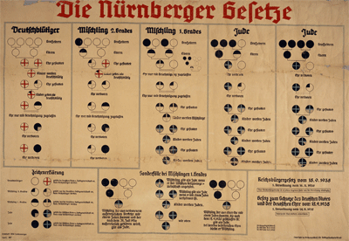
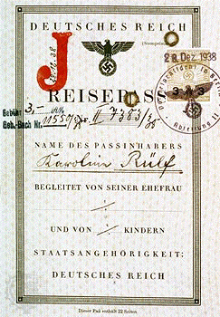
Source 2
Took away German citizenship from Jews
Marriage between Jews and Aryans illegal
Jewish businesses disbanded
Jewish doctors, lawyers not allowed to have Aryan clients
Jews had a J stamped on their passports
Aryan women under 45 not allowed to work for Jews
The Nuremberg Laws - 1935

Slide 3
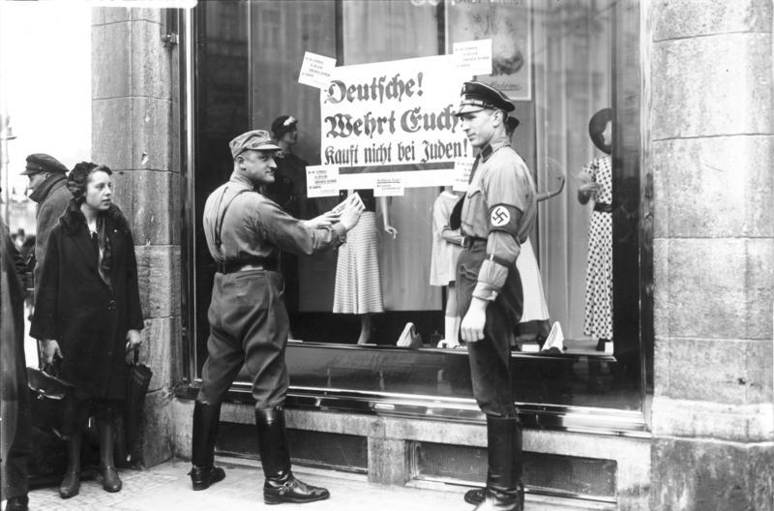
Source 3
People were told not to use Jewish shops – posters were stuck in windows to tell people they were owned by Jews.
Boycott of Jewish shops 1933

Slide 4
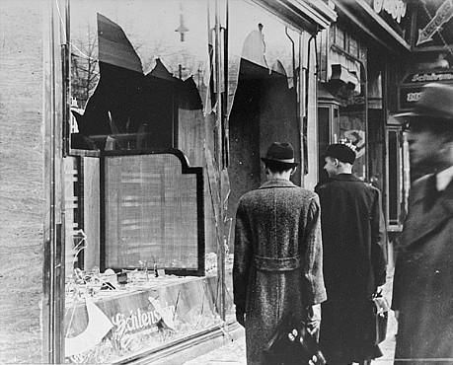
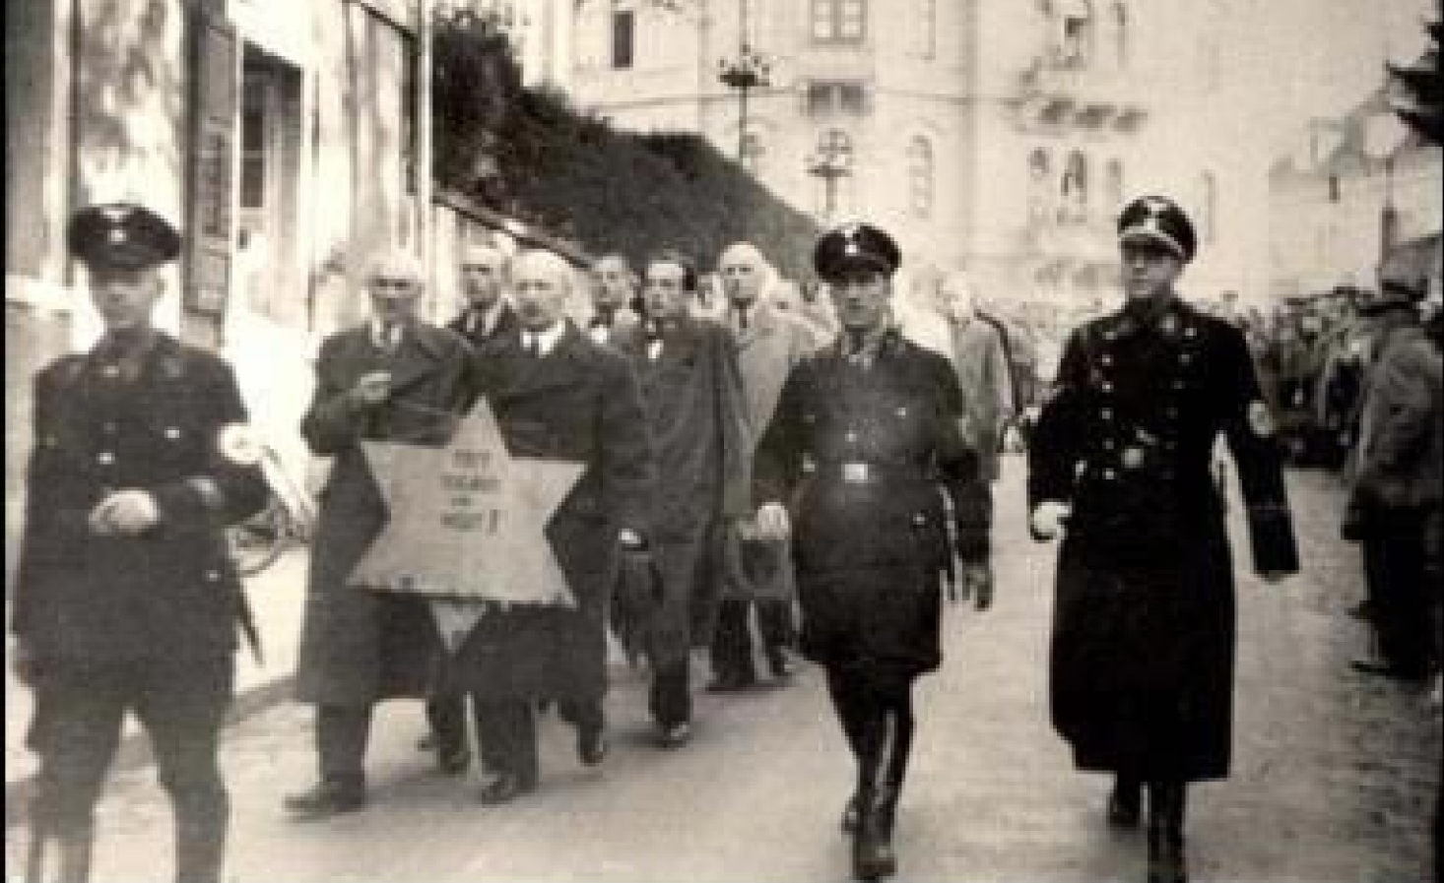
Source 4
Kristallnacht 9-10th November 1938
Members of the SS encouraged people to smash windows, loot houses and firebomb synagogues. Jews were arrested and paraded in the streets. Jews were fined 1 billion marks for the ‘damage’.

Slide 5
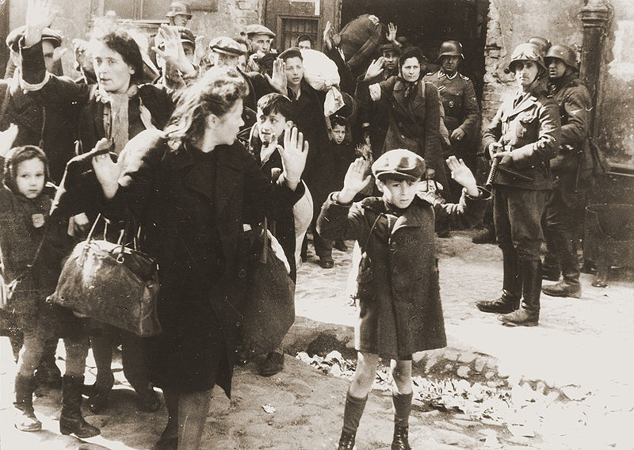
Source 5
Warsaw Ghetto
Made at least 7 people live in every room
Only allowed them 300 calories of food a day (this was the equivalent of two slices of bread and margarine per day – and nothing else)
Wouldn’t allow heating in the house
Allowed dirty water to enter all the washing and drinking systems
Took all their money, belongings and jobs
The Jewish population in Warsaw were forced into a ghetto [a small area of a town or city]. A large wall was built to stop the leaving.

Slide 6
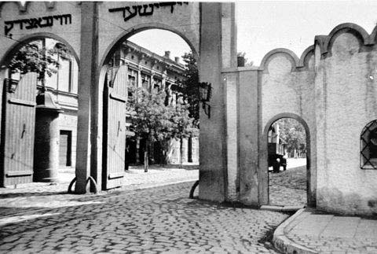
Source 6
The Nazis organized coach tours through the ghetto
“seeing this race which is decaying, decomposing and rotten to the core will stop anyone having sympathy for the Jews. It is the state rubbish dump. Five to six thousand die each month.”
Albert Rosenberg (Nazi)

Slide 7
Source 7
The Einsatzgruppen [mobile killing units].
A description of the actions of an Einsatzgruppe in 1941. This was written by a German builder.
“The people who had got off the lorries had to undress on the orders of an SS man, who was carrying a dog whip in his hand. Without weeping or crying these people undressed and stood together in family groups embracing each other and saying goodbye.
I walked to the huge grave. There were about 1,000 bodies, so tightly packed that only their heads were visible. The people climbed down steps and stopped at the spot indicated by the SS man. They lay down. They I heard a series of rifle shots.”

Slide 8
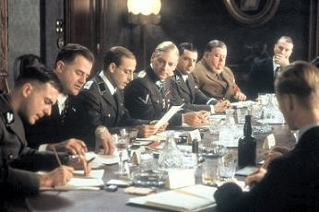
Source 8
The Wannsee Conference – 20th January 1942
Minutes from the Wannsee Conference where leading Nazis discussed the ‘Final Solution’.
“In the course of the final solution, the Jews will be brought to the East for labour. Large labour gangs will be formed, with the sexes separated, which will work on road construction. No doubt a lot of them will drop out through natural wastage. The remainder will have to be dealt with accordingly.”

Slide 9
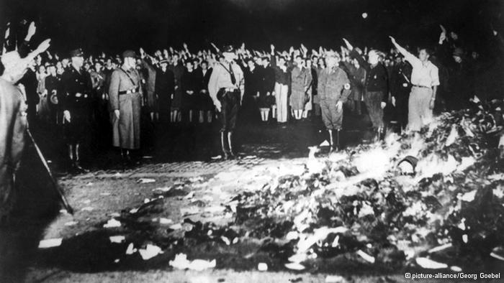
Source 9
The Book Burnings 1933
Germans students and the SS organised public book burnings – people were encouraged to bring books by Jewish authors, Jewish religious books and Jewish history books to public burnings.

