Slide 1
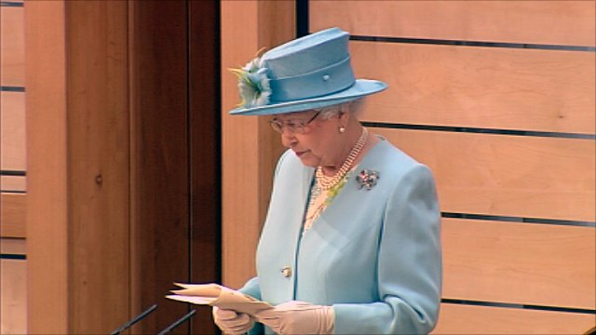
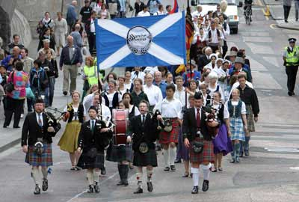
The Scottish Parliament
The Queen officially opened the Scottish Parliament on 1st July 1999 after nearly 300 years of British rule. In order to understand the importance of the Scottish Parliament in meeting the needs of the people of Scotland today, we need to understand the history of the country.

Slide 2
Opening the Scottish Parliament
In 1997, the Labour party became the UK government and promised the people of Scotland a REFERENDUM. On the 11th September voters were asked ‘should there be a Scottish Parliament?’ 74.3% of the electorate voted yes.
1998 – The Scotland Act was passed by the UK Parliament.
1999 – On 1st July the Scottish Parliament met for the first time in Edinburgh.

Slide 3
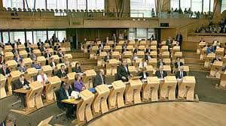
Devolved and Reserved Powers
It was decided that the SP should have control over certain issues and these should be handed over (DEVOLVED) from the UK Parliament.
The powers that the SP got reflected areas where Scotland maybe needed to have more of a control.
In Scotland we have DEVOLUTION NOT INDEPENDENCE!

Slide 4
Task 3: Displaying Our Learning
Design an information poster which clearly shows the devolved and reserved powers of the Scottish Parliament.
For each of the powers you should explain what this means and illustrate with pictures and examples.

Slide 5
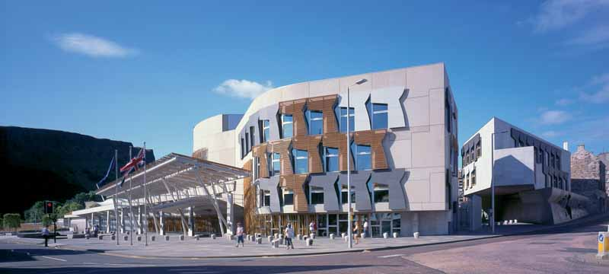
The Scottish Parliament has law-making powers over many issues which affect our lives.
Here are some of them
Education
Housing
Fisheries
Agriculture Local Government
Health
Law and Order
Police and Fire Services
Environment
Tourism and Culture
Sport and the Arts
Transport

Slide 6
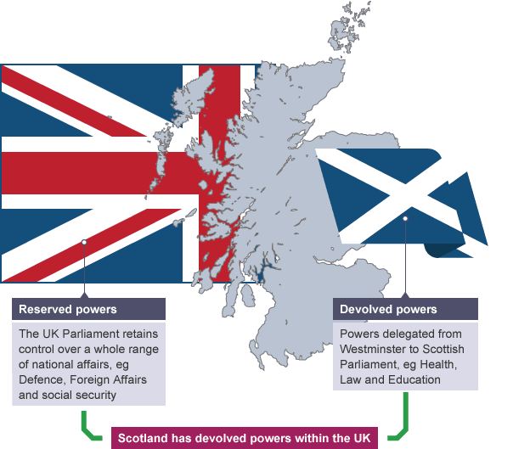
Reserved Powers

Slide 7
Some Powers are RESERVED to Westminster
Here are some of them
Foreign affairs
Defence
National security
The Constitution
Welfare
Immigration
Broadcasting
Energy – electricity, gas, coal, oil and nuclear
Economic policy for the UK

Slide 8
Task 3: Displaying Our Learning
Design an information poster which clearly shows the devolved and reserved powers of the Scottish Parliament.
For each of the powers you should explain what this means and illustrate with pictures and examples.

