Slide 1
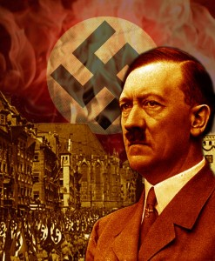
Rise of the Nazis:
The ‘Stab in the Back’
Lesson starter:
What does the saying to be ‘stabbed in the back’ mean?
https://www.youtube.com/watch?v=P4I85LK46Ew

Slide 2
We are learning to…
Explain why German people felt ‘stabbed in the back’ after WWI
Summarise the ‘stab in the back’ theory in a speech
I can…

Slide 3
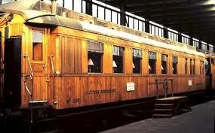
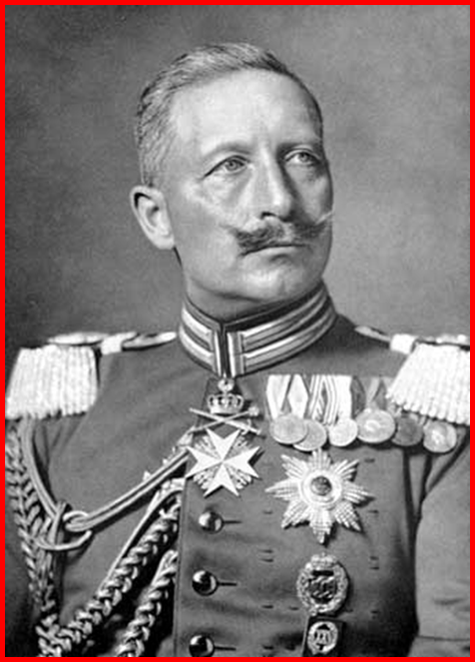
The German Generals had negotiated a surrender with Britain and her allies in November 1918
The Kaiser had abdicated two days earlier
This effectively meant that Germany ‘gave up’ and lost the war
German people couldn’t understand why the Generals and politicians had given up
After all – there were no allied soldiers in Germany so surely Germany could have fought on?

Slide 4
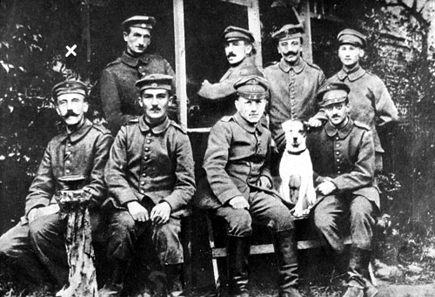
The German people started to believe the generals and politicians had surrendered too soon
They had given up the war when they didn’t have to
The German people felt they had been stabbed in the back by the government
They became known as the ‘November Criminals’
Soldiers like Hitler felt especially betrayed

Slide 5
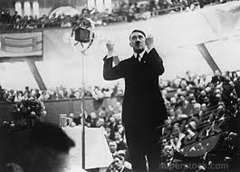
Hitler started to speak about the ‘stab in the back’ theory
He blamed a collection of Socialists, Communists and Jews for betraying Germany in this way
People began to listen – Hitler offered people to blame for Germany’s defeat

Slide 6
https://www.youtube.com/watch?v=soFhWkxSZAY
https://www.youtube.com/watch?v=pLypyyW6dUA

Slide 7
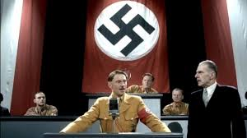
Task One
Hitler has asked you to help him write a speech to perform at a Munich beer hall
He wants to gain some new followers – he wants to talk about the ‘stab in the back’ and try to get people to believe his opinions
Write a short speech which explains
Why Germans have been stabbed in the back
Who is to blame for the stab in the back
What Hitler will do to restore Germany’s pride

Slide 8
Britain and France wanted to ensure Germany could never start another war as they had in 1918.
What could they do to ensure this was the case?

