Slide 1
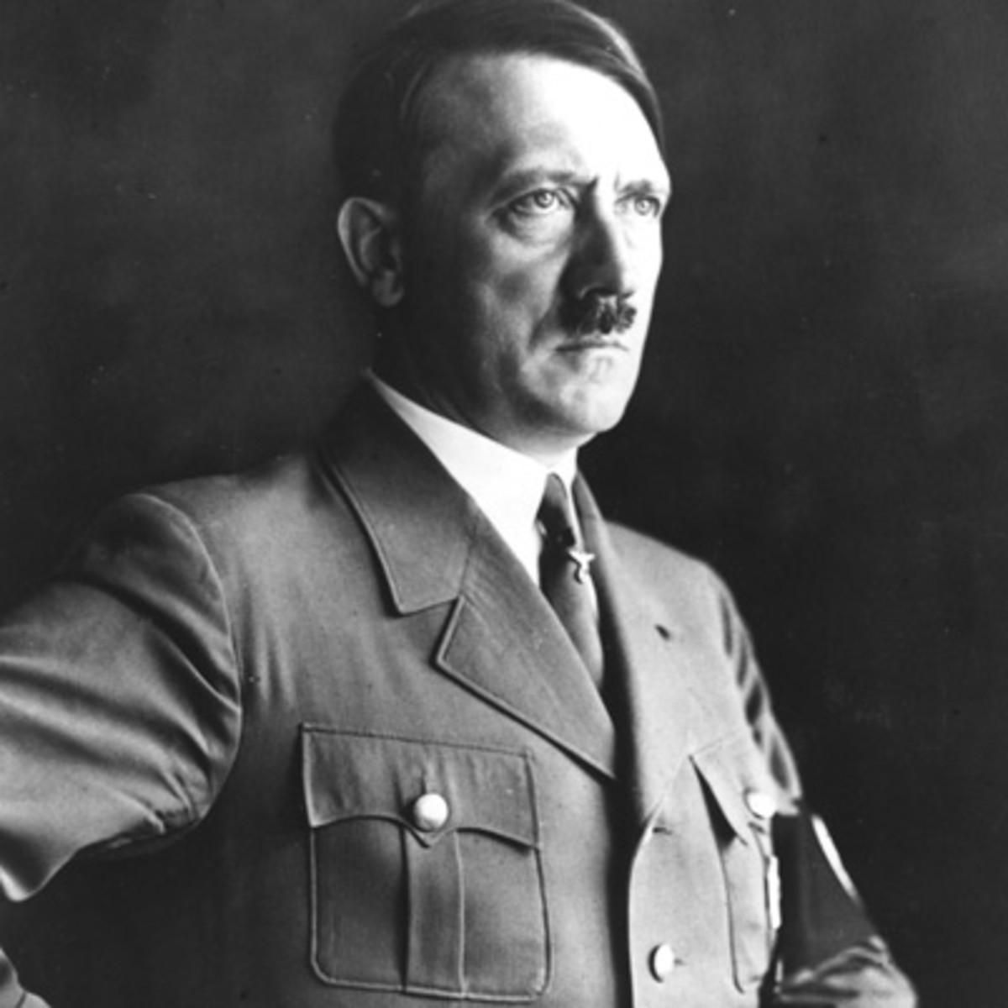
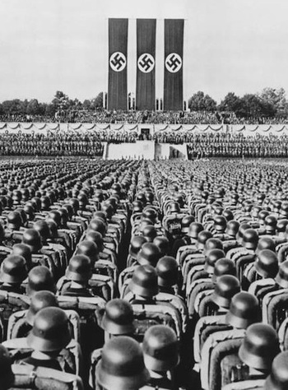
Hitler and Nazi Germany
Economic problems, 1919-1933

Slide 2
Economic problems 1919-33
In today’s class, I am learning to:
Describe economic crises faced by the Weimar Republic, 1919-1933
Explain why these events caused problems for the Weimar Republic

Slide 3
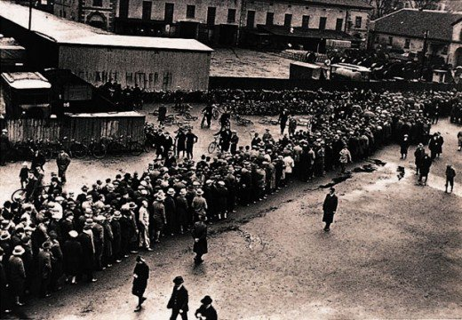
Economic problems 1919-33
The Weimar Republic faced various major economic crises that caused chaos all across Germany. These events led to a rise in extremist support.

Slide 4
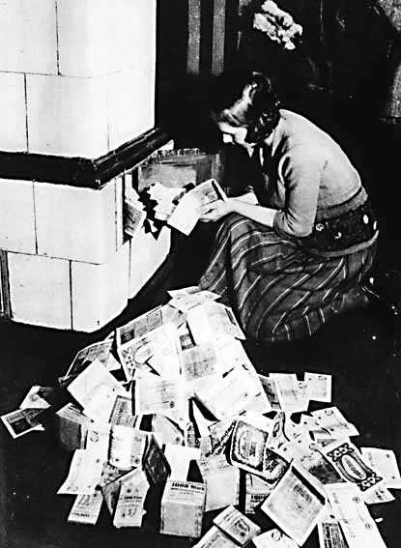
Economic problems 1919-33
The first major economic crisis faced by the Weimar Republic was hyperinflation, which in 1923 destroyed Germany’s economy.
An even bigger (and global crisis) started in 1929: the Depression. This also devastated German society.

Slide 5
Revolts against Weimar
Economic crisis
Hyperinflation

Slide 6
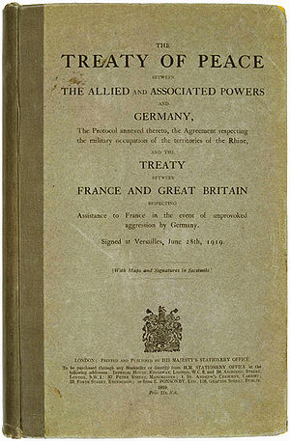
Economic problems 1919-33
As part of the Treaty of Versailles, Germany had to pay reparations to the war’s victorious countries.
Germany struggled to pay the huge sums of money (£6.6 billion set in 1921), especially given that they were also still trying to rebuild after the war.

Slide 7
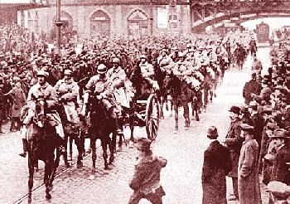
Economic problems 1919-33
When Germany failed to pay reparations to France and Belgium, these two countries invaded the Ruhr.
The Ruhr was Germany’s industrial area. France and Belgium planned to take ‘payment in kind’ - such as coal and steel – in place of the reparations.

Slide 8
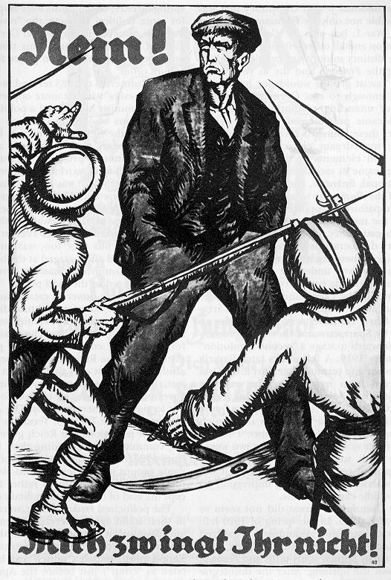
Economic problems 1919-33
Germany did not fight back against the invaders. Instead the German government ordered workers to refuse to work with them.
Ruhr workers went on strike, but the Weimar government kept paying them by simply printing more money.

Slide 9
Economic problems 1919-33
The more the Weimar government printed money, the less valuable that German money became.
Inflation is when prices rise and money loses its value.
In Germany in 1923 prices were up massively and very quickly: this is called hyperinflation.

Slide 10
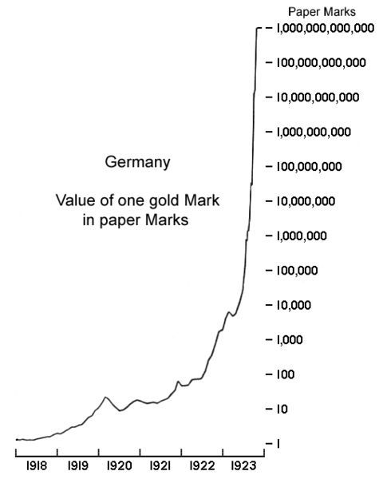
Economic problems 1919-33
The impact of hyperinflation was absolutely devastating.
At the start of World War One, the exchange rate was (roughly) four German marks to one US dollar.
By November 1923, the rate was (roughly) four billion German marks to one US dollar.

Slide 11
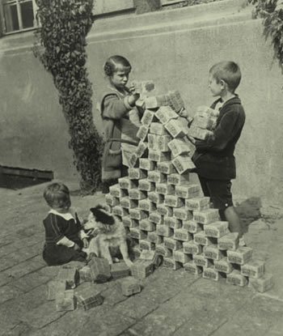
Economic problems 1919-33
Money became worthless. Workers rushed from being paid to quickly buy food before it became too expensive.
People would burn money instead of firewood, use money to wallpaper their house, or let children play with it like a toy.

Slide 12
Economic problems 1919-33
Many Germans saw the value of their life savings completely wiped out.
Germans on fixed incomes (such as pensioners and war widows) could not afford to pay for things, and often starved, became homeless or could heat their homes.

Slide 13
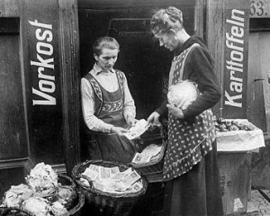
Economic problems 1919-33
A barter economy developed, where people would swap things or provide services in exchange for food or other goods.
However some Germans benefitted from hyperinflation, letting them quickly pay off loans or mortgages.

Slide 14
Economic problems 1919-33
Germans blamed the Weimar government for their problems.
Working class Germans turned towards Communist parties. Others wished for a return of a strong, Kaiser-style government and supported groups like the Nazis.

Slide 15
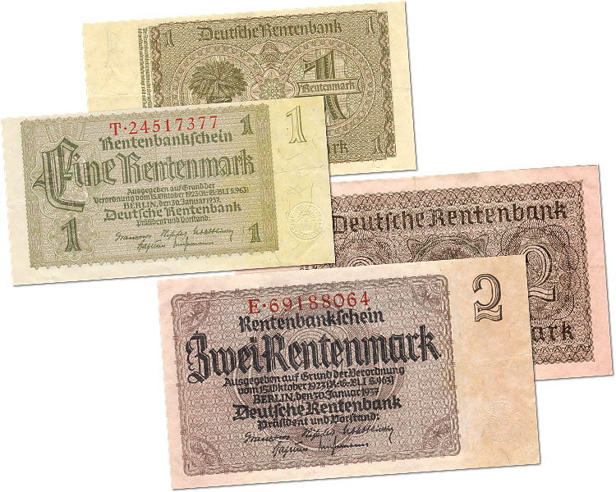
Economic problems 1919-33
In November 1923 a new currency was introduced in Germany – the Rentenmark.
This quickly ended the crisis and stabilised prices. However many Germans were still angry at the effects of hyperinflation, and wanted change.

Slide 16
Revolts against Weimar
Economic crisis
The Depression

Slide 17
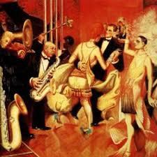
Economic problems 1919-33
After the devastation of hyperinflation, the German economy eventually improved.
The years from 1924 to 1929 are sometimes called Weimar’s ‘Golden Years’. Support for extremist parties fell during this period, especially the Nazis.

Slide 18
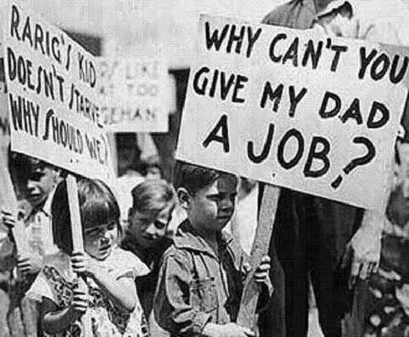
Economic problems 1919-33
One reason the German economy improved was that they received loans and other help from the USA.
However in October 1929 the American economy collapsed during the Wall Street Crash, resulting in global economic problems, including Germany.

Slide 19
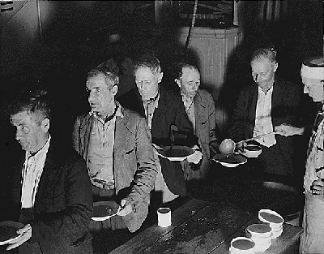
Economic problems 1919-33
Many Germans felt the Depression was even worse than hyperinflation.
By 1932 there were six million Germans unemployed.
Homelessness, poverty and other problems also increased due to this.

Slide 20
Economic problems 1919-33
The German government struggled to deal with the economic crisis.
They could no longer get loans from the USA (and had to repay some of the loans they’d been given).
Various governments could not could agree on what action should be taken.

Slide 21
Economic problems 1919-33
Due to the Depression, Germans again turned towards extremist parties.
Support for the Communist Party increased, but the Nazis saw the biggest gains.
They were especially backed by the upper and middle classes that feared the growth of Communism.

Slide 22
Economic problems 1919-33
Government actions at this time, included reducing public spending and cutting pensions for older people and war widows, all led to German anger.
Some governments collapsed because they could not agree on actions to fix the problem.

Slide 23
Economic problems 1919-33
The Nazis promised to improve people’s lives. They even opened soup kitchens to feed hungry people.
As a result of this the Nazis went from being the Reichstag’s smallest party in 1928 to the largest by 1932.
Hitler became German Chancellor in January 1933.

Slide 24
Economic problems 1919-33
Many historians believe the Depression was the key factor which led to the Nazis taking power.
AJP Taylor said that “the Depression put the wind in Hitler’s sales”. William Carr said it was “inconceivable” that the Nazis would have gained power without it.

