Slide 1
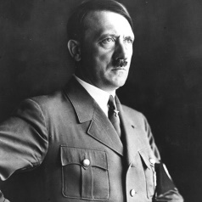
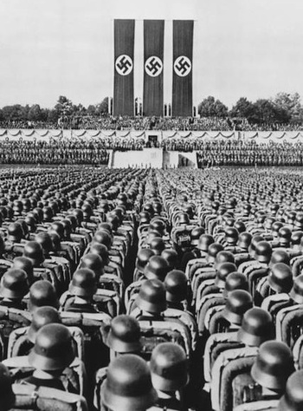
Hitler and Nazi Germany
Revolts against Weimar

Slide 2
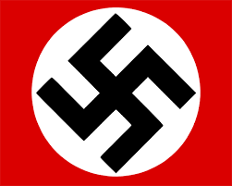
Revolts against Weimar
In today’s class, I am learning to:
Describe left-wing attempts to overthrow the Weimar Republic
Describe right-wing attempts to overthrow the Weimar Republic

Slide 3
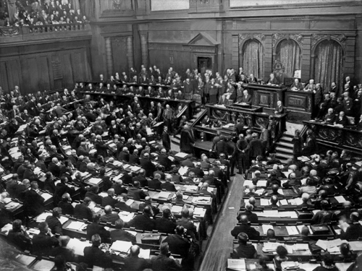
Revolts against Weimar
After the Weimar Republic was established it faced challenges from many left-wing and right-wing groups, each of which wanted to run the government.

Slide 4
Revolts against Weimar
Left-wing
May want to see big changes in society
More likely to want the people to choose how their country will be run
Wants income equality (no rich and poor)
Right-wing
Often prefers to stop major changes
May want a single strong leader
Might be nationalist (strongly supporting their own country)
Might be against high taxes

Slide 5
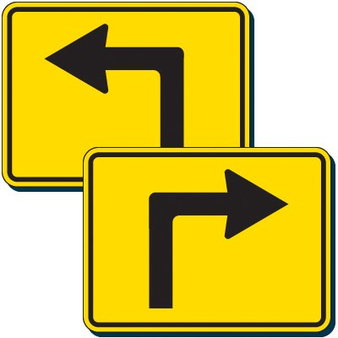
Revolts against Weimar
One of the major problems that the Weimar Republic faced was that it did not fully please anyone.
The Left wanted to see more radical changes (about income, for example).
The Right wanted a return to something more like a Kaiser-style government.

Slide 6
Revolts against Weimar
Left-wing revolts
The Spartacist Revolt

Slide 7
Revolts against Weimar
The Spartacist Revolt
The Spartacists were a Communist (Far Left) group that wanted to see more radical change in Germany.
This included a Revolution like in Russia, and giving full power and control to workers’ and soldiers’ groups.

Slide 8
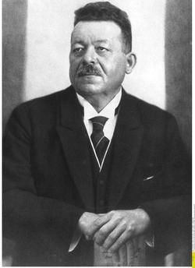
Revolts against Weimar
The new Chancellor of Germany – Friedrich Ebert – was a member of the Social Democratic Party (SDP).
He believed that all parties should be represented in the Reichstag. Ebert was very opposed to a Communist system of government.

Slide 9
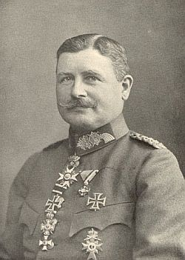
Revolts against Weimar
Ebert worried that the Communists would try and overthrow his government.
As a result he reached a secret deal with Wilhelm Groener (the head of Germany’s army) to support the new government, in exchange for the army’s leaders keeping their jobs.

Slide 10
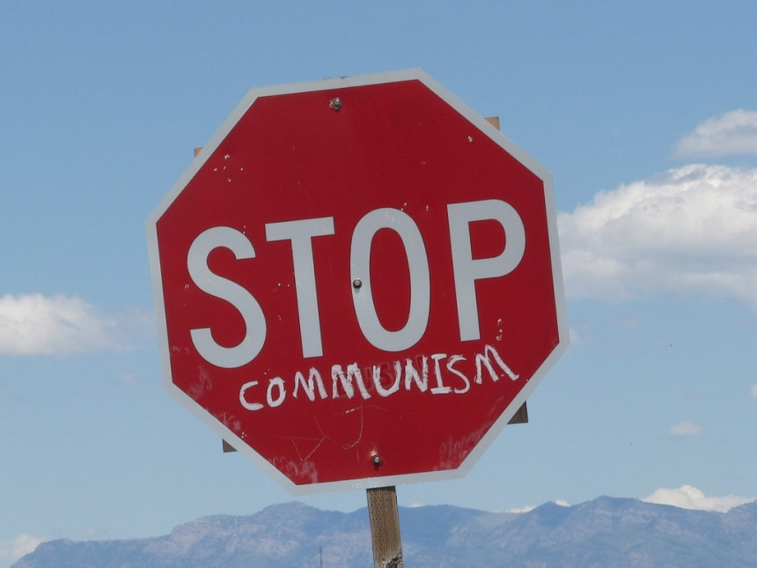
Revolts against Weimar
Neither Ebert nor Groener liked the other; Ebert had criticised the army’s actions during the war. Groener was suspicious of Ebert’s political party.
However both were united in their desire to stop a Communist revolution taking over Germany.

Slide 11
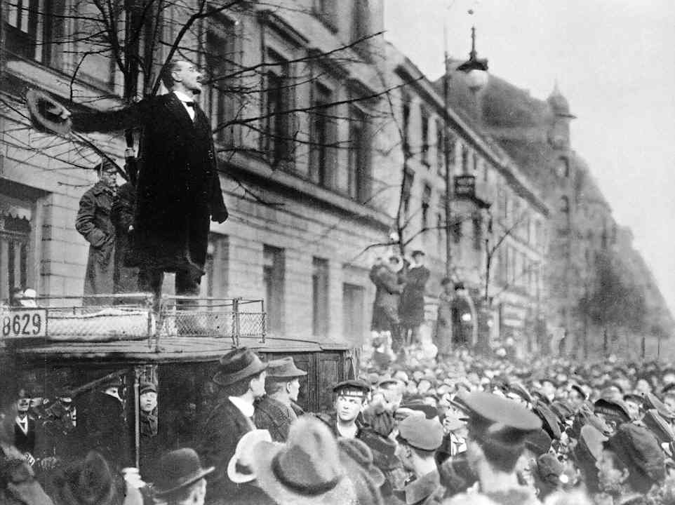
Revolts against Weimar
In January 1919 100,000 workers staged a demonstration in Berlin, to complain about the poverty and poor working conditions that they faced.
The Spartacists (and other Communist groups) joined the protest, and it soon turned violent.

Slide 12
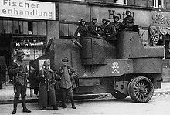
Revolts against Weimar
The German Army was sent in to tackle the Spartacists and end the revolt.
They used a group of former soldiers called the Freikorps.
This group were known for their violence, and blamed Communist groups for Germany’s defeat in World War One.

Slide 13
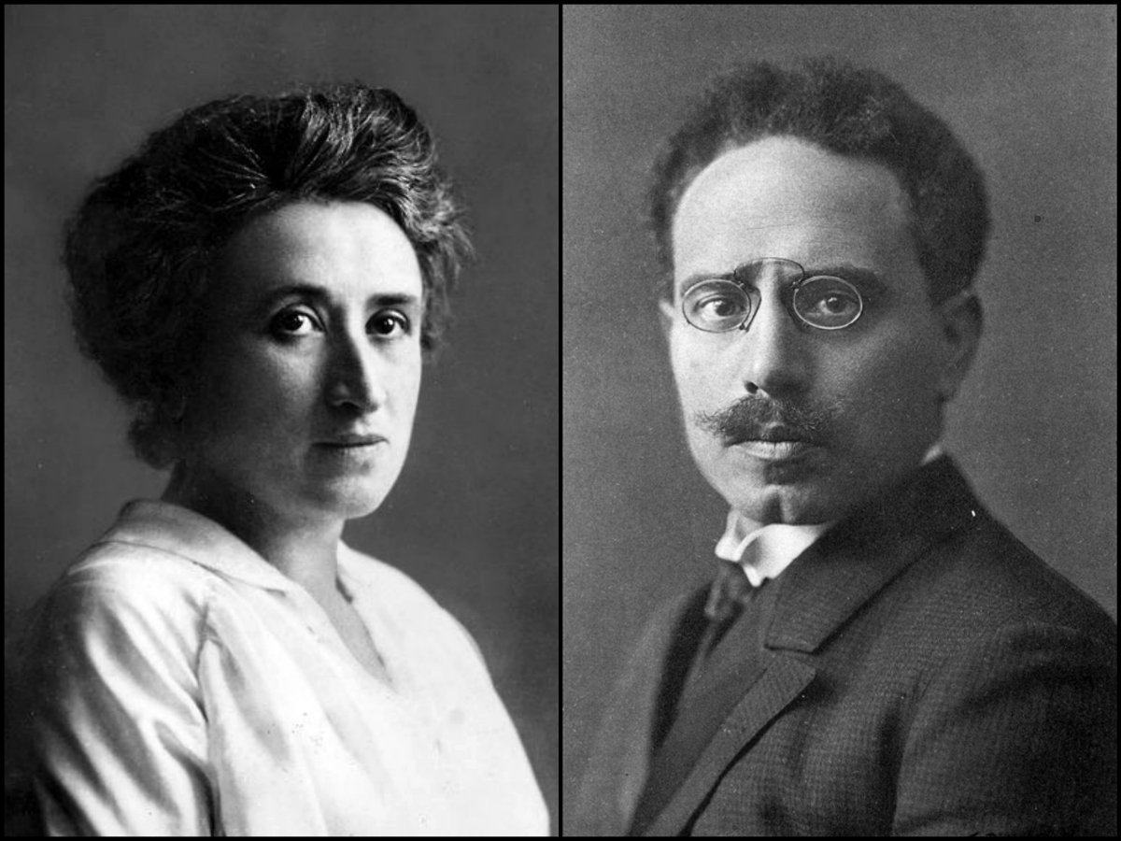
Revolts against Weimar
During a ‘Bloody week’ of violence, hundreds of protestors were killed, including Spartacist leaders Karl Liebknecht and Rosa Luxemburg.
The Spartacist Revolt came to an end, an action supported by most people in Germany.

Slide 14
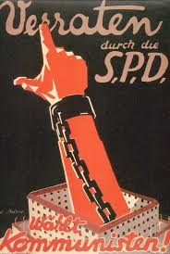
Revolts against Weimar
The SPD’s decision to use the Freikorps would later help Hitler gain power.
This is because the Communists refused to ever again work with the SPD, a division that limited possible obstacles to the Nazis taking control in Germany.
1919 Communist poster:
“Betrayed by the SPD”

Slide 15
Revolts against Weimar
Right-wing revolts
The Munich Putsch

Slide 16
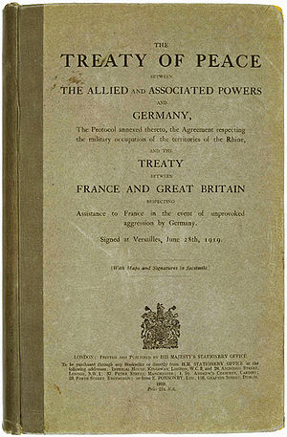
Revolts against Weimar
Many people in Germany were unhappy with events since 1918. They were angry with issues such as:
Germany’s surrender in World War One
The impact of the Treaty of Versailles
The effects of economic problems

Slide 17
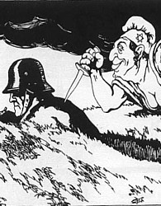
Revolts against Weimar
These Germans blamed different groups for this: Jews, Communists, and above all else, the Weimar government.
These right-wing and nationalist Germans wanted to remove from power the ‘traitors’ who ‘stabbed Germany in the back’.

Slide 18
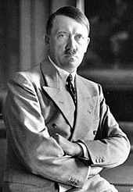
Revolts against Weimar
One group was the German Workers’ Party.
Adolf Hitler was a German army worker sent to spy on this small political party.
Instead Hitler joined and later became leader of the party, changing its name to National Socialist German Workers’ Party.

Slide 19
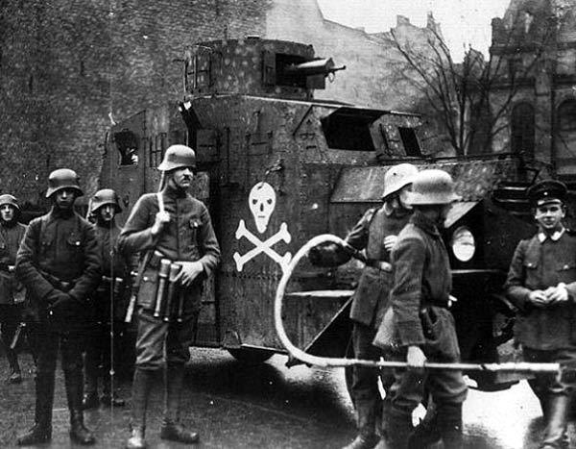
Revolts against Weimar
Hitler was a powerful speaker and he soon began to win supporters.
Hitler used these new members – including members of the Freikorps – as part of a plan to violently overthrow the Weimar government.

Slide 20
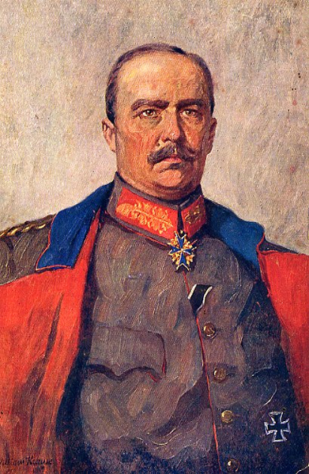
Revolts against Weimar
Hitler had powerful supporters too, including politician Gustav von Kahr and Bavarian army leader Otto von Lossow.
Germany’s wartime leader – and national hero - Erich von Ludendorff was also a backer of Hitler and the Nazis.

Slide 21
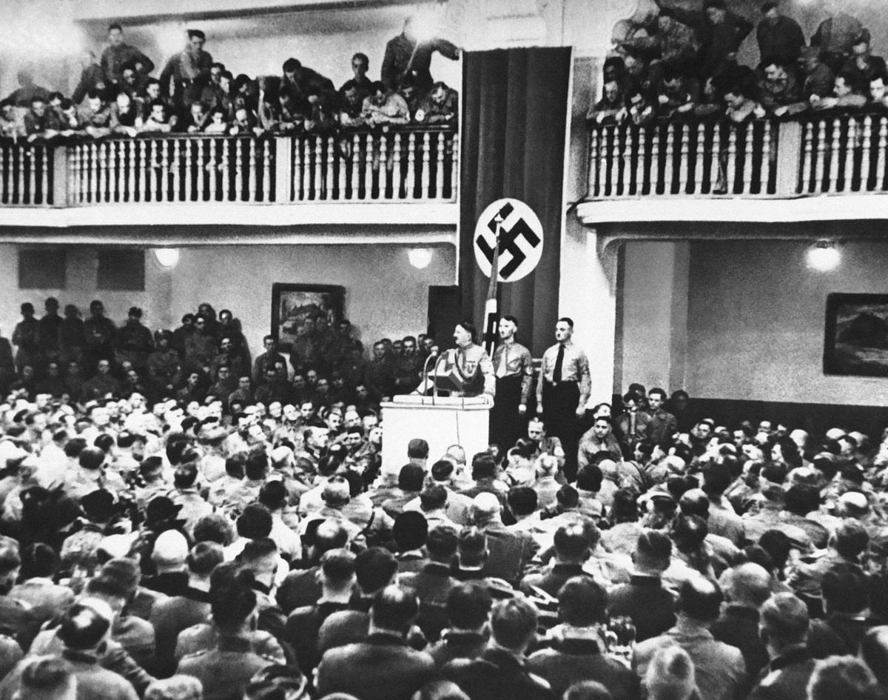
Revolts against Weimar
On 8 November 1923, Hitler led a group of 600 men to a Beer Hall in Munich where Karr and Lossow were holding a meeting.
They stormed the meeting, surrounding the room, and Hitler took the stage with a gun. He said ‘the National Revolution has begun’.

Slide 22
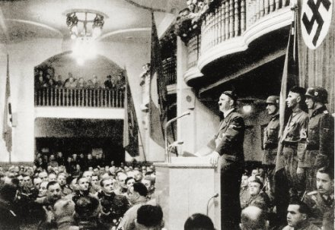
Revolts against Weimar
Karr and Lossow refused to back Hitler.
Hitler then brought them and Ludendorff onto the stage to make it look like they supported him.
Eventually Karr and Lossow managed to get out of the hall. They blamed Hitler for organising the rebellion

Slide 23
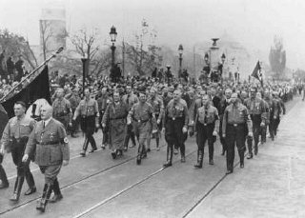
Revolts against Weimar
Hitler then led his men on a march to the centre of Munich, to try and win public support.
The Bavarian Army and police force was sent to end the revolt. There was a shoot out between the two groups, with Nazis and police officers being killed.

Slide 24
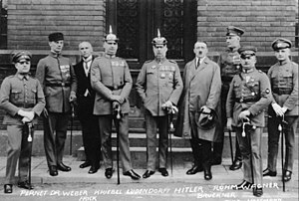
Revolts against Weimar
Hitler was injured during the failed Putsch. After the revolt he was arrested and put on trial (along with other leaders).
Hitler used his court appearances to build a national profile. Each day he gave passionate speeches that were reported in German newspapers.

Slide 25
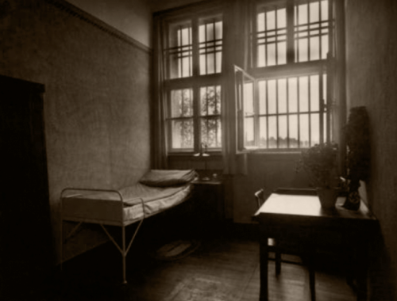
Revolts against Weimar
Hitler was found guilty but sentenced to only five years in Landsberg Prison and served only nine months.
This was a hugely lenient sentence (especially compared to Spartacist leaders). Many powerful Germans sympathised with Hitler’s views.

