Slide 1
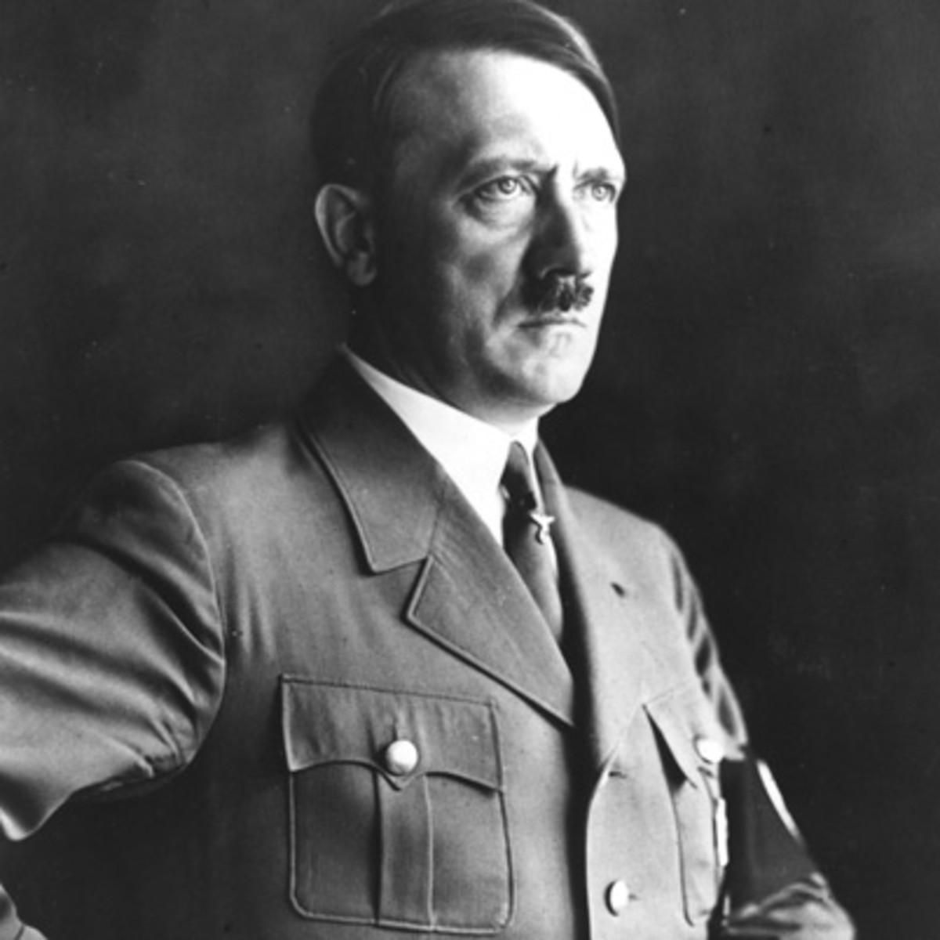
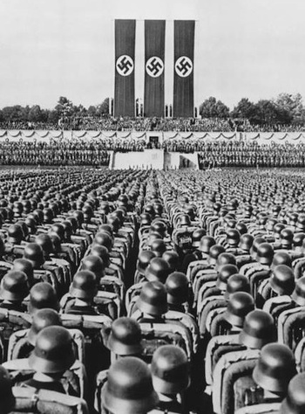
Hitler and Nazi Germany
The
Weimar Republic

Slide 2
The Weimar Republic
In today’s class, I am learning to:
Describe key features of the new Weimar Constitution
Explain why the new Weimar Republic faced problems

Slide 3
The Weimar Republic
After the end of World War One, a different type of German government was needed. This new system was known as the Weimar Republic.

Slide 4
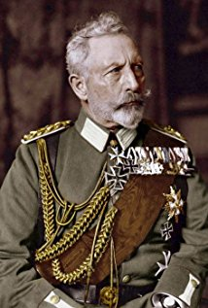
The Weimar Republic
After the Kaiser’s abdication, Germany needed a new system of government.
A group of experts and politicians met in the German town of Weimar. Here they designed a proposed new constitution for the country.

Slide 5
The Weimar Republic
The new constitution was split into two parts:
Part 1 – dealt with Germany’s system of government
Part 2 – dealt with the civil rights that all Germans would have
It was formally introduced in August 1919.

Slide 6
The Weimar Republic
Weimar Constitution
Part 1 – Government

Slide 7
The Weimar Republic
Part 1 – Government
The first part of the Constitution described how Germany’s government was to be run.
The country would now be a Republic (without a monarchy), meaning the people would vote for their government.

Slide 8
The Weimar Republic
All Germans (men and women) who were age 20+ had the right to vote to choose members of the Reichstag (national parliament).
People aged 35+ were also able to vote for the country‘s President (every seven years).

Slide 9
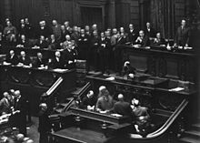
The Weimar Republic
The Reichstag
The Reichstag had the power to pass laws and decide how money would be spent
It could remove members of the government (such as the Chancellor) from their jobs

Slide 10
The Weimar Republic
Reichstag elections
Elected using a system known as proportional representation (PR)
This meant that parties got Reichstag members based on the number of votes they got
PR helped smaller parties get elected

Slide 11
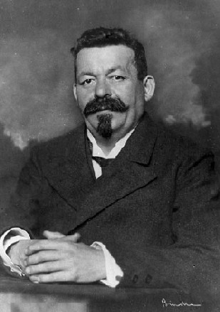
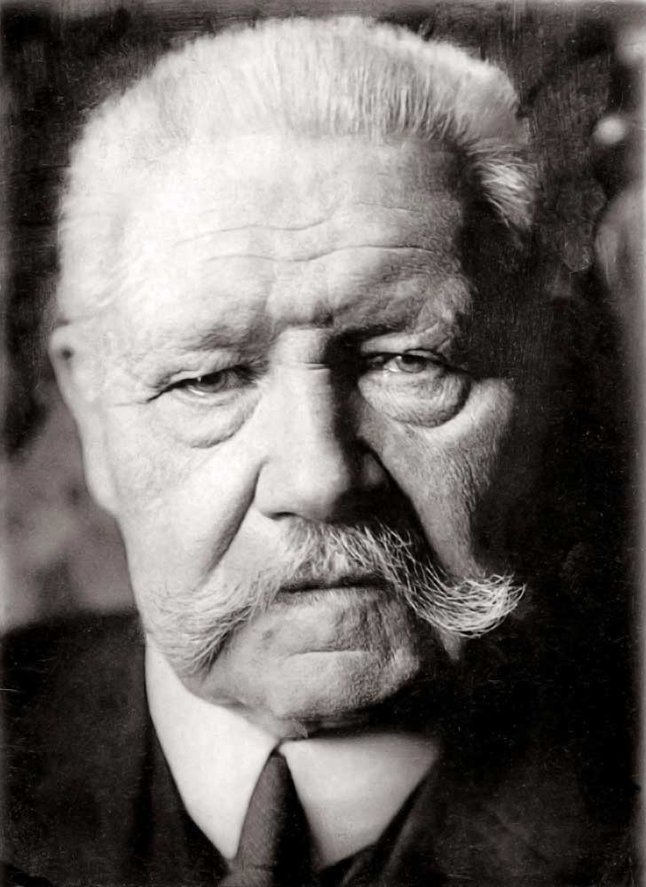
The Weimar Republic
The President
Had the power to appoint members of the government (such as the Chancellor)
Could dissolve the Reichstag and call new elections
Article 48 – could pass laws in an emergency

Slide 12
The Weimar Republic
Weimar Constitution
Part 2 – Civil rights

Slide 13
The Weimar Republic
Part 2 – Civil rights
The second part of the Constitution described all of the various rights that were to be given to Germans.
As well as being able to vote, Germans were free to choose their own religion (or none), without any government action.

Slide 14
The Weimar Republic
Germans had free speech, including the right to protest and criticise their government.
They could also choose to join or set up any group (as long as that group does not break criminal law).
Germans were also entitled to privacy.

Slide 15
The Weimar Republic
Germans were required to attend primary school, although free education was available up until the age of 18.
All Germans were to be treated equally, regardless of their gender. This included in jobs such as the civil service.

Slide 16
The Weimar Republic
Weimar Constitution
A real democracy?

Slide 17
The Weimar Republic
The Weimar system of government was very different from life under the Kaiser.
Some people said it was a genuine democracy, although others disagreed.
Either way, Weimar faced various problems due to the Constitution.

Slide 18
The Weimar Republic
Democracy? Yes
All Germans given an equal vote
Reichstag and President both elected
Small parties elected, meaning more voices heard
Various rights guaranteed in law

Slide 19
The Weimar Republic
Democracy? No
Voting rights not completely equal (age)
Government appointed by President, not elected by the people
President could pass laws without Reichstag support (in an emergency)

Slide 20
The Weimar Republic
One problem with the system was that using PR for elections meant that no-one ever won a majority.
This led to coalitions, and they often fell apart because they could not agree on what to do so. Germans were very frustrated by this.

Slide 21
The Weimar Republic
Making it easier for smaller parties to get elected was democratic – but it also meant that extremist parties were more likely to be represented.
This meant that groups like the Nazis – with only a small support – could begin to build a national profile.

Slide 22
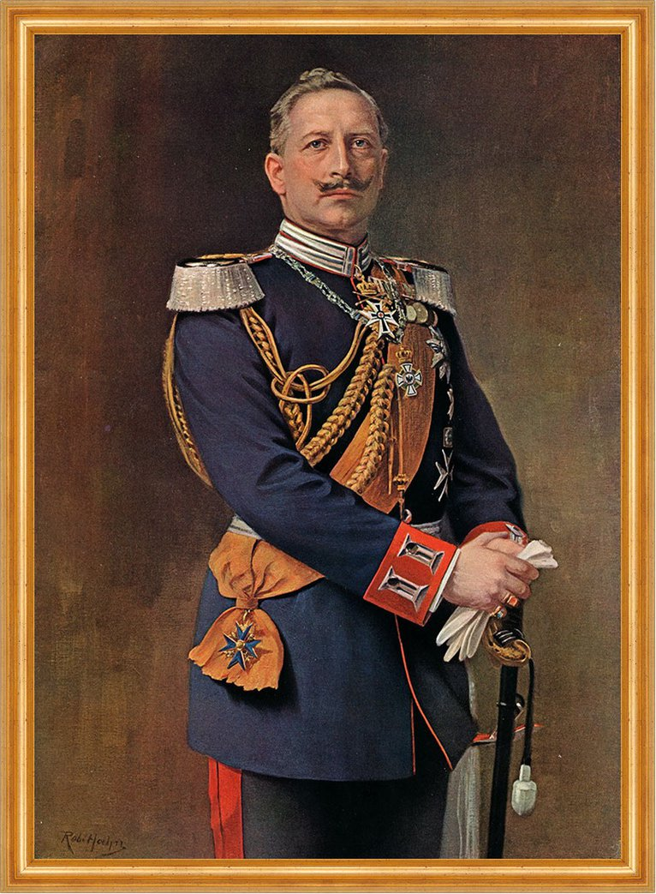
The Weimar Republic
Many Germans did not trust the new democratic system.
Some of them blamed the Weimar Republic for war defeat and signing the Treaty of Versailles.
Others wanted the return of the Kaiser, whilst others did not think they had enough power.

