Slide 1
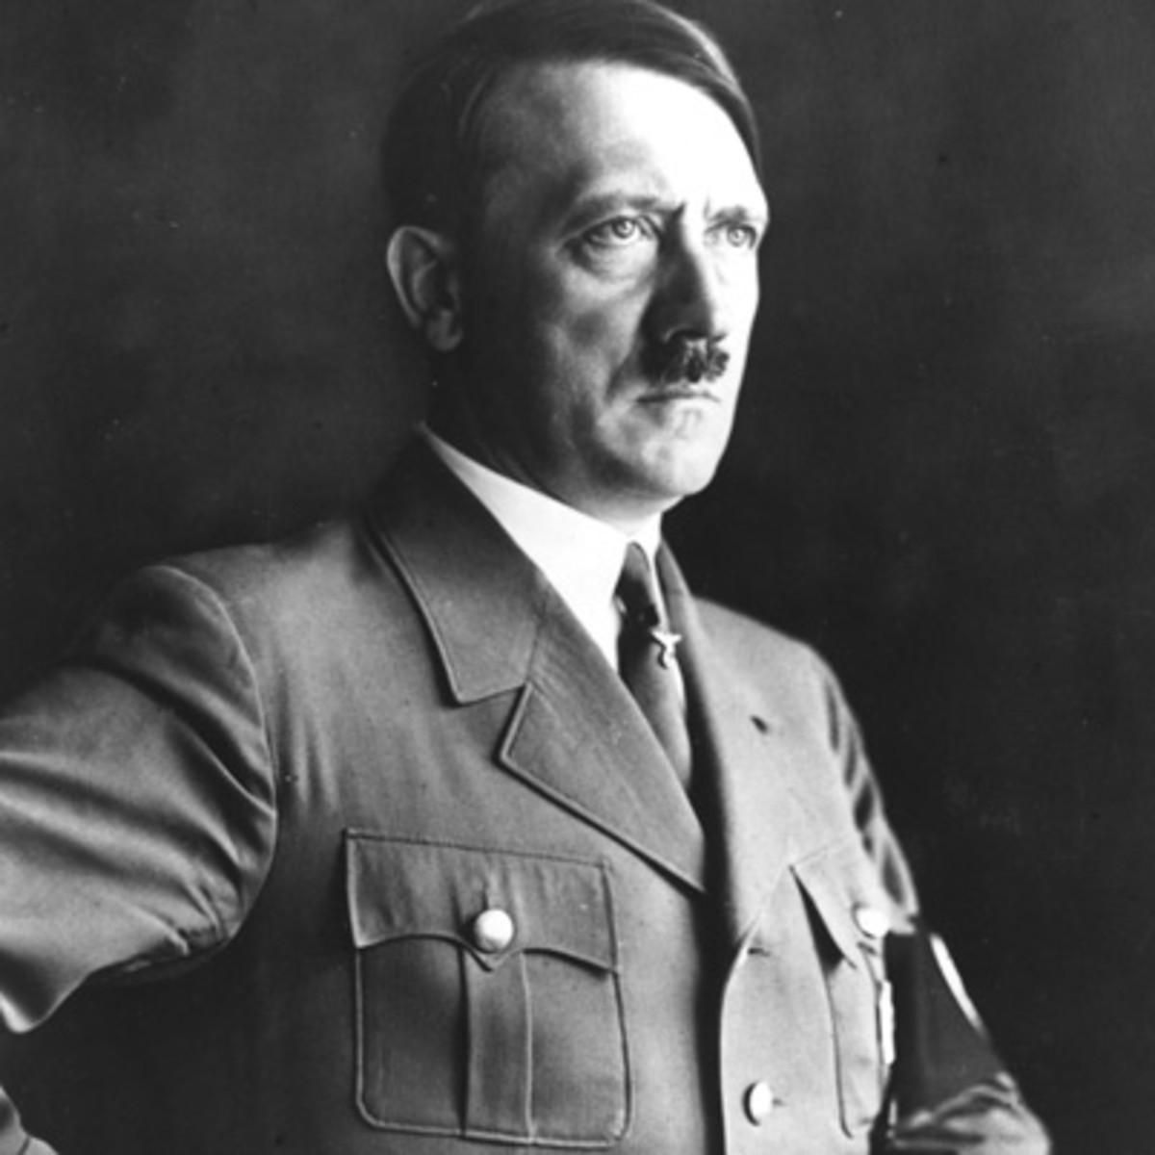
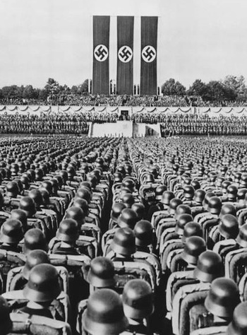
Hitler and Nazi Germany
The
Treaty of Versailles

Slide 2
The Treaty of Versailles
In today’s class, I am learning to:
Describe the conditions included in the Treaty of Versailles
Explain why Germans were opposed to the Treaty

Slide 3
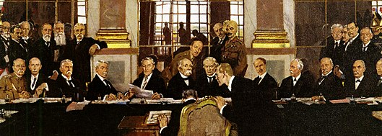
The Treaty of Versailles
Germany’s November 1918 surrender was only a temporary agreement – a more formal deal was needed to officially end the war.

Slide 4
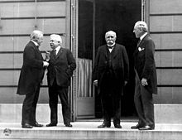
The Treaty of Versailles
In January 1919, the winning sides began a Peace Conference in Paris.
This involved the sides meeting to discuss what punishments they intended to inflict on Germany.
Germany was not a part of these discussions.

Slide 5
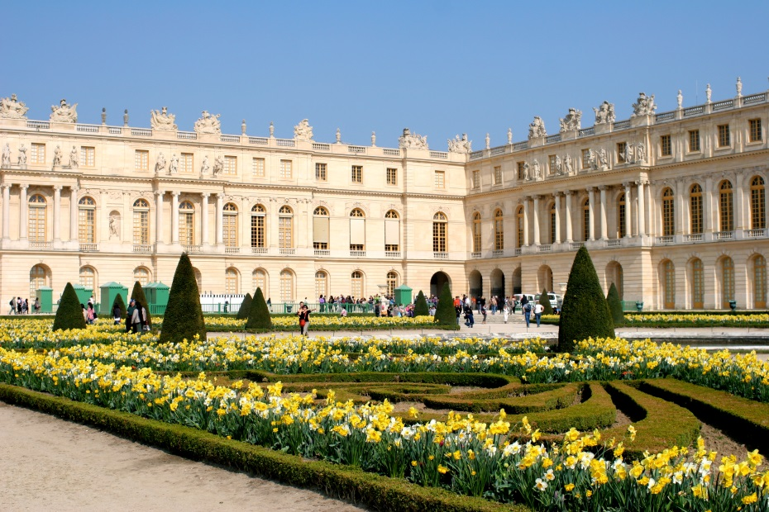
The Treaty of Versailles
A final deal was agreed by June 1919.
This agreement – signed at Versailles Palace in Paris – became known as the Treaty of Versailles.
Germany was forced to sign the deal – or face the prospect of the war being restarted.

Slide 6
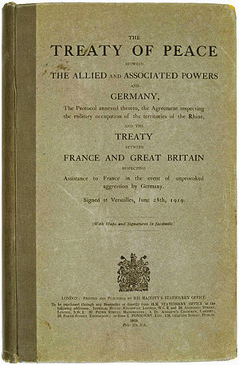
The Treaty of Versailles
The final treaty included 440 articles, outlining various punishments for Germany. These covered:
Germany’s military
German territory/land
Blame for the war
The costs of war

Slide 7
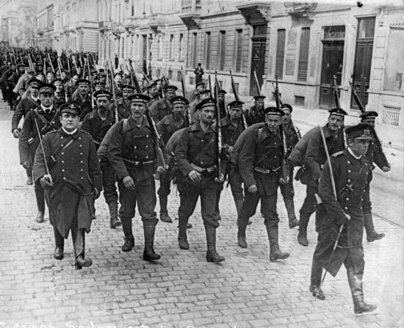
The Treaty of Versailles
German military
Germany’s army was limited to only 100,000 soldiers
Army conscription was banned in Germany
Germany was not allowed submarines or an air force
Size of navy was limited

Slide 8
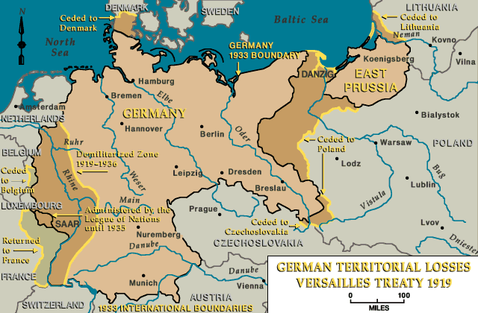
The Treaty of Versailles
German territory
The Alsace-Lorraine area was given to France
Germany was divided to create the Polish Corridor
The Sudetenland was given to Czechoslovakia
Germany also lost all of their overseas territories

Slide 9
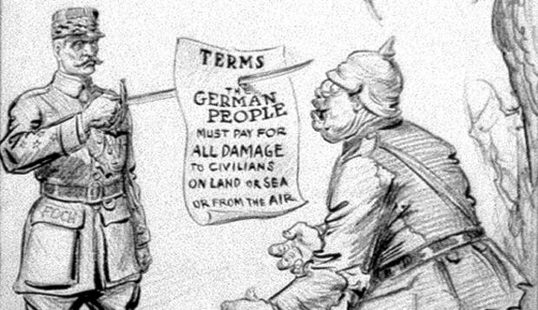
The Treaty of Versailles
Blame for the war
One of the most controversial sections of the Treaty was Article 231.
The so-called ‘War guilt clause’ forced to officially accept the blame for starting the war, and any subsequent problems it caused.

Slide 10
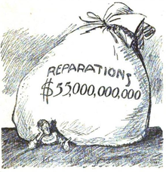
The Treaty of Versailles
Costs of war
As Germany was forced to accept blame for starting the war, it had to pay the full costs of war.
This involved paying reparations to the winning countries – a figure that was initially set at 132 billion gold marks.

Slide 11
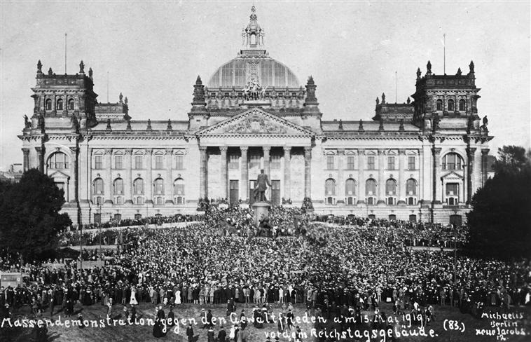
The Treaty of Versailles
Germans were outraged at the conditions of the Treaty and called it a ‘diktat’, meaning they were being forced to accept it.
They were angry for different reasons, including military concerns, the loss of land and also the costs of defeat.

Slide 12
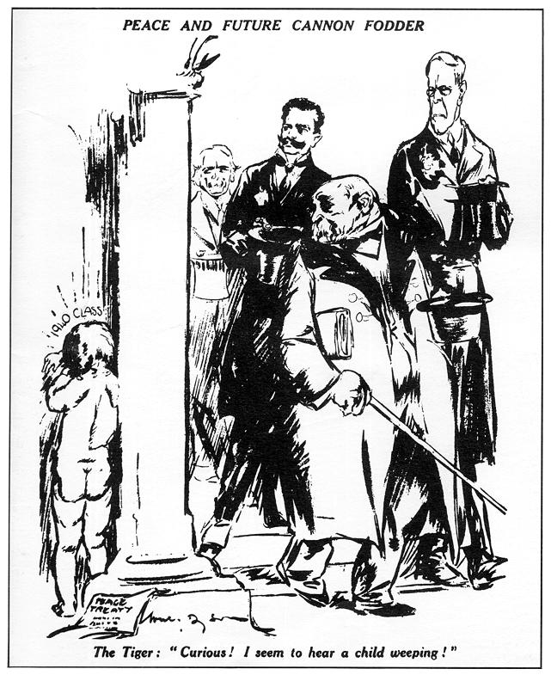
The Treaty of Versailles
General concerns
Germans were angry because they had been forced to accept the Treaty, without any chance to negotiate.
Many Germans felt they were being unfairly punished for the actions of their leaders.

Slide 13
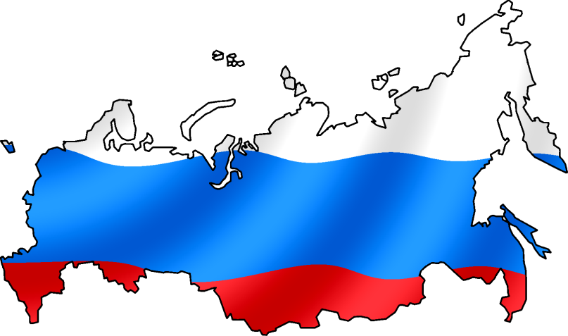
The Treaty of Versailles
Military worries
Many Germans were worried that their weakened military left them open to attack from countries such as France or Russia.
They also felt humiliated by being forced to accept a smaller military.

Slide 14
The Treaty of Versailles
Blame for war
Most Germans did not believe that their country was solely responsible for the war taking place.
They were therefore very angry at the idea they should accept official responsibility for this.

Slide 15
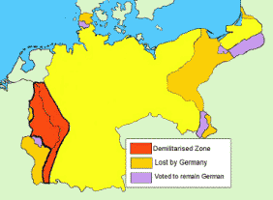
The Treaty of Versailles
Territory
Germans were angry that land they believed was rightly German had been taken. The loss of land made it harder to rebuild their economy.
Germans living in these areas were also furious and confused at being forced to accept a change of country.

Slide 16
The Treaty of Versailles
War costs
Germans did not want to have to pay the full costs of the war, especially if they believed the war was not their fault.
This was made worse by ongoing poverty problems in Germany, who had to pay their own war costs.

Slide 17
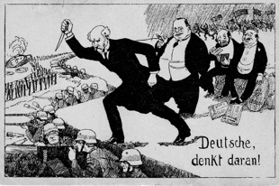
The Treaty of Versailles
As a result of signing the Treaty, the new German government became very unpopular with many Germans.
They complained about the November Criminals, who had “stabbed them in the back”. Hitler would later exploit these views.

