Slide 1
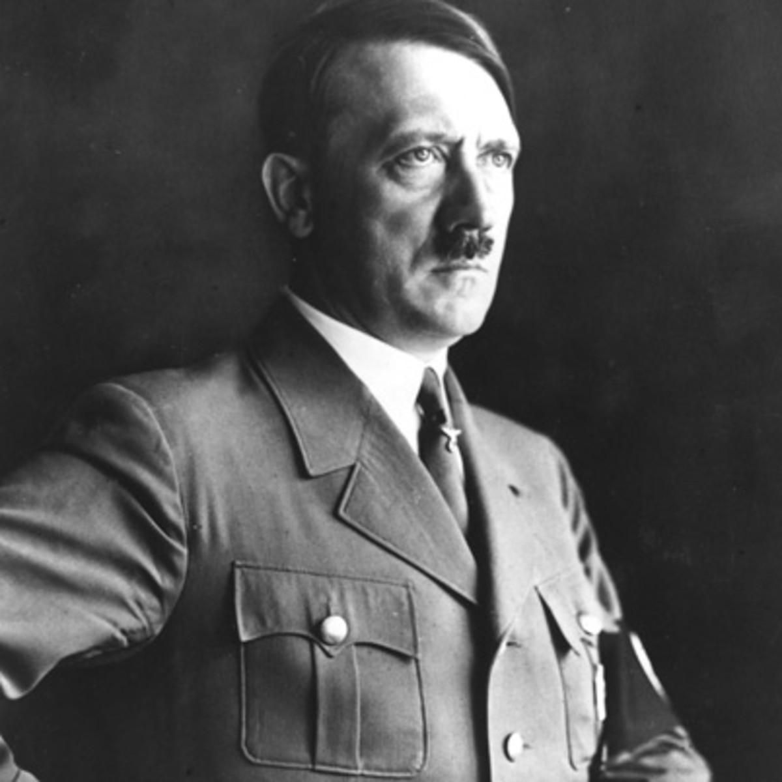
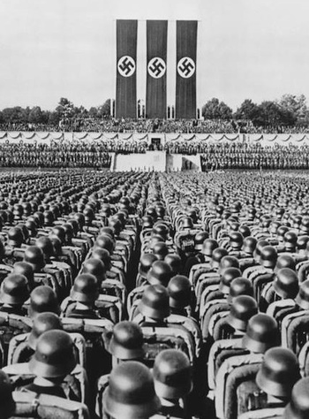
Hitler and Nazi Germany
The end of World War One

Slide 2
The end of World War One
In today’s class, I am learning to:
Describe events at the end of World War One
Describe how Germany was affected by these events

Slide 3
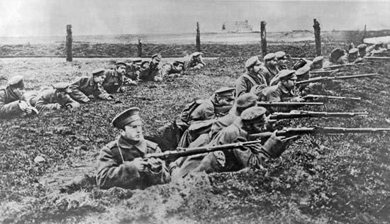
The end of World War One
World War One lasted from 1914-1918. It profoundly changed Europe and Germany’s loss had an especially big effect on the country.

Slide 4
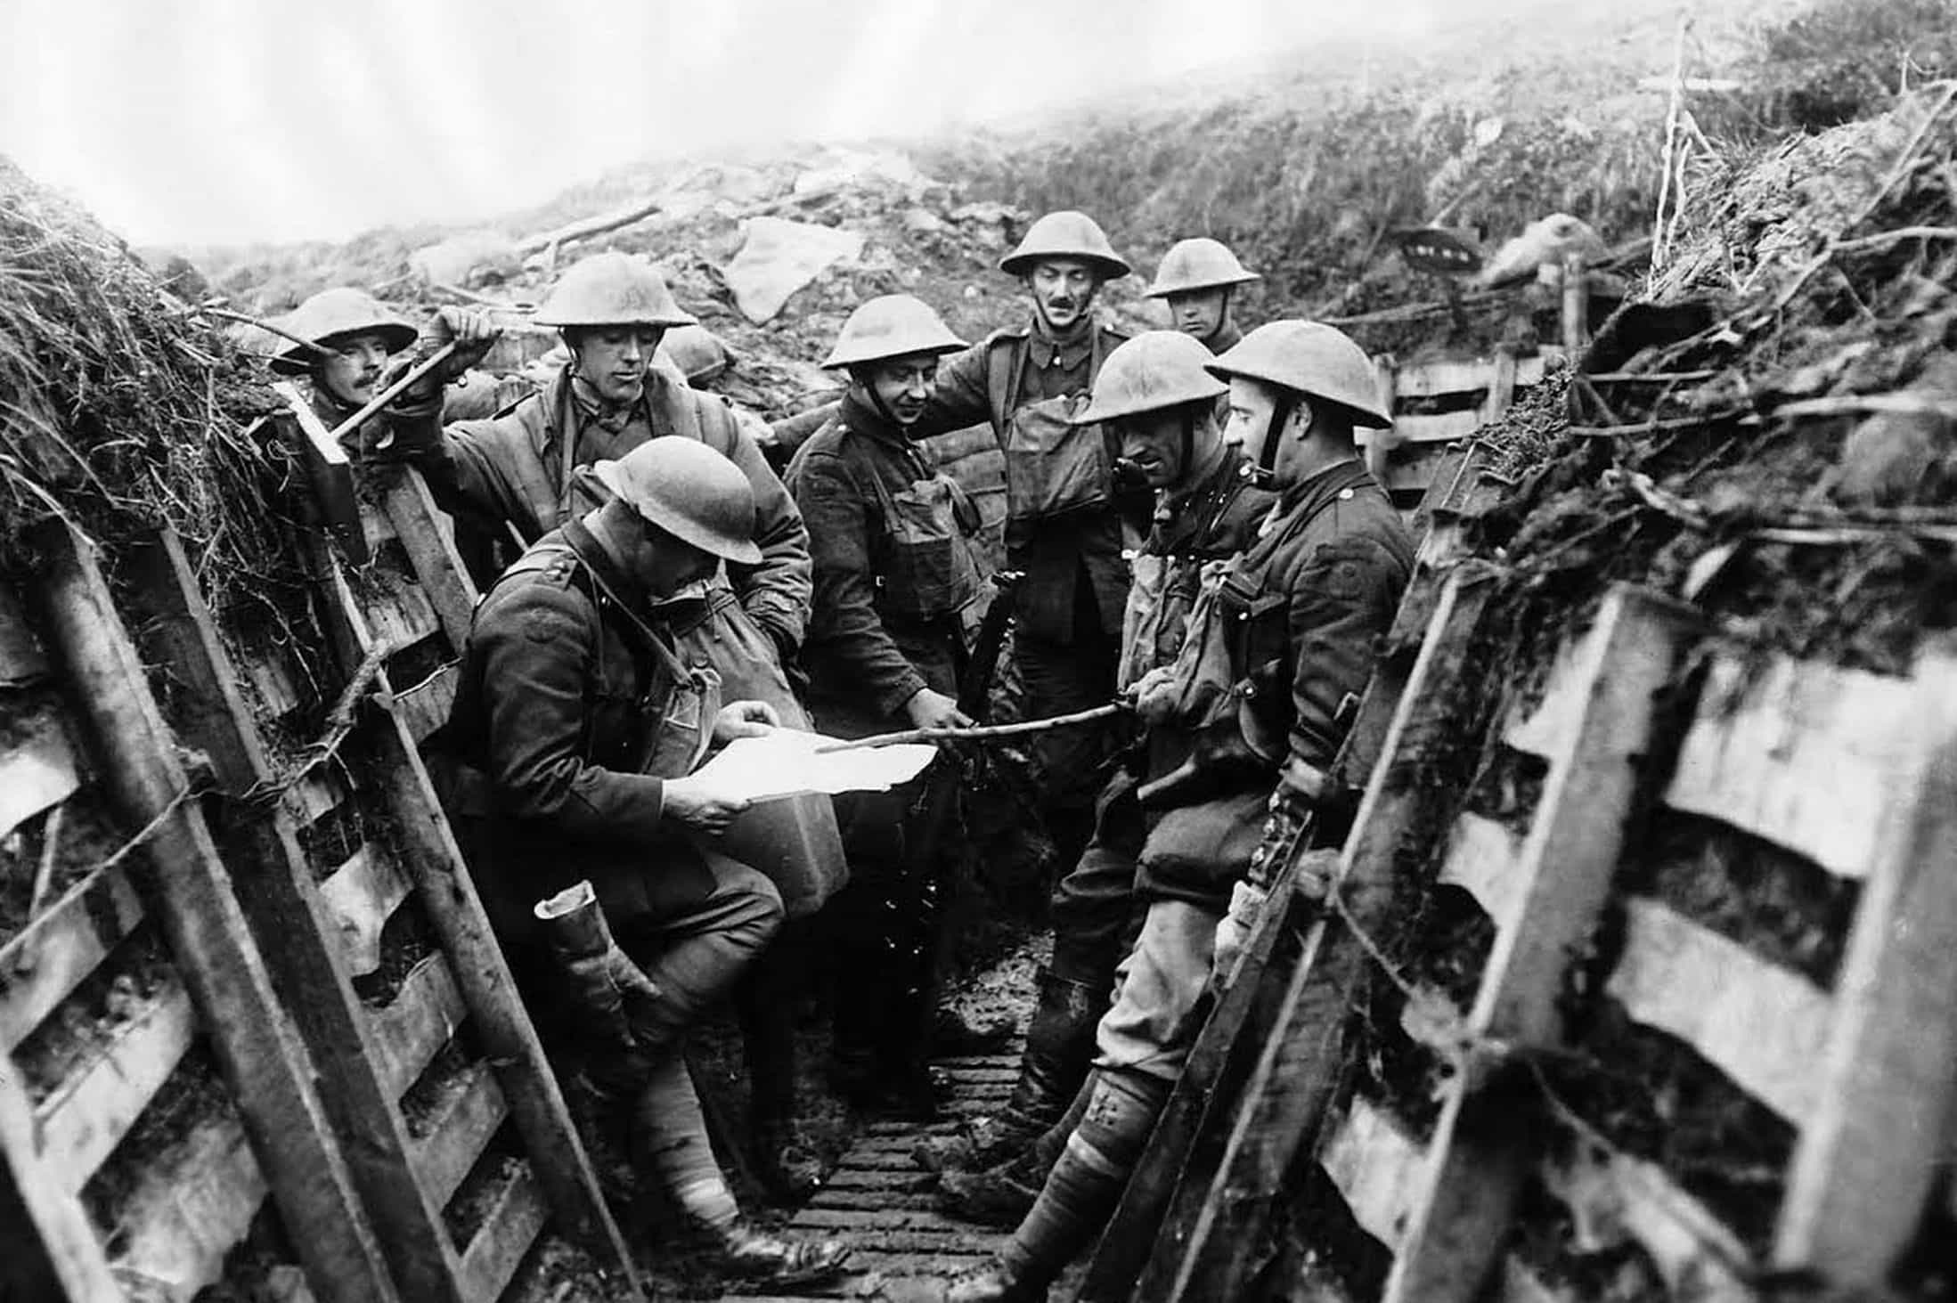
The end of World War One
When the war started it was expected to not last long and be ‘over by Christmas’.
However instead the battles lasted longer than predicted, and they led to the deaths of millions of people and the suffering of many others.

Slide 5
The end of World War One
Some Germans believed that a peace deal should be agreed, but others wanted to fight on until they achieved victory.
Many people faced extreme poverty in the war years. Winter 1917 was known as the ‘turnip winter’ due to a lack of food.

Slide 6
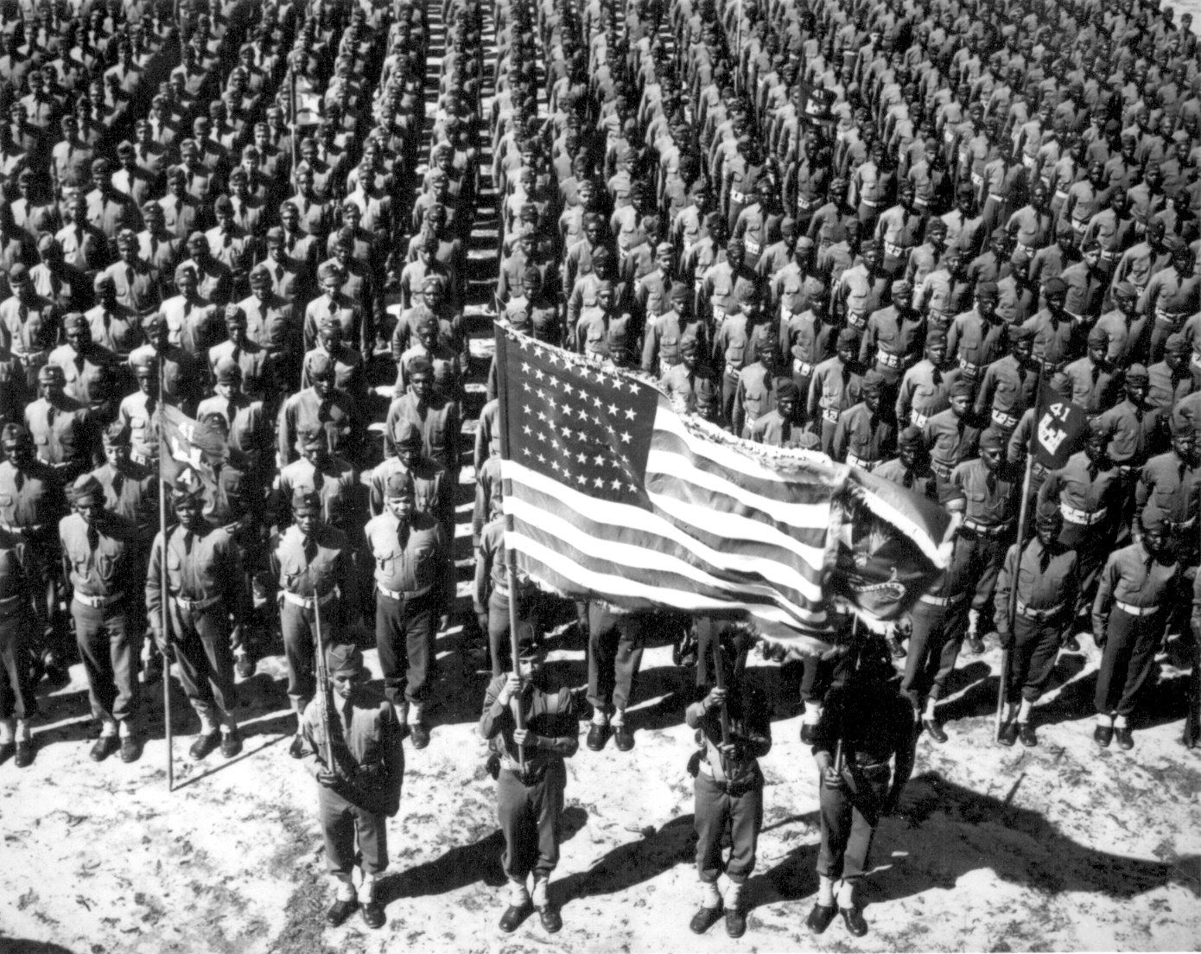
The end of World War One
By 1918 it was becoming likely that Germany would lose the war.
Although Russia had stopped fighting (and agreed a peace deal with Germany), the USA had entered the war.
The USA’s strengths would be hard to beat.

Slide 7
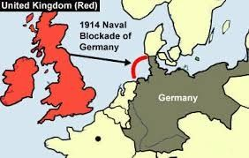
The end of World War One
Britain’s naval blockade of Germany had starved the country of food and other resources. This led to the public protests.
Some navy sailors also mutinied (refused to follow orders) because they believed it would lead to their certain deaths.

Slide 8
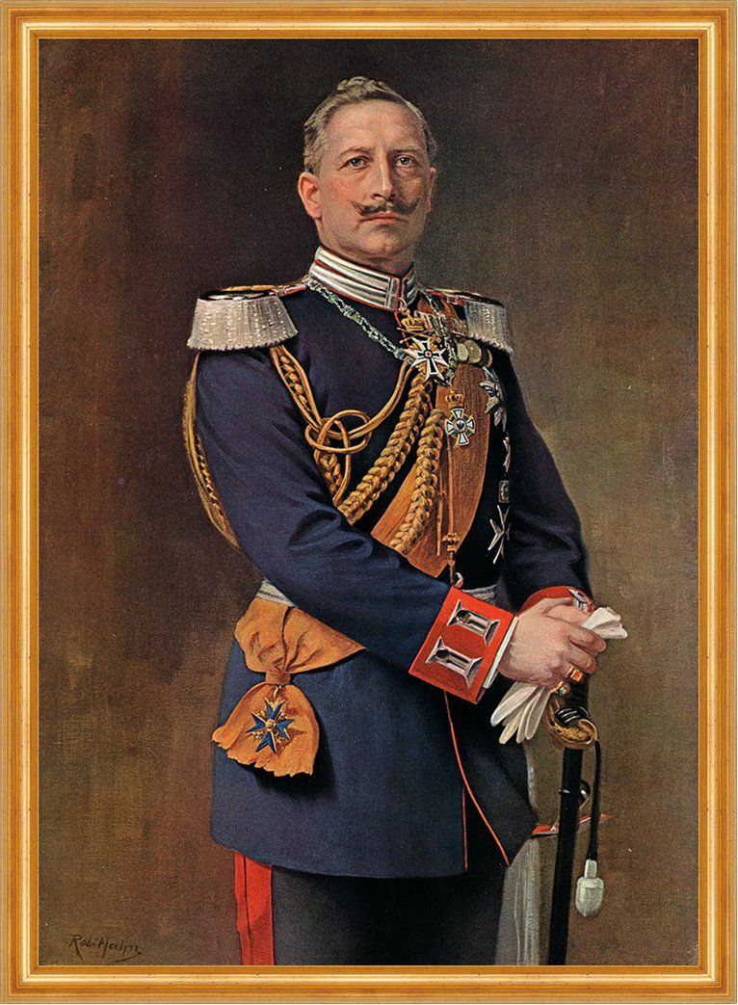
The end of World War One
Germany’s leader – Kaiser Wilhelm II – at first passed some power to the German Reichstag (Parliament).
This failed to stop public protests so eventually the Kaiser abdicated (gave up power). This left Germany without an organised government.

Slide 9
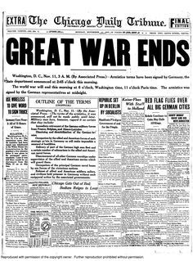
The end of World War One
Germany surrendered on 11 November 1918.
Across Germany arguments and protests took place to decide the country’s future.
Some people wanted a Communist/Soviet type of government, but many opposed this and wanted less extreme changes.

Slide 10
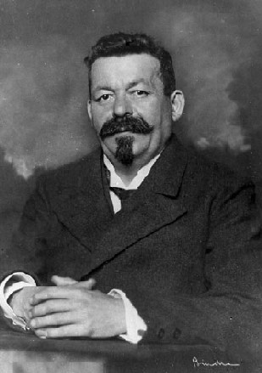
The end of World War One
Eventually a civilian government – led by Friedrich Ebert – was formed.
Ebert opposed a Communist takeover and reached secret deals with the German military to stop attempts to overthrow the new government.

Slide 11
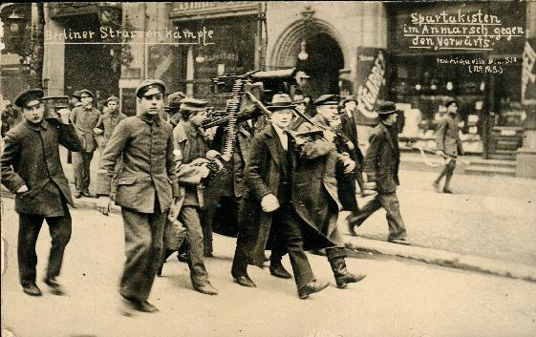
The end of World War One
Ebert’s government faced challenges from left-wing groups that tried to overthrow them.
These attempts were defeated and eventually the new German government brought forward plans to introduce a new political system in Germany.

Slide 12
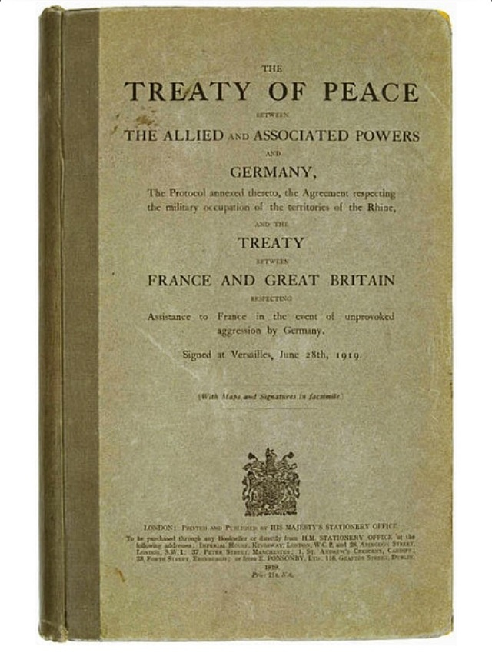
The end of World War One
November 1918 was only a temporary end to the war. In 1919 the Treaty of Versailles was signed, formally ending the war, and giving various punishments to Germany.
These sanctions included a reduced military and paying the costs of war.

