Slide 1
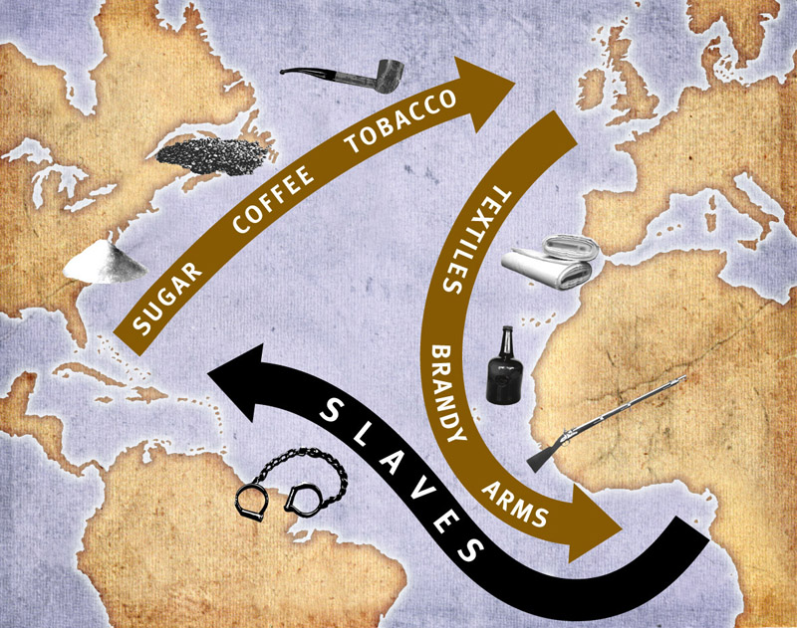
Atlantic
Slave
Trade
1770-
1807

Slide 2
British
Cities and
People

Slide 3
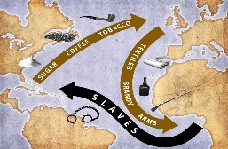
Atlantic Slave Trade 1770-1807
LEARNING INTENTIONS
Describe how British cities benefitted from the Atlantic Slave Trade
Describe examples of British merchants who benefitted from the slave trade

Slide 4
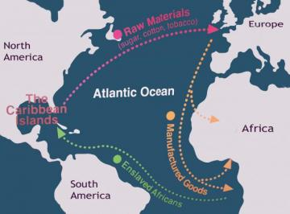
Atlantic Slave Trade 1770-1807
Although slavery took place in the Americas, European countries were at the heart of the trade, including Britain. Many British cities and people became very rich due to slavery.

Slide 5
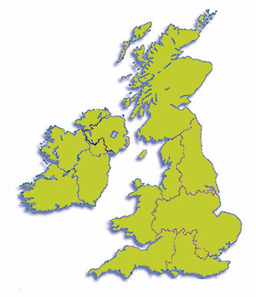
Atlantic Slave Trade 1770-1807
Many different parts of Britain benefitted from slavery, but three cities in particular:
London
Bristol
Liverpool
In Scotland, Glasgow had a role too.

Slide 6
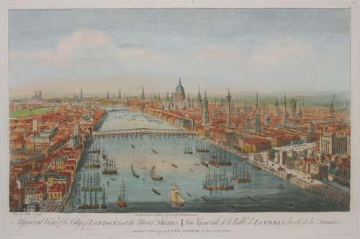
Atlantic Slave Trade 1770-1807
London
For 1663-1698, London was the only British city allowed to trade African slaves.
Even after other cities were allowed to do so too, London continued to be a major port for slave ships.

Slide 7
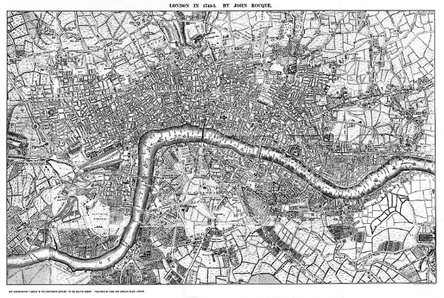
Atlantic Slave Trade 1770-1807
The slave trade also helped people set up businesses in London which still exist today.
Finance organisations such as Lloyd’s, Barclays Bank, Barings Bank and the Bank of England helped provide finance to merchants, or were set up using slave trade money.

Slide 8
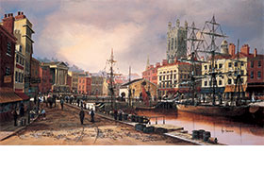
Atlantic Slave Trade 1770-1807
Bristol
Many slave ships left from Bristol. The city also sold products grown by slaves.
Many buildings and industries (sugar-refining, glass making) were set up based on Bristol’s slavery role.

Slide 9
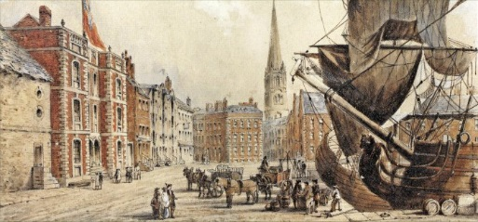
Atlantic Slave Trade 1770-1807
Liverpool
Liverpool was the main British port for slave ships.
As a result it had a huge shipbuilding industry.
Liverpool also sold many of the products that were grown by slaves.

Slide 10
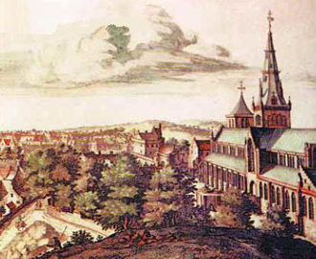
Atlantic Slave Trade 1770-1807
Glasgow
Many of the merchants that built parts of Glasgow did so using money from tobacco and sugar (slave products).
A small number of slave ships also left from the city too, although none after 1766.

Slide 11
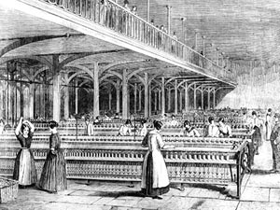
Atlantic Slave Trade 1770-1807
Manchester
Manchester benefitted from the slave trade but did not sell slaves.
A big industry in Manchester was mills that produced cloth. This was largely thanks to cotton from slave colonies.

Slide 12
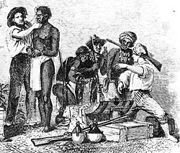
Atlantic Slave Trade 1770-1807
Many British merchants made a great deal of money from the slave trade too.
This was either from directly selling slaves, or from trading in the goods and products that slaves were used to grow.

Slide 13
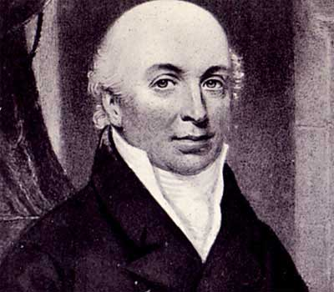
Atlantic Slave Trade 1770-1807
Thomas Leyland
Leyland was Liverpool’s richest man.
He was a small-time merchant but expanded his business to sell slaves.
Leyland fiercely argued against abolishing slavery.

Slide 14
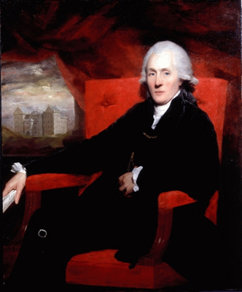
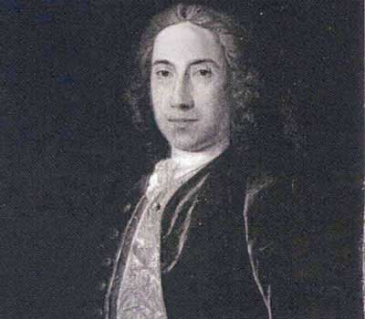
Atlantic Slave Trade 1770-1807
Sir James Stirling of Keir came from Perth. His family owned slave plantations in Jamaica.
Richard Oswald was a Scottish merchant who set up one of the most active slave trading posts in Africa. He owned slave ships too.

