Slide 1

Lesson Five: Labour Under Blair – New Labour and Policy Reform

Slide 2
What you will learn…
Success Criteria – I can…
Describe the transition to “New Labour” under Blair.
Explain the impact of these changes.
Detail specific New Labour policies.
The changes within the Labour Party following Tony Blair’s successful leadership bid.
Specific policy changes that led to the 1997 Landslide victory
Specific policies that contributed to both the rise and then fall of New Labour.

Slide 3

New Labour
The Economy

Slide 4
Background
Labour had long been blamed for the economic woes of the county during the 1970s
The Conservatives quickly became the party of economic credibility and with a booming financial sector replacing old style industry, the country had witnessed a huge upturn in fortunes
Labour had to win back economic credibility before they were ever going to be able to persuade the public to vote them into government again

Slide 5
‘Old’ Labour – Economic Policies
We are going to fit these into two main strands:
1) High taxation - Encouraged a ‘Tax and Spend’ policy in order to redistribute wealth through high taxation and increased government spending
2) Public ownership of state industries - Rejected wholeheartedly privatisation of national industries or private involvement in any government business

Slide 6
So why the change?
Well as we have pointed before, the country had changed.
Old Labour had always promoted the idea of an equality of outcome for people in society.
New Labour would go onto promote the ideas of an equality of opportunity
“Equality of outcome and equality of opportunity.”
In your pairs discuss what you think both of these phrases mean.

Slide 7
So why the change?
Equality of outcomes is really the idea that it is the governments job to reduce inequality by transferring wealth from the richest to the poorest, usually through taxation
Equality of opportunity is much more about government ensuring that everyone has a fair start and fair chance in life. Then after that it is down to the individuals talent and hard work.
New Labour adopted the second idea. This was significant because it meant a move away from their core policy of taxing people highly and redistributing it to the poorer.
Instead they were going to invest hugely in education and health and ensure that everyone had equal opportunities

Slide 8
Changes made by New Labour
Scrapping of Clause IV (4)
Moving away from high tax and spend policies
Increased use of private companies to run public services
Using your phones/laptops, research what Clause IV was in the Labour Party constitution.

Slide 9
Clause IV
This was Labour’s commitment to the government owning and running national industries and formed part of their constitution.
Tony Blair made it a priority to scrap this commitment
This meant that for the first time Labour would be in favour of private companies running industries such as the railways and energy companies
Notes:
https://www.youtube.com/watch?v=pyLVEcbPxi0 - Newsnight

Slide 10
What Impact Did All this Have?
In your notes, write down the evidence that shows that Labour’s new economic policy was working for them in terms of election success.
Notes:
C– bring back clause 4

Slide 11

New Labour: Law and Order

Slide 12
Starter Task:
What is more important, protection of society or protection of people’s individual rights?

Slide 13
Old Labour into New Labour
There is a fine line between freedom of the individual and protection of society
Old Labour certainly rejected state interventions which eroded people’s freedoms, but New Labour were going to take a different tack
Also, Old Labour had traditionally held a more compassionate attitude towards criminality – looking at the sociological influence behind crime, as well as economic factors which may result in criminal tendencies.
They had often sought to explain crime and criminals as ‘victims of Thatcher’
Parts of New Labour’s political philosophy did link crime with social exclusion, but a heavier conservative influence than Old Labour resulted in Blair paving a “Third Way” in relation to crime.
“Tough on crime, tough on the causes of crime”
Tony Blair's Original 1993 Article on Crime
Notes:
https://www.newstatesman.com/2015/12/archive-tony-blair-tough-crime-tough-causes-crime

Slide 14
Why the change?
Labour MPs were hearing a greater number of complaints from their constituents about crime than about benefits, housing and unemployment.
Blair realised that the victims of crime were not just the middle classes.
In fact the opposite, victims were most likely to be people in poorer areas
So what did they actually do?

Slide 15
Do you agree with the following policies or disagree with them in principle?
Anti-Social Behaviour Orders (ASBOs) were introduced by New Labour
Child curfew order – Councils could apply to keep children under 10 off the street at night, later extended to 15 years of age
Crime and Disorder Act 1998 abolished the presumption that children under 14 did not know the difference between right and wrong, leaving England and Wales with a actual age of criminal responsibility of 10 - one of the lowest in the western world
The prison population in 2005 rose to over 76,000, mostly due to the increasing length of sentences, about 20,000 more than it had been

Slide 16
Success
New Labour’s approach yielded massive success, with the party now being seen by the voters as ‘the party of law and order’, topping opinion polls on who could be trusted on crime
However their popularity in this area was not too remain as strong as time wore on.

Slide 17
Anti -Terror Legislation
Blair's stance on crime was really just a morphing of Thatcherism.
The public bought into this to begin with, but trouble was around the corner
After 9/11, Blair sought to introduce a whole range of anti-terror legislation, a lot of which became very unpopular. Proposals included:
  - Detaining terror suspects for 92 days without charge
  - ID cards for every UK citizen
  - Control Orders (House arrest for terror suspects instead of a trial in court)
New Labour were weakened in 2005 when they lost their first ever vote in the Commons (on detention of terror suspects) , which paved the way for further defeats.

Slide 18
Conclusion
New Labour adopted a ‘third way’ approach to crime.
There new ‘tough’ approach to crime, coupled with the traditional sympathetic view of criminals as victims of their circumstances, was hugely popular
Arguably, Blair would not have achieved such a big margin of victory in 1997 without changing Labour’s stance
However his instincts of community protection over individual freedoms started to become his undoing as New Labour were defeated on several occasions over his anti-terror laws, weakening them in the eyes of the public

Slide 19
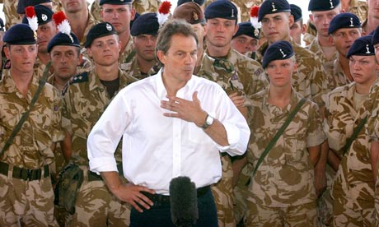
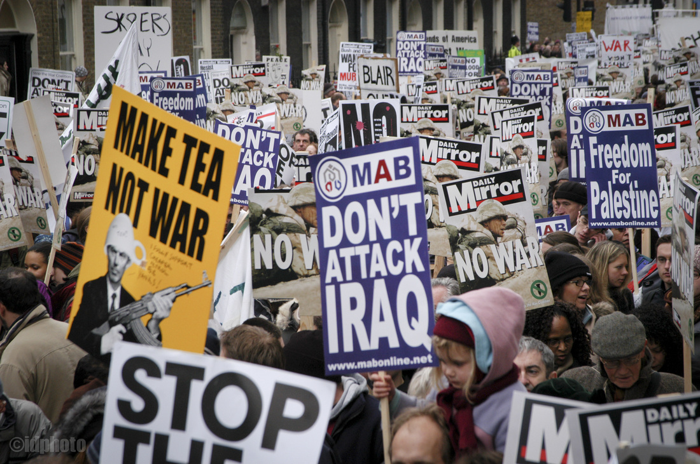
New Labour and the War in Iraq

Slide 20
The distinguished nineteenth century politician Lord Palmerston once said Britain had “no permanent allies - only permanent interests.”
What do you think he meant by this statement?

Slide 21
Foreign Policy
Answer the following questions as you watch the video clip
What did Tony Blair say the question facing the international community was?
What name was given to the type of government New Labour were in relation to foreign policy?
What concept does Jack Straw say we need to put into practice?
What moment turned many people off of New Labour?
How many conflicts did New Labour become involved with?

Slide 22
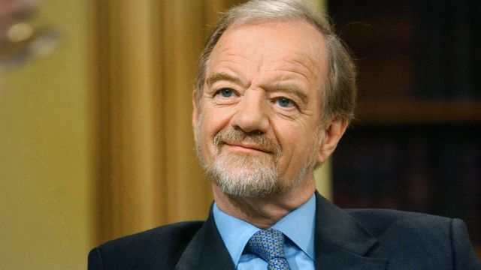
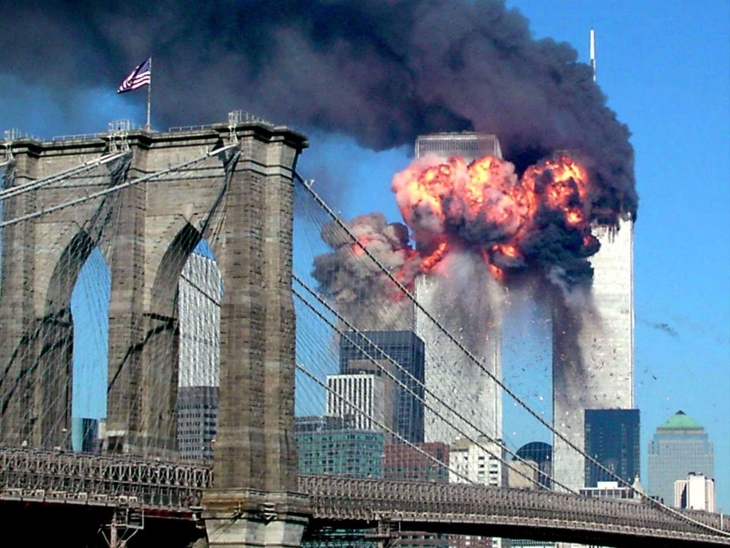
Ethical Foreign Policy
Robin Cook (the first of Tony Blair’s Foreign Secretaries) said Labour would have an ‘ethical’ foreign policy.
Blair’s would go onto to repeat this ideological vision of the UK’s role in the world
"Our foreign policy must have an ethical dimension and must support the demands of other peoples for the democratic rights on which we insist for ourselves," he told assembled journalists.
The Labour government will put human rights at the heart of our foreign policy.“
Then came the events of September 11 2001.

Slide 23
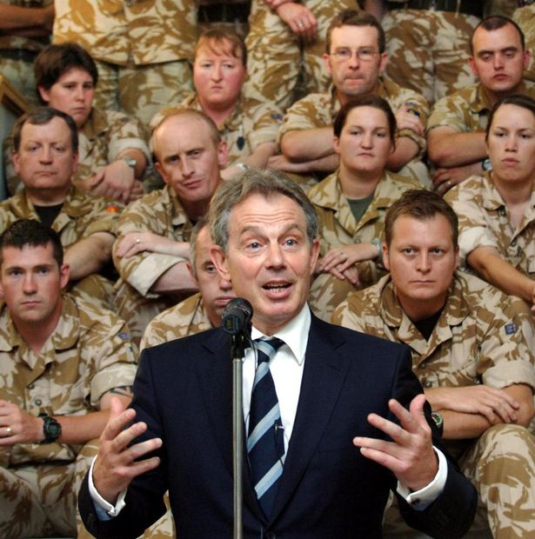
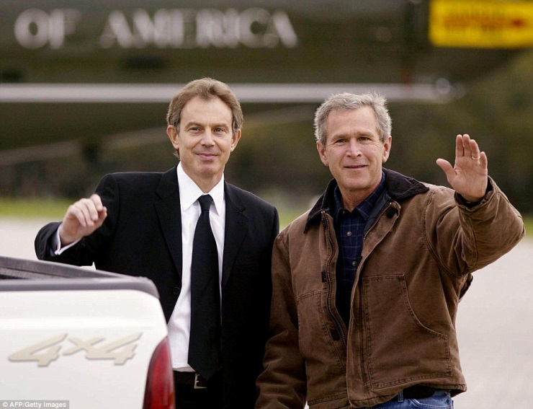
Shortly after 9/11, at the Labour Party's annual conference, the Prime Minister Tony Blair gave what most observers conceded was a barnstorming speech
He pledged international action against the Taliban; but he went further, proclaiming a moral duty to intervene across the world, wherever necessary - in Kosovo or even in Central Africa.
"If Rwanda happened again today, as it did in 1993," he said "when a million people were slaughtered in cold blood, we would have a moral duty to act there also," he declared.
Tony Blair 2001 speech

Slide 24
New Labour
But why did New Labour have such an interventionist strategy?
So they could influence world affairs
Make the world and more secure place
Moral obligation to help
Support for America

Slide 25
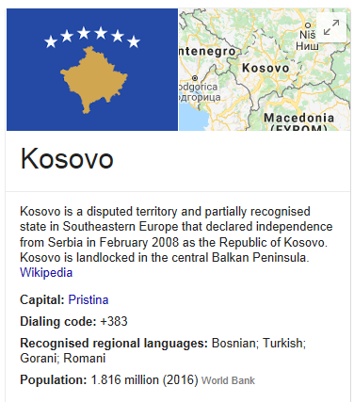
Kosovo
NATO air strikes against Serb forces in Kosovo began in March 1999.
Tony Blair said Britain fully supported the use of military action by NATO*
This was the first time the alliance had ever attacked a sovereign European country.
He said the action was necessary “to prevent Slobodan Milosevic from continuing to perpetrate his vile oppression against the Kosovo Albanian people".
Public supported – little damage done to New Labour.
*In 2000, the UK also intervened in the Civil War in Sierra Leone which did little to harm the UK’s opinion of the Labour Party.
*NATO – North Atlantic Treaty Organisation; the largest military alliance in the world.

Slide 26
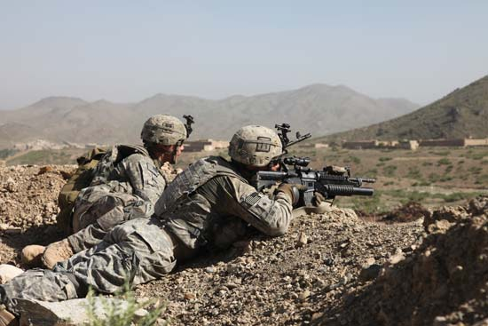
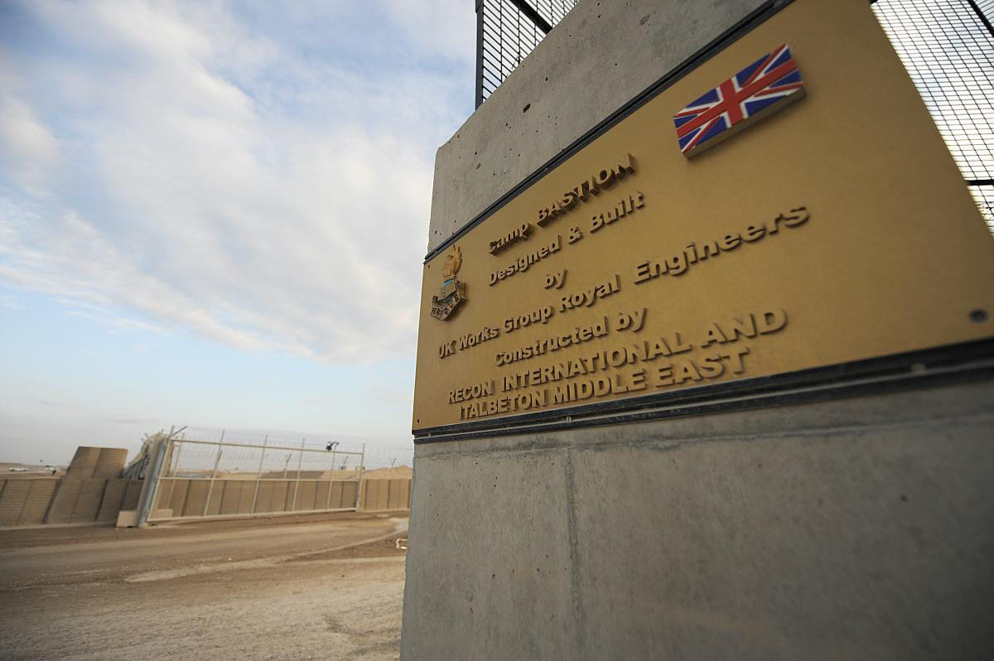
Afghanistan
Response to 9/11 attacks
Invasion was to remove the Taliban from power and remove Al Qaeda from the country
A democracy was to be installed
Labour gained broad support for invasion from the public, although by 2005 support had started to falter as the war dragged on

Slide 27
War in Iraq
The most controversial foreign policy decision in recent UK history
The UK backed a US invasion of Iraq to remove Saddam Hussein based on the premise he had developed WMDs and had the capability to use them
A democracy was to be set up here also
Research
From watching the documentary and through use of the internet, find out:
1) Why were people so against the war in Iraq?
2) Evidence which shows the public punished New Labour at the polls in 2005
https://www.youtube.com/watch?v=Pg9aEV9bcxs

Slide 28
Evidence of how the war in Iraq hurt New Labour
Loss of support of Muslim community
The biggest shift came in Bethnal Green and Bow, the second largest Muslim seat in the country - making up 40% of the population
Respect Party's George Galloway unseated Oona King in this area in 2005
In total, Labour lost 47 seats and around 5.5% of the vote
Lib Dems, the only major party to oppose the war, seen around a 4% increase

Slide 29
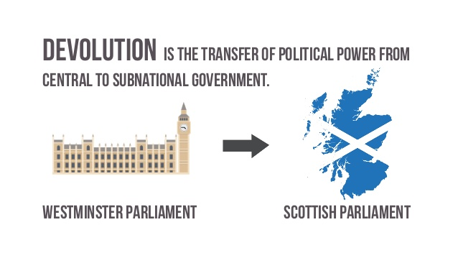
New Labour and Constitutional Reform

Slide 30
Devolution
The feeling was in Scotland after the 1992 election, that the Conservatives did not have Scotland’s best interests at heart
And despite rejecting them at the ballot box in Scotland, the people were still left subject to Conservative rule
In the 1997 election, New Labour promised the Scottish people a referendum on whether they wanted to have their own parliament
The idea behind this was to devolve more power to Scotland
The Conservative party opposed this, saying it would lead to the eventual break up of the UK
The result? Labour increased their vote share by 6% and the Conservatives dropped by around 8%
More significantly, all of the 11 Conservative MPs were ousted, leaving the party with no representation in Scotland

Slide 31
Evaluate the impact of the dominant ideas of a political party on its electoral performance.
Things to evaluate:
Economic decisions
Law and Order
Foreign policy
Devolution
Remember to include an overall conclusion to your essay which should answer the question directly with supporting arguments

Slide 32
Introduction
The dominant ideas of the Labour Party have changed at several points in the parties history. Arguably the most significant change in the dominant ideas of the party was when Tony Blair became the leader of the Labour Party in 1994. On becoming leader of the Labour Party Tony Blair launched ‘New Labour’. A key part of this change in the dominant ideas of the party was Tony Blair’s attempt to move Labour away from being associated with public ownership and nationalised industries and acceptance of free markets and competition. Labour had been out of Government since 1979 therefore Tony Blair believed a significant change in the party’s ideology was required to allow it to appeal to the electorate.

Slide 33
Paragraph Plan
Discuss the change in the dominant ideas of the party – what did Tony Blair change and what the changes were.
Indicate how this impacted upon electoral performance.

Slide 34
Economic decisions
Blair attempted to change the Labour Party’s constitution by scrapping its commitment to nationalisation and public ownership of sections of the economy. Labour held a special conference and Blair succeeded in scrapping the old Clause IV of the Labour constitution and by doing so he sought to change public perceptions of Labour’s economic credibility. Blair knew that the increased social mobility of the British public had changed their perceptions of the economy with a great increase in the number of people considered “middle class”. (K) This change was referred to as New Labour’s Third Way approach and was clearly an attempt to attract middle and aspirational ‘new working class’ voters who Labour needed to appeal to and in the past had been deterred from supporting Labour because of its association with high public spending and inefficient nationalised industries. (E)

Slide 35
Economic decisions
Immediately after the change to Clause IV and the launch of New Labour the party saw an increase in support in opinion polls. Labour then saw itself surpass the Conservatives in public rating on economic competence and this helped secure its landslide victory in 1997. (K) The success of Tony Blair’s vision was symbolised in Labour actually defeating the Conservatives in the C1 category of voters in 1997 — a middle class category — as well as heavily defeating the Conservatives in in the C2 category most usually associated with the ‘new working class’ voters. (E)

Slide 36
Conclusion
Remember to include an overall conclusion to your essay which should answer the question directly with supporting arguments

