Slide 1
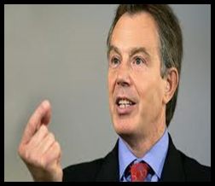

Starter
What do you already know about Tony Blair? | What did Tony Blair and his Labour Party do during their time in Government?
Why could Tony Blair be described as a controversial Prime Minister? | Why do you think when Tony Blair became leader of the Labour Party he wanted to ‘re-brand’ them New Labour?
Things Can Only Get Better
Notes:
https://www.youtube.com/watch?v=dmwqEg-06Ww

Slide 2

Lesson Five: Labour Under Blair – The Birth of New Labour

Slide 3
What you will learn…
Success Criteria – I can…
Describe the transition to “New Labour” under Blair.
Explain the impact of these changes.
Detail the reasons for Blair’s electoral success.
The changes within the Labour Party following Tony Blair’s successful leadership bid.
Why these changes were ‘essential’ for many.
Why Labour would go on to win the 1997 General Election with a landslide result.
.

Slide 4
Labour Before Blair
Prior to Tony Blair the Labour Party:
Were mainly a party of the left
Remained socialist on many policies
Had brushed up its image during the Kinnock years but policies still held party back from electoral victory
Had lost 4 elections in a row
Remained committed to ‘high tax, high spend’ policies and ‘public ownership’ of state industries.
Notes:
https://www.youtube.com/watch?v=JRilf3i8MrQ

Slide 5
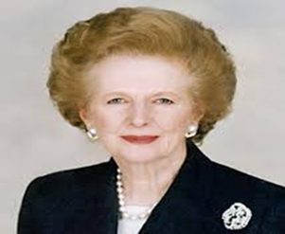
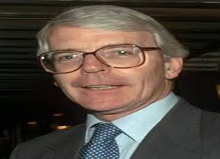
Background to 1992 Election
Margaret Thatcher stepped down as leader of the Conservative Party and PM in 1990.
She was forced out by her own party and cabinet who had lost confidence in her ability to lead.
The economy had lost its way, the introduction of the poll tax was unpopular and her stance on Europe lost her support which was questioned by many in the party prior to 1987.
John Major replaced Thatcher as Conservative leader and PM from 1990 and ran in the 1992 General Election.
John Major was very different to Thatcher in terms of leadership style – more open to working with members of cabinet – less ‘dictator-like’ during cabinet meetings.

Slide 6

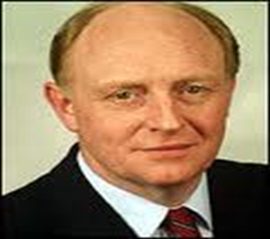
1992 Election
Conservative Majority – 21 – Conservatives win forth term – John Major (replaced Thatcher after she resigned remains) PM
Party | No of Seats | From 1987 Election | % share of the Votes
Conservatives | 336 | -21 | 41.9 (-0.4)
Labour | 271 | +20 | 34.4 (+2.9)
Liberals/SDP | 20 | -1 | 17.8 (-4.7)

Slide 7
Reforming the Party
Blair realised the rise in social mobility in the UK meant Labour had to appeal to more then their traditional ‘working class’ base.
The party had to move towards the centre of UK politics therefore New Labour embraced what became known as the ‘Third Way’.
It retained left wing values such as reducing inequality and the belief in an active government, however it was to achieve these goals changed under New Labour.

Slide 8
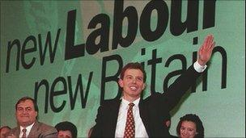
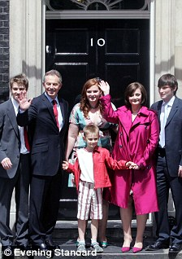
The Third Way
Tony Blair first mentioned “The Third Way” in a party conference speech in 1994.
As a “dominant idea” it is somewhere between Thatcherism and the traditional socialism of the Labour Party (so called “Old Labour”).
New Labour was aimed to appeal to all social classes, but above all it tried to capture new, young, white-collar middle class voters from Thatcher.

Slide 9
Labour did this by accepting the market economy whilst attempting to ensure that those in need of help were able to freely access it.
They wanted to push for people to engage in cooperative self-help, be self-reliant and aim for self-improvement. They believed that the state was not a pre-made cure but rather a facilitator – offering a hand up not a hand out.
Policies that implemented this philosophy included:
‘Welfare to work’ – a programme of subsidies and training for benefits claimants to get back onto the job market – including tax credits to bump up income
‘Minimum wage’ – aimed to make work pay higher than benefits
Significantly, due to Anthony Giddens’ belief that the majority were now middle class, policies were aimed more at those excluded from society – disabled, single mothers, extreme poor underclass, homosexuals – making sure they had rights too. So, Equality and social justice were still central to New Labour, but in a different manner to traditional Labour policies.

Slide 10
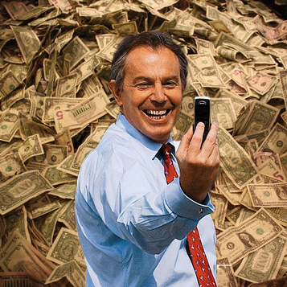
Economic Policy
More emphasis on the role of business and an acknowledgment of the limitations of the state
A move away from high tax and spend policies
Money instead would be raised through a prosperous economy, which needed a thriving business/financial sector with minimal government intervention

Slide 11
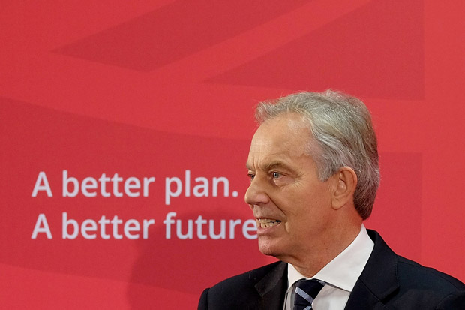
Taking on the Right
New Labour wanted to take back issues seen as ‘owned’ by the ‘right’
No longer would crime, social disorder, migration and so on be explained away but instead tackled head on
“Tough on crime tough on the causes of crime” was not just a slogan, but the basis of New Labour’s ideology
They also introduced competition in state provided areas such as education (tuition fees and academy schools) and health (private providers competing with NHS providers)

Slide 12

The Offer of Devolution
New Labour had also taken note of the increased regional frustration developing in regards to lack of power.
The Tory years had left Scotland governed by a party that it did not support – frustration had built!
Labours ‘97 manifesto promised devolution (sharing of power) for Scotland, Wales and NI.
All three regions voted in favour the establishment of decision making bodies through the process of a referendum and devolution was delivered.

Slide 13
1997 General Election – Landslide Victory
Labour majority 179, Tony Blair becomes PM
Party | No of Seats | From 1992 Election | % share of votes
Labour | 418 | +147 | 45%
Conservatives | 165 | -178 | 31%
Liberal Democrats | 46 | +30 | 17%
SNP | 6 | +3 | 7%

Slide 14
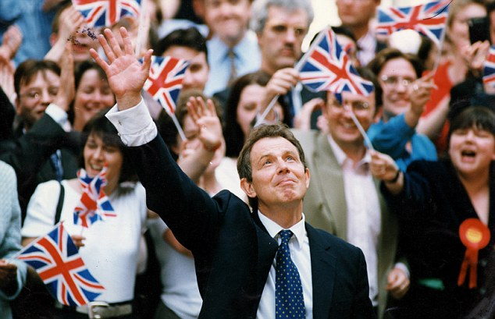
What Led to Labour’s Victory in ‘97?
A tired Conservative party after 18 years in Government vs. a re-energised Labour Party.
Tony Blair himself – younger, well presented, strong image, excellent communicator – continued with the progress which had been made under Kinnock to make the party more sellable as a package.
A ‘new’ party with a change in ideology? – move away from controversial left policies which had hindered previous elections.

Slide 15
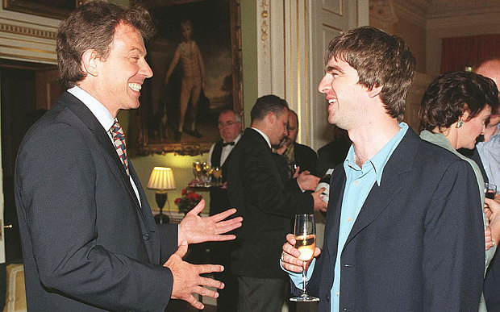
Using popular culture during the Britpop era – socialising with Noel Gallagher etc to be seen as party that was ‘down with the kids’.
Blair even presented David Bowie with a lifetime achievement award at the 1996 Brits!
Promise of devolution – popular in decision making excluded regions of the UK.
the story of the '97 election

Slide 16
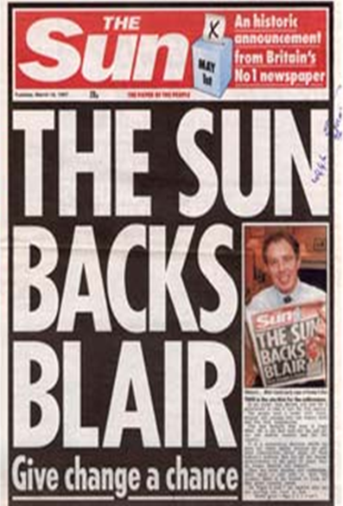
The Sun Backs Blair
The Sun newspaper has successfully predicted elections and backed the winning candidate for the past few decades and is arguably a genuine influence over voting behaviour in the UK.
Having their support was important in Blair’s campaign. (We will return to campaign management later in the unit!)

Slide 17
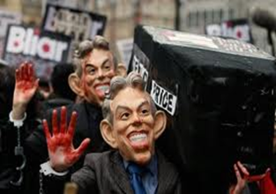
Blair’s First Term in Office
Successes
Began to tackle poverty legacy left behind by Conservative party
Introduced National Minimum Wage – New Deal – National Childcare Strategy.
Growth in the economy heading into the new millennium
Issues
9/11 and increasing threat of terrorism
Increasingly close relationship developing with American President George Bush (criticised by many)
War in Afghanistan – entered with US forces following 9/11

Slide 18
2001 General Election Results
Labour majority 167 (-8 from 97)
Tony Blair remains PM
Party | No of Seats | From 1997 Election | % Share of Votes
Labour | 413 | -6 | 40.7 (-4.3%)
Conservatives | 166 | +1 | 31.7 (+0.7)
Liberal Democrats | 52 | +6 | 18.3(+1.3%)
SNP | 5 | -1 | 9.3 (+2.3%)

Slide 19
How was a 2nd Term Victory achieved?
Only a slight fall in majority indicates relative success of Tony Blair’s first term.
Good use of power of patronage – Tony Blair could have waited until 2002 to call election but called it one year early due to opinion poll suggestion of Labour’s healthy lead over the Conservative Party. (Strike while the iron is hot!)
Conservatives still faced identity crisis to progress from legacy of previous 18 years in Government – William Hague had failed to unite party.
Economic growth in the UK
Labour being seen to tackle key issues and making changes to the welfare state.
Delivered devolution in Scotland, Wales and NI
Good Friday Agreement in NI

Slide 20
Blair’s Second Term in Office
More turbulent second term in Government for Tony Blair – would eventually catch up with Blair and see him resign from office in 2007.
Criticism over style of leadership – ‘Presidential’
War in Afghanistan continued
War in Iraq – criticism over justification – September dossier (WMD) – perceived by many to have misled Parliament and the UK public - led to massive trust issues – decision to invade without backing of UN Security Council – continued enhanced relationship with US President over Iraq – Dr Kelly, government weapons inspector, suicide
Resignation of key cabinet members following Iraq decision – Clare Short / Robin Cook

Slide 21
Blair’s Second Term in Office
7/7 terrorist attack on London transport system in 2005
Minimising role of cabinet instead relying on key ‘special advisors’ e.g. Alistair Campbell.
War with BBC over Iraq.
Cash for Honours scandal.
Blair would still go on to win in 2005 but would see a massive decrease in his majority (drop in 101 seats)
Lost massive grip over ethnic minority vote due to conflict in Afghanistan and Iraq
Conservatives still unable to unite behind new leader Michael Howard – personality of Michael Howard failed to attract public – unable to hold Blair to account effectively.
Notes:
https://www.youtube.com/watch?v=gwyqT7rcCYk – 7/7 bombings

Slide 22
2005 General Election – Historic Third Term
Labour majority 66 (-101 from 01)
Tony Blair remains PM
Party | No of Seats | From 1997 Election | % Share of Votes
Labour | 356 | -46 | 35.3 (-5.4)
Conservatives | 198 | +33 | 32.3 (+0.6)
Liberal Democrats | 62 | +10 | 22.1 (+3.4)
SNP | 6 | +1 | 10.3 (+1)

Slide 23
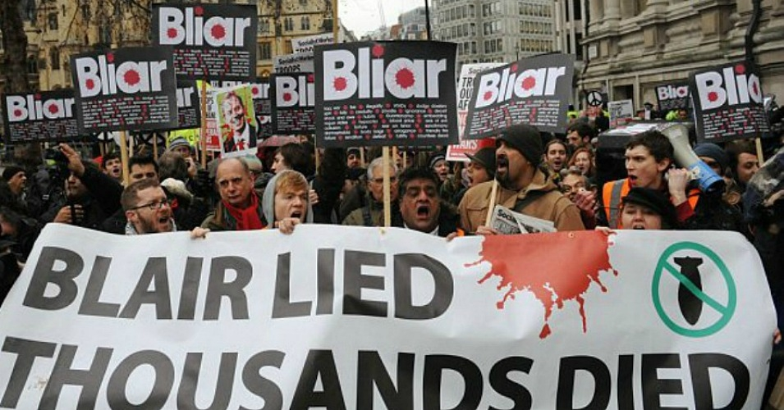
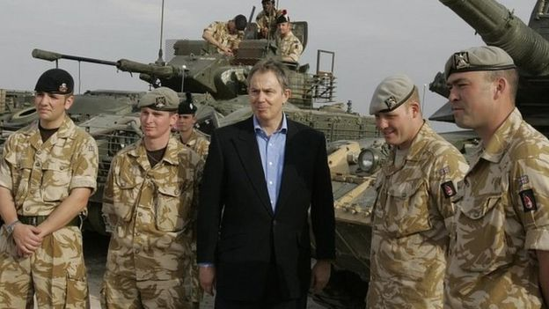
Events Leading to War in Iraq and Blair’s Response
https://www.youtube.com/watch?v=6daSrkgDX0k
https://www.youtube.com/watch?v=_oOtN59_Ft0

Slide 24
Task
Answer the following questions in your jotter:
1. Explain the continued electoral success of New Labour from 1997-2005.
2. Describe the events leading to Blair’s resignation from office.
3. In your opinion, what was the main reason for success, and later failure, of the Labour Party under Blair?

Slide 25
Watch, Listen and Learn!
In the next lesson we will move on to examine Labour’s electoral decline and the impact the Iraq War had on Blair and the Labour Party.
Panorama Part 1/4

