Slide 1
Give me 5…
Key policy decisions made by Thatcher during her time as PM
1.
2.
3.
4.
5.

Slide 2
Pro-Thatcherism or very Weak Labour?
Overall, it can be seen that the key ideas of Thatcherism resulted in the Conservative wins during the 1980’s.
However, there is also need to look at other factors – especially as the decade continues.
Is it really that Labour were just too weak in the 1980s?

Slide 3
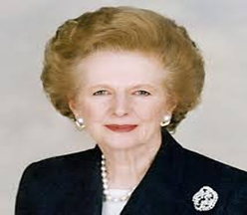
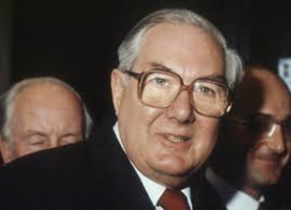
Background to the 1979 election
The Labour government that came to power in 1974 (as a minority administration from February and with a wafer thin majority from October) faced difficult economic circumstances, with inflation and unemployment both running at post-war record levels.
In April 1976, Prime Minister Harold Wilson was succeeded by Jim Callaghan.
By March 1977 Callaghan agreed to a parliamentary arrangement with David Steel and the Liberal Party which became known as the 'Lib-Lab Pact‘
The ‘Winter of Discontent’ hit and crisis over the Devolution referendum in Scotland all led to a vote of ‘no confidence’ and a General Election was called.

Slide 4
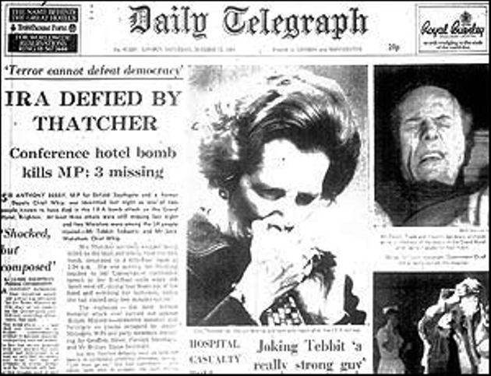
Thatcher’s First Term: 1979-83
Margaret Thatcher’s first term was not without it’s problems.
The country was still struggling and the public were still to see the advance to more prosperous times promised by Thatcher when she arrived in Downing Street in 1979.
Terrorism and the threat from the IRA to mainland Britain had increased.
Britain had become involved in conflict with Argentina over Argentina’s occupation of British owned Falkland Islands.
There were real opportunities for Labour to get back into power after one term out.

Slide 5
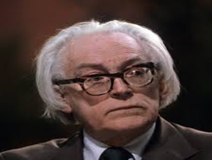
The 1983 Election
Thatcher’s new opponent was Michael Foot. Despite a rocky first term Thatcher was perhaps saved as the economy was beginning to progress by 1983 and victory was achieved in the Falklands presenting Thatcher as a successful ‘war PM’.
Party | Number of Seats | From 1979 Election | Percentage of the Overall Vote
Conservatives | 397 | +58 seats | 42.4 (-1.5)
Labour | 209 | -50 seats | 27.6 (-9.3)
Liberal | 23 | +12 seats | 25.4 (+11.6)
1983 Election Campaign

Slide 6
Why Did Labour Fail to Capitalise in 1983?
Conservative Majority 144 Margaret Thatcher remains PM
The Labour party was still struggling to re-build its reputation following the mess it left in 1979.
Choice of Leader – Michael Foot was credited with holding the party together at it’s weakest point but he was poorly presented and was not packaged as a ‘PM in waiting’ vs. Thatcher who was beginning to embrace key charismatic leadership qualities.
Poor Election Campaign – shambolic campaign vs. well organised Conservative campaign.
BBC review of Michael Foot when he died March 3rd 2010
Labour's 1983 manifesto

Slide 7
Thatcher’s Second Term: 1983-87
Margaret Thatcher’s second term was also not without it’s problems.
Country was beginning to show real economic progress.
For many this was at the expense of manual industries which were in decline – Miners strikes (84-85) etc. – Thatcher had tightened her grip over the unions. miners strike anti poll tax campaign
Threat from the IRA was still prevalent – 1984 Brighton Bomb attack during Conservative Party Conference presented this first hand to Thatcher
Mid-Cold War – Thatcher and her US counterpart Ronald Regan still deep in negotiation with Russia to reduce east-west tension

Slide 8
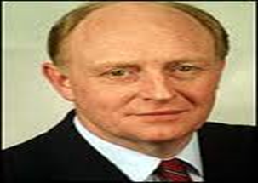
1987 Election
Conservative Majority – 102
Margaret Thatcher wins third term
Party | No of Seats | From 1983 Election | % of overall votes
Conservatives | 376 | -21 | 42.3 (-0.1)
Labour | 229 | +20 | 31.5 (+3.9)
Liberals/SDP | 22 | -1 | 22.5 (-2.9)

Slide 9
Why Did Labour Fail to Capitalise in 1987?
The Labour leader in the 1987 election was Neil Kinnock.
Despite issues in her second term Thatcher was perhaps again saved as the economy had improved further and the UK public were feeling this improvement in.
The Labour party had worked hard to present itself better than during the 1983 election.
Labour had a better Election Campaign – had progressed campaign methods to better present the party and its leader.
Choice of Leader better – Neil Kinnock was a massive improvement on Michael Foot - better presented and was packaged better as a possible ‘PM in waiting’.
Policies still failed to appeal to the electorate.
The Sun was still backing the Conservatives.

Slide 10
Party Policies/ Dominant Ideas of the Party
Leader/Leadership
Impact of factors on Conservative Party Electoral Performance
1979 - 1987
State of the Opposition Party
Media/Media Portrayal

