Slide 1
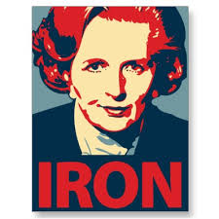
Dominant Ideas - Thatcherism
Conservative Party Rule 1979-1997

Slide 2
What you will learn…
Success Criteria – I can…
Describe the key tenants of Thatcherism
Explain why Thatcherism was a popular ideolody in the UK in the 1980s
Describe the factors which contributed to the Conservatives electoral success
to explain the key tenants of Thatcherism as a political ideology
The impact of Thatcherism on the electoral success of the Conservative Party from 1979-1987.

Slide 3
Conservatism
The core ideas of Conservatism revolve around:
tradition
human imperfection
organic society
hierarchy and authority
Property
Conservatives are supposed to be pragmatists who put simple straightforward common sense ahead of non-rational ideology. One of the main criticisms Conservatives have of liberalism and socialism is that these are utopian ideologies which are focusing on a perfect society which Conservatives believe is wholly unattainable.

Slide 4
Thatcherism
The basis of Thatcherism can really be traced to Margaret Thatcher’s personal roots.
From a lower middle-class family (daughter of a greengrocer), Thatcher had an incredibly different background to her predecessors as leader of the Conservative party.
Her beliefs were really centred around Victorian ideals of a Church of England, “Protestant” work-ethic. This is very much based on tradition, respect for your elders, working hard and knowing your place. However later Thatcherism was seen to link to the neo-liberal economics of Milton Friedman and Friedrich Hayek which was more about cutting taxes and making people more individually responsible for their finances.

Slide 5
Therefore, Thatcherism is based on the key principles of:
Individual Responsibility
Limited Government interference in personal freedom
Harsh punishments for law-breakers
There are clear links to the very basic form of Conservatism we discussed earlier – society should be allowed to developed without interference from government and authority is to be obeyed.
The best way to frame Thatcherism as an idea is that if you work hard then you can achieve whatever you want to, and people do not require society or community.

Slide 6
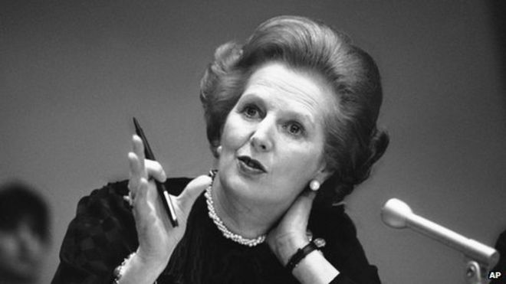
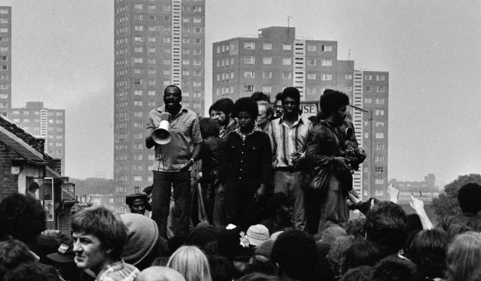
“I think we have gone through a period when too many children and people have been given to understand ‘I have a problem; it is the government’s job to cope with it’…. And they are casting their problems upon society, and who is society? There are individual men and women, and there are families, and no government can do anything except through people and people look to themselves first. It is our duty to look after ourselves and our neighbour… and people have got their entitlements too much in mind without the obligations… There is no such thing as society”. – Margaret Thatcher
This quote is often repeated and often a little misrepresented, by just repeating that last phrase. However, when looking at the full quote it is clear that Thatcher was making quite an individualistic point here. She was against any kind of collectivism which she saw as the dark figure of communism invading from the East.

Slide 7
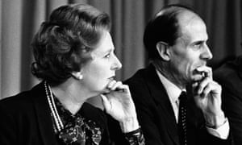
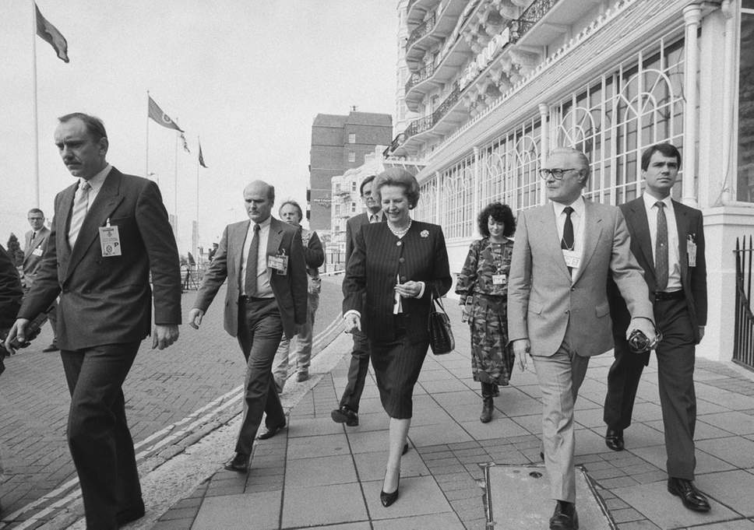
Thatcherism and Economics
At the same time as Thatcher was making her ascent in the 1970’s, an Austrian economist- Friedrich Hayek – was making the case for further free-marketism and unrestricted capitalism.
Thatcher and her advisers took on many of the economic policies of Hayek, while putting a distinctly socially Conservative spin on it.
Thatcherism can probably be defined as neo-liberal economics with right-wing social conservative policies.

Slide 8
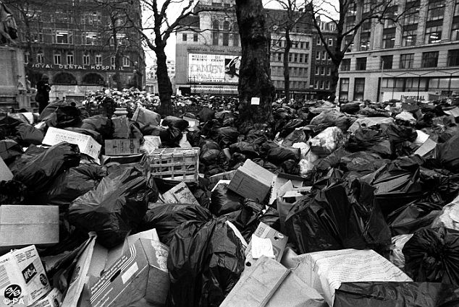
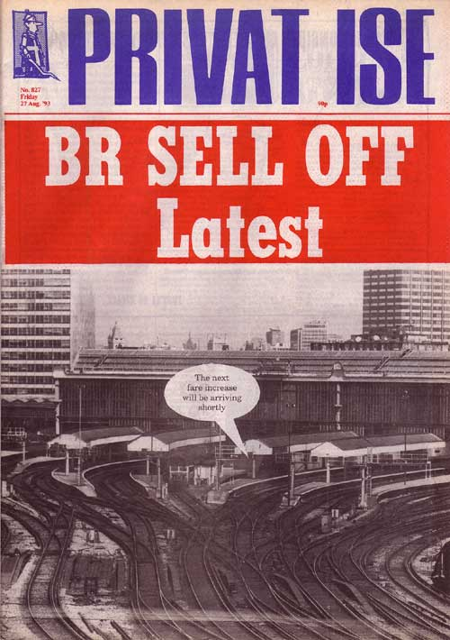
Economically the party followed a new-liberal path which had an effect on employment. She privatized many state industries, causing massive, long-term unemployment in the North of the UK.
She put in place legislation which smashed the unions, and ordered the police to break strikes on several occasions.
Thatcher was not a consensual politician – she outmanoeuvred and “destroyed” her opponents rather than compromise.

Slide 9
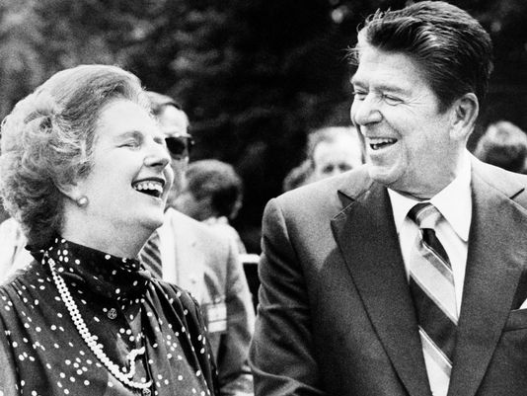
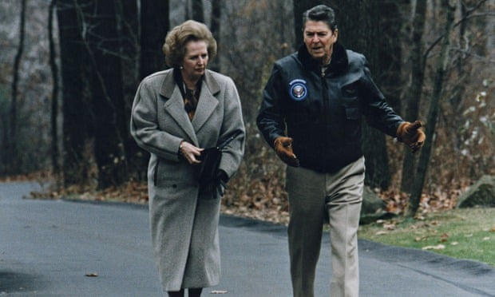
A similar movement was happening in the USA at the same time as Thatcher was in power in the UK:
President Ronald Reagan became the figurehead of the “Neo-Con” movement, which had strict socially conservative policies (like longer prison sentences and trying to limit abortions) and neo-liberal economic policies (cutting taxes and limiting public services).
Thatcher and Reagan were seen as great international allies.

Slide 10
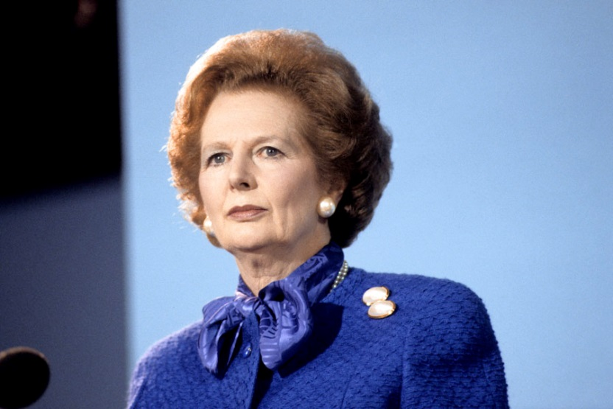
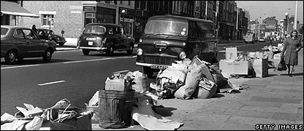
There was also a move to much greater nationalism under Thatcher. The Conservatives had had a difficult relationship with nationalism throughout the 1960’s and 70’s, with Enoch Powell, who had been a Conservative MP, making incendiary speeches against the increased waves of immigration.
However, in the 1970’s, recession hit and unemployment grew. Parties like the National Front (which became the BNP) were formed and race crimes – though they were not recorded as such – grew in numbers across much of the country.
Thatcher moved the party considerably to the right on the issue of race, managing to outmanoeuvre the National Front.

Slide 11
The History of Modern Britain
Watch “Andrew Marr’s a History of Modern Britain” and take notes on Thatcherism and it’s effect on Britain in the 1980s. Look for:
The basic Principles of Thatcherism
Economics and money
Problems in Thatcher’s first term in office
International issues
Industrialism vs Privatisation
https://www.bbc.co.uk/iplayer/episode/b007nn9k/andrew-marrs-history-of-modern-britain-4-revolution

Slide 12
Questions
Using your notes and the “What is Thatcherism?” Reading answer the following questions in detail.
Describe the roots of Thatcherism
Explain what is meant by Economic Neo-Liberalism and social Conservatism.
What is the impact of Thatcherism on Nationalism in the UK?
How would this new nationalism have an effect on inequality in the UK?

Slide 13
Thatcherism and its effect on elections
Margaret Thatcher was the leader of the Conservative Party for a number of consecutive elections (1979, 1983, 1987)
Thatcherism therefore had an effect over a long period of time.
For each of the following elections take notes the:
Impact of Thatcherism on the success of the party
The election results in each year.

Slide 14
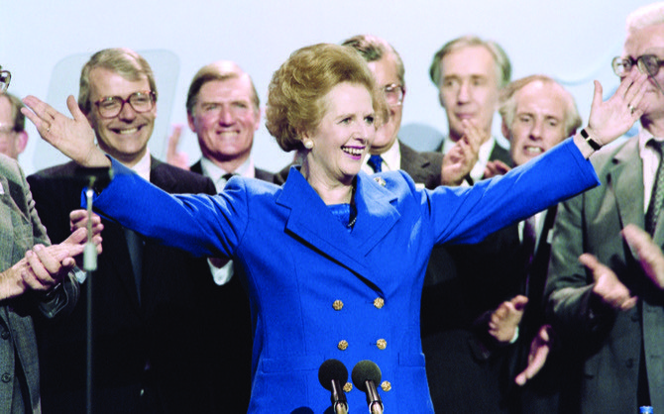
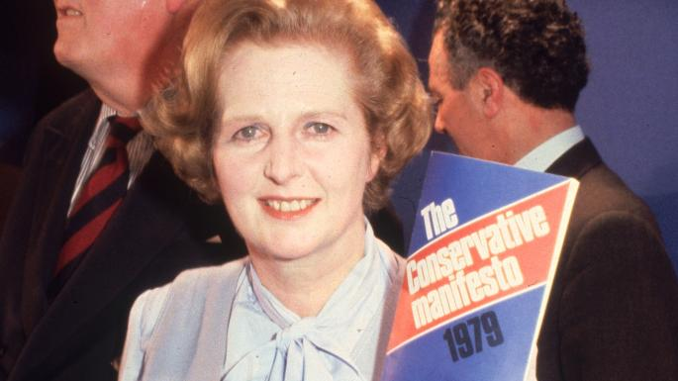
Thatcherism and the 1979 election
Thatcher had only recently taken over as the leader of the Conservative Party (who were in Opposition to Labour at the time).
Thatcher moved the party away from it’s previous roots in “One-Nation” conservatism however the ideology of Thatcherism was not fully formed yet.
The aim of Thatcher’s first manifesto was to dramatically reduce the power of trade unions in Britain, given the significant levels of strikes that had taken place in the country throughout the 1970s.
The Conservatives promised to bring in stricter rules on picketing and balloting on strike action in the UK, severely limiting the power of trade unions.
The manifesto also contained promises to reduce inflation, reduce the top rate of income tax and the basic rate of tax.

Slide 15
Thatcherism and the 1979 election
The stated purpose of the Conservatives 1979 manifesto was to increase personal responsibility in the population.
The Conservatives were making a clear move away from their previous roots and towards a new era.

Slide 16
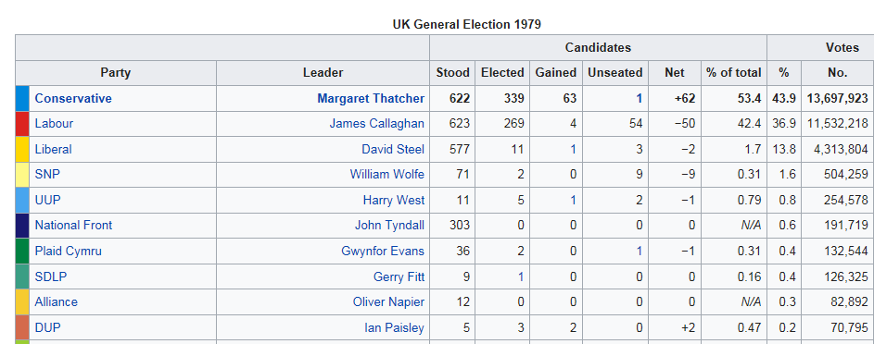
The Conservatives won the 1979 election with 339 seats out of 635 seats giving them a clear majority.
The Conservatives polled 43.9% of the vote compared to Labour’s 37%.

Slide 17
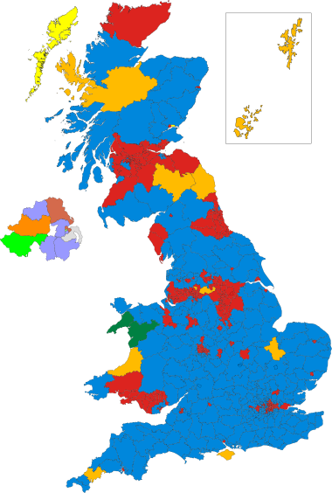
In 1979 there were clear pockets of support for the Conservatives across the most of the UK. This does not necessarily match up with the image of this time that “Scotland didn’t vote Tory”.
Many people across the UK had suffered great economic hardship during the 1970s and were looking for a new economic promise, which the Conservative manifesto provided.

Slide 18
Thatcherism and the 1979 election Questions
What was in the 1979 manifesto?
How did this fit in with Thatcherism’s core ideas?
What impact did Thatcherism have on the results of the 1979 election?

Slide 19
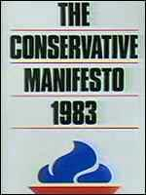
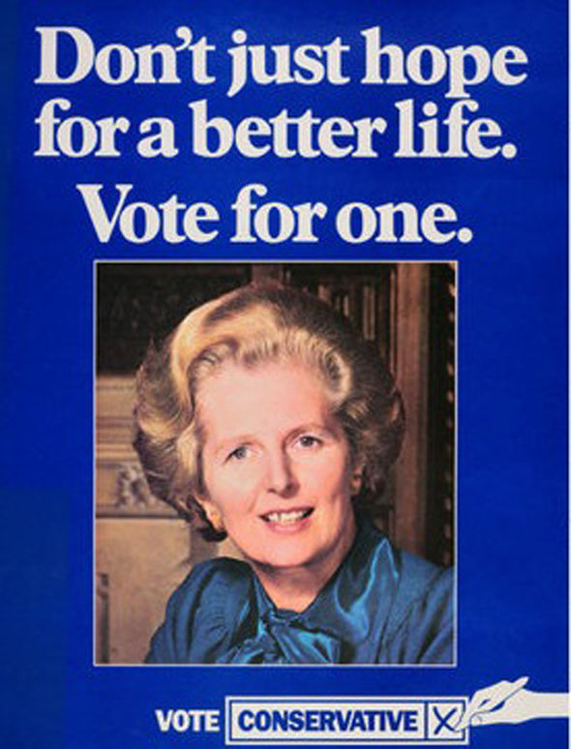
Thatcherism and the 1983 election
By 1983, Thatcher had made clear that she was not a “consensual politician” and that she would not compromise if she could help it.
The Falklands War had bolstered her image as a strong leader.
The 1983 manifesto was called “Forward – the challenge of our time” and it was considered to be far more radical than the previous manifesto.
It was based on three key pillars: defence, employment and economic prosperity.

Slide 20
Thatcherism and the 1983 election
The Tories remained committed to membership of the European Community, an independent nuclear deterrent, trade union reform, further privatisation, a long-term reduction in taxation and a war on inflation.
Thatcher promised even more reform of trades unions – further reducing their power by reforming the political levy.
This was also the beginning of privatisation of many publicly owned industries like British Telecom, British Airways and British Steel. These companies were sold off in order to make money for the country, and to further the policy that the government should not be taking a significant role in people’s lives

Slide 21
The money gained from privatisation was used to fund tax cuts. So you can see here that the dominant idea of Thatcherism – economic neo-liberalism was at the core of the election.
Margaret Thatcher's second election victory in 1983 was one of the most decisive in post-war Britain.
The Conservatives benefited from a three horse race, in which votes for the opposition were split between the Labour Party and the Liberal/SDP Alliance. Thatcher saw her majority rise to 144 seats. In terms of share of the vote, Labour only just managed to come in ahead of the Alliance, in their worst election performance since 1918.
Although Margaret Thatcher was one of the most unpopular Prime Ministers in history during her first years in office, Britain's victory in the Falklands conflict in 1982 radically improved her personal popularity and that of the Conservative Government.
Labour, on the other hand, were weakened by internal divisions and defections to the new Social Democratic Party (SDP).
The Falklands war allowed Thatcher to prove her credentials in terms of defence policy, radically defending an outpost of the British Empire. Defence became a top spending priority, and the government invested heavily in nuclear submarines. This proved a huge boost to UK arms manufacturers.

Slide 22
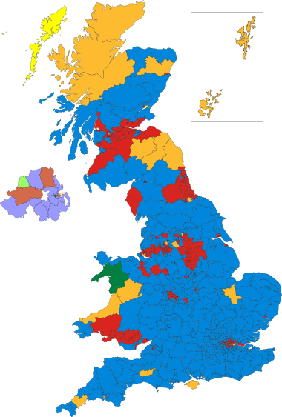
Thatcherism and the 1983 election
The Conservatives won 397 seats with 42.4% of the votes, compared to Labour’s 27.6% of the vote and 209 seats.
Nationally, there was a swing of 3.8% from Labour to the Conservatives.
The most pronounced regional swings occurred in Southern England, where Labour won only two seats out of a possible 110.

Slide 23
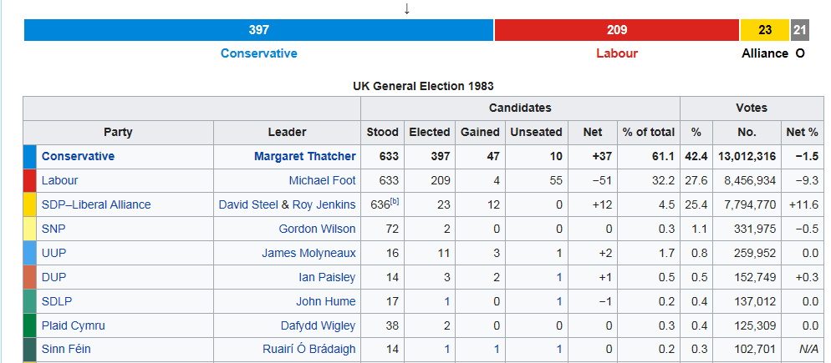
Constituency boundary changes meant there were, for the first time, 650 seats in the House of Commons up for election.
The Conservatives ran away with the victory, taking 397 seats out of a possible 650.

Slide 24
Thatcherism and the 1983 election Questions
What was in the 1983 manifesto?
How did this fit in with Thatcherism’s core ideas?
What impact did Thatcherism have on the results of the 1983 election?

Slide 25
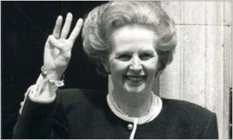
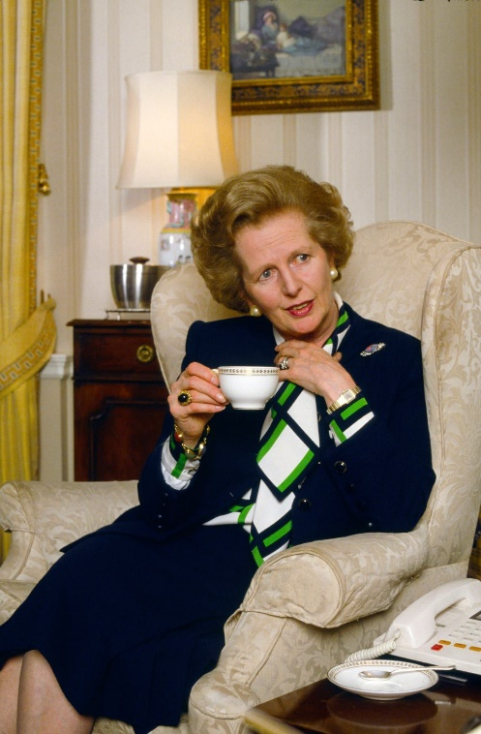
Thatcherism and the 1987 election
When Thatcher announced the election for 11 June 1987, she was confident that the Government was strong.
Local elections proved the Government's strength, and the Conservatives were helped no doubt by a solid economy, falling unemployment and low inflation.
As campaigning began, opinion polls showed the Conservatives on 43%, Labour on 29% and the SDP-Liberal Alliance on 26%.

Slide 26

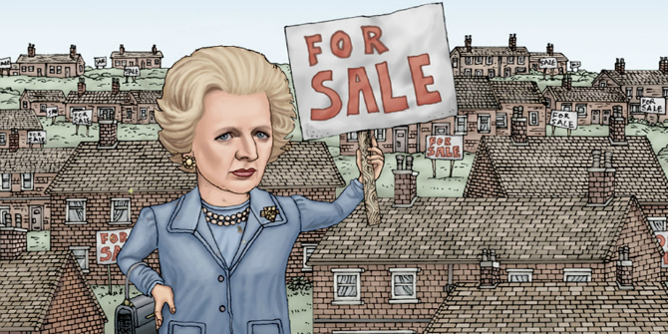
Thatcherism and the 1987 election
The 1987 Conservative Manifesto was called “The Next Moves Forward”, and this focused on spreading home ownership by allowing council tenants to buy their houses.
This was to increase people’s feelings of personal responsibility. A core belief of Conservatism is that home ownership increases people’s stake in society and is essential to a person’s sense of identity. By allowing people to buy their council houses, the government could make money from the sales and would no longer be responsible for upkeep. Thatcher believed it would give people more of an incentive to stay in work.
Notes:
https://www.youtube.com/watch?v=ycBH_BWrEUM

Slide 27
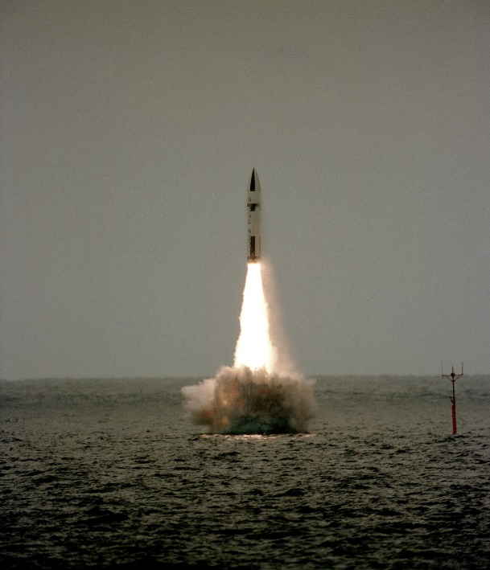
Thatcherism and the 1987 election
In 1987, privatisation of publicly owned industries continued – again bringing in windfall payments for the government who could offer further tax cuts for the rich
Nuclear weapons were the final key point of the manifesto. Labour had promised in 1983 to get rid of the nuclear deterrent, which had proven quite unpopular, so the Conservatives promised to replace Polaris with Trident.
Defence is a key Conservative ideal – protecting the Nation

Slide 28
Thatcherism and the 1987 election
As predicted by the polls, Thatcher was returned for an historic third term, albeit with a reduced majority of 102 seats, down from 144. Overall there was a 1.2% swing to Labour. Labour increased its number of seats from 209 to 229 and did particularly well in Scotland and the north of England.
The Conservatives won 376 seats with 42.8% of the votes and Labour won 229 seats with 30.8% of the votes.

Slide 29
Thatcherism and the 1987 election Questions
What was in the 1987 manifesto?
How did this fit in with Thatcherism’s core ideas?
What impact did Thatcherism have on the results of the 1987 election?
Why was there a swing to Labour in the 1987?

