Slide 1



Higher Politics
Assignment

Slide 2

Overview
Not a report
30 mark essay
You know what the topic is
It should be easier than the exam- its your chance to pick up marks- if you are prepared for it!
250 word resource sheet, 1.5hr write up

Slide 3
Stages
1. Choose topic & question
2. Carry out research
3. Find sources
4. Carry out the write-up
5. Create your resource sheet
6. Your work will be collected in, sent away and marked

Slide 4

Choose Topic
Any political issue/topic- at least two sides or different points of view or arguments for/against
Area of interest to you personally or something you feel strongly about, can collect evidence on
Easier to attempt if you possibly have some background knowledge already
Think of a question around your issue
MOST IMPORTANT – it must be open to argument i.e. have two or more sides to argue

Slide 5
Topical/ Issues of Interest
Brexit
US Presidents
UK Prime Ministers
Popularity/ unpopularity of leaders and parties
Voting systems
Voting behaviour
Crime and the Law
Democracy
Should Britain pursue a ‘Hard Brexit?’
How successful a President was Barack Obama?
Did Thatcher improve Britain 1979-90?
Why have the Scottish Conservatives grown in popularity?
Should the UK abandon FPTP in favour of a PR voting system?
To what extent does race influence voting behaviour?
Arguments for and against legalisation of drugs in the UK.
Do the benefits of Direct Democracy far outweigh those of Representative Democracy?

Slide 6
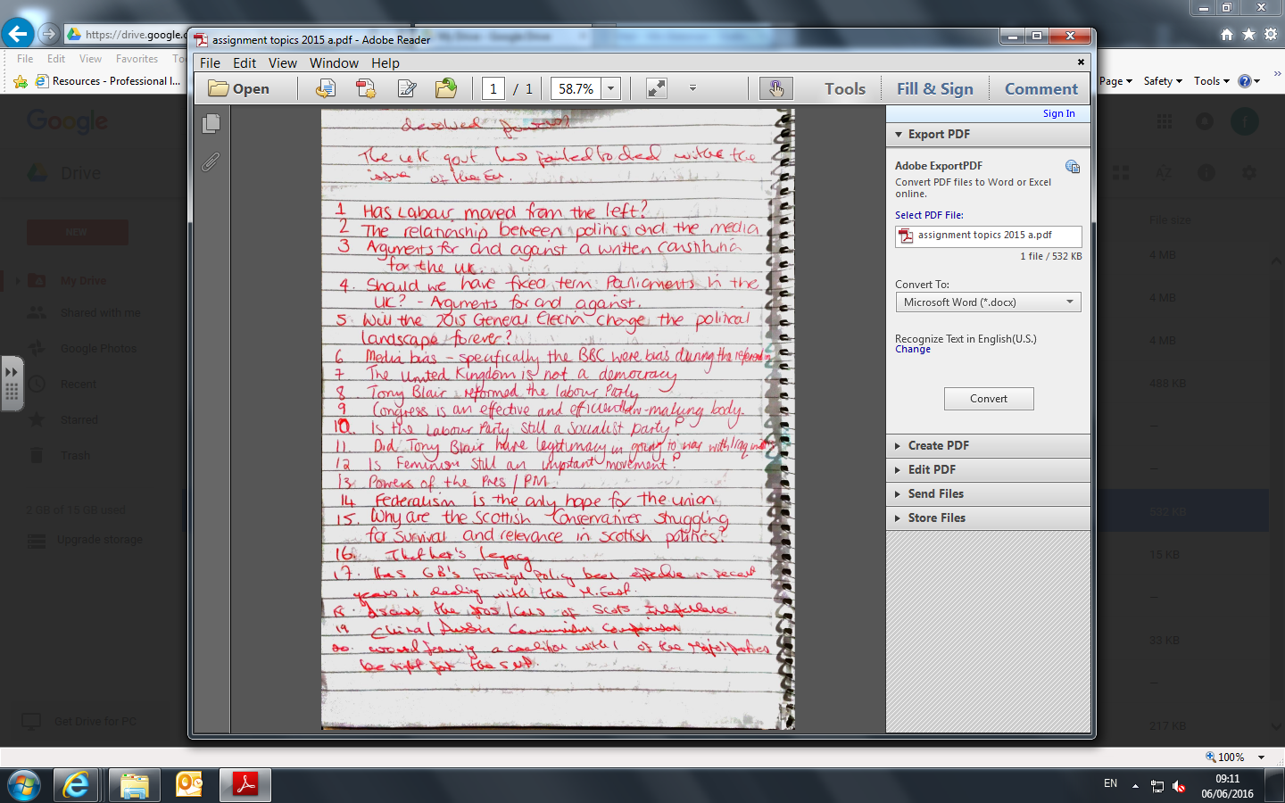

Slide 7
Carry out Research
Must have at least 2 sources (probably more). In order to successfully gain 30 marks you should definitely have more than 2 sources.
Consider and discuss suitable sources e.g
Newspaper article
Statistics
YouGov polls
Quotes

Slide 8

Collate and Analyse Evidence
3 or 4 different arguments or points of view on each side- but don’t just list evidence- need to analyse it
Analyse the evidence/ arguments/ points of view
Break down the issue and look at the key points/ arguments
I.e. what each point tells you about the issue/ what links it has with the issue or other relevant issues
Implications/ consequences
What are the key points
Contrasts/ similarities/ differences
Different interpretations
Synthesis – linking things from different sources

Slide 9
Create your Resource Sheet
Not a plan (history)
Not a collection of sources
Only 1 side
Not detailed points for you to copy out (will cost you marks)

Slide 10
Resource Sheet
Evidence of what you have found out (marker will refer to it -at least 2 different sources)
Bullet points/ headings | Evidence /data (electoral stats/results/polls)/ graphs
Mind maps | Survey results
Interview questions | Questionnaire results
Summary notes | Quotes from texts etc.
Newspaper articles | Extracts from books
Notes from a video/ radio programme | Internet search results
Quotes from sources

Slide 11

The Write-Up
Exam conditions
Marks- 30 in total
KU – 10
Analysis & Synthesis - 14
Referring to political sources – 2
Drawing conclusions about your issue- 4

Slide 12
The Write Up
Knowledge and understanding - (10 marks)
(describe/ develop/ explain/ exemplify)
Intro:
Clarify what your issue is
Provide detailed background to the issue
Outline your line of argument
Identify alternative points of view (other factors)
Why is your issue significant?
How does your issue relate with related political concepts?
Plus you need knowledge points in each paragraph

Slide 13
This assignment will focus on the issue of Representative Democracy and whether they far outweigh the benefits of Direct Democracy. Democracy can be defined as government of the people, by the people, for the people and comes from the Greek word ‘Demos’ meaning ‘The People’. Citizens are at the heart of democracy, and much like Ancient Athens, an effective government is considered to be one which regularly consults the people on important issues. Winston Churchill describes democracy as ‘by far the worst form of government, apart from every other kind’ showing that Democracy is a key part of our modern society and the best way to govern. It can be argued that the advantages of representative democracy do outweigh those of direct democracy because in a densely populated modern society, Representative democracy is far more practicable and provides a division of labour in society. However, it may be argued that it means the public have to rely on self serving politicians and caused apathy or disengagement in some citizens. This is a very significant issue because recently the UK has offered citizens the opportunity to participate in Direct Democracy, such as the EU Referendum in June 2016 and the Scottish Independence Referendum in 2014, and it is clear that citizens felt included, involved and engaged in these votes. Therefore many people now argue that further opportunities should be given to citizens to participate directly; the potential use of e-voting in the 21st century has also led to debate in the media over the ease of citizen participation however some have claimed this could lead to electoral fraud. The issue of representative and direct democracy links with almost every other political concept in our modern society as the type of democracy utilised in society can often lead to debate over a leader’s legitimacy or indeed the legitimacy of a decision. An example of this would be the fact that in 2011 the UK public voted in a referendum to keep the FPTP voting system and successive Conservative governments have used this to defend disproportionate election results and the fact they have formed governments without achieving 50% of the vote.

Slide 14
Paragraph Plan
TS – Indicate the focus of the paragraph
K – Start with your facts. They should be relevant, detailed, factual and accurate. You should include statistical data where possible
S: If you have a source introduce it here i.e.
An article in The Guardian stated that ‘Barack Obama was…’ draw out the meaning – ‘this shows that…’
A/S: It may be argued that…
This shows that…
This has caused/ The impact of this is that…
Counterarguments –
‘However, it may be argued that…’
C: Mini Conclusion – Sum Up
Overall, it can be argued that…

Slide 15
The Write Up
Analysis – (14 marks)
Use the KU (above) to breakdown the issue i.e.
Analytical comments i.e. ‘It can be argued that…’
Linking factors with explanation to the central issue
Implications/ political consequences
Making comparisons between different interpretations
Backing up analysis with supporting evidence

Slide 16
The Write Up
Refer to at least 2 political sources (2 marks)
i.e. text book, programme, article used etc.
Referring to political sources & communications ideas from them accurately ‘This means that…’

Slide 17
The Write Up
Drawing conclusions (4 marks)
Overall weigh up the evidence/arguments
Evaluate the evidence- what does it tell you about the issue
Key reasons why you came to this view
Argue your case
Can do mini conclusions also

Slide 18
Conclusion Plan
1) In conclusion… state that the question cannot be answered in very simple terms i.e.
‘The instability in Northern Ireland government cannot be attributed to only one factor.’
2) Recap all factors/ arguments with a quick explanation i.e.
‘It could be argued that Obama’s foreign policy gained him support and the death of Bin Laden gained him popularity’
3) Make your final judgement
Give two pieces of supporting evidence i.e.
It could be argued that Donald Trump is largely viewed as an illegitimate President because…
This is also due to …. Which has led to …

Slide 19
Redraft/ Redo Assignment
Thursday 28th Feb

