Slide 1
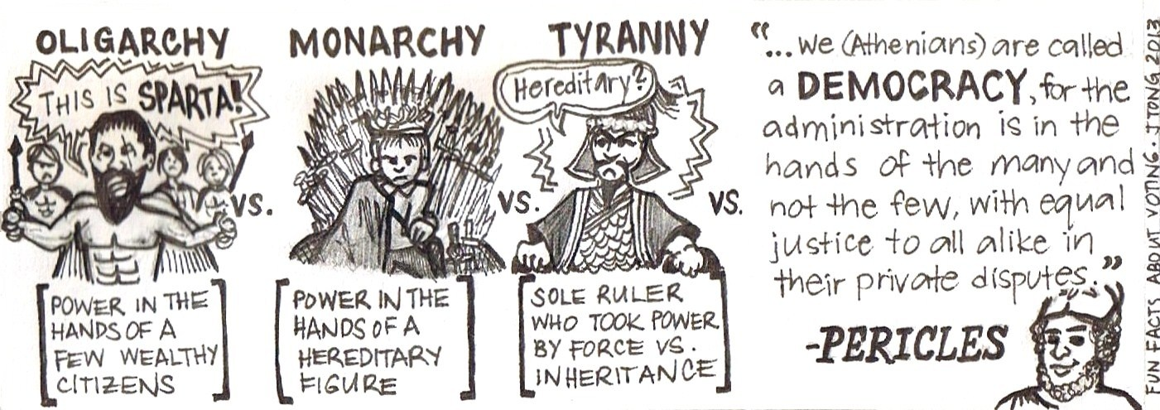
Theories of Voting Behaviour
Party Identification Model

Slide 2
What you will learn…
Success Criteria – I can…
Describe the Party Identification of voting behaviour
Explain why the Party Identification model can be questioned
Describe the Dominant Ideology Model of voting behaviour

Slide 3
Party Identification
This theory is based on the sense of psychological attachment that people have to parties. Voters are seen as people who ‘identify’ with a party, in the sense of being long-term supporters who regard the party as ‘their’ party. This group of voters are known as “partisan voters”
Voting is therefore a manifestation of partisanship, not a product of influence by policies, campaigns etc. Those who are influenced by policies, campaigns etc are “floating voters”.
This model places heavy stress on early political socialisation i.e. through family.Most people vote the way ‘their family votes’ as they have been influenced by family at early stage and political loyalties are then formed.

Slide 4
Voter Bias
Voters display bias towards their own party, in that people who identify with a Political Party will vote for that party most of the time even if they don’t think the party is doing a good job. This was particularly true in the post war period.
It can also be seen in each of the 2005/2010/2015 elections most of social class DE have voted for Labour, even when they were not seen to be the best option.
 | Oct 1974 | 1979 | 92 | 97 | 01 | 05 | 10
 | % | % | % | % | % | % | %
Conservative | 22 | 34 | 31 | 21 | 24 | 25 | 31
Labour | 57 | 49 | 49 | 59 | 55 | 48 | 40
Lib / Alliance / LD | 16 | 13 | 16 | 13 | 13 | 18 | 17

Slide 5
Voter Bias
This long-term attachment to a specific party (partisanship) colours a voter’s perception of politics and is expressed by them at election time. Voting is a reflex rather than a choice.
There are clear links to class here however this is NOT the same as the theory behind the Sociological Model.

Slide 6
Party Identification and class
Party identification is often the political extension of class identification or a residual identification with a class one has left.
In the Party ID model some voters vote against their ‘natural’ class parties, e.g. Labour being the most popular party among some middle class groups, like teachers.
A two-party system allows for this, reflecting the major ideological division in society. There is very limited voting for smaller parties.

Slide 7
Party Identification and class
 | Oct 1974 | 1979 | 1983 | 1987 | 1992 | 1997 | 2001 | 2005 | 2010
 | % | % | % | % | % | % | % | % | %
Middle class (ABC1)
Conservative | 56 | 59 | 55 | 54 | 54 | 39 | 38 | 37 | 39
Labour | 19 | 24 | 16 | 18 | 22 | 34 | 34 | 30 | 27
Lib / Alliance / LD | 21 | 15 | 28 | 26 | 21 | 20 | 22 | 26 | 26
Skilled working class (C2)
Conservative | 26 | 41 | 40 | 40 | 39 | 27 | 29 | 33 | 37
Labour | 49 | 41 | 32 | 36 | 40 | 50 | 49 | 40 | 29
Lib / Alliance / LD | 20 | 15 | 26 | 22 | 17 | 16 | 15 | 19 | 22

Slide 8
Party ID and Dealignment?
The Party ID model fails to address the continued evidence of ‘dealignment’ - some commentators argue that class support for political parties has started to decline.
For example, support for the main two parties has declined from over 95% in the 1950’s to around 68% in 2015, and voting behaviour has become more volatile.
https://www.youtube.com/watch?v=mYzQzJ262Qw

Slide 9
Party ID and Dealignment?
This model is also seen to fail to take individual interest into account (Rational Choice?) as well as the growing influence of short term influences on voting.
Evidence of Conservative voters voting UKIP and in Scotland most of the SNP gains in the 2015 election were at the expense of the Labour party.
https://www.youtube.com/watch?v=-6_zWG0b9ak
https://www.youtube.com/watch?v=BqIZKYVa7a0

Slide 10
Relevance of Party ID model?
The Party Identification model has become weaker although there is still evidence that it carries on. 29% of the electorate were partisans in 1974, but only 9% in 2005. The number of DE voters who continue to vote for the Labour party and A voters who vote for the Conservatives does highlight partisanship still exists in the UK.
The electorate is more volatile than in the past due to changes in class identification (particularly through policies of the 1980s), changes in the parties’ ideological positions, which brought the parties much closer together ideologically, the increasing importance of TV as the major source of news, and better education, which encourages critical thinking and the assessment of policies rather than a simple blind adherence to a party whatever their policies.

Slide 11
Questions
Summarise the Party Identification Model, using the following terminology: partisan voters; “not a product of influence” and early political socialisation.
Explain why the Party Identification Model can be questioned.

