Slide 1
What influenced Voting behaviour before the late 1970s/early 1980s?
What happened that made people change their voting behaviour?
What factors became more important in determining how people voted?
Based on your experience of the 2019 Election, list as many factors or reasons that influenced how people voted

Slide 2
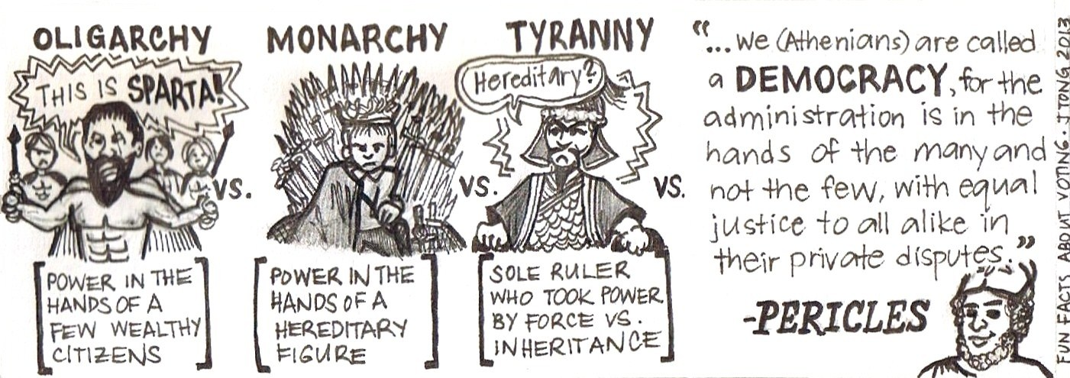
Theories of Voting Behaviour
The Rational Choice Model

Slide 3
What you will learn…
Success Criteria – I can…
Describe the Rational Choice of voting behaviour
Explain why the Rational Choice model is considered relevant in the UK today.
Describe the Rational Choice model of voting behaviour

Slide 4
Background
Prior to the 1980s, the Sociological Model was the most relevant theory.
Due to the changing nature of British Society, the UK electorate went through a period of partisan/class dealignment
A pattern of more individualistic voting behaviour emerged

Slide 5
The Rational Choice Model
The Rational Choice Model of Voting Behaviour views voters as ‘consumers’.
Task: Make a list of all the factors that influence you as a consumer.
For example, you can’t decide whether you want to buy an iPhone, a Samsung or an Huwawei. What factors are going to influence you when making that decision?

Slide 6

Consumers make a choice of what to purchase based on a ‘Rational Choice’
E.G. they weigh up the pros and cons of each option and make a self interested decision, based on what is best for themselves

Slide 7
The Rational Choice Model views voters as consumers
They look at the options, and make a Rational Choice based on what party would make their life, their families lives and society better

Slide 8
Voters are now far less likely to vote based on Social Background, and especially based on class
The greatest influence is now their own assessment of the policies of different parties on issues they consider to be salient

Slide 9
Salient Issues
most noticeable or important – Oxford Dictionary
A Salient Issue is one that voters place very high important on
Healthcare, Education, Immigration etc.
https://www.youtube.com/watch?v=W90buvgQ-Mk

Slide 10
It’s the Economy, Stupid!
It has long been argued that the state of the Economy is the most important issue to voters
Polls at the time of GE15 clearly show that voters considered the Economy to be a key issue
It has also been suggested that the failure of the Yes! Campaign to win the economic debate, was key to their failure to win the Independence Referendum

Slide 11
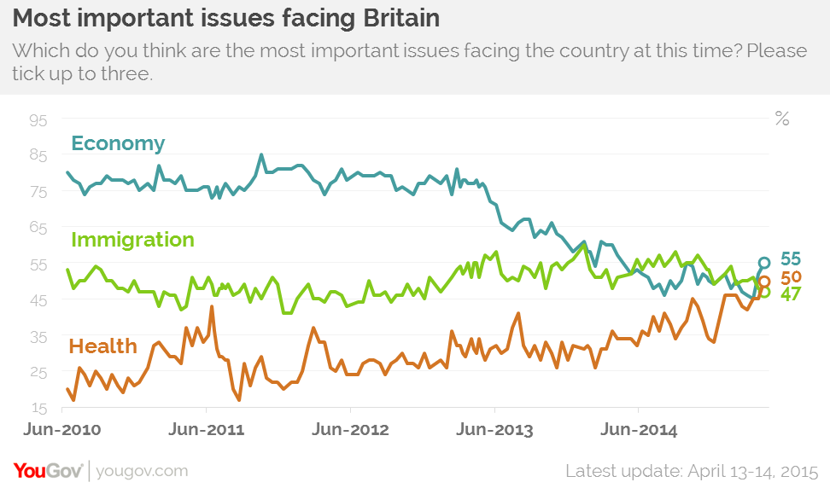

Slide 12
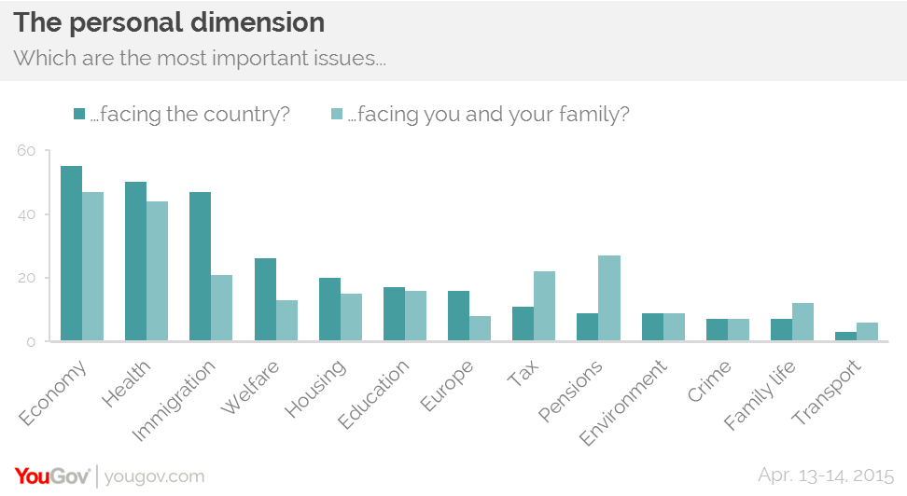

Slide 13
1992, 1997, 2010, 2015
1992 – Labour lost the Economic Argument (Tax Bombshell) – Conservatives win
1997 – Labour gains economic credibility (Keep Tory Spending Plans, No Tax Rises, also post Black Wednesday) Labour Wins
2010 – Labour emerging from financial crisis, high debt and deficit – Conservatives seen as a safe pair of hands – Conservatives win
2015 – “Crashed the Car, so why hand them back the keys” Tory continue to portray Labour as incompetent - Conservatives win

Slide 14
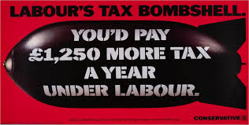
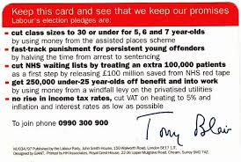
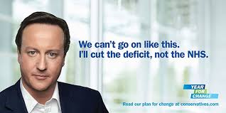


Slide 15
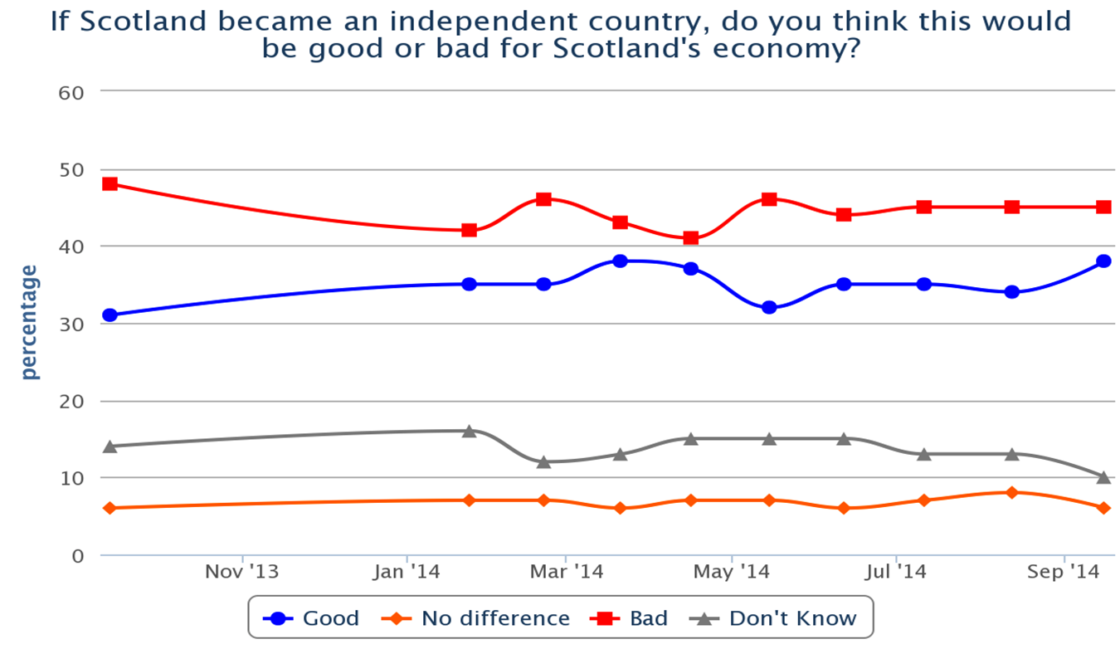

Slide 16
How Yes Never Won the Debate (YouGov)

Slide 17


Slide 18
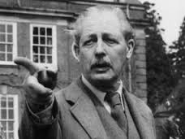
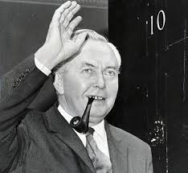
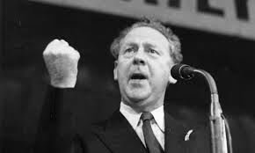
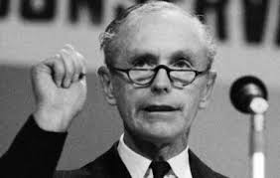
Image and Leadership
In the era of mass partisan identification – leadership and image wasn’t as important

Slide 19
Image and Leadership
However, it has been argued more recently that in the era of declining party identification and increasing mass media focus on the political leaders that political leadership is an increasingly important influence on voting behaviour.

Slide 20
Image and Leadership
It is the perceived abilities [or otherwise] of the party leaders in dealing with salient issues such as the economy, health and education which are crucial to the creation of an image of governing competence.

Slide 21
1992, 1997, 2010, 2015
1992 – Major favoured over Kinnock
1997 – Blair favoured over Major
2010 – Cameron favoured over Brown
2015 – Cameron favoured over Miliband
2019 – Johnson favoured over Corbyn

Slide 22
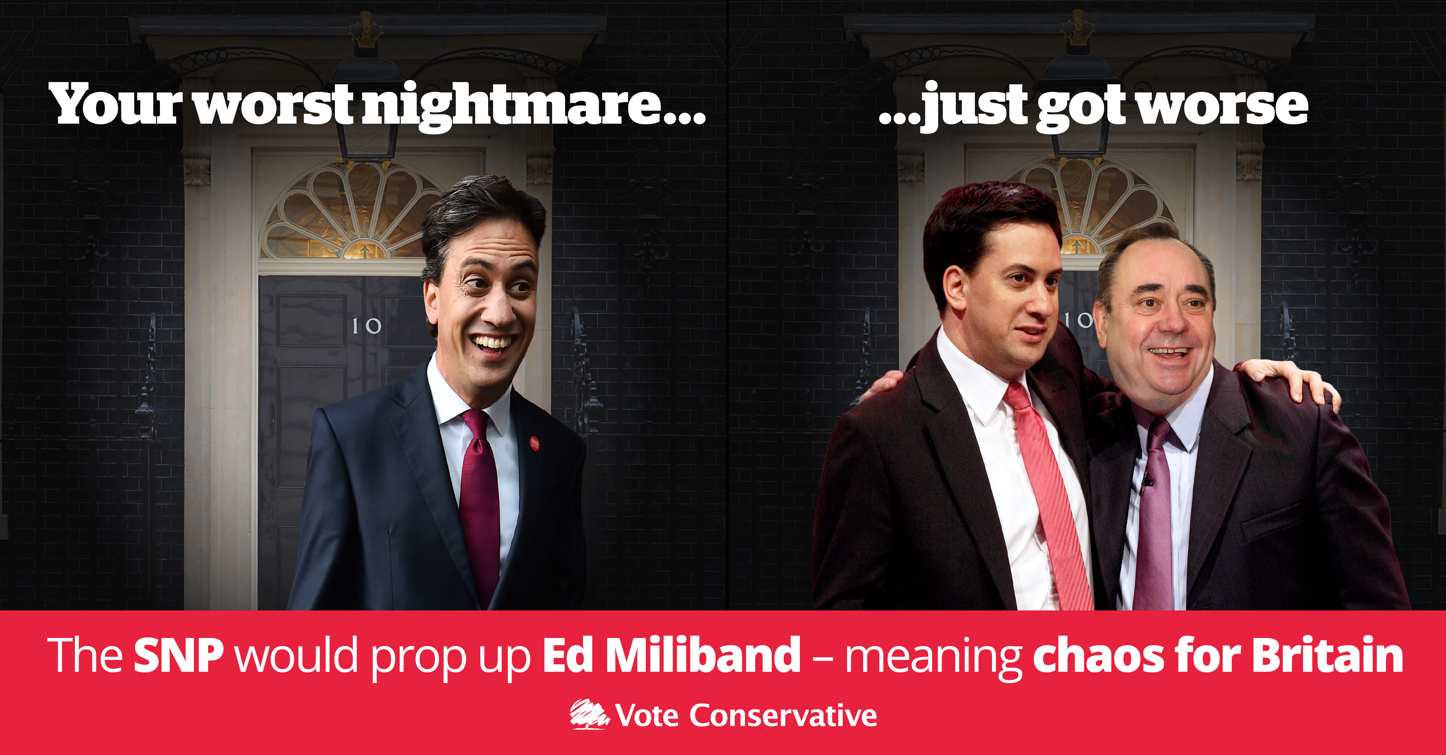
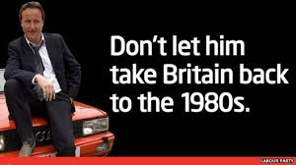
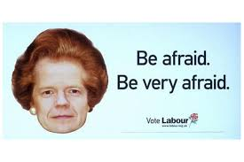
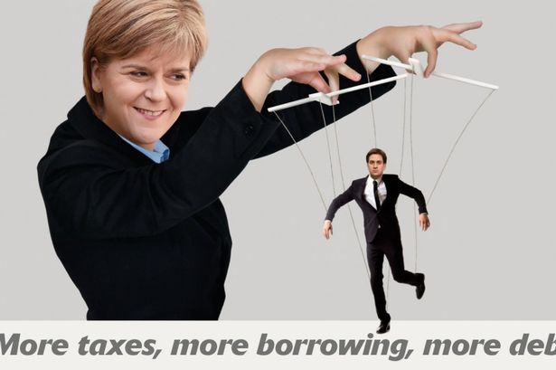

Slide 23
Summarise the Rational Choice Model
Why has the Rational Choice Model became more important over the last 30+ years as an explanation of voting behaviour?
Identify and explain the short term issues that help voters make a rational choice at election time.
For the 2015 election what were the salient issues?
Do you think the Rational Choice Model is correct? Explain your answer!

Slide 24
Evaluate the relevance of the Rational Choice model in explaining voting behaviour. (12) 2015
Credit reference to the following aspects of the question:
Self-interest and “consumer” voting
Issue voting (which issues are most prominent?)
Party leadership (do voters like individual leaders?)
Campaigns
Competence and reputation of political parties

Slide 25
The rational choice model of voting behaviour is concerned with the way in which people may vote based on their own rational self-interest. This can often be in relation to the economy, as there can be a link between the performance of a government and the strength of the economy at that particular time. Issues such as high unemployment, pay freezes and cuts in public spending “hurt” the voter, which can affect how they will cast their vote. Previous Prime Ministers have been accused of creating pre-election “booms” with regards to the economy, trying to curry favour with the electorate. Voters can be influenced by how the economy is performing and the subsequent impact (either of a positive or a negative nature) on their lives. House prices, interest rates and taxation are just some of the different policies that are covered by “the Economy”.
In 2010, the economy was identified as the single most important issue in the mind of voters. The Labour party was associated in the minds of many voters with the financial crisis. Opinion polls carried out before the 2010 election indicated that many voters blamed the Labour government. This was viewed as a major factor in Labour’s defeat. Increasingly, the handling of the economy is becoming more prominent in voters’ minds. Surveys of voters’ attitudes indicate it is always one of the main factors affecting how people vote. For example in 2010, the economy was ranked the number one issue by voters above other factors such as immigration and the NHS.

