Slide 1

Source Based Questions
Data Analysis Questions
Notes:
https://www.youtube.com/watch?v=oc3xTj3g9QQ

Slide 2
We are learning to…
Analyse complex sources of information
Discuss how to analyse complex data
Write exam style answers for the data analysis style questions

Slide 3
Success Criteria
I will analyse sources by breaking them down into manageable chunks.
I will be follow the suggested answer structure for data analysis questions.

Slide 4
Source-based Questions
There are two different source based questions in the Higher Politics exam.
“Comparison” Questions (8 marks)
Data Analysis Questions (20 marks)
Both questions in Paper 2

Slide 5
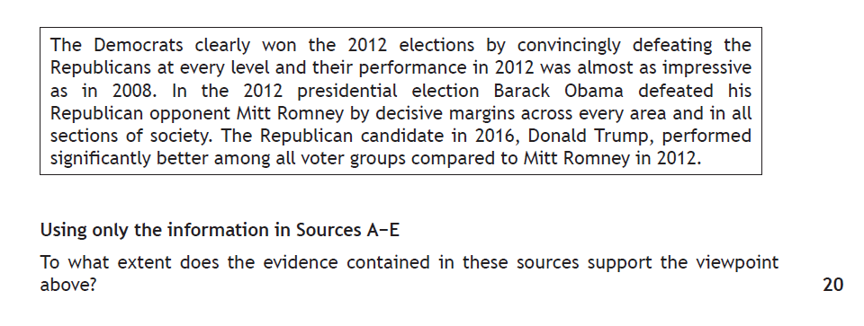
Up to 7 Sources – mixture of Statistical and Written
Asked to determine how accurate the provided statement is.
Overall evaluation is important.
Step 1: Split the statement into two separate sections. (this will be obvious)
Step 2: Split each again to create 5 individual parts

Slide 6
Data Analysis Questions (20 marks)
Use of data and synthesis – 15 marks
Evaluation – 5 marks
Deal with the actual data first – go through every source and identify the data that is relevant.
This will then enable you to synthesise it (link it together).
Once you have dealt with the data and linked it together, you can evaluate wither the statement provided it correct or incorrect.

Slide 7
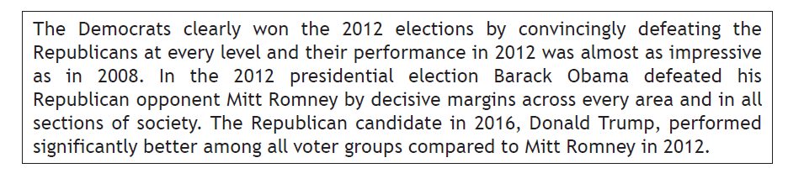
Step 1: Split the statement into two separate sections.
There is a clear difference in the agenda of each section here: the first half of the statement talks about The Democrats and the Republicans election performances.
The second half of the statement talks about specific presidential candidates and their individual performances.

Slide 8
Step 2: Split each again to create 5 individual parts
Within the first half there is a clear split in two: Democrats defeating Republicans at every level in 2012 and then the Democratic performance in 2012 compared to 2008.
The second half can be split into three: Obama vs Romney in 2012 in every area; Obama vs Romney in all sections of society and the Trump 2016 compared to Romney 2012.

Slide 9
Step 3: Highlight language for EVALUATION
Before you look at the data, quickly check each of the 5 parts of the statement for EVALUATIVE language – this will help you when looking at the data itself and also frame your overall evaluation.
“The Democrats clearly won the 2012 elections by convincingly defeating the Republicans at every level”
“The Democrats clearly won the 2012 elections by convincingly defeating the Republicans at every level”

Slide 10
Step 4: DATA ANALYSIS TIME!
You must now use the sources – ALL OF THEM – to decide if each part of the statement can be supported by the evidence.
Do one part at a time – colour coding will help you here.
SQA GUIDANCE: There will always be a MINIMUM of two pieces of data and a MAXIMUM of four aspects of data for each part of the statement.

Slide 11
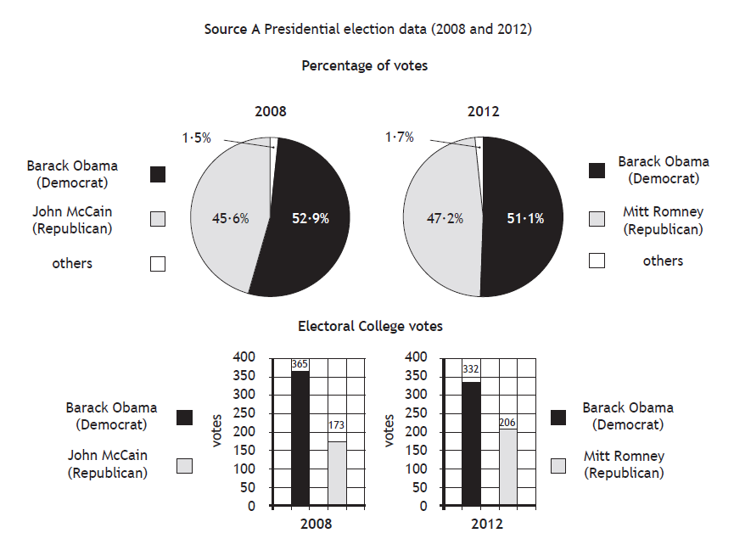
“The Democrats clearly won the 2012 elections by convincingly defeating the Republicans at every level”

Slide 12
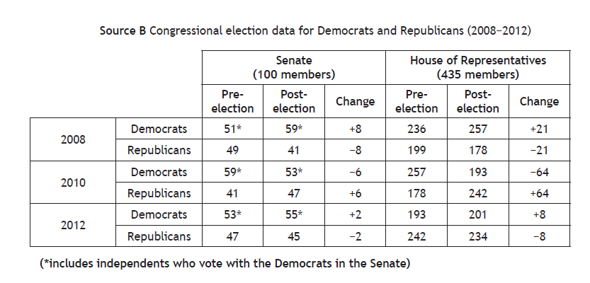
“The Democrats clearly won the 2012 elections by convincingly defeating the Republicans at every level”

Slide 13
Writing your answer
5 paragraphs – one for each part of the statement - worth 4 marks each.
Write out the part of the statement you are focusing on
Collate your data, explaining what it shows in basic terms and naming your sources clearly (up to 2 marks)
Link the data together by talking about it in more detail (1 mark)
Evaluate the data against the wording of the statement, making clear wither the statement is correct or incorrect. (1 mark)

Slide 14
“The Democrats clearly won the 2012 elections by convincingly defeating the Republicans at every level”
Source A shows that the Democratic candidate Barack Obama easily won the election with 332 to 206 electoral college votes. Obama won with over 50% of the actual votes compared to Romney’s 47.2%. In the Senate, the Democrats defeated the Republicans to keep control of the Senate by winning 55 seats to the Republicans 45. This was a net gain of 2 seats, increasing their majority (Source B). Source B also shows that although the Democrats made a net gain of 8 seats in the House of Reps, they were still behind the Republicans. The Republicans won the House election with 234 seats to the Democrats 201 seats. As such, in terms of the Presidency and the Senate race in 2012 the Democrats clearly won the election although in many ways it was tight in terms of the vote share. Unlike the Presidential race and the Senate race, the Democrats lost the election in the House of Reps despite making gains. Overall, it is clear that Barack Obama convincingly won the 2012 Presidential race in terms of Electoral college votes. Whilst, the Democrats were also victorious in the Senate race, this was hardly by a large margin and they were defeated in the House of Reps and therefore, it cannot be said that the Democrats won the 2012 elections by convincingly defeating the Republicans at all levels as this is untrue.
4 marks (2 for data, 1 for synthesis, 1 for evaluation)

