Slide 1

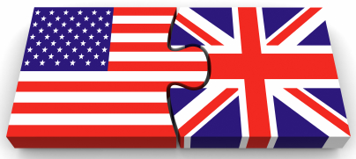
Political Systems
Part 4 - Political Executives

Slide 2
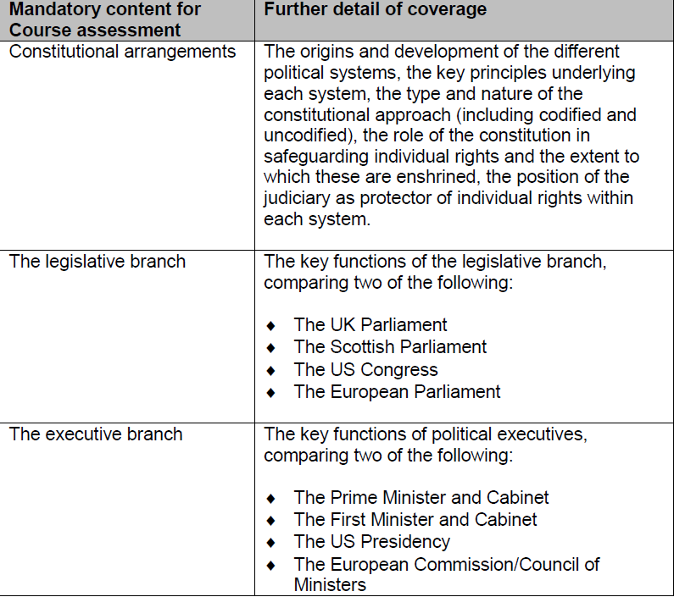
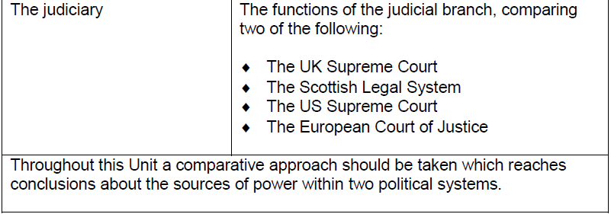
What to cover according to the SQA

Slide 3
What you will learn…
Success Criteria – I can…
About the executive components of each system
To compare the political systems in the two countries
Answer essay questions comparing the UK and US political systems

Slide 4
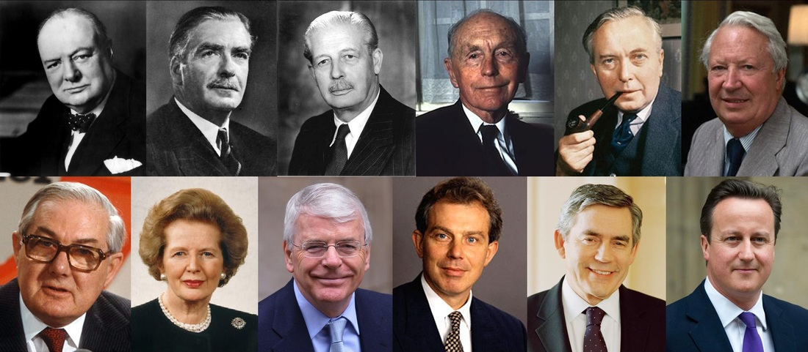
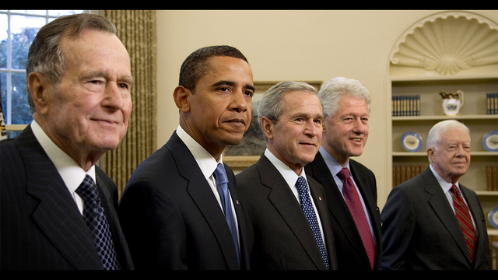
Part 4
POLITICAL EXECUTIVES

Slide 5
Can you name the Prime Ministers of the UK? (post WW2-2016)
Top Row: Winston Churchill (51-55); Anthony Eden (55-57); Harold Macmillan (57-63); Alec Douglas-Hume (63-64); Harold Wilson (64-70 & 74-76)
Edward Heath (70-74);
Bottom Row: James Callaghan (76-79); Margaret Thatcher (79-90); John Major (90-97); Tony Blair (97-2007); Gordon Brown (07-10); David Cameron (10-16).

Slide 6
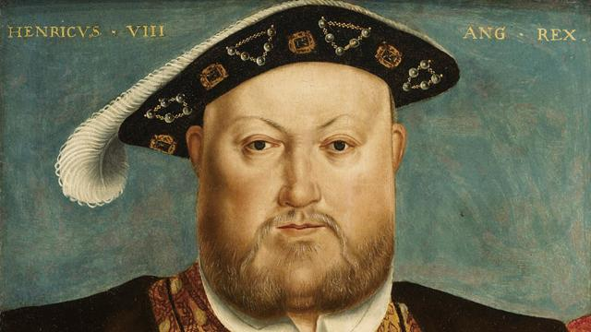
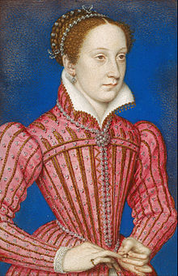
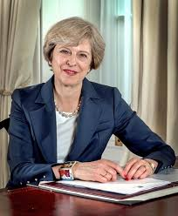
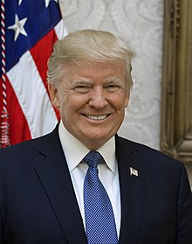
Political Executives
Historically, executives predated the emergence of separate legislatures or judiciaries.
These bodies developed to aid, advise and later to constrain “executive” rulers.
At the core of an executive branch is the top leader and his or her ministers and key officials.
The executive is, technically, the branch of government that is responsible for the execution or implementation of policy.
In practice, its responsibilities are substantially broader.
The major task of the political executive is leadership and this involves several functions:

Slide 7
Political Executives
Making Policy
The key function of the political executive is to direct and control the policy process. The executive is expected to develop social and economic programmes that meet the needs of their countries and citizens.
Executives usually initiate legislative programmes and also exercise a range of law-making powers.
Mobilising Support for Policies
The ability of the executive to mobilise support for policies ensures people respect and follow the laws that are enacted. Without the support from the public, or from key groups in society, policy implantation becomes difficult.
Supervising the Implementation of Policy
The implementation of policy means that the political executive has major responsibilities.
This work is organised through departments and the coordination is usually accomplished through a cabinet system.

Slide 8
Political Executives
Ceremonial Duties
In the UK The Queen is the Head of State and is the personal embodiment of the state and what it stands for: this is largely a ceremonial role.
However, ceremonial duties for political executives allow the top leaders to portray themselves as ‘national leaders’ and provides a building block for legitimacy and political loyalty.
Crisis Leadership
A critical advantage that the political executive has over the assembly it its ability to take swift and decisive action.
When a crisis breaks out political executives are expected to take the lead. In times of national emergencies political executives can impose direct executive control through ‘states of emergencies’.

Slide 9


Task: Success, Crisis, Controversy
For each of the following executives find an example of a success story; a crisis that occurred at the time and a controversy that has overshadowed them.
- Blair
Cameron
May
G.W. Bush
Obama
Trump

