Slide 1
In regards to power and authority, the President of the United States is far more limited in his position than the Prime Minister of the UK.
Do you agree or disagree with the above statement? Why?

Slide 2

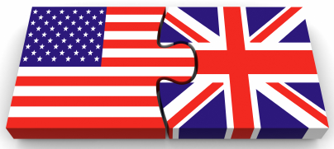
Political Systems
20 mark Essays

Slide 3
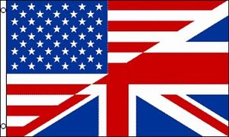
What you will learn…
Success Criteria – I can…
Identify the appropriate structure of a 20 mark Higher Politics essay
Structure a 20 mark essay successfully

Slide 4
20 mark Responses
Discuss… or To what extent…
Component | Marks
Knowledge: description, explanation, example | 8
Analysis It can be argued that… It is clear that… However… | 6
Conclusion Therefore… Overall… | 4
Structure | 2

Slide 5
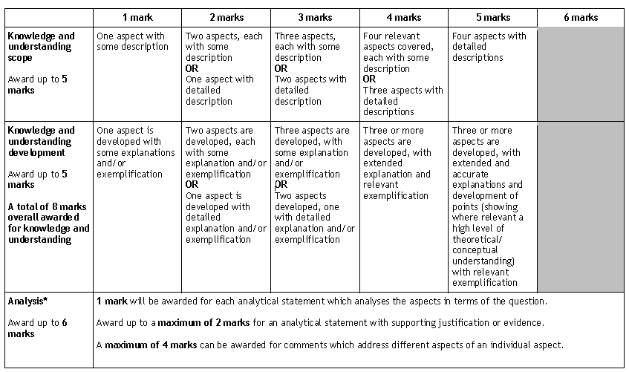
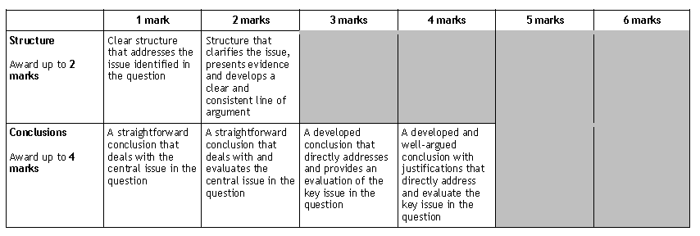

Slide 6
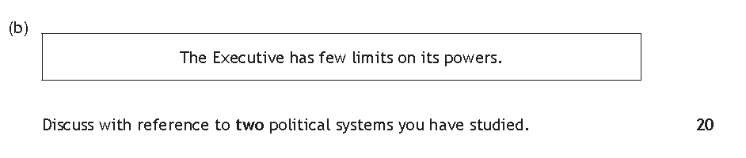
2015 H Politics Paper

Slide 7
Essay Plan
Intro – highlight background and factors to be discussed
Par 1
Par 2
Par 3
Par 4
Conclusion

Slide 8
Paragraph Structure
T
K + E
K + E
A
Topic Sentence
Knowledge + Example (Prime Minister)
Knowledge + Example (President)
Analysis

Slide 9
The Executive has few limits on its power.
Discuss with reference to two political systems you have studied. 20 marks
Marking scheme suggests:
Constitutional limits on power of Executive
Checks by the Legislature
Position in relation to Cabinet
Limits on role as commander-in-chief/control of the armed services
Term limits
Removal of Executive by Vote of No Confidence or Impeachment

Slide 10
Intro – Structure marks available
Background & Factors you will discuss.
The roles of the Prime Minister of the UK and the President of the USA are often compared in regards to the power each position wields (Background). Both positions are limited in regards to the actions they can carry out although it is clear that in some areas, there is contrast between the limitations placed on the executive branch of government. For example…
(Factors).

Slide 11
Para 1 – Checks by the Legislature
In the UK, the Executive branch and the Legislative branches overlap whereas in the USA the two branches are entirely separate. This creates a distinct difference between the ability of the President and P.M to wield power and the limitations placed upon them. (topic sentence)
In the UK the Prime Minister leads the largest party and the whip system usually ensures that the Government can pass its legislative programme. For example, Tony Blair as Prime Minister had majorities in three different parliaments. Like all prime ministers, he used both the parliamentary whips and the loyalty of backbench MPs to have his key policies passed in parliament. In his first two terms Tony Blair suffered no parliamentary defeats, but in his third term he was defeated in parliament on a number of issues after rebellions by backbench Labour MPs. (K – description & example UK)
In the US however, Congress is elected separately from the President and is often controlled by a different political party than that of the President and in this circumstance the President may be unable to have his preferred legislation passed. Party loyalty is not as strong in the US than it is in the UK. For example, Congress blocked President Obama’s request for immigration reform and he also found it very difficult to have his health care bill passed by Congress. (K – description & example USA)
As such, it is clear that UK prime ministers have fewer restrictions on their powers than American presidents and will usually be able to pass their legislative programmes as long as they have a majority in parliament. This can also be attributed to the fact that in the USA far more checks and balances are built directly into the political system due to the total separation of the branches and therefore Presidents can not always rely on party support or unity in order to push forward their legislative agenda. President Obama frequently failed to pursue his legislative agenda due to the partisan and often hostile nature of the Republican dominated Congress during his final term in office. (2 x Analysis – direct link to the actual question; clearly explained and with further (SHORT) example to provide clarity.

Slide 12
Par 2 – Position in relation to the Cabinet
PM – first among equals but can be ousted by his own Cabinet members
Pres – Cabinet is hired and fired (with some restrictions) by the President. President has overall control.
Par 3 – Term Limits
PM – No official limits on PM’s term. They can hold the position for as long as they are the leader of their party. Long tenure Thatcher, Blair etc whereas short tenure – Brown, May.
President – limited officially by the constitution. Cannot continue beyond this. Pros and Cons – don’t usually outlive their welcome?
Par 4 – Removal from office
PM – Vote of No Confidence; can be called easily although doesn’t happen very often etc
Pres – Impeachment process v. difficult to initiate, hardly every happens etc

Slide 13
Conclusion – 4 marks available/ Structure marks
Address the overall issue of the essay, providing an obvious judgement, based on the aspects you have discussed.
In conclusion, (which system has greater or more limitations? – be CLEAR in your judgement!)
In the UK, (sum up briefly points on Prime Minister).
On the other hand, the constitution of the USA is… (sum up briefly points US President).
Overall, it is clear that due to the differences in… that the … is far more limited.

